Slide 1
Information and Women’s Participation: Experimental Evidence from Kenya
Solomon Zena Walelign
ICED and World Bank
Soazic Elise Wang Sonne and Ganesh Seshan
World Bank
2022 Africa Evidence Summit
June 29 - July 01, Kigali

Slide 2
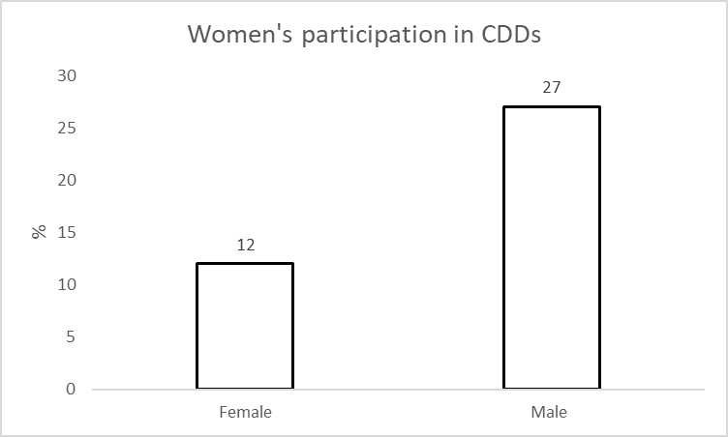
Motivation
Women’s participation in community driven development (CDD) projects
Increase in community driven development projects
  Implemented in more than 105 countries (Saguin 2018)
  As of June 2021, the World Bank supported 374 active CDD projects in 93 countries
Women’s participation in CDDs is lower than men
Barron et al. (2009)

Slide 3
Motivation
Poor information could be one reason for the low participation
Barriers for women’s participation
  Cultural (Fongchingong 2006; White et al. 2018)
  Poor information (Kongolo et al. 2009, White et al. 2018)
    Women’s awareness about CDD programs is 0.5 times less than men
We study the impact of information provision on women’s participation in community driven development project.

Slide 4
Literature
Focus on the impact of CDDs
Two strands of literature
  Impact of CDDs on different outcomes (White et al. 2018, Casey 2012)
    Infrastructure development
    Social cohesion
    Women participation
    Institution formation
  Information experiments on various other domains of participation and outcomes
    Voting (Banerjee et al. 2011)
    Educational outcomes (Jensen 2010)
    Health outcomes (Dupas 2011)
Evidence on the effect of information on women participation is limited

Slide 5
Motivation
Why do we care about women participation in CDDs?
Most CDDs have not been effective (White et al. 2018, Casey et al. 2012)
Participation of women in leadership roles has linked with improved outcomes
  Lower incidence of corruption and bribery (Jha and Saranji 2018; Bauhr et al. 2018)
  Improved social services, e.g., childcare (Bratton and Ray 2002)
  Better aspiration levels and educational attainments for children (Beaman et al. 2012)
  Higher investment in public goods and infrastructure benefitting women and the community at large (Chattopadhyay and Duflo 2004)
Hence, women participation could bring a positive outcome of CDDs (Onwuaroh 2020). How?
  Improve the design of CDDs
  Reducing corruption in managing the CDD funding
  Invest more in the needs of the community and women themselves

Slide 6

Research questions
Research questions
  Does providing information increase women’s participation in community driven projects?

Slide 7
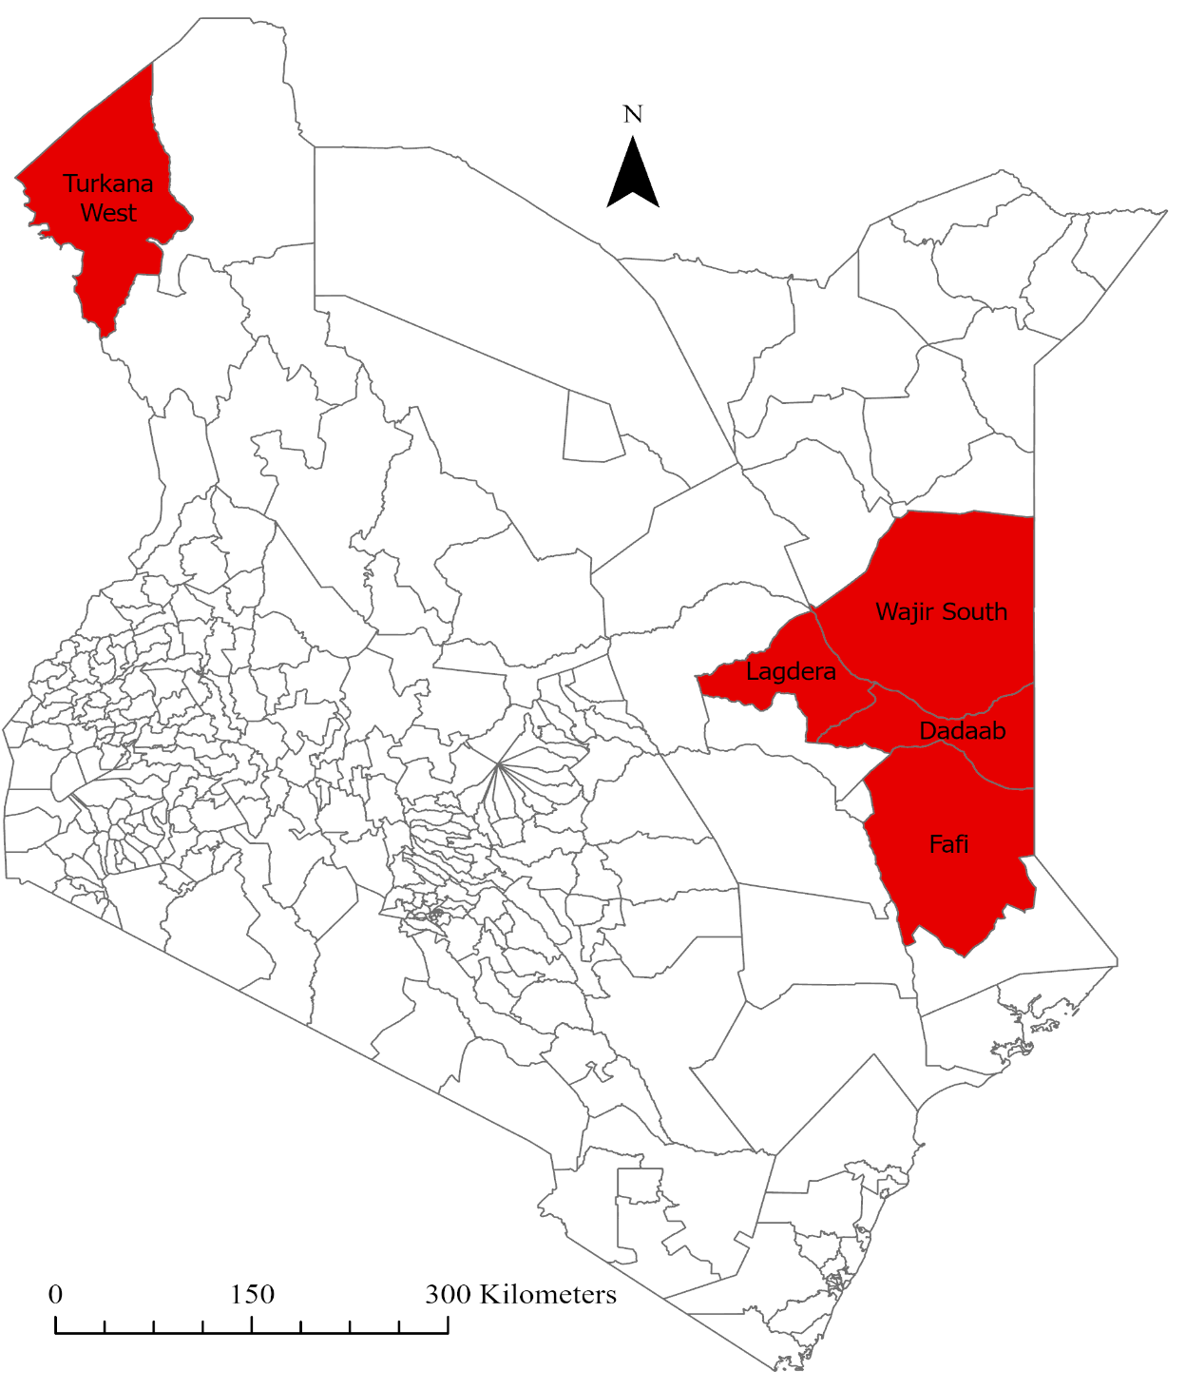
KDRDIP
Funds community driven projects in refugee host communities in Kenya
Encourage the participation of disadvantaged peoples and communities
  Encourage participation of women (aged between 25 and 60 years) and the poor
So far, about 470 investments has been made or community groups has been formed.

Slide 8
Treatment and placebo scripts

Slide 9
Treatment variables
Treatment variable
  Information treatment
  Information treatment take-up
Sample woman
Control
Treatment
Information treatment assignment
Did not understand the script
Understand the script
Control
Information treatment take-up

Slide 10
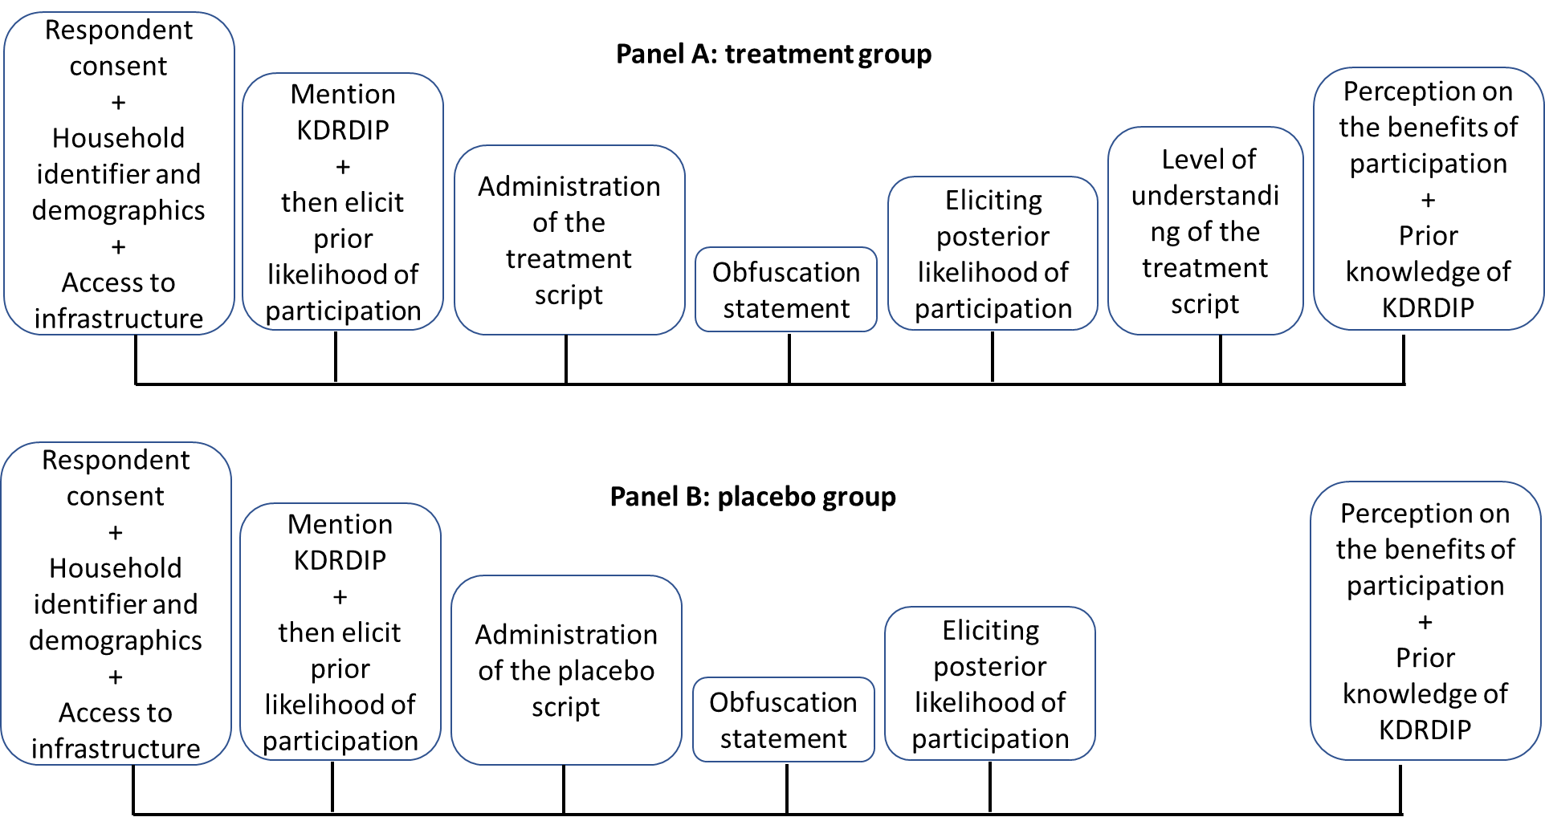
Presentation of experiment instrument for the treatment and placebo group

Slide 11
Sampling and data
Sampling
  of a total of 830 eligible households
Data from a total of 709 households (women) from 50 sublocations
  341 assigned to treatment
  368 assigned to control
Data
  Likelihood of participation (prior and participation)
  Perception on the effectiveness of the information script
  Prior knowledge of KDRDIP
  A bunch of socio-economic variables

Slide 12
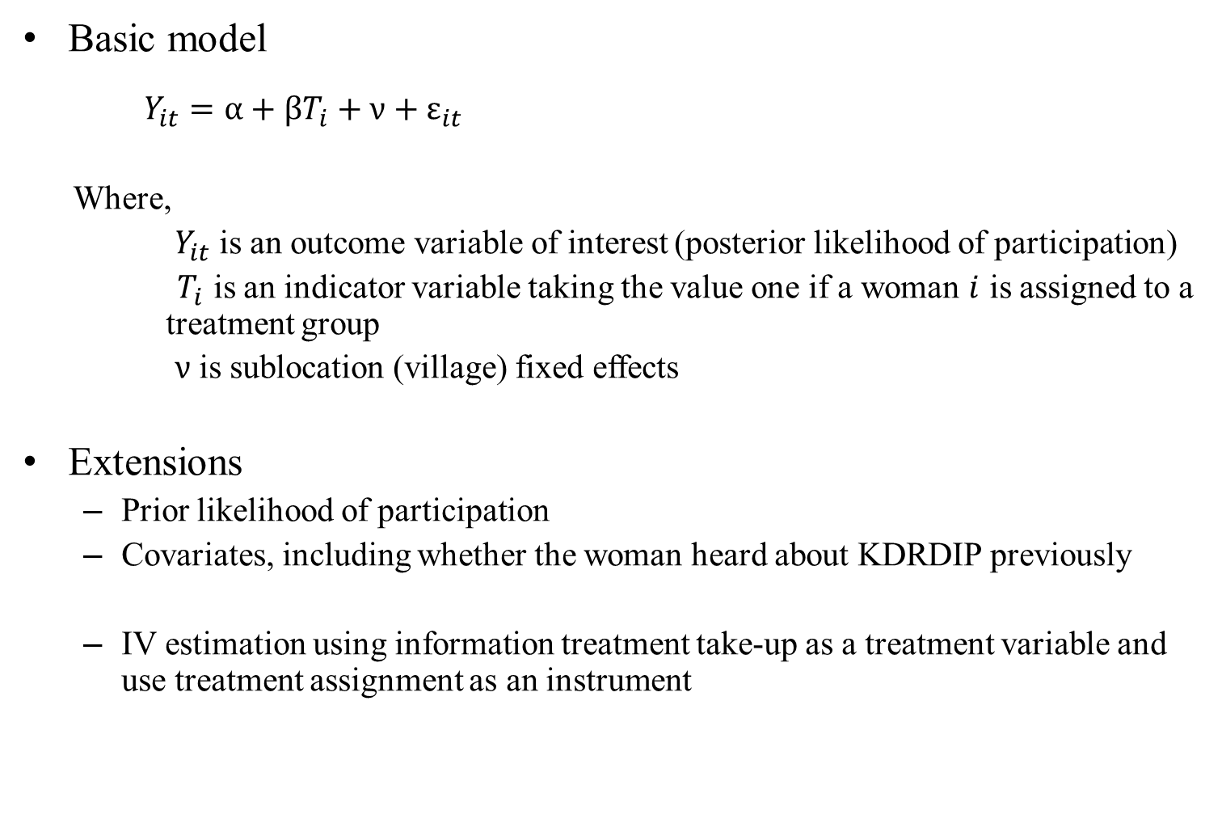
Empirical strategy
Basic model
$Y_{it}=α+βT_{i}+ν+ε_{it}$
Where,
$Y_{it}$ is an outcome variable of interest (posterior likelihood of participation)
${ T}_{i}$ is an indicator variable taking the value one if a woman $i$ is assigned to a treatment group
$ν$ is sublocation (village) fixed effects
Extensions
  Prior likelihood of participation
  Covariates, including whether the woman heard about KDRDIP previously
  IV estimation using information treatment take-up as a treatment variable and use treatment assignment as an instrument

Slide 13
Results:
OLS estimation – information treatment assignment

Slide 14
Results:
OLS estimation – information treatment take-up

Slide 15
Results:
IV estimation – information treatment take-up

Slide 16
Conclusions
Information treatment (assignment to the information)
  Did not increase women’s likelihood of participation
Information treatment take-up
  Had a non-robust positive effect on women’s likelihood of participation
Prior likelihood of participation was a strong predictor of posterior likelihood of participation
Why null effect?
  Did not affect (change) woman’s perception to change their prior likelihood of participation
  The information experiment does not overcome cultural barriers
  Providing information just about the project has the same effect as providing information on the benefits of participating in the project

Slide 17
Next steps
Conduct follow-up survey (end of July)
  Actual participation
  Spillovers to female and male household members
  Spillover to other households (male and female)
Spillovers
  Network questions (Carter et al. 2021; Conley and Udry 2010)
If treatment does not affect actual participation,
  Explore why?

Slide 18
Thank You

