Slide 1
Claudia Costin Secretary of Education
Dynamics and Results of Rio de Janeiro’s Education Reforms
2009-2014

Slide 2
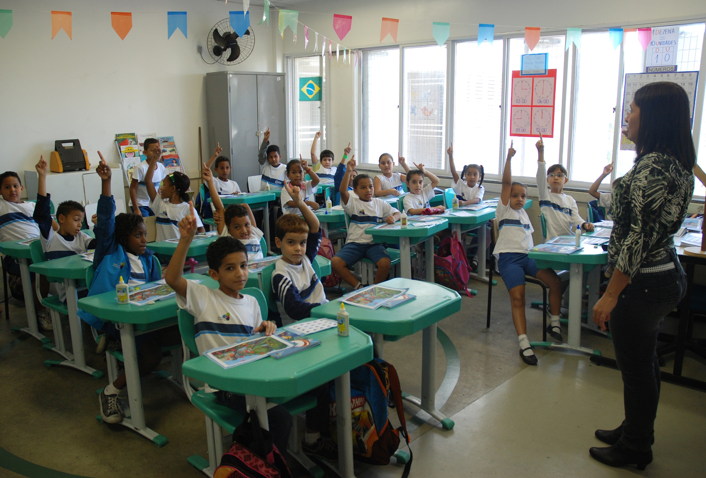

Slide 3
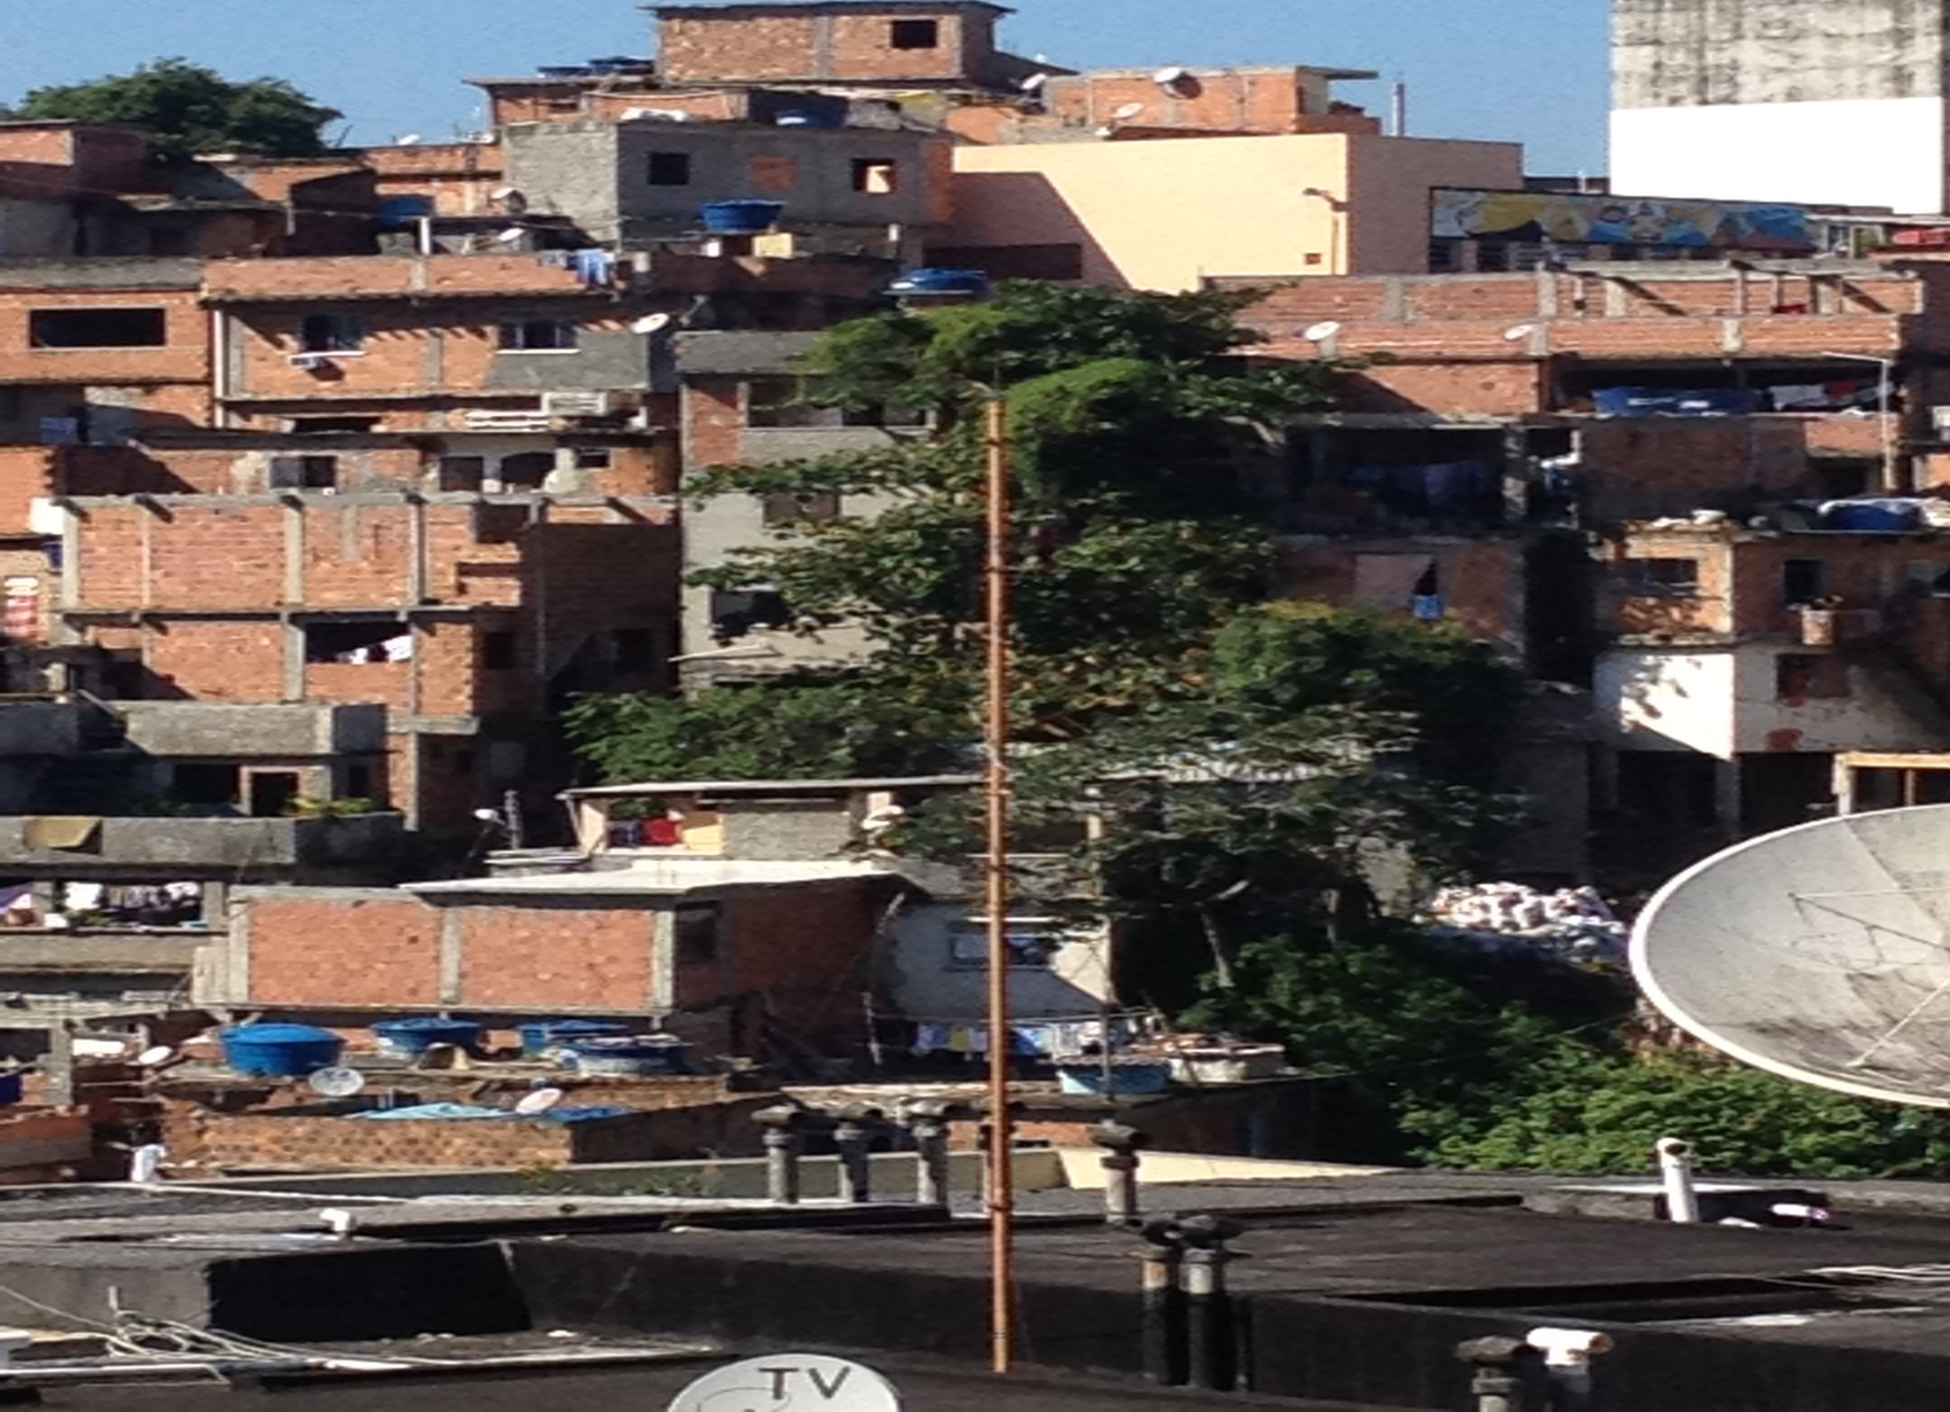

Slide 4
Building a team
Suggestions from Todos pela Educação and reformers from successful school systems;
Initial meeting to present the plan and hear reactions;
Invitation to the undersecretary to stay as special advisor and confirmation of all the line members.

Slide 5
Lessons learned from managing other public policies
Dosing continuity and change;
Identifying and communicating precisely the problems that need to be addressed;
Building good teams;
Using project managers for new initiatives and having them work with the permanent structure team (different skills);
Building good partnerships with civil society and private sector.

Slide 6
Applying management lessons from other areas to education
Building a good incentive system;
Focusing on results (learning – not buildings or fancy projects);
Studying recent literature on education and ensuring that team members are updated, despite avoiding academicism;
Inform society systematically about phases and results, even the negative ones.

Slide 7
The context
Education in Rio de Janeiro

Slide 8
Context in 2009
1,063 schools, of which 250 creches (now 1,075 and 384 creches
Students: 705.659 in March 2009 (now 668.919)
Teachers: 36.060 in January 2009 (now 42.184)
Teachers Union very radical, but not representative neither strong. Opposed to the reform since the beginning
Good results in the national Educational index in comparison to Brazil’s average
But declining performance: 5th grade students with adequate language skills on national test fell from 33.05% in 2005 to 29.07% in 2007
Social promotion created a paternalistic culture: no tests, no homework, no assignments = drop in student learning

Slide 9
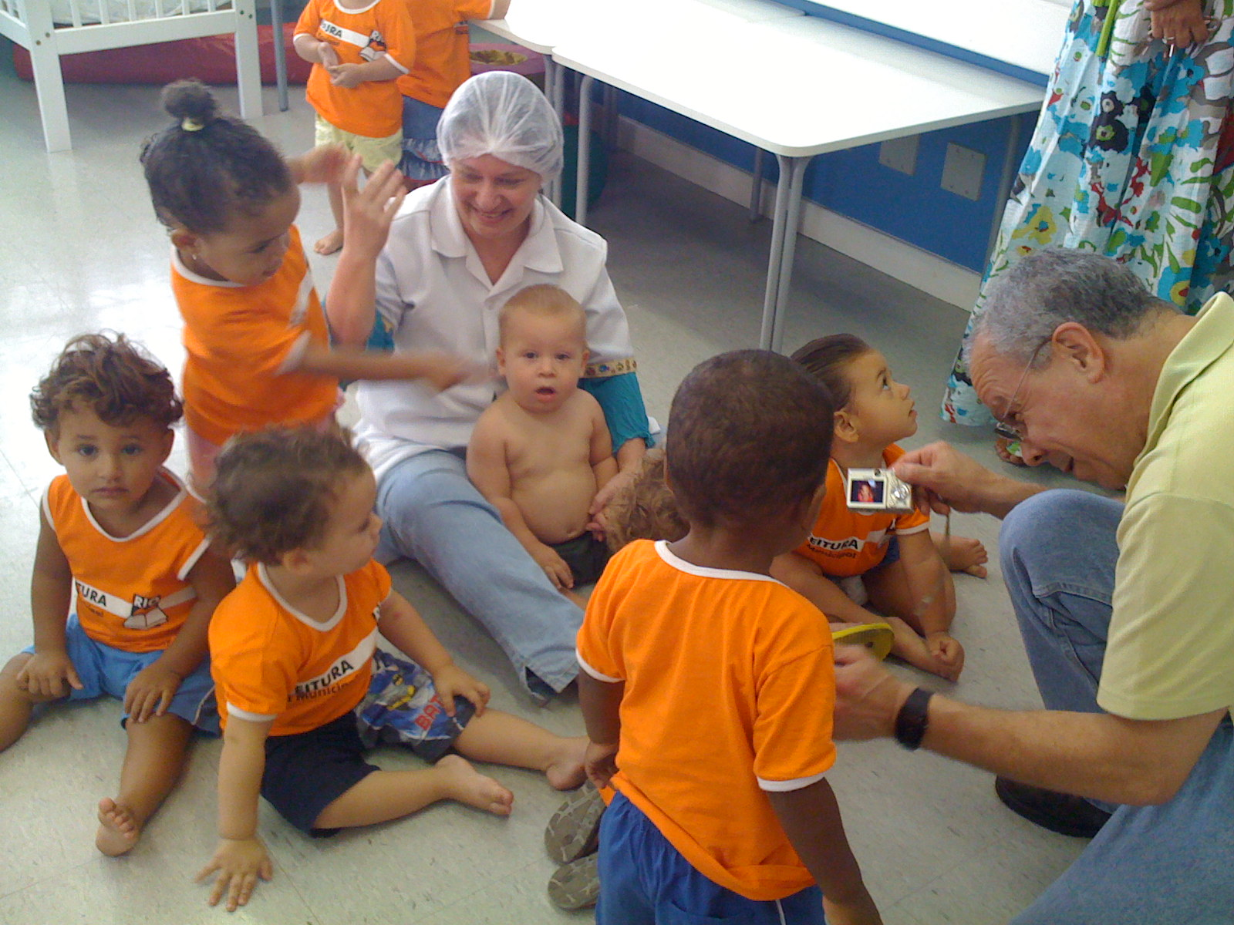

Slide 10
Context in 2009
28,000 students in 4th, 5th, and 6th grades (14%) were functionally illiterate
40% performing below grade level in Math
Lack of clear policies (curriculum, teacher training, assessment, learning reinforcement)
De-motivation among teachers

Slide 11
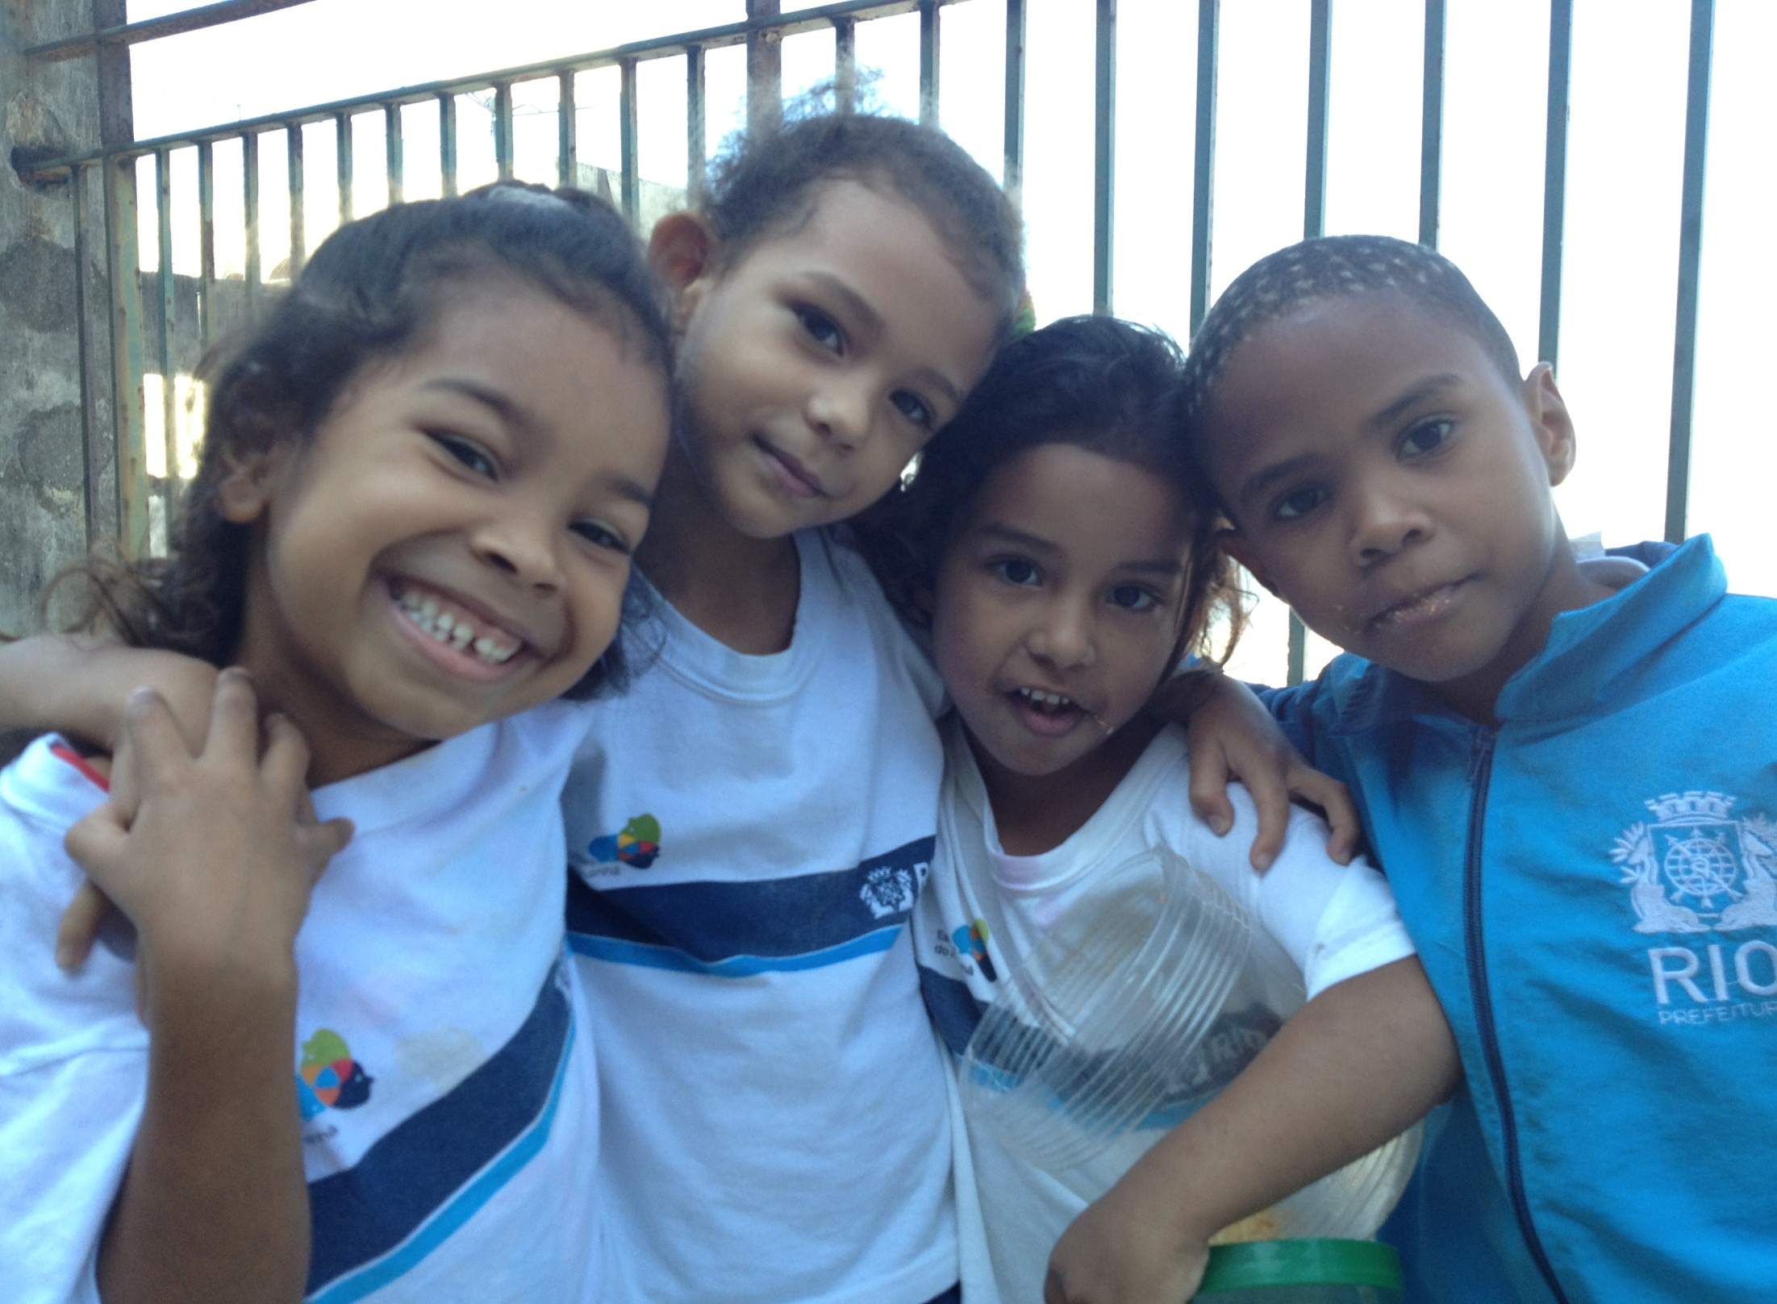

Slide 12
Context in 2009
Teacher shortages in elementary and middle schools and shortage of caregivers for early childhood education
Low involvement of parents in their kids’ education
Areas controlled by drug traffickers or militias had double the average dropout rate and much lower test scores

Slide 13
Our strategy, our implematation and the results
How to Increase Quality Fast

Slide 14
First Actions
Design of an integrated intervention program to ensure learning
Big effort to promote civil society participation and social control:
Monthly meetings with Parents’ Councils
“Parceiros da Educação Carioca”
Major initiative for schools situated in violent areas – Schools of Tomorrow

Slide 15
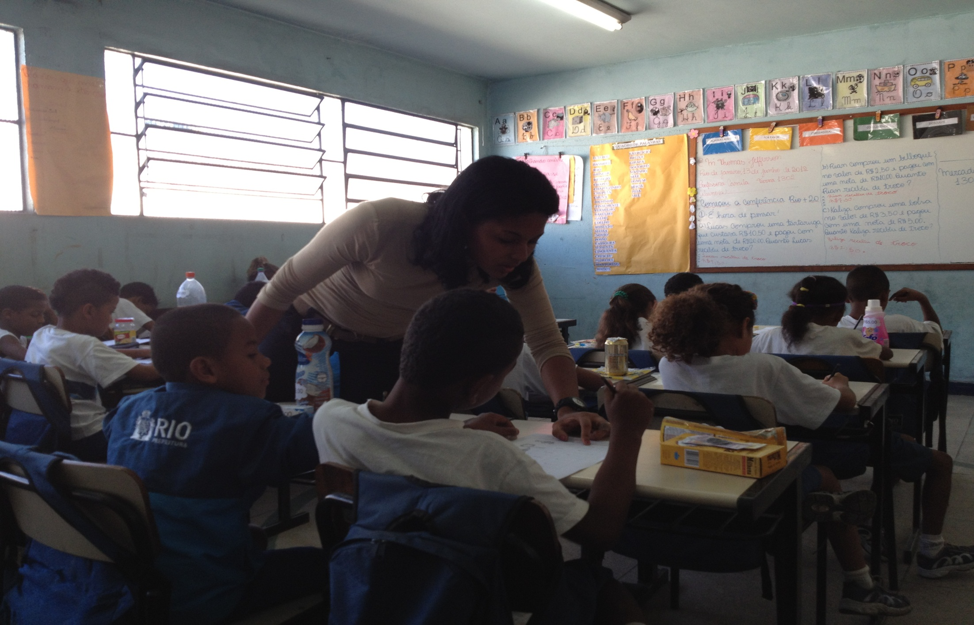
Escola do Amanhã Thomas Jefferson

Slide 16
First Actions
Created a clear set of curriculum guidelines;
Established Portuguese, Math, Science and Writing tests which happen every 2 months;
Got teachers’ involvement in decision-making;
Established separate tracks for illiterate and/or older students – intensive tutoring;
Increased the number of school (learning) hours;
Constant monitoring of school results – especially academic achievement and dropout rates
Accountability for results: quarterly meetings with district supervisors and school directors to review progress, school by school

Slide 17
First Actions
Focused on 4 areas: reading skills (1st and 2nd grades), learning reinforcement, middle school, and early childhood education;
Signed annual management contracts with schools establishing goals for learning improvement and dropout rates;
Rewarded school teams that reached the goals – one extra monthly salary per year.

Slide 18
First Results: IDEB & Prova Brasil
IDEB = prova Brasil + student promotion rate
End of social promotion = initial decrease in IDEB in middle school due to increase in retention
Prova Brasil scores for final years improved consistently:
2005: 4.71
2007: 4.60
2009: 4.86
2011: 5.10

Slide 19
Some Results
90% of 1st year students adequately reading and writing (2013, after the strike- 86.6%);
38,000 illiterate students re-alphabetized (from 2009 to 2013);
49.200 students with discrepancies age/grade accelerated;
43% of the schools received bonuses – many were Schools of Tomorrow (as for 2012);
In Schools of Tomorrow, evasion rate dropped from 5,1% to 3.18% in 2012 and to 2.3% in 2013.

Slide 20
IDEB – Results 2009 - 2011
IDEB (Standardized grade X flow indicator EARLY YEARS (1st to 5th GRADE)
2005 | 2007 | 2009 | 2011 | Goal 2011 | % 2009-2011
4.2 | 4.5 | 5.1 | 5.4 | 5.1* | +6%
IDEB (Standardized grade X flow indicator FINAL YEARS (6th to 9th GRADE)
2005 | 2007 | 2009 | 2011 | Goal 2011 | % 2009-2011
3.7 | 4.3 | 3.6 | 4.4 | 4.3* | +22%

Slide 21
Results 2009 - 2011
Prova Brasil (Standardized grade X flow indicator EARLY YEARS (1st to 5th GRADE)
2005 | 2007 | 2009 | 2011 | % 2009-2011
4.91 | 4.86 | 5.68 | 5.99 | +6%
Prova Brasil (Standardized grade X flow indicator FINAL YEARS (6th to 9th GRADE)
2005 | 2007 | 2009 | 2011 | % 2009-2011
4.71 | 4.62 | 4.86 | 5.10 | +5%

Slide 22
IDEB 2011 – Early Years
Position Early Years IDEB 2011 | CAPITAL Cities | Students | IDEB 2011 | IDEB 2009 | % 2009- 2011
1º | Florianopolis | 8,533 | 6.0 | 5.2 | 15%
2º | Campo Grande | 43,409 | 5.8 | 5.2 | 12%
 | Curitiba | 87,133 | 5.8 | 5.7 | 2%
 | Palmas | 12,262 | 5.8 | 5.6 | 4%
3º | Belo Horizonte | 64,722 | 5.6 | 5.3 | 6%
4º | Rio de Janeiro | 299,584 | 5.4 | 5.1 | 6%
5º | Goiania | 42,772 | 5.3 | 5.1 | 4%
6º | Teresina | 35,475 | 5.2 | 5.2 | 0%
7º | Boa Vista | 16,158 | 5.0 | 4.7 | 6%
 | Vitoria | 15,647 | 5.0 | 4.8 | 4%
8º | Cuiaba | 21,021 | 4.8 | 4.5 | 7%
 | Rio Branco | 8,053 | 4.8 | 5.0 | -4%
 | Sao Paulo | 210,391 | 4.8 | 4.7 | 2%

Slide 23
IDEB 2011 – Final Years
Position Final Years IDEB 2011 | CAPITAL Cities | Students | IDEB 2011 | IDEB 2009 | % 2009 - 2011
1º | Campo Grande | 29,714 | 5.0 | 4.8 | 4%
 | Palmas | 8,807 | 5.0 | 5.0 | 0%
2º | Curitiba | 7,351 | 4.7 | 4.4 | 7%
3º | Florianopolis | 6,792 | 4.6 | 4.5 | 2%
4º | Belo Horizonte | 59,199 | 4.5 | 3.8 | 18%
5º | Rio de Janeiro | 230,375 | 4.4 | 3.6 | 22%
 | Teresina | 24,824 | 4.4 | 4.7 | -6%
6º | Sao Paulo | 242,275 | 4.3 | 4.2 | 2%
7º | Cuiaba | 7,624 | 4.2 | 4.1 | 2%
 | Vitoria | 13,062 | 4.2 | 3.8 | 11%
8º | Joao Pessoa | 16,982 | 3.9 | 3.4 | 15%
 | Sao Luis | 27,653 | 3.9 | 4.1 | -5%

Slide 24
Alfabetiza Rio 2012
Results
Literacy Rates
Portuguese Language
Reading
2012 | 90%
2011 | 81,7%
2010 | 79,6%

Slide 25
Alfabetiza Rio 2012
Results
Numeracy Rates
Math
Math
2012 | 90,5%
2011 | 83,8%
2010 | 80,7%

Slide 26
KEY INITIATIVES: Educopédia

Slide 27
An online platform for collaborative digital lessons, where students and teachers can access self-explanatory activities through play and practice anywhere, anytime.
Google Analytics | Visitors | Views
2013 | 597.340 | 10.070.752
2012 | 567.894 | 10.465.858
2011 | 64.289 | 1.060.029
 | 2012 | 2013 | %
Desktop | 560.970 | 577.037 | 3%
Mobile | 3.655 | 10.633 | 191%
Tablet | 3.269 | 9.669 | 196%

Slide 28
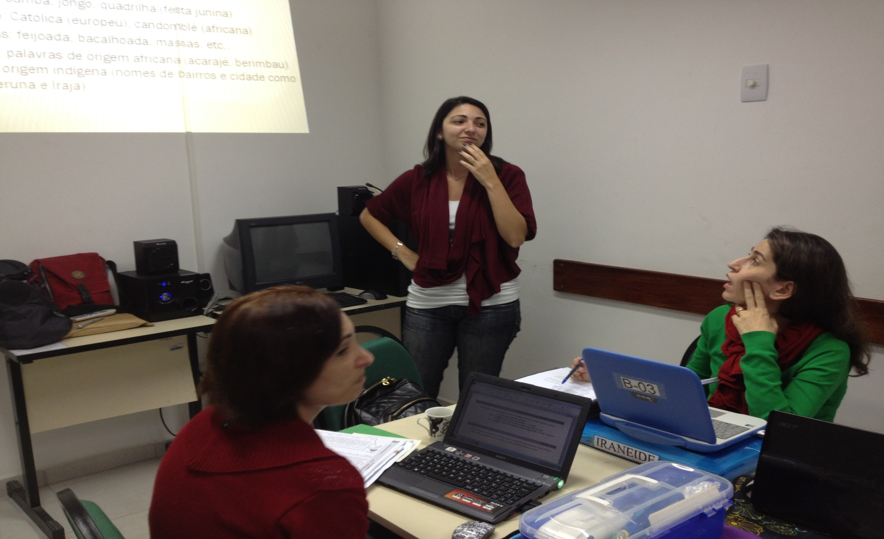
Teachers working collaboratively on Educopédia content

Slide 29
KEY INITIATIVES:
Experimental Middle Schools

Slide 30
Experimental Middle Schools
Schools for adolescents (7th to 9th grades)
Young protagonism - Science, Drama and Movie Clubs, electives and Future Life Projects.
Full-time day schools, with high expectations and rigor
7th and 8th grade teachers covering more than one subject area- Hard Sciences and Humanities (with mentoring)
Exceptional results.
Special experimental middle schools for Arts, Sports, Samba and New Technologies (GENTE)

Slide 31
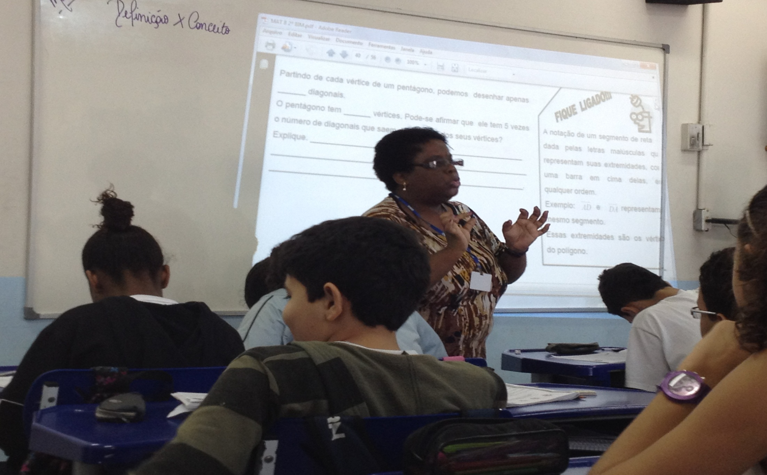
Team teacher in Ginásio Experimental

Slide 32
GENTE
GENTE - new school concept that makes the learning process personal, adjusting it to each student’s needs.
We have changed everything: content, method and management.
No classes, grades or classrooms. To develop skills and competencies, teachers and students use digital classes from Educopédia and tablets and smartphones as part of the school material
The role of teachers is reinvented. At GENTE, teachers become mentors guiding students’ academic and social-emotional development
Disseminate practices developed in GENTE to the Experimental Middle Schools and the least performing schools (e.g. formative assessment)

Slide 33
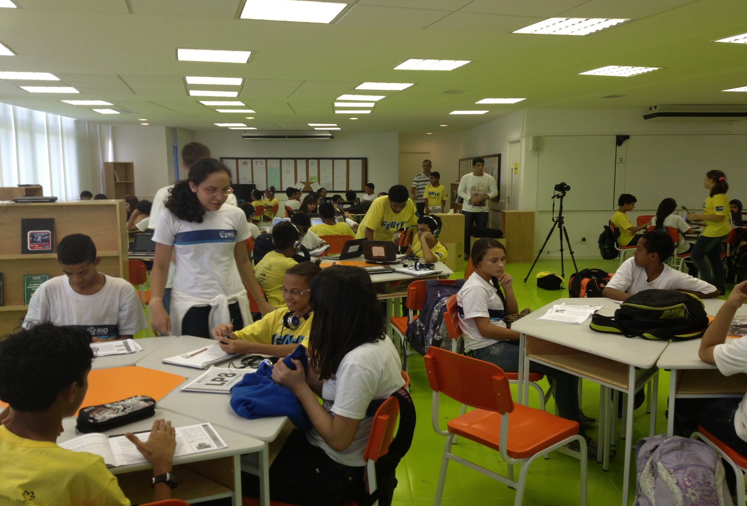
GENTE school

Slide 34
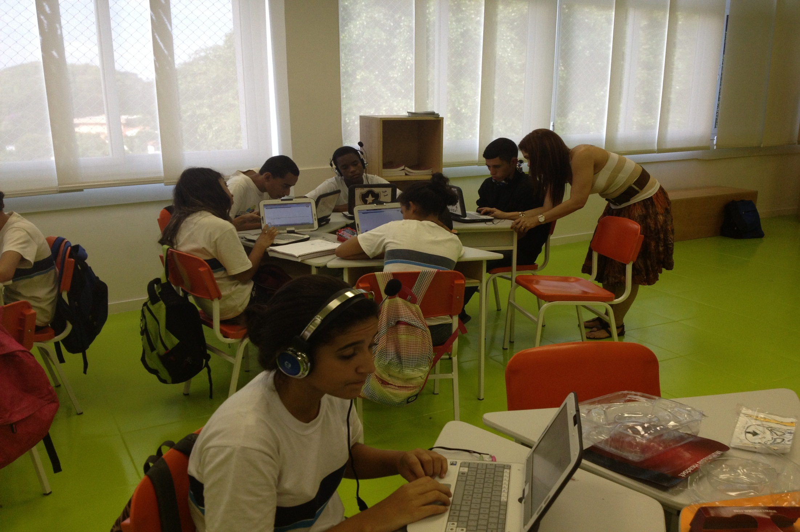
GENTE school André Urani

Slide 35
Preliminary Results- 2013:
Parents and teachers have noticed relevant development of the student’s social and emotional skills – especially in terms of autonomy, collaboration and solidarity.
Relevant academic results have also been noticed: in general, GENTE’s general results grew more than those of the municipal schools, especially in Maths, Science and Writing.
Results of the qualitative evaluation show that the students:
Think this school is far better than any school they have been before (due to technological aspects, infrastructure and the respect to everyone’s rhythm);
Multigrade classrooms are positive (younger students like to learn from older peers, and the older students like to be regarded as references);
The main focus of the school in 2014 will be:
To solidify the pedagogical practices within the school
To built a technological solution which will integrate the tools of diagnostic assessments, the construction of personalized Formative Itineraries, adequate digital educational contents and formative/adaptive assessments
To disseminate GENTE’s components to other schools

Slide 36
Escolas do Amanhã
KEY INITIATIVES:
Schools of Tomorrow

Slide 37
Schools Of Tomorrow The Program In Numbers
Caring for Rio de Janeiro’s
most vulnerable
155 - Schools of Tomorrow in Rio de Janeiro
38% - Decrease in dropout rates since 2009
105k - Students benefitted by the Program
6k - Teachers working in the Schools of Tomorrow
33% - Growth on Brazil’s 2011Basic Education Development Index
40% - Growth on Rio’s 2012 - Basic Education Development Index

Slide 38
How Does it Work?

Slide 39
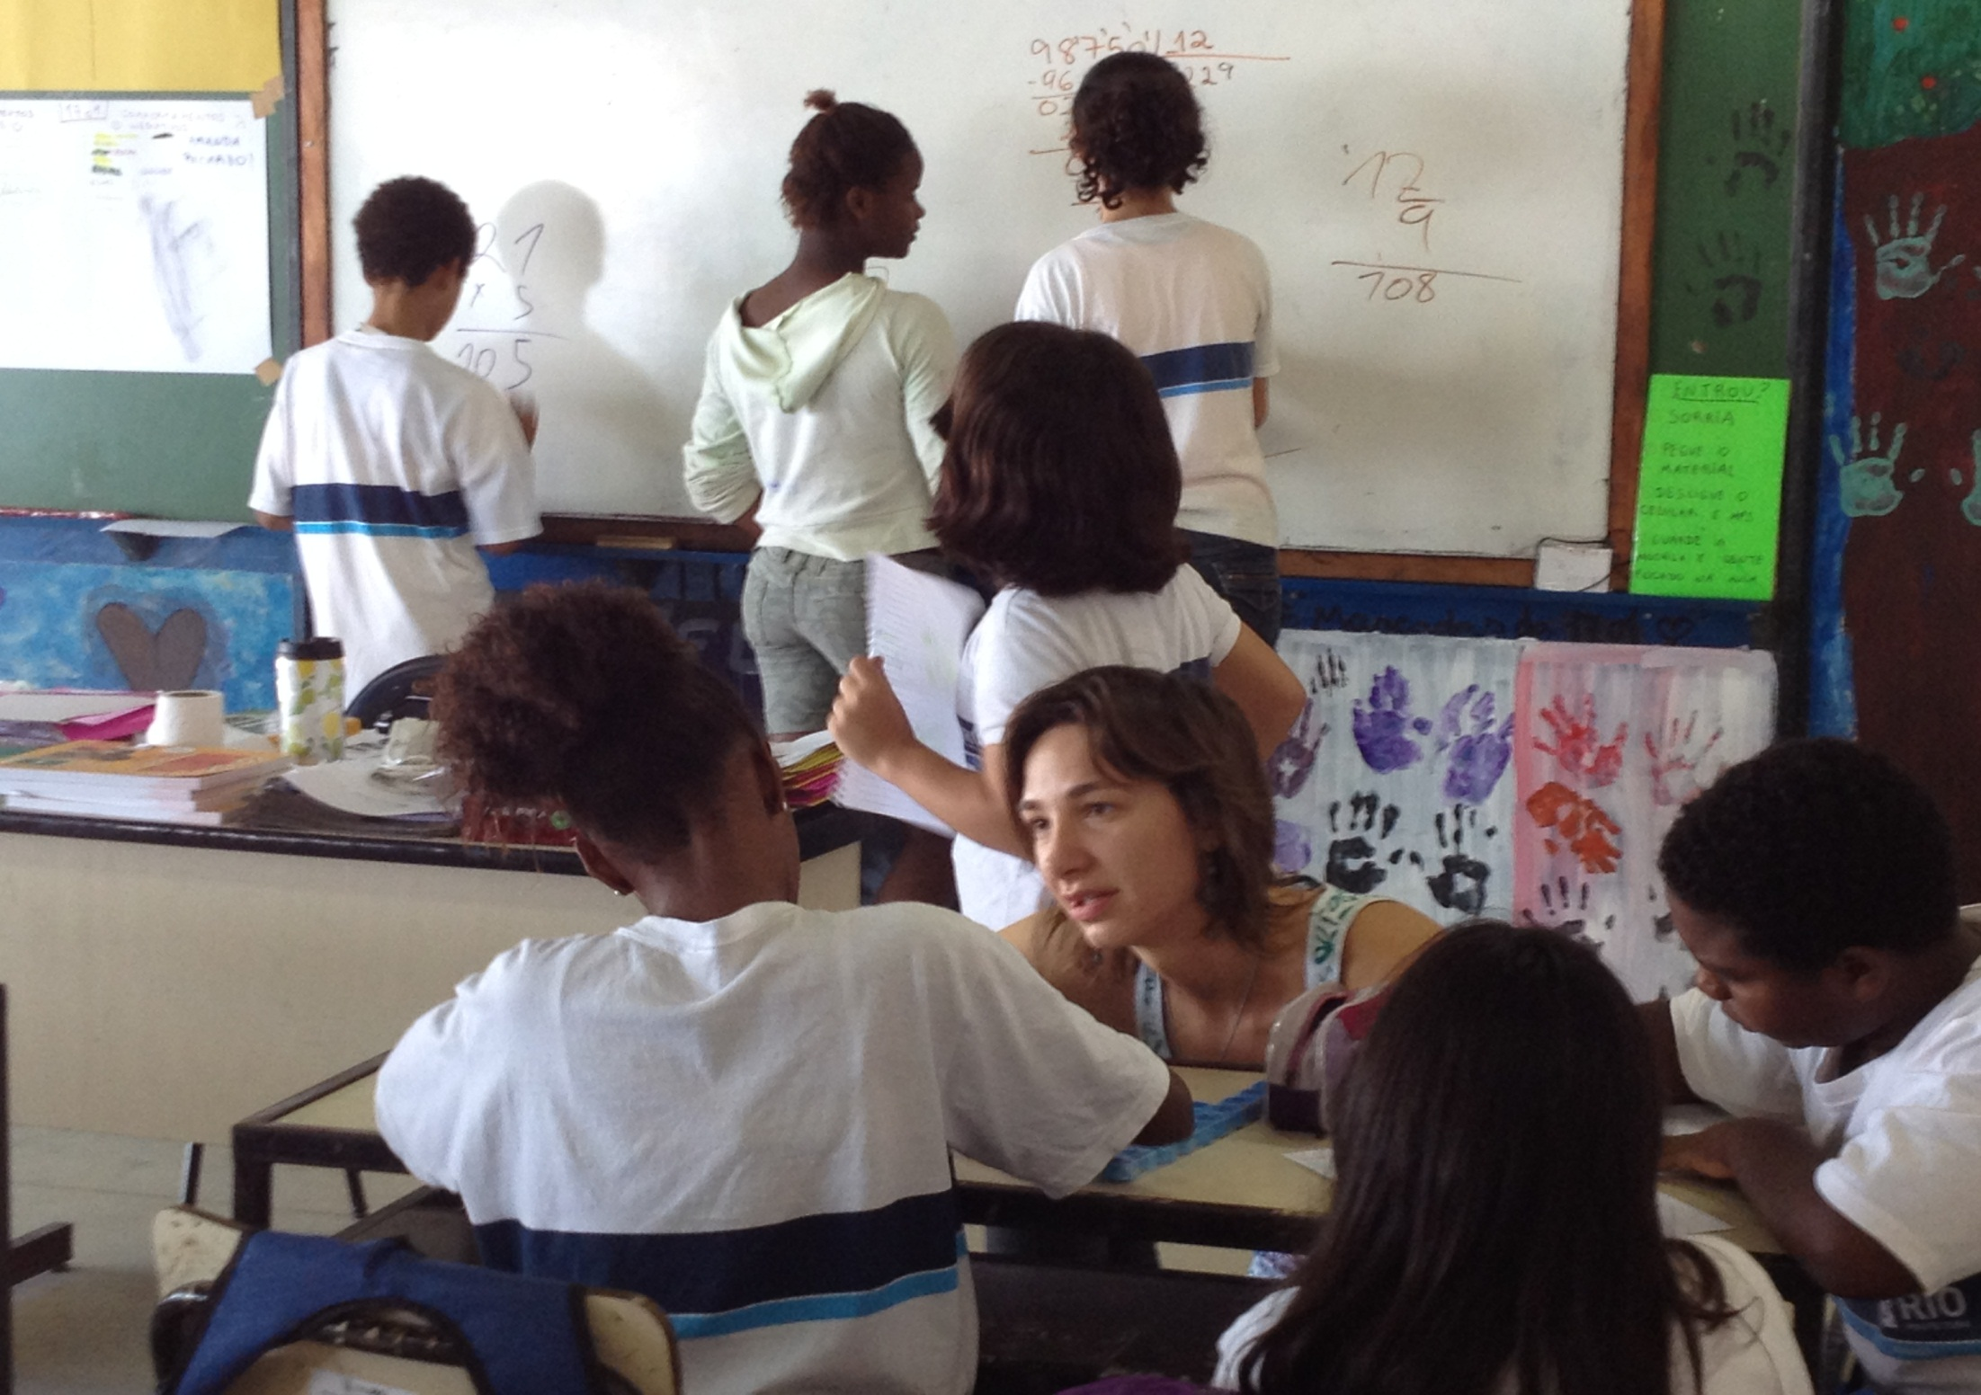
Ensina teacher in Escola de Amanha

Slide 40
IDEB 2011 – Schools of Tomorrow
IDEB (Nota Padronizada X Indicador de Fluxo) ANOS INICIAIS (1º ao 5º ANO)
2005 | 2007 | 2009 | 2011 | Diferença 2009-2011
3.8 | 4.1 | 4.6 | 5.0 | +8%
IDEB (Nota Padronizada X Indicador de Fluxo) ANOS FINAIS (6º ao 9º ANO)
2005 | 2007 | 2009 | 2011 | Diferença 2009-2011
3.3 | 3.9 | 3.1 | 4.0 | +33%

Slide 41
Results
Percentage of schools that received bonuses was higher among the Schools of Tomorrow;
Dropout rate fell from 5,1% to 2.3%;
Test scores have increased in all years;
Attendance rates have increased dramatically

Slide 42
Biggest challenges and Next Steps
How to Keep Improving

Slide 43
The goals behind our strategies
Develop autonomous, caring, and competent young adults
Redeem the admiration for public schools and teachers
Involve the entire society in the positive transformation of public education

Slide 44
Biggest frustrations
Lack of emphasis on and support for some preconditions of the reform
Bureaucratic view on management
Slow rhythm of the transformation (and lack of courage) at the federal level
General attitudes towards the teachers (respect and admiration X pity)

Slide 45
Biggest challenges
Changing the teacher
Dealing with violence in and around the school
Improving math results
Not enough hours in the school day
Institutionalizing and deepening the changes already in place

Slide 46
Next wave of actions
What we teach
Strategic persistence with curriculum guidelines, tests and learning reinforcement
Emphasize literacy, math and science
English language starting in 1st grade
How we teach – focus on excellence and innovation in teacher practice
Higher standards for new teachers
Hiring and training mentors for new teachers (and unprepared ones)
Ginásio Carioca Program: integrated approach to teaching in middle schools with 3 axes (excellence in teaching, character education, and structured teaching resources);
Integrated Teaching; one shift schools (extended day); time for teacher study and collaboration; Educopédia, textbooks, life plans, experimental middle schools (innovation hubs which disseminate new actions)
How we manage – focus on results, reward excellence, hold people accountable, address problems early, and never stop!!

Slide 47
claudiacostin@rioeduca.net @ClaudiaCostin
THANK YOU!

