Slide 1
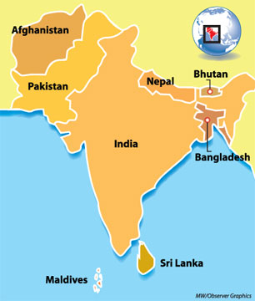
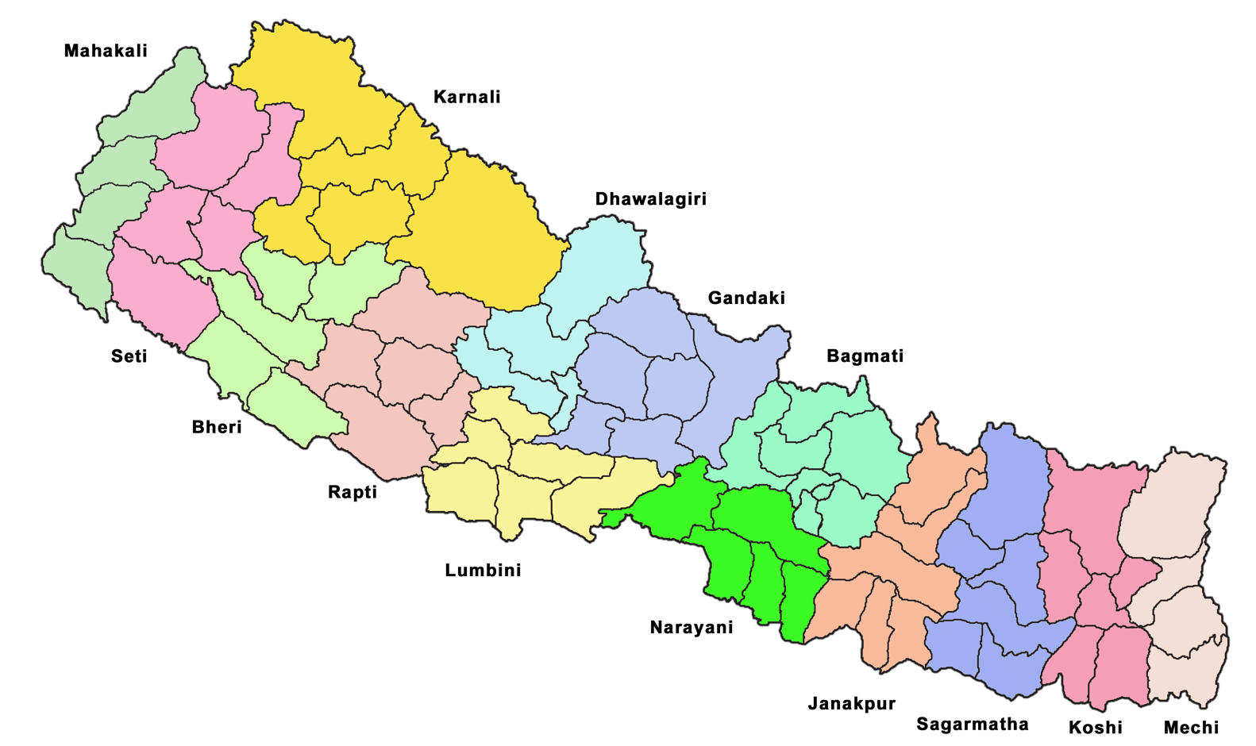
2nd South Asia Regional Public Procurement Conference Islamabad, Pakistan, (March 25-27, 2014) Country Presentation - Nepal
Draft
Naresh Kumar Chapagain , Joint Secretary
Public Procurement Monitoring Office (PPMO)
Kathmandu, Nepal

Slide 2
Outline of the Presentation
Nepal at a Glance
Background
Country Procurement Reform Initatives
Achievements in Public Procurement so far
Current Initiatives
Issues
Challanges
Way Forward
Question Answer Session

Slide 3
Nepal at a Glance
Type of Information | Fact and Figure
Area | 147,181 sq. km.
Administrative Divisions | Five Development Regions, 14 Zones, 75 Districts, 58 Municipalities, 3915 VDCs
Capital City | Kathmandu
Population (2011 A.D) | 26.49 million
Languages | Nepali and more than 120 regional and indigenous languages.
GDP (2012 A.D.) | $18.96 billion
GDP Growth (2013 A.D) | 3.01%
Per capita GNP (2012 A.D) | $1347 USD
Inflation (2012 A.D) | 9.6%.
Government Expenditure (F/Y 2012/13 A.D ) | US $3.55 billion
Revenue (2009/10E A.D) | US$ 2.46 billion
Literacy Rate (2001 A.D.) | 54.1 (69 – 2009 estimate)
Draft

Slide 4
Background
Provision of Government Procurement was under Financial Administration Regulations, 1999 A.D
Country Procurement Assessment Report (CPAR) in April 2002 A.D
Enactment of Public Procurement Act and Regulation in 2007 A.D.
Establishment of Procurement Review Committee
Establishment of Public Procurement Monitoring Office (PPMO) in August, 2007 A.D. under the Office of the Prime Minister and Council of Ministers (OPMCM).

Slide 5
Country Procurement Reform Initiatives
Enactment of Public Procurement Act and Regulation (PPA/PPR)
Key Features:
Transparency
Fair Competition
Non Discrimination
Value for Money
Complaint Mechanism
Establishment of Procurement Review Committee (PRC)
Establishment of Public Procurement Monitoring Office (PPMO)
Based on UNCITRAL Model

Slide 6
Country Procurement Reform Initiatives
Enactment of Public Procurement Act and Regulation (PPA/PPR)
Key Functions:
Review of Procurement Proceeding
Review of Procurement Decision
Establishment of Procurement Review Committee (PRC)
Establishment of Public Procurement Monitoring Office (PPMO)
Based on UNCITRAL Model

Slide 7
Country Procurement Reform Initiatives
Enactment of Public Procurement Act and Regulation (PPA/PPR)
The main functions:
Public procurement policy formulations
Monitor the public procurement law implementation
Develop the indicators for the continuous monitoring
Advise on public procurement matters.
Establish and maintain websites dedicated to public procurement management
Develop and Issue SBDs
Issue manuals, directives, instructions & technical notes for facilitating the procurement proceeding
Coordination in public procurement
Develop human resource and professionalism for public procurement
Solicit the views of the business community as well as stake holders thoughts
Planning and coordinate foreign technical assistance in the field of public procurement
Establishment of Procurement Review Committee (PRC)
Establishment of Public Procurement Monitoring Office (PPMO)
Based on UNCITRAL Model

Slide 8
Achievements made so far in Public Procurement
Amendment in Pubic Procurement Regulation
Formulation of Procurement Review Committee (PRC)
Development of SBDs
e-GP system development & implementation PHASE I
Development of Monitoring Checklist
Procurement Unit in each Spending Offices
Develop Baseline Indicator using OECD DAC
Nepal Public Procurement Strategic Framework (NPPSF)
NPPSF I- 2010-2013
NPPSF II- 2013-2016

Slide 9
Current Initiatives
Full Fledged Centralized e-GP Implementation
e-Evaluation and Contract Award
e-Contract Management
e-Payment
Public Procurement Management Information (PPMIS)
NPPSF II (2013-16)
Standardization of Process
Capacity Development
Institutional Development
Framework Agreement
Accreditation
Revision and Translation of SBDs

Slide 10
Pipeline Activities
Development of Operational Guidelines:
Document Preparation
Evaluation
Contract Management
Development of Guidelines and SBDs:
Design Build /Engineering Procurement and Construction (EPC)
Framework Agreement
Procurement Monitoring Manual
Technical Notes
Catalogue/ Online Shopping

Slide 11
Capacity Development Issues
Expert Level
Establishing Expert Pool & Engagement
Public Entities (PEs) Level
General Procurement Capacity
Sectoral / Specific Capacity
e-GP Training
Private Sectors
Awareness and e-GP Training
Oversight Agencies
Interactions / Workshops

Slide 12
Challenges
e-GP implementation:
Sustainability , Reliability , Security
Access of internet service,
Technical support
Resource Mobilization:
Human Resources (Retention, Career Development, Professionalism)
Fund Mobilization
Coordination
Awareness Campaign :
Civil Society, Mass Media, Private Sector, Oversight Agencies

Slide 13
Way Forward
Internal Diagnostic Mechanism
Procurement Clinic
Case studies
Best practices
Performance Monitoring activities
DPs Consultation / Advise
Expert Prescription and Surgery
Regional/International Forum:
Knowledge/ experience sharing (SARPFF)
Social Networking /Video conference
LinkedIn, Discussion Board

Slide 14
Thank You
Public Sector
Draft

