Slide 1
Rajaraman on Evolution of Fiscal Discipline at the State level in India
Comments by Anwar Shah
World Bank Workshop On Subnational Fiscal Rules, Islamabad
24 April 2014

Slide 2
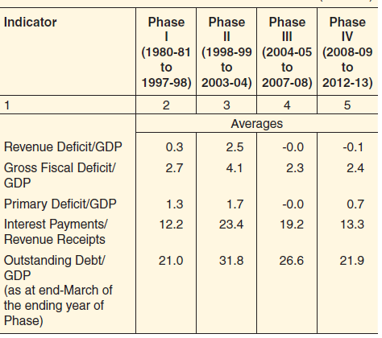
All indicators by RBI point towards a successful fiscal consolidation at state level in India

Slide 3
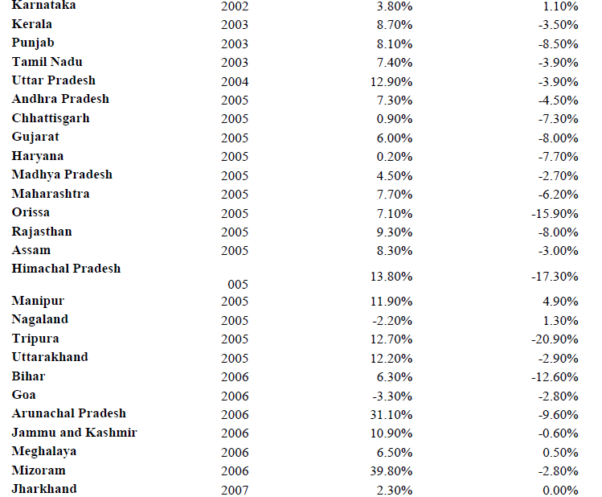
Growth in Debt/SGDP has been lower in the post FRL period (5 year pre and post averages)

Slide 4
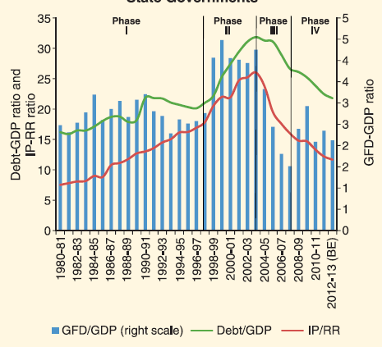
Downward Trends in Deficit, Debt and Interest payments of states’ debt

Slide 5
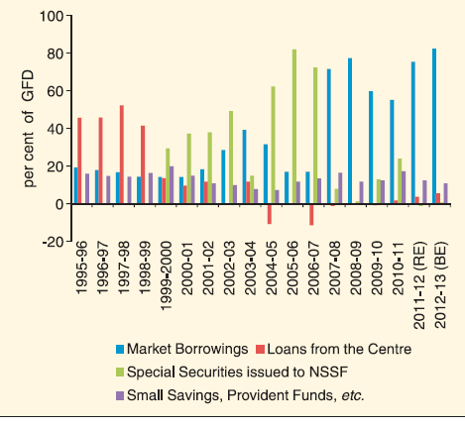
Credit market access has replaced states’ borrowing from the central government

Slide 6
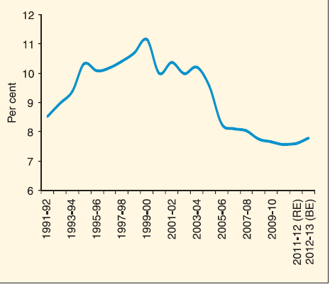
Lower interest rates a major contributory factor to States’ fiscal consolidation

Slide 7
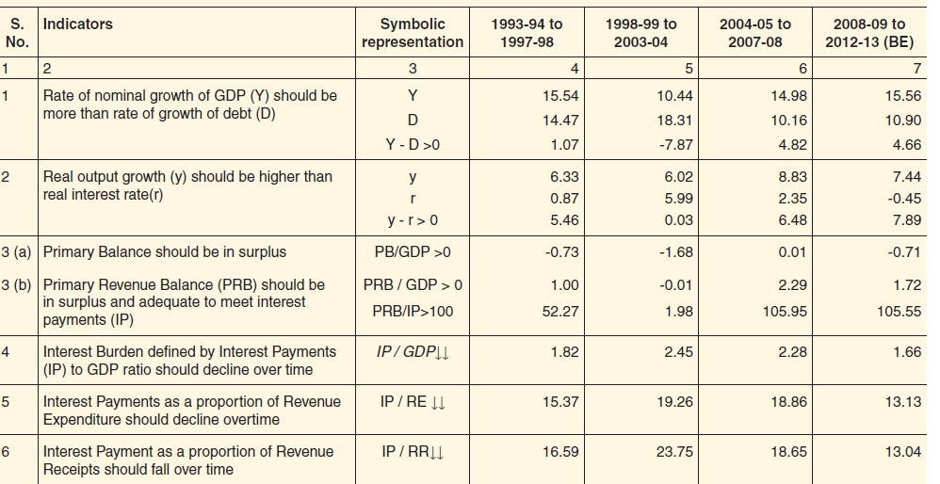
Fiscal Sustainability indicators of Indian States show positive trends

Slide 8
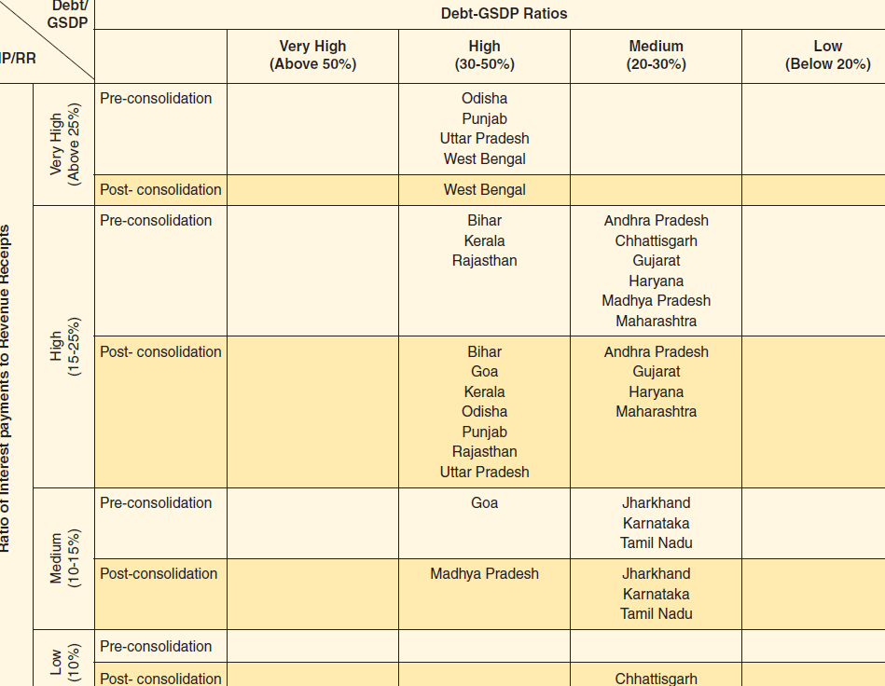
Vulnerability in non-special category states has been reduced but not overcome

Slide 9
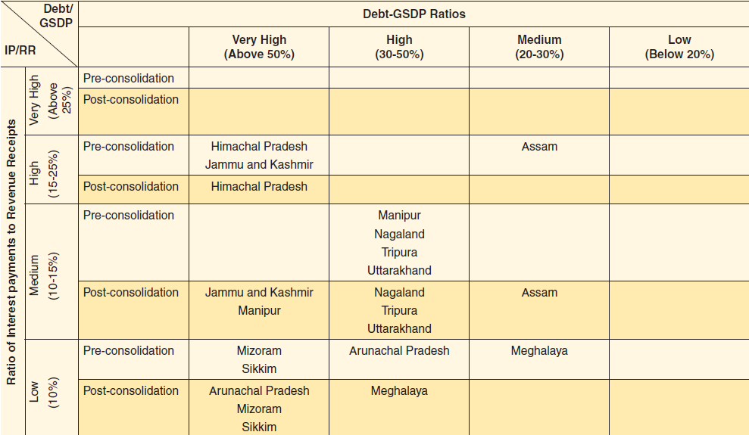
Vulnerability in special category states has also been reduced.

Slide 10
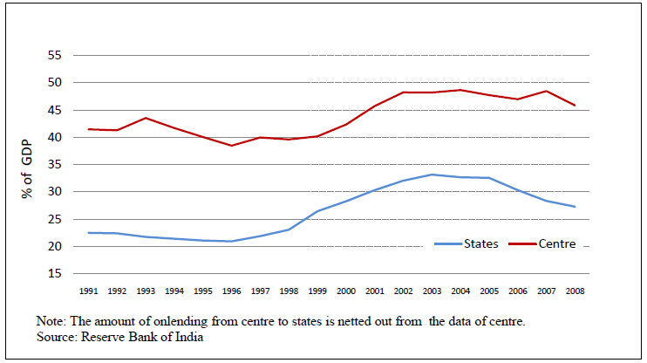
Overall states have done better than the Centre in Fiscal Consolidation in India

Slide 11
A note of caution
States’ fiscal consolidation remains fragile as mostly due to lower interests, debt swaps and debt forgiveness. Limited revenue growth and little retrenchment of current expenditures. Capital expenditure retrenchments hurt growth.

Slide 12
Lessons from emerging success story in India
Political consensus and commitment critical for success.
Fiscal rules are not a panacea but do help constrain politics of populism.
Incentives with accountability for results do matter. A common element of Brazil and India approaches.
Local ownership matters. Political commitment motivated by jurisdictional competition – an important ingredient for success.
Centre should focus on fiscal policy coordination and the enabling environment for credit market access. Central controls on sub-national borrowing negates federalism – federal controls neither necessary nor sufficient – examples Australia and Canada

Slide 13
Lessons …….2
Better measurement of fiscal health needed to account for contingent and non-contingent and explicit and implicit liabilities – an area requiring further thought and analysis in India.
Administrative decentralization must go hand in hand with political and fiscal decentralization. Task specialization with accountability for results should be the hallmark of States civil service. A unified federal service with rotating life-long appointments to executive positions in states contributes to a centralized federal structure. The Brazilian approach for capping wages and benefits for all tiers a better approach.

