Slide 1

Nepal Country Partnership Strategy
FY 2014-2018
The World Bank Group

Slide 2

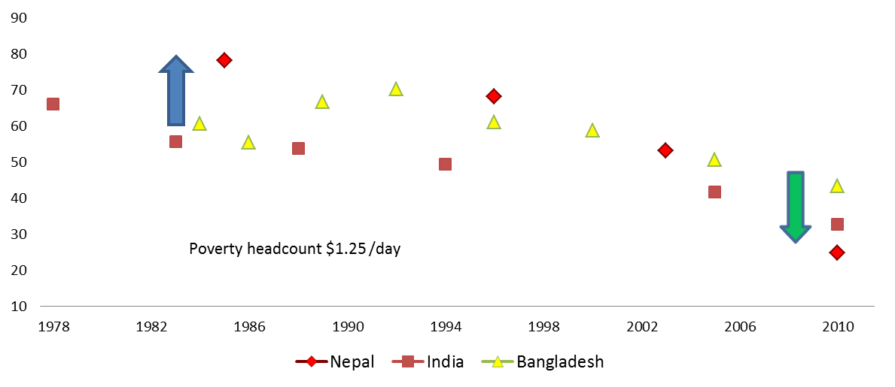
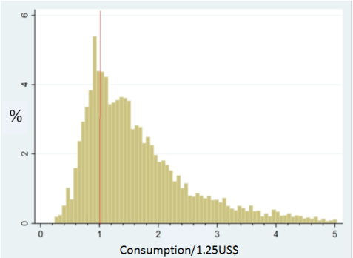
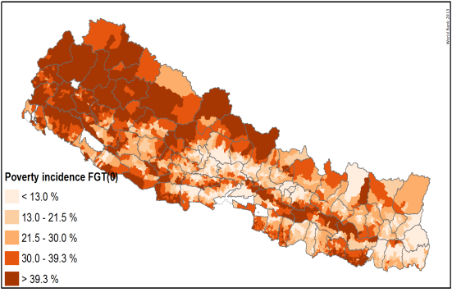
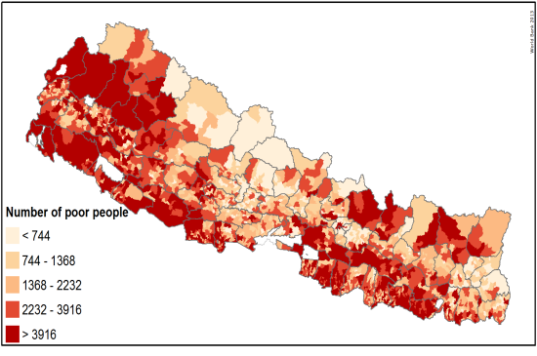
Nepal has made good progress on poverty reduction…
…but vulnerability remains high, especially in rural areas
Pockets of poverty are concentrated in the Western Hill regions
Most of the poor are densely populated in the southern plains.
Notes:
Nepal halved poverty in only seven years (2004-2011) and is also on track to reach other MDGs on health and education
Also strong progress in enhancing gender equality and other social indicators
But progress on poverty reduction has to continue – the bottom 40 percent are clustered too close to the poverty line and vulnerability remains high
Poverty is also more severe in rural areas as well as in the western and mountainous parts of Nepal (but more poor people live in the densely populated Terai).

Slide 3
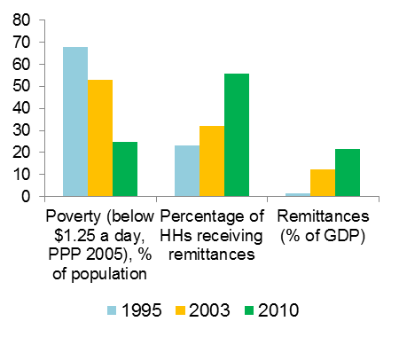
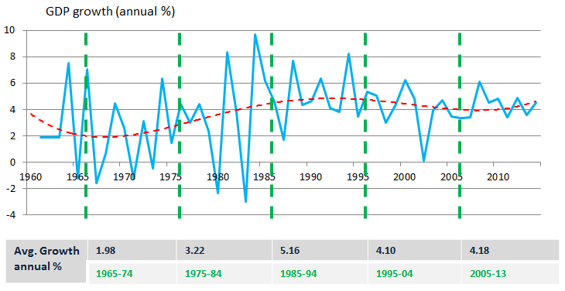
Poverty reduction has been driven by remittances…
…but reducing poverty further will require faster and more sustainable growth.
Notes:
The driver of poverty reduction in Nepal is income received from remittances.
However, to further reduce poverty, the World Bank has found that Nepal will have to achieve higher and more sustainable levels of growth.
While growth has been positive, most notably during the conflict, the country’s overall growth levels have been tampering off over the last decade (around 4 percent during a time in which India reached near double digit growth).

Slide 4
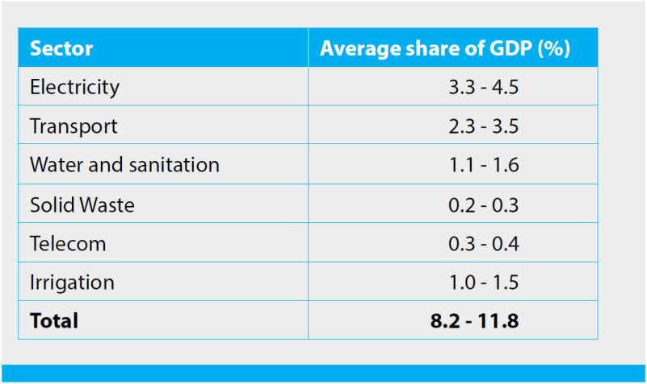
Development Challenges and Opportunities
Faster, inclusive and sustained economic growth
Political stability/policy certainty as key prerequisite
Poor infrastructure as major bottleneck
    Energy
    Transport
  Regulatory environment/financial sector stability
  Agriculture as source of growth and poverty reduction
  Opportunities: quality health/education and skills
  Governance and management of public expenditures
Notes:
The Bank will present policy notes for the government, which will go into more detail on the link between growth and poverty reduction, which is not to focus of this presentation.
The key constraints to growth and poverty reduction that we will discuss in the policy notes, however, also provide the basis for our engagement in the CPS. They are the three Is: Investment, Infrastructure, Inclusion
Within this very broad framework, the major development challenges and growth constraints for Nepal include:
Political stability – continues to be identified by investors as the number one constraint – even before access to electricity
Nepal’s hydropower potential is well known and tapping it should be the country’s prime goal
Transportation is the second most important infrastructure challenge, especially with respect to linking Nepal to India
Financial sector stability and providing a conducive business environment are important to incentivize private investments
Agriculture provides an important link between growth and poverty reduction – it provides one third of GDP and employs three quarters of the population
To make growth inclusive, it will be important to not just provide access to services, but also make sure these services are equally available and of improved quality
Given Nepal’s demographics, the country needs to provide jobs to its youth to allow them to earn higher wages either at home or abroad
Governance and especially improved management of public expenditures is important to allow for more effective and efficient private investment to stimulate the economy

Slide 5
WBG Country Partnership Strategy (FY14-18)
Overall Objective: to support Nepal’s aspirations for increasing economic growth through increased investments in key sectors while providing support to make growth more inclusive and to help equalize opportunities across groups and communities.
Pillar 1: Increasing economic growth and competitiveness | Pillar 2: Increasing inclusive growth and opportunities for shared prosperity
Outcome 1.1: Increased supply of electricity, including import, and improved access to reliable and affordable electricity within Nepal | Outcome 2.1: Increased agricultural productivity and commercialization
Outcome 1.2: Improved transportation connectivity, internally and with India | Outcome 2.2: More equitable access to education and skills development, of higher quality and relevance
Outcome 1.3: Improved environment for private sector investment, including increased financial sector stability | Outcome 2.3: Improved health and nutrition services, particularly for the poor and disadvantaged
 | Outcome 2.4: More efficient and transparent social safety net system
Notes:
The WBG stands ready to support the Government in addressing some of its key development challenges within the areas where it as a distinct comparative advantage
The WBG focus will be to support fast and sustained growth that is also inclusive and will help reduce extreme poverty and promote share prosperity

Slide 6
WBG Country Partnership Strategy (FY14-18)
Pillar 1: Removing the binding constraints to private investment and growth by focusing on energy, transport, the financial sector and the enabling business environment.
Pillar 1: Increasing economic growth and competitiveness
Outcome 1.1: Increased supply of electricity, including import, and improved access to reliable and affordable electricity within Nepal
Outcome 1.2: Improved transportation connectivity, internally and with India
Outcome 1.3: Improved environment for private sector investment, including increased financial sector stability
Notes:
Under Pillar 1, the primary focus will be on increasing the electricity supply within the country by tapping the country’s hydropower potential
The transport connectivity objective will focus on strategic investments in the road sector that will link with other parts of our engagement (e.g. on agribusiness) and help to connect markets within Nepal and with Nepal’s main export partner, India
Financial instability remains a threat to Nepal’s financial sector and the Bank will continue to provide support; IFC will continue to support improvements in the broader business environment

Slide 7
WBG Country Partnership Strategy (FY14-18)
Pillar 2: Increasing inclusive growth and providing historically-disadvantaged Nepalis with opportunities to improve their resilience and increase their prosperity.
Pillar 2: Increasing inclusive growth and opportunities for shared prosperity
Outcome 2.1: Increased agricultural productivity and commercialization
Outcome 2.2: More equitable access to education and skills development, of higher quality and relevance
Outcome 2.3: Improved health and nutrition services, particularly for the poor and disadvantaged
Outcome 2.4: More efficient and transparent social safety net system
Notes:
Growth alone will not help Nepal to further reduce poverty and it is necessary to make growth more inclusive; inclusion will also support growth, e.g. through strengthening human capital.
The WBG will support increased agriculture productivity and commercialization especially in remote areas. A focus will be on cash crops for export markets, in particular India.
The WBG will move away from supporting all levels education to a stronger focus on providing young Nepalis with the necessary skills to find better-earning jobs.
The WBG will continue to support the provision of health and nutrition services, but with a focus on making these services more equitable and focusing on the poor.
The WBG will support the development of a more focused, efficient and transport social safety net system that helps those Nepalis that are either in poverty or on the risk of falling into poverty.

Slide 8
WBG Country Partnership Strategy (FY14-18)
Cross-Cutting Dimensions
  Governance
    Manage public expenditure efficiently and effectively
    Improve public procurement
    Strengthen demand-side / social accountability
  Gender
  Climate Change
Notes:
Governance, Gender and Climate Change are important cross-cutting dimensions that our program is already supporting and will continue to support during the CPS period.
In governance the focus will continue to be on PFM, procurement and social accountability
Our program will continue to focus on gender and making sure women as well as other socially disadvantaged groups are fully included in the economy.
We will continue to support climate change, e.g. through ongoing activities focusing on improving weather forecasting.

Slide 9
WBG Country Partnership Strategy (FY14-18)
Implementation
  Financing
    IDA: $200-300 million/year
    IFC: $300-800 million in hydropower; $20-40 million financial institutions, manufacturing, agribusiness, services
    MIGA: Potential for 1-2 risk guarantees
  Knowledge
  Partnerships
Level of Engagement |  | Engagement Areas | Top Five Development Partners (size of commitments)
 | CPS Engagement Areas | Electricity | WBG, Germany, ADB, China, India
 |  | Transportation | WBG, ADB, Japan, India, Switzerland
 |  | Finance | WBG, UK, ADB, Norway, Germany
 |  | Agriculture | ADB, WBG, UN, USAID, Switzerland, EU
 |  | Education/Skills | WBG, ADB, EU, Denmark, UN
 |  | Health/Nutrition/Sanitation | WBG, UK, USAID, Global Fund, Germany
 | Prior WBG Areas | Primary/Basic Education | WBG, ADB, EU, Denmark, UN
 |  | Peace and Reconstruction | WBG, EU, UN, Denmark, Germany
 |  | Urban Development | ADB, Germany, Japan, WBG, UN
 |  | Local Development | ADB, India, UK, WBG, Finland
 |  | Social Development | UN, USAID, Denmark, UK, Norway, WBG
Less
More
Notes:
Implementation focuses on financing, knowledge and partnerships.
Financing will continue through all instruments at the Bank’s disposal, including DPCs, risk guarantees, investment financing, etc.
The knowledge program will be enhanced through various core diagnostics, including a comprehensive Country Economic Memorandum in the first year of the CPS. We will strengthen the link between our knowledge program and our operations to make sure we learn from implementation and apply the correct knowledge in improving our engagement.
Partnerships are key and the WBG will disengage in areas where other partners have a stronger presence and where it lacks a comparative advantage.

Slide 10

Thank you!!
For further information please visit:
www.worldbank.org/np
www.ifc.org
www.facebook.com/worldbanknepal

