Slide 1


Renewable Energy Committee Progress Report
June 2014

Slide 2
TABLE OF CONTENTS
RENEWABLES TODAY
WHERE WE ARE HEADED
SE4ALL OBJECTIVES
RENEWABLES COMMITTEE ACTIVITY
RENEWABLES COMMITTEE AREAS OF FOCUS
WHERE TO NEXT? – POTENTIAL INITIATIVES

Slide 3
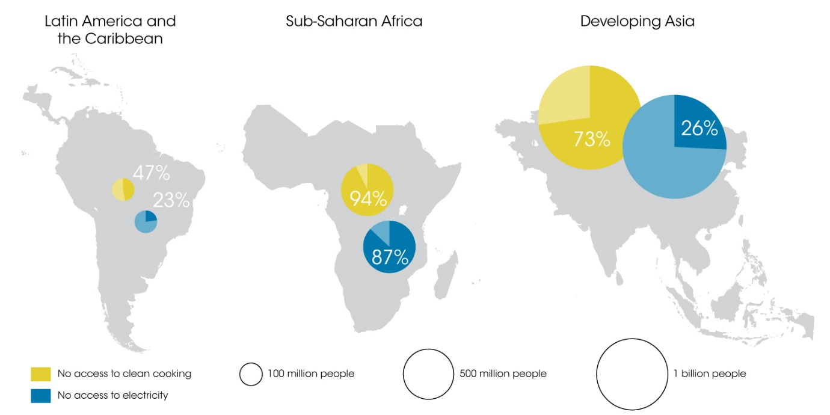
RENEWABLES TODAY
Economic, demographic and energy consumption trends and concerns around the environment and climate change are sharpening the focus on the necessity for an energy transition.
Source: IEA, United Nations Population Division
Notes:
Graph: Share of rural population without access to electricity and clean cooking, 2010

Slide 4
RENEWABLES TODAY
Renewable energy is:
  Available in some form anywhere in the world,
  Economically competitive, technically viable, socially and environmentally beneficial,
  One of the most effective long-term responses to climate change.
Source: IRENA analysis and global data
Notes:
Countries around the world are already taking decisive action:
138 countries have defined renewable energy targets
127 have policies in place to facilitate the deployment.
Since 2011, global electricity generation from renewable sources increased by 18 percent, almost 800 TWh.
Photovoltaic (PV) generation accounts for nearly one-eighth of this total – a staggering 237 percent increase since 2011.
Graph shows RE capacity growth by year.

Slide 5
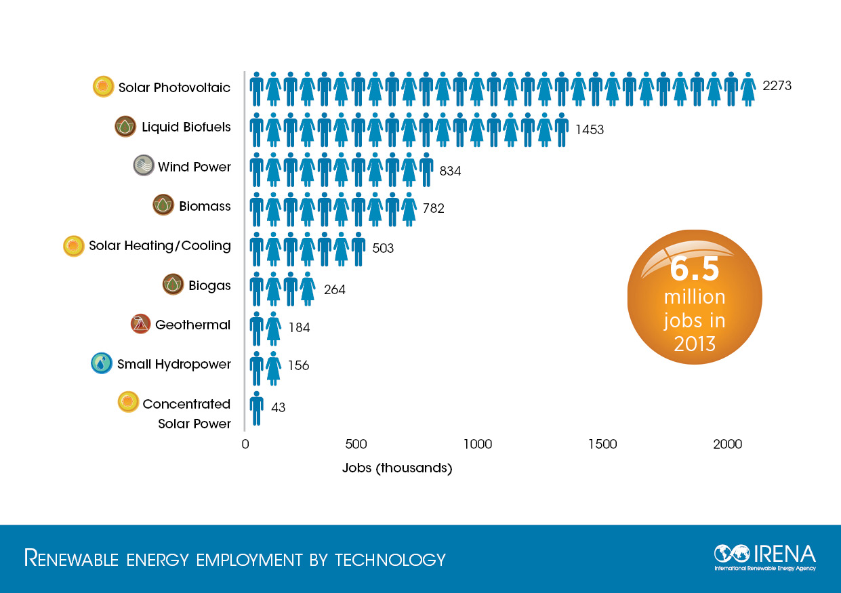
RENEWABLES TODAY
Source: IRENA
Notes:
Jobs graph illustrates the importance of social benefits of RE.

Slide 6
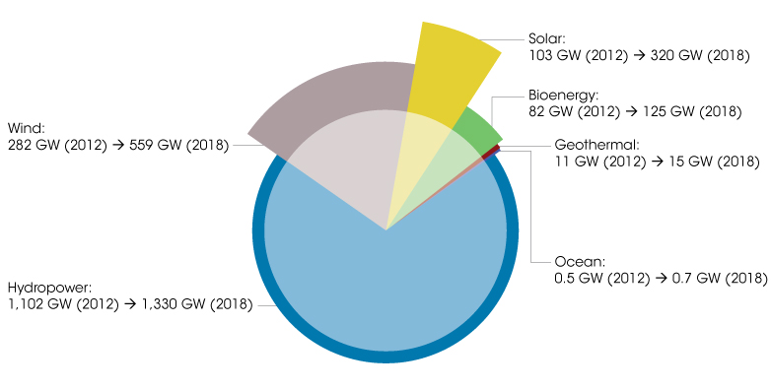
WHERE WE ARE HEADED
Renewables are taking an increasing role world-wide
Source: IEA
Notes:
Figure: Installed renewable capacity in 2012 and projections to 2018
2012 is the inside circle. 2018 the outside circle. Projections are based on projects in the pipeline and country action plans.

Slide 7
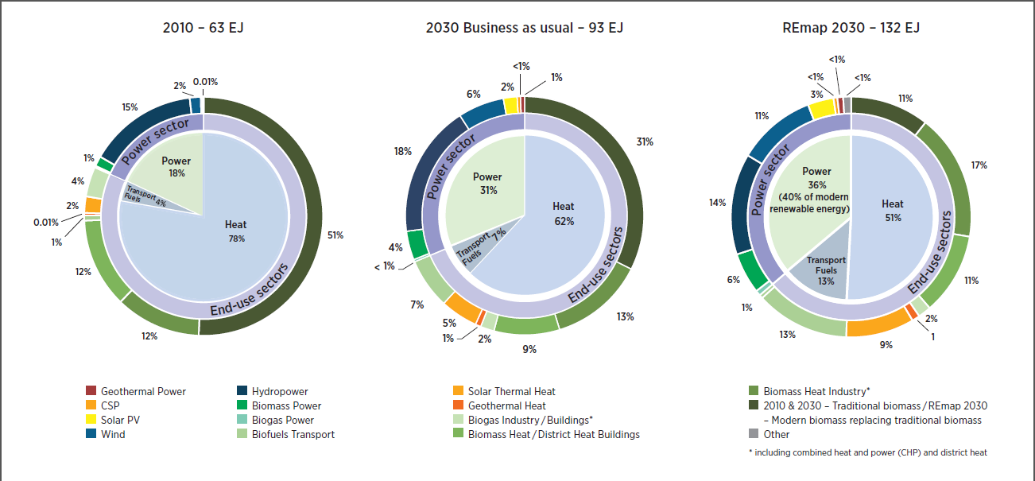
SE4ALL and REmap 2030
One of SE4ALL’s goals is to double the share of renewable energy by 2030. IRENA analysis, REmap 2030, concludes that doubling the share of renewable energy by 2030 is:
Technically feasible and affordable
Achievable with cost neutrality or cost savings
Source: IRENA

Slide 8
RENEWABLE COMMITTEE
The work of the Renewable Committee started in January 2014 with two immediate objectives:
Identifying the key focus areas to advance the objective of doubling the share of renewable energy in the global mix by 2030.
Initiating a set of game-changing initiatives/instruments in support of the renewables objective, which will be led/backed by Advisory Board members and other partners.

Slide 9
RENEWABLES COMMITTEE ACTIVITY
R.C. MILESTONES:
January 2014: Co-leads and the GFT focal points for each Committee drafted the scope of work.
Feb-May 2014: Acciona hosted the first face to face meeting in Madrid and virtual meetings followed between committee members which led to the development of the draft terms of reference.
June-Sept 2014: Presentation of the Renewable Energy Committee deliverables – Recommended set of actions.

Slide 10
RECOMMENDED AREAS OF FOCUS
Knowledge management | Policy and regulation | Public support
Availability of financial resources
Capacity building and job creation

Slide 11
WHERE TO NEXT? – POTENTIAL INITIATIVES
Knowledge Management
  REmap 2030, the 10 Principles of Renewables, Global Atlas, Manual for hydropower, Global bioenergy partnership,…
Policy & Regulation
High Level Regional Platforms, grid integration, small island solutions,…
Public Support
Dissemination of the 10 Principles of Renewables, identify civil society, system operators, TSOs and distributors, parliamentary, media,…

