Slide 1
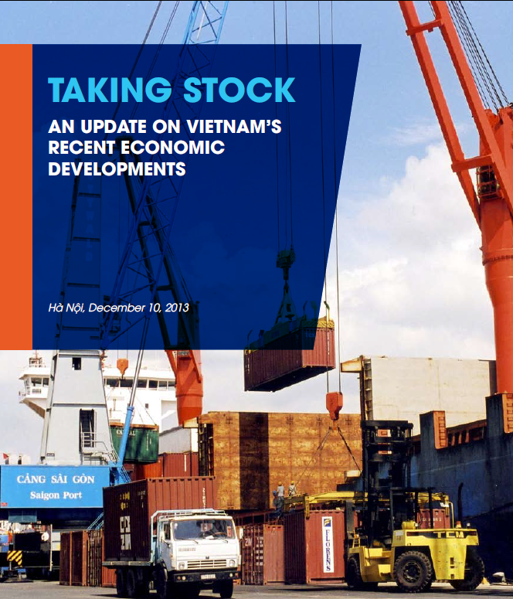

Slide 2
Taking Stock: Coverage
External economic environment
Recent economic developments in Vietnam
Special topic 1: Trade facilitation, competitiveness, and growth in Vietnam
Special topic 2: Corruption and economic growth in Vietnam
Special topic 3: Poverty and inequality in Vietnam

Slide 3
External economic environment
Despite gradual recovery, EAP to remain global growth leader

Slide 4
Risks to the global economy
Less-than-orderly tapering of QE in the US
Prolonged fiscal deadlock in the US
A sharper than expected slowdown of investment in China
Stronger than projected recovery of global economy
Japan successful in reflating and reviving its economy

Slide 5
Macro stability in Vietnam has improved…
Source: Bloomberg
State Bank of Vietnam

Slide 6
…growth however stagnant at modest levels

Slide 7
Constraints to growth
Growth remains stagnant at modest levels
  Short run:
    Subdued private sector confidence
    Shrinking fiscal space
  Long-term:
    Evaluating the role of the state in a market economy
    Structural constraints – SOE and banking sector issues
    Declining competitiveness and productivity growth
    Tight supply of market-oriented technical skills

Slide 8
Short-term constraints to growth
Subdued private sector confidence
  Sharp drop in private investment rate, from 15% from 2007-10 to 11.5% in 2013
  The Provincial Competitiveness Index indicates firms less likely to invest or expand production
  PMI has mostly been in –ve territory
  Subdued HH consumption growth: 5.1% in 2009-12, compared to 8.9% in previous 4 years

Slide 9
Short-term growth: Global situation has important implications

Slide 10
ST growth constraints: Shrinking fiscal space
Crucial fiscal policy choices: balance between supporting growth and sustainability
  Low debt distress, but fiscal expansion is stretching limits of this assessment
    Even a small increase in pace of spending will lead to a rapid deterioration in debt dynamics.
  Consolidation of capital spending welcome move
  Greater fiscal transparency needed

Slide 11
Longer-term growth: getting the business climate right

Slide 12
LT growth: getting SOE reforms right

Slide 13
LT growth: getting SOE reforms right
Relatively slow SOE reforms on account of:
  Lack of clarity of state ownership plans
    Top-down approach, lacking policy and implementation coordination
    Restructuring targets not kept realistic
  Unclear, and fragmented regulatory framework
  Limited underlying financial and operational analysis for divesture
  Weak market conditions lately

Slide 14
LT Growth: Getting banking reforms right
Banking sector fragilities remain
  High NPL ratios (financial disclosure & transparency big concerns)
  Loan classification not per international stds
  State retains a big share in banks
  Regulations on bankruptcy, insolvency, creditor rights need attention
  VAMC an important step: its organizational and financial capacity needs bolstering

Slide 15
Medium-term outlook and risks
Medium-term outlook is favorable on balance, albeit with considerable downside risks
Downside risks
  Forex reserves still low
  Weak private sector demand vulnerable to further bad news
  Possibility, though diminished, of departure from prudent macro policies
  Structural reforms could further slow down
  Banking sector highly fragile with weak financial position
 | 2012 | 2013 (p) | 2014 (p) | 2015 (p)
GDP Growth (%) | 5.2 | 5.3 | 5.4 | 5.5

Slide 16
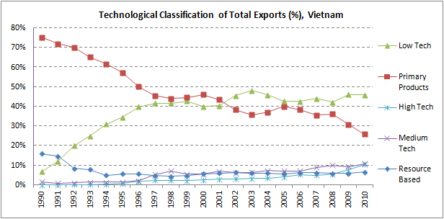
Special topic 1: Trade facilitation, competitiveness and growth in VN
Impressive gains in leveraging benefits of global integration
However, export growth mostly low tech

Slide 17
Special topic 1: Trade facilitation, competitiveness and growth in VN
Attention needed in the three pillars of trade facilitation and competitiveness
  Transport infrastructure and logistics
  Regulatory procedures for trade
  Supply chain organization
Adopt dual-track approach
  Long run: Upgrade tech &move up value chain
  Short run: Get more value addition in existing exports

Slide 18
Special topic 2: Corruption and growth
Corruption long seen as a serious problem
A few troubling cross-country comparisons

Slide 19
Special topic 2: Corruption and growth
Vietnamese firms that paid bribes have done worse!
Need for: administrative reforms and greater transparency

Slide 20
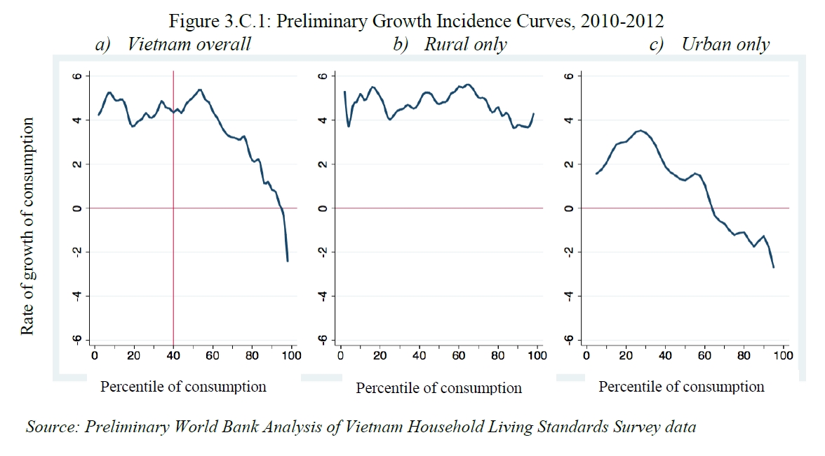
Special topic 3: Poverty and inequality

Slide 21
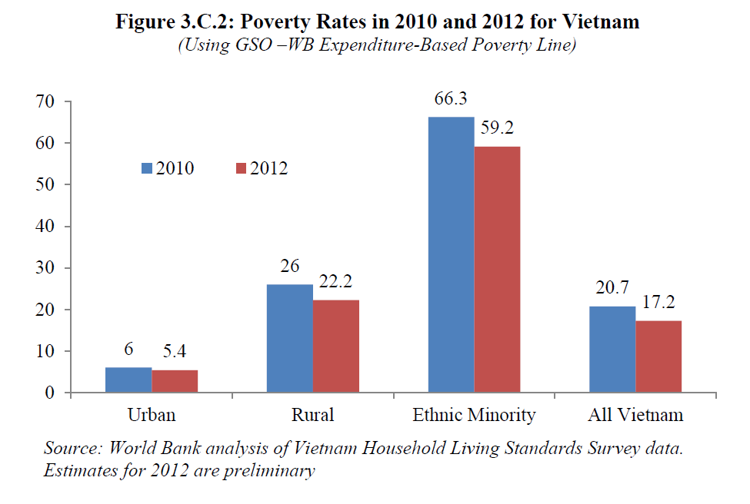

Slide 22
Special topic 3: Poverty and inequality
Poverty remains concentrated among ethnic minorities. HOWEVER,
  Even ethnic minority poverty has improved significantly
  The situations of the 53 ethnic minority groups are diverse
  Observed pathways out of poverty for ethnic minorities are similar to rest of population

Slide 23
Thank you!

