Slide 1
Debt Management Facility Briefing
Abha Prasad
DMF Program Manager and Senior Debt Specialist
Economic Policy and Debt Department
The World Bank
May 6, 2014

Slide 2
Contents
DMF I – 5-years of implementation
DMF II -Multi-donor Trust Fund
Expanded Activities Coverage
Country coverage
Governance arrangements
Contributions and commitments
Findings from TA activities and how that shapes DMF II work program

Slide 3
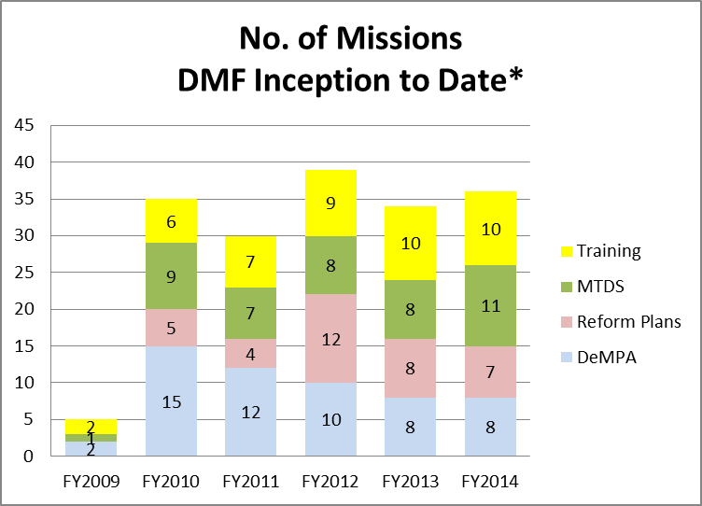
DMF 1: Program Implementation (1) Activity wise
Move towards formulation of debt management strategy
Increase in capacity building trainings
* up to April 2014

Slide 4
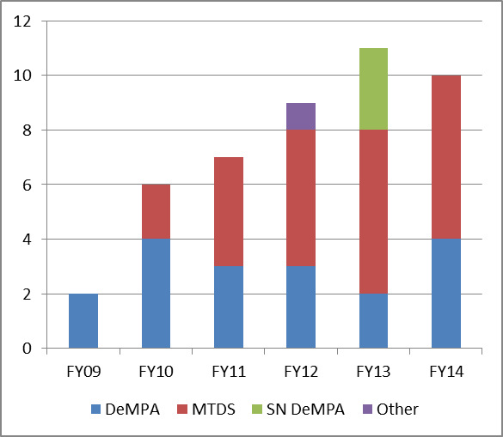
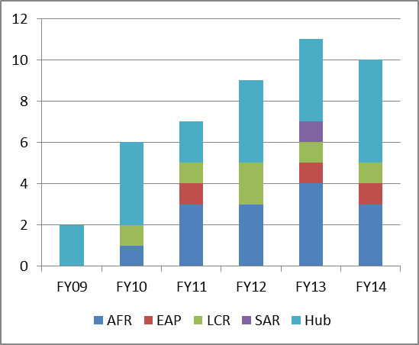
Program Implementation (2) Capacity Building -Trainings
Training by Type
Training by Region

Slide 5
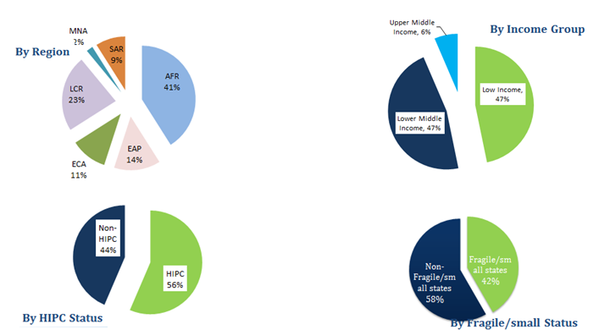
Program Implementation (3): Diversity (DeMPA, Reform Plan and MTDS)

Slide 6
Program Implementation (4) (Planned vs Actuals: inception to April 2014)
DMF Program implementation January 2009-June 2014 | Planned till June 2014 | Actual till April 2014
Total missions | 183 | 134
of which DeMPA missions | 82 | 54
of which MTDS missions | 66 | 45
of which Reform Plan missions | 35 | 35
Training events | 32 | 42
DMPP | 24 | 24
DMN | 8 | 8
Stakeholders Forum | 5 | 4 (+1)*
* Fifth in April 2014

Slide 7
DMF II- Multi-donor Trust Fund Launched
DMF II launched on April 4, 2015 in partnership with IMF
Builds on basic principles of DMF I
Programmatic approach
Sustained engagement
Promote collaboration among wide range of institutions and partners
Builds on strong partnership with IMF
to leverage institutional expertise
to deliver capacity building in debt policy and management
Working together on debt relief and debt sustainability initiatives, and technical assistance on medium-term debt management strategy (MTDS) formulations

Slide 8
Expanded Coverage of Activities
Current DMF Activities to be continued
DeMPA
Debt Management Reform Plans *
New Activities
DSF- capacity building*
Debt Managers’ Network Peer Learning Activities
Advice on Domestic Debt Market Development*
MTDS *
Debt Managers’ Network and Peer Learning Activities
Debt Managers Practitioners’ Program
Debt Portfolio Risk Management
International Capital Market Operation – advice on issuances
Knowledge generation and dissemination*
Subnational debt management*
*Activities will be carried out jointly for both the Bank and IMF, and Implementing Partners.

Slide 9
Country Coverage – Similar to DMF I
All IDA-eligible countries, LICs and those that have graduated but were part of the initial program
IMF’s Poverty Reduction and Growth Trust countries
a sub-set of LICs

Slide 10
Governance Arrangements
Steering Committee
Donor representation - one representative of each donor (contributions of USD 1 million over a 2-year period)
Co-chairs WB and IMF
Endorses work program, Reviews reports
Secretariat
Manages day-to-day operations
Coordinates with donors, IMF and implementing partners
Complies annual report (and log-frame report)
Panel of experts
Advising and quality review
Implementing Coordination Group
Coordinates partner activities

Slide 11
Contributions and Commitments
Existing donors spearheading financing efforts
Austria
EU
Germany
Netherlands
Norway
Switzerland
Administration Agreements finalized with 3 donors and funds transferred to DMF II.
Potential commitments and interest from the Asian Development Bank, the EU, France, Russia and Sweden
Support down the pike likely from – the African Development Bank, Belgium, and Canada
Exploring interest from Australia, Denmark, the European Investment Bank, Korea, and Luxembourg

Slide 12
What have the DeMPA results shown us?
Note: The chart is based on the results of 62 sovereign DeMPA reports

Slide 13
What have the MTDSs shown us: Average values of risk indicators
Source: WB Internal Study

Slide 14
Progress Made: Early Outcomes
DeMPA Indicator | Steps taken | Country
Legal framework | Strengthened legal framework | Burundi, Malawi, Sierra Leone, Togo, Mongolia, Sao Tome Principe, Sierra Leone
 | Enhanced institutional framework governing loan guarantees | Malawi, Senegal, Sierra Leone
Managerial structure | Upgraded or modernized organizational structure | Burundi, The Gambia, Ghana, Kenya, Maldives, Malawi, Tanzania, Senegal
 | Strengthened middle office | Bangladesh, Papua New Guinea, The Gambia, Liberia, Malawi, Nicaragua, Sierra Leone. Moldova
Debt Management Strategy | Debt management strategy development based on cost-risk analysis, strengthen debt management analysis | Bangladesh,B urkina Faso, Ethiopia, Maldives, Cape Verde, The Gambia, Ghana, Kenya, Malawi, Mali, Moldova, Mozambique, Nigeria, Nicaragua, Rwanda, Tanzania
Audit | Strengthened audit function | Malawi, Mongolia
Domestic Borrowing | Deepening domestic market development | Bangladesh, Kenya
Cash Flow Forecasting & Cash Balance Management | Strengthened cash management | Burkina Faso, Malawi, Maldives
Segregation of Duties, Staff Capacity & BCP | Reduced operational risk | Bangladesh, Bhutan, Maldives, Rwanda, Togo
Debt Records and Debt Reporting | Improved debt recording and reporting | Bhutan, Burundi, Liberia, Burkina Faso, Malawi, Mali, Mozambique, Nigeria, Togo
Notes:
/ This reflects areas where countries have taken explicit steps to enhance capacity; it does not measure the effectiveness or completeness of the steps taken. This is based on information at the time of a mission visit.
Source: DeMPA and Reform Plan updates, mission staff, and country authorities.

Slide 15
Conclusions
Programmatic approach continues to bear fruit
Greater number of reform plan mission than past, results from upstream assessment and analytical work increasingly taking root and triggering institutional reforms and capacity building
Reform momentum most sustained when strong links between upstream and downstream implementation activities and is consistent within the broader PFM reforms
Importance of maintaining integrity and quality of upstream work through independent assessments, peer review, and quality control process
DMF continues to strengthen coordinating mechanism among providers of providers of TA, development partners and donors

Slide 16
Thank You
For more information:
http://www.worldbank.org/debt

