Slide 1
e-Procurement Experiences
of Korea
Third South Asia Regional Public Procurement Conference
Dhaka, Bangladesh, November 2015
Kang-il Seo |
Deputy Director, International Cooperation Division
Public Procurement Service (PPS), the Republic of Korea

Slide 2
I
e-Procurement in Korea

Slide 3
Public Procurement in Korea
Korea’s Public Procurement Process
PR (mandatory)
PR (optional)
Centralized procurement through PPS (2014) : USD 33.9 B
- 31.6% of Korea’s public procurement (107 B)
Transaction via KONEPS : USD 67.3 B (63%) of Korea’s public procurement
However, 100% of tender notices are published through KONEPS

Slide 4
e-Procurement in Korea
KONEPS (Korea On-line E-Procurement System)
Single window for public procurement
End-to-end service that covers the entire procurement processes
Seamless service through data interconnection with 160 database systems
“KONEPS”
Korea
ON-line
E-Procurement
System
e-Bidding
e-Contracting
e-Payment
Online
Shopping
Mall
e-Ordering

Slide 5
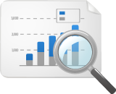
e-Transformation – Before & After
Seamless Service through Data Integration
Data interchange with 160 external info systems for seamless process
Before
Ministry of Strategy
and Finance
Public Buyer
Industry
Associations
Bid
Supplier
National Tax Office
Surety Companies
Construction
Authorities
Credit Rating Companies
Certification-
Related agencies

Slide 6
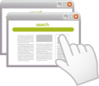
e-Transformation – Before & After
Seamless Service through Data Integration
Data interchange with 160 external info systems for seamless process
After
Contract
Delivery
Ministry of Strategy
and Finance
Industry
Associations
Public Buyer
National
Tax Office
KONEPS
Credit Rating
Company
Construction
Authorities
Surety
Companies
e-Bid
Korea Financial
Telecommunications
& Clearings Institute
Certification-
Related agencies
Supplier

Slide 7
Data Input & Integration
Data entry in the procurement cycle
Gov. Finance System
Gov. Finance System
Gov. Finance System
Banks
Budget & Procurement Requests
e-Contract
Electronic Fund Transfer
KONEPS
Supplier
Registration
SME Status
Special Status
(women-owned, high employment of the disabled, etc.)
Total # and Value of Contracts via e-GP
# of Low Value Contracts via e-GP
Data by Size, Location, Special Status of Supplier
Unsuccessful procurement processes
G4C Systems
(tax office, natl. insurances)
No disbursement if payment amount does not match e-Contract amount
Delivery/Acceptance date is checked against e-Contract before payment
- Therefore, contract modifications must be registered to administer payment
Direct contract negotiations / Framework Agreement Transactions are also carried out via KONEPS
Notes:
7
7
현재 우리나라는/ 각 부문에서/
세계 10위권대의/ 중견국가로 부상하였습니다./
경제력 면에서는/ GDP 규모로 세계 15위이고,/
수출은 2009년 기준으로/
세계 9위로 올라설 것으로 예상됩니다.
산업경쟁력 측면에서는/
조선과 디스플레이 부문 세계 1위,/ 휴대폰 2위 등/
다양한 제품들이/ 세계시장에서 선두권을 지키고 있습니다.
과학기술력은/ 국제특허출원 면에서/
세계 4위의 위치를 점하고 있습니다.
그 외에도/ 스포츠, 인적자본 등 다양한 영역에서/
상당한 성과를 거두고 있습니다.

Slide 8
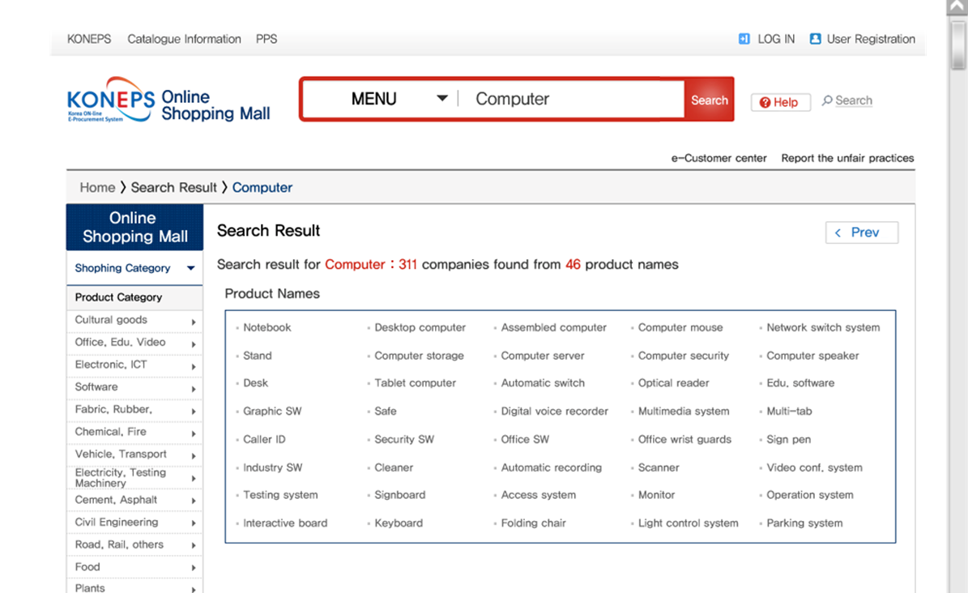
Online Shopping Mall for Framework Contracted Products

Slide 9
Effect of e-Procurement
Increased Transparency
Real-time information disclosure
Bidding results and contract details disclosed to the public on-line
Peer monitoring on fair results
Accuracy in bid evaluation
Support for decision-making
Traceable prices and specifications
[Integrity perception index on public procurement (Korea Civil Rights Commission)]
Year | 2002 | 2003 | 2004 | 2005 | 2006 | 2007 | 2008 | 2009 | 2010 | 2011
Integrity index | 6.80 | 7.34 | 8.52 | 8.65 | 8.36 | 9.20 | 8.44 | 8.80 | 8.77 | 8.52
KONEPS Launch
KONEPS Roll-out
Expansion of Decentralized Procurement

Slide 10
Information Disclosure
Bidding Results

Slide 11
Test Result

Slide 12
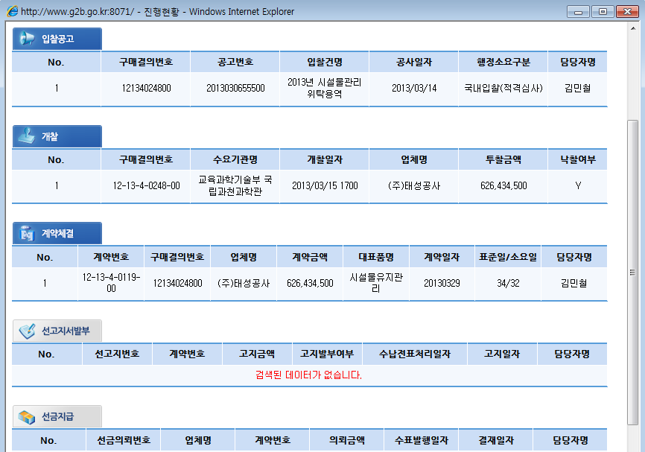
Information Disclosure
Progress Report
Tender Notice
Purchase #
Tender #
Tender Name
Date
Compt. Type
Contr.
Official
Awarding
Purchase #
Procuring Entity
Bid Opening
Nominee
Price
Award
Contracting
Contr. #
Purchase #
Contractor
Price
Item
Date
Process time (days)
Standard / Actual
Contr. Official
Upfront Payment Request
Upfront Payment

Slide 13
Effect of e-Procurement
Saving of Transaction Costs via KONEPS
Cost saving : USD 8 B per year
Private Sector : USD 6.6 B
Public Sector : USD 1.4 B
Transaction Cost Saving
- Reduced visits
- Reduced labor costs
$ 6.6 B
Increased efficiency
Receiving bids, validating related docs.
and selecting the winning bid
Reduction of 7.8 million pages of paper documents per year
Before | over 30 hrs
After | less than 30 mins.
- Reduced lead-time
- Streamlined Process
$ 1.4 B
Public Sector
Private Sector

Slide 14
Rolling out e-Procurement
Training and User Support
Nation-wide training sessions
Marketing visits to public entities
- educate people who feel hard to use KONEPS
Marketing visits Web Call-Center
- 70 staff offering 5,300 consultations daily via phone and video-conferencing
In the early onset of e-Bidding, PPS held 130 training sessions in 2001 and operated training courses at 23 locations
98%
Incentives
40%
Discount for service fees when procurement request is made via KONEPS
e-GP usage was included in the government-wide performance evaluation criteria (‘05-’09)
20%
2002
2006
2010
e-Contracting Ratio

Slide 15
II
Recent Initiatives in e-Procurement

Slide 16
KONEPS for Private Sector Purchasers
Objective : Spreading the benefits of e-Procurement into the private sector
Transparency, fairness and cost savings
Shared supplier data with KONEPS
KONEPS
Private purchaser’s system
Public agency
Suppliers
Procurement service
Additional service
Central Gov.
Local Gov.
Public Enterprise
others
Single Window
Registration
Quotation
Reverse auction
e-Tendering
e-contract
Information service
Delivery/inspection
Invoicing
Supplier info
procurement info
Sharing KONEPS’s modules
Function
Linkage service
DB
Doc. distribution
Signature
G4C
Associations
Private DB
Log-in
encryption
Public DB
KMS
Certification
Certification agency
Surety company

Slide 17
KONEPS for Private Sector Purchasers
Progress
e-Bidding service for apartment complex mgt. offices and agricultural/fishery associations (October, 2013)
e-Bidding, e-Contracting, e-Invoicing for non-profit organizations and SMEs (December, 2014)
2013
2014
2015
Users
Apartment Complex Mgt. Offices
Agricultural/fishery Associations
Non-profit orgs.
SMEs
Functions
e-Bidding
e-Bidding
e-Bidding
e-Contracting
e-invoicing

Slide 18
KONEPS for Private Sector Purchasers
Roll-out
Gradual buy-in Oct. 2013 to Dec. 2014, and rapidly increased use from 2015
Number of e-Biddings by Private Sector Purchasers
 | 2013 | 2014 | 2015 | Total
Apartment Complex Mgt. | 27 | 340 | 2,694 | 3,061
Agricultural/fishery assoc. | 4 | 13 | 31 | 48
Non-profit orgs. | - | 45 | 89 | 134
SMEs | - | - | 50 | 50
Total | 31 | 398 | 2,864 | 3,249 (USD 102 million)
Users reported average 7.2% lower contract price compared to the projected price

Slide 19
Subcontract Management System
Objective
Promote and enforce fair subcontracting practices in public procurement contracts
Unfair contract &
delayed payment
Prime
contract
Sub
contract
Employment
Public Agency
Prime contractor
Sub contractor
worker
Inefficient subcontract
management
Delayed payment
of wage
Request to payment
payment

Slide 20
Subcontract Management System
Progress
Launch of Subcontract Mgt. System (December, 2013)
e-Subcontracting, e-Payment, Contract performance Certificate Issuance
Allows project owners (public entities) to monitor subcontracting practices
Subcontract management system
User
Linked Entities
Contract
Payment
past-performance certificate
Draft
Request
Request
Public agency
Internet
Agreement
Verification
Verification
Gov. finance system
Linkage
With
Other systems
Main contractor
Contract
payment
Issue
Mobile
Statistics of subcontract
Banks
Sub contractor
Linkage
KONEPS(G2B)
Employee
Surety company
Agency Info.
Supplier Info.
Contract Info.

Slide 21
THANK YOU
Notes:
제 발표를 경청해 주셔서 감사드립니다.

