Slide 1
Session 3:
How to get to …
Well-advanced and well-functioning public procurement systems
Paulo Magina
Head of the Public Procurement Unit, OECD
Third South Asia Regional Public Procurement Conference
Dhaka, Bangladesh – Nov. 2015

Slide 2
Who we are

Slide 3
The OECD…
…is the global organisation that drives better policies for better lives:
The OECD provides a forum where countries compare and exchange policy experiences, identify good practices, discuss emerging challenges and adopt recommendations for better policies.
The OECD’s mission is to promote policies that improve economic and social well-being of people around the world.
www.oecd.org

Slide 4
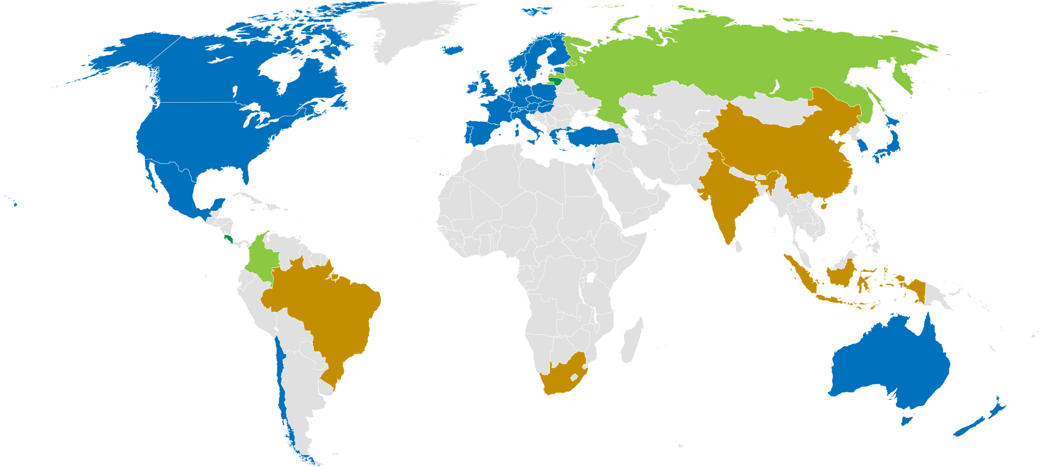
34 member countries, 3 + 2 accession
5 Key partners

Slide 5
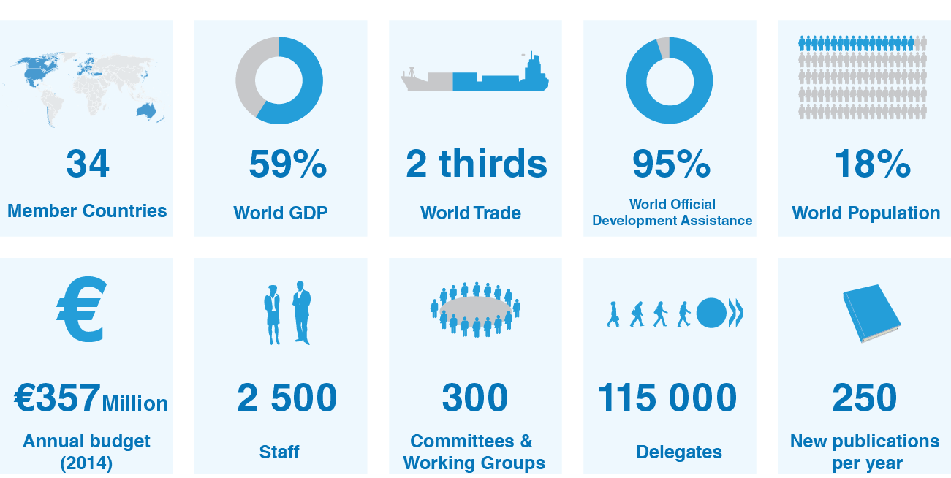
Fast facts

Slide 6









Part of a global community

Slide 7
PUBLIC PROCUREMENT matters…

Slide 8
Public Procurement matters
It stands as a crucial pillar of strategic governance for any government body;
It is also a high-risk area due to the close interaction between private and public spheres
Governments face the challenge of ensuring that different priorities are clear, work together and overlaps or conflicts are avoided.

Slide 9
Public Procurement really matters
Government procurement as share of GDP and of total govt. expenditures
Source: OECD National Accounts Statistics. (2013)

Slide 10
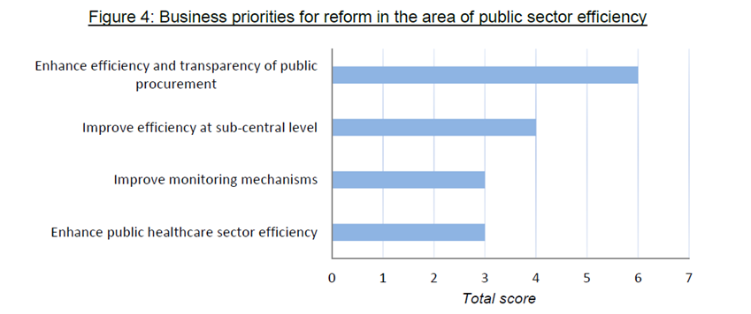
And it matters for everyone
For the private sector, public sector efficiency is the second business priority area for reform after product market regulation.
And public procurement the top priority in this sector:
BIAC Economic Survey, 2014

Slide 11
OECD contribution to reforming public procurement
Supports governments in reforming public procurement systems for sustainable and inclusive growth and trust in government through:
Building evidence from useful, reliable and comparable data across OECD countries on the performance of public procurement – Government at a Glance; Key Performance Indicators
Undertaking hands-on peer reviews that provide assessment of public procurement systems, either national or sectorial, and tailored proposals to address implementation gaps in specific context – in Italy, Greece, Northern Ireland but also US, Korea, Mexico, Colombia
Organising policy dialogue to share insights & shape directions for future reforms, build strategic partnership with private sector - G20
Identifying good practices and providing international standards on public procurement – Compendiums on Green Procurement, Transparency, Accountability and Anticorruption

Slide 12
Main OECD findings from the work in public procurement
The OECD’s experience working with countries shows that a sound public procurement system includes:
procurement rules and procedures that are simple, clear and ensure access to procurement opportunities;
effective institutions to conduct procurement procedures and plan, conclude, manage and monitor public contracts;
appropriate electronic tools;
suitable, in numbers and skills, human resources to plan and carry out procurement processes; and
competent contract management.

Slide 13
A standard for Public Procurement in the XXI century
The 2008 OECD Recommendation on Enhancing Integrity in Public Procurement focused on integrity, transparency, accountability, good management, risk prevention and control.
Interest in governance of public procurement to achieve efficiency and advance public policy objectives has significantly increased.
The 2015 OECD Recommendation on Public Procurement supports a shift from an administrative and compliance-based approach to a strategic and holistic approach to realise government policies.

Slide 14
The 2015 Recommendation on Public Procurement: 12 integrated principles
Transparency
Accountability
Access
Participation
E-Procurement
Efficiency
Evaluation
Integration
Capacity
Integrity
Balance
Risk Management

Slide 15
Investing in Better Policies
The 2015 OECD Recommendation:
Supports dedication of public resources to address the increasing complexity of strategic public procurement
Yields returns as the investment in a sound public procurement brings major outcomes: a 1% saving represents 43 billion EUR per year in OECD countries.
Supports achievement of policy goals such as job creation, innovation, environmental protection or the development of SME, a crucial pillar of strategic governance and services delivery for any government.
Supports risk mitigation such as those arisen from public works, complex digital technology or major events.

Slide 16
Strategic Public Procurement

Slide 17
9.2 Strategic public procurement
Development of Procurement Strategy
Policy for Secondary Policy Objectives
Source: 2014 OECD Survey on Public Procurement

Slide 18
9.2 Strategic public procurement
Mandatory Use of Public Procurement for Secondary Policy Objectives (2012 vs 2014)
Source: 2014 OECD Survey on Public Procurement

Slide 19
9.2 Strategic public procurement
Measuring of the results
Source: 2014 OECD Survey on Public Procurement

Slide 20
Smart procurement: The case study of going green

Slide 21
Plenty of will ... but not so easy to achieve.
Major challenges to going green:
  Fear that green products cost more;
  Lack of technical knowledge and training on integrating green criteria;
  Lack of monitoring if green policies work;
  Absence of incentives;
  Lack of sufficient suppliers.

Slide 22
OECD initiative on green procurement
In 2012 the OECD Council requested to collect green procurement good practices.
The compendium was designed to help countries implement GPP.
It is focused on 6 areas:
http://www.oecd.org/gov/ethics/procurement-green-procurement.htm

Slide 23
Good practice areas 1-3
GPP legal and policy framework.
Plan GPP, assessing life-cycle costs and understanding market solutions and capacity.
Environmental standards in the design, selection and award of projects and in contract performance.
See: www.oecd.org/gov/ethics/best-practices-for-green-procurement.htm

Slide 24
Good practice areas 4-6
Professionalisation: multidisciplinary procurement teams and GPP training.
Raising awareness of buyers, market & citizens about GPP solutions and benefits.
Mechanisms to monitor green projects
See: www.oecd.org/gov/ethics/best-practices-for-green-procurement.htm

Slide 25
Smart procurement: The case study of POLICY Objectives in Korea

Slide 26
Holistic and Strategic Approach
Support goes beyond the awarding of contracts to reinforce business stability and liquidity in additional ways
Support for innovation and small and medium enterprises is mutually reinforcing
Accomplished through strong central procurement systems and good coordination between relevant Ministries

Slide 27
Support for Small and Medium Enterprises
Set-aside targets for SMEs
Network Loan Program – Up to 80% of contract value
Up-front Payment – Up to 70% of contract value
Prompt Payment – Integrated e-Procurement system allows payment in as little as 4 hours

Slide 28
Support for Innovation
10% of purchase from SMEs must come from SME-manufactured goods with new technology
Certification programmes to identify Newly Developed Technology Products, designated by the Small and Medium Business Administration
Highest certification allows direct contract award

Slide 29




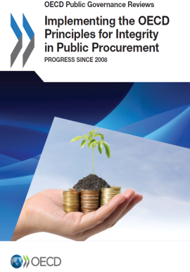



For more information on OECD work on public procurement and integrity
www.oecd.org/gov/ethics/public-procurement.htm

Slide 30
paulo.magina@oecd.org
Thank you

