Slide 1

Lindsey Marchessault
www.open-contracting.org
@opencontracting
@LMarchessault

Slide 2
Our mission is to open up public contracting through disclosure, data
^{& participation...}
...so that the trillions of dollars spent every year on providing goods and services to citizens deliver on their promise of public benefit

Slide 3
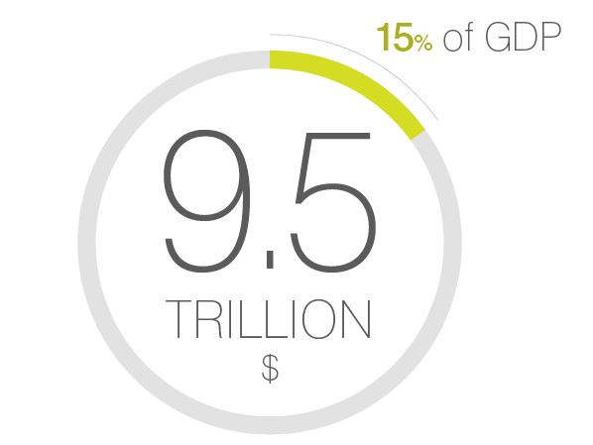

Slide 4

What is open contracting?
^{Publication & disclosure}
^{of contracting data}
^{Participation & use}
^{of the data}
Feedback and redress so problems get fixed
^{Innovation}

Slide 5
Disclosure & participation throughout the contracting cycle
^{Planning}
^{Formation}
^{Award}
^{Implementation}
^{Termination}
Information about the planning of a contract
Information about the tendering
^{or negotiation process}
^{Information about the awarded}
^{contract}
Information about implementation including payments
^{Information on}
^{end of contract life}
^{Consultation}
^{Observation}
^{Observation}
^{Monitoring}

Slide 6
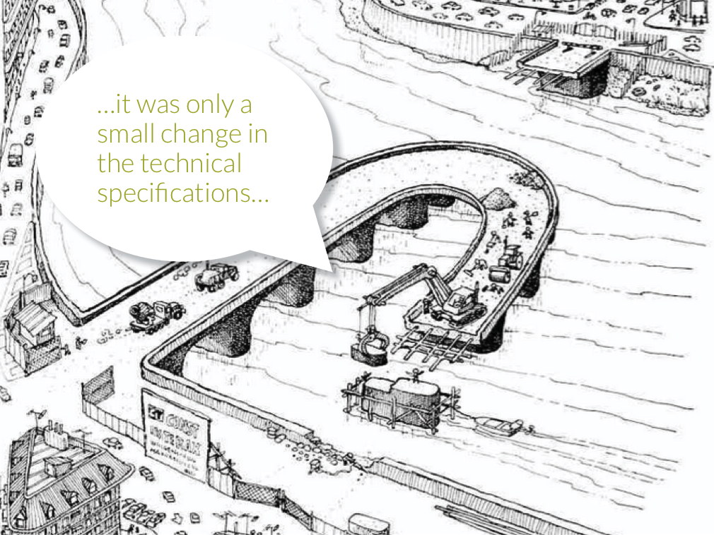
…it was only a small change in the technical specifications…

Slide 7
^{OC main features}
Multi-stakeholder collaboration
^{Constructive engagement}
^{Disclosure of contracting data}
Capacity building of stakeholders
^{Tool development/adaptation}
Contract monitoring and reporting
Institutional mechanisms for feedback
^{Innovation}

Slide 11
What does open contracting look like in practice?

Slide 13
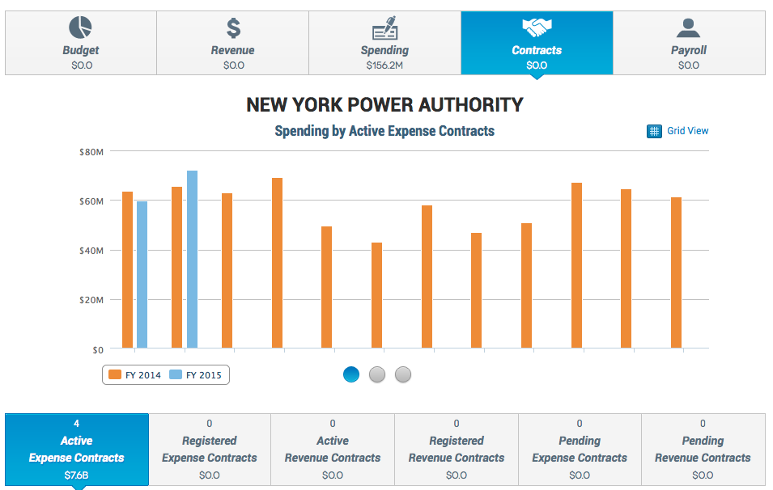

Slide 14
KONEPS’s transaction volume in 2014 : $67.3 B (63%) of Korea’s public procurement ($107 B)

Slide 15
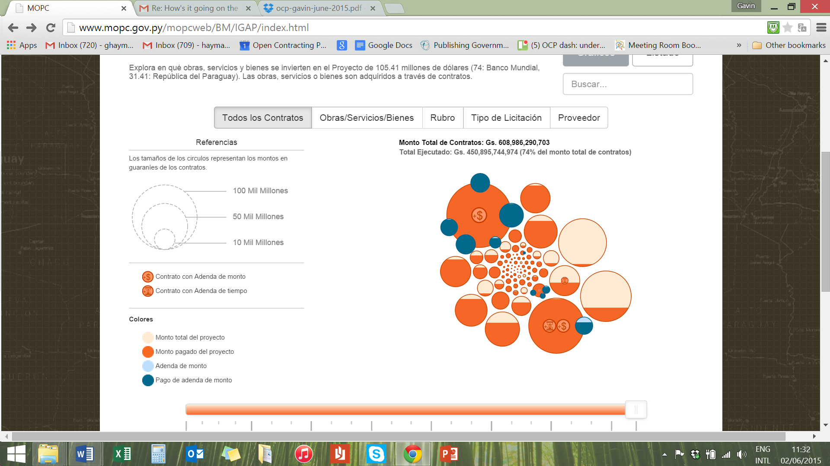
Paraguay’s new procurement portal using OCDS
Notes:
Make Paraguay visualisation a lot bigger. Put in Prozorro Ukraine.

Slide 16
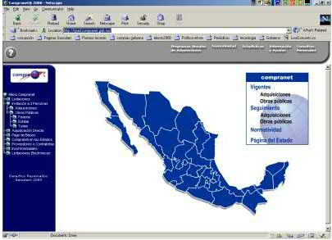

Boosting Accountability:
Multi-stakeholder action planning
Capacity Building
Creating Feedback Loops in the Contracting Process
^{Mongolia}
^{Philippines}
^{Mexico}
^{Zambia}

Slide 17
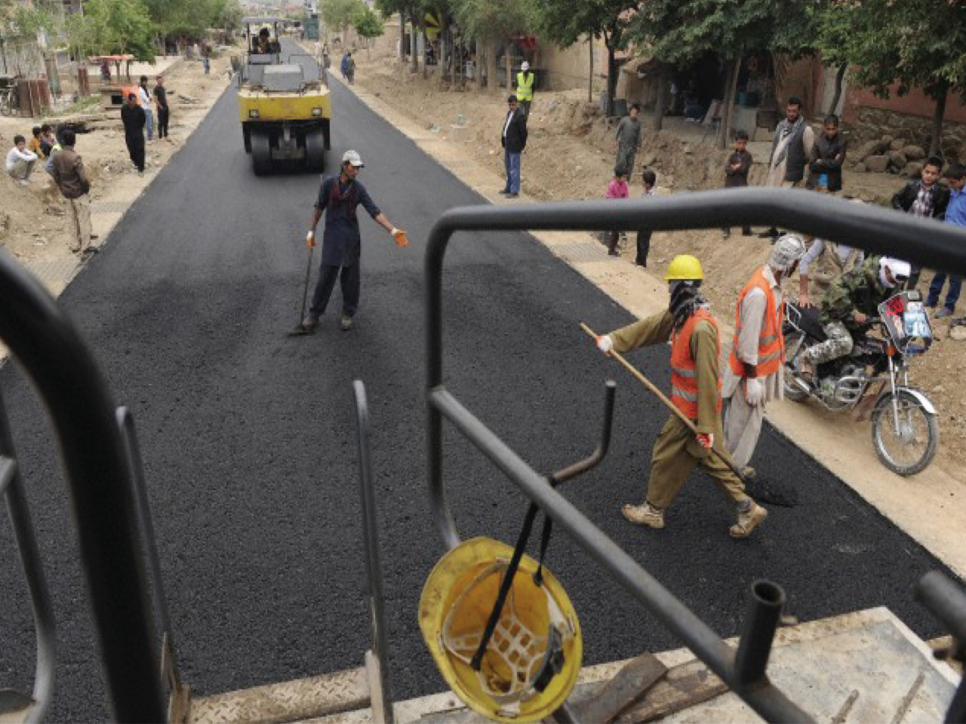

Slide 19
The data standard describes how to release documents and data at, and about, each stage of a contracting process…
^{Planning}
^{Tender}
^{Award}
^{Contract}
^{Implementation}

Slide 20
^{Planning}
^{Tender}
^{Award}
^{Contract}
^{Implementation}
^{Contract Record}
…and OCDS describes how to bring those releases together in a snapshot record providing timely, and accessible, open data in all aspects of contracting.

Slide 21
Integrated Data
Documents & Notices
Line items &
their classification
Buyers, Suppliers &
Organizations involved
Milestones &
Performance
Key Dates
Location
Contract Values,
Budget & Spending
Contract Record
Joined-up data links

Slide 22
What can users do with this data?
Government
Private Sector
Civil Society

Slide 23
Good value for money on the goods and services in the procurement process & identify value for money in concluded contracts.
Analyze trends in prices and supplier performance

Slide 24
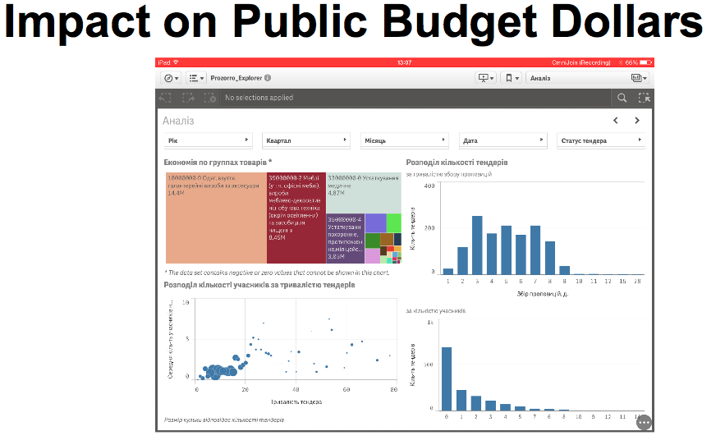
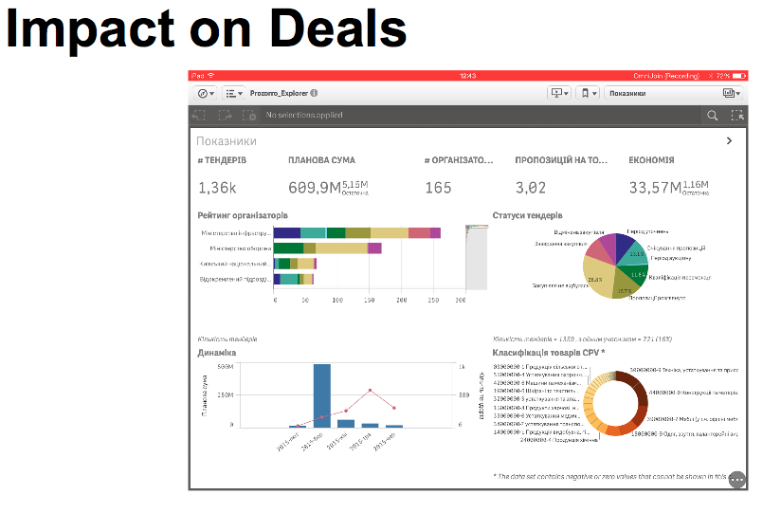
Notes:
“In the first 3 months, 1.5 million USD in public budget savings were measured, competition was increased to an average of 3 bidders per opportunity & opportunities were becoming available in more places.”

Slide 25
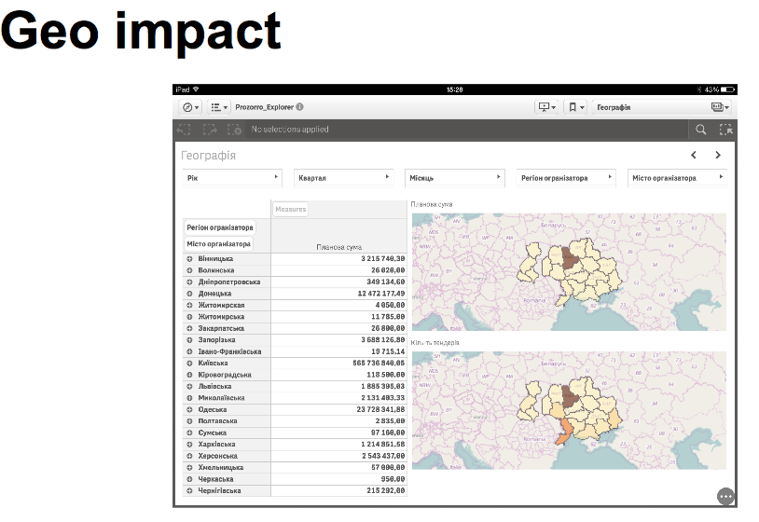

Slide 26

Scrutinize procurement documents and data for ‘red flags’ that might indicate public monies are being mis-used.
‘Micro’ approach and ‘systemic’ approach
Linkable data using globally unique identifiers for companies

Slide 27
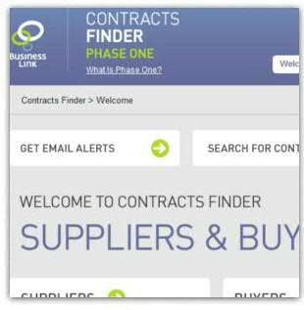

Competing for public contracts
Forward looking
and timely
information
Track contracting
opportunities
Information on past contracts

Slide 28
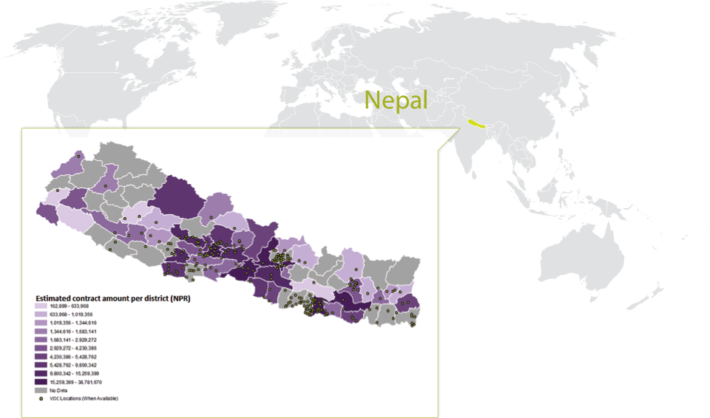
Monitoring Service Delivery
Ensure that public contracting is delivering value to citizens in terms of quality of goods, works, and services.
Especial interest on data on location and subcontracting

Slide 29
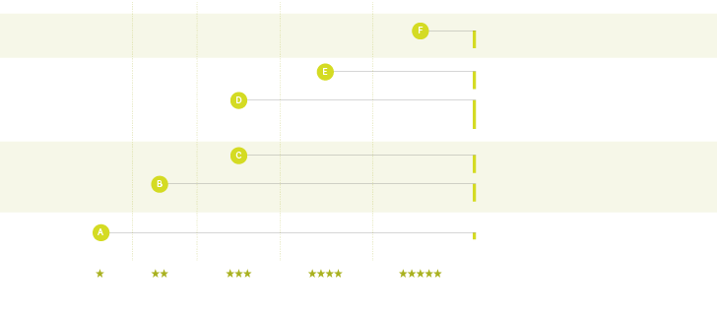
How to implement OCDS
+ adding other useful data (geolocation, integration with budget and treasury data).
^{+ accessible by API}
^{+ persistent URLs}
^{+ Addendum}
^{+ Physical progress data}
^{+ Financial progress data}
^{well structured in JSON format}
Tender + Award data structured with unique identifiers + classifications in JSON format
Tender + Award Notices with structured downloadable CSV data
^{Only Tender Notices as PDFs}

Slide 30


















Open Contracting as part of eGovernment
Seamless Service through Data Integration
Data interchange with 160 external info systems for seamless process
After
Contract
Delivery
Ministry of Strategy
and Finance
Industry
Associations
Public Buyer
National
Tax Office
KONEPS
Credit Rating
Company
Construction
Authorities
Surety
Companies
e-Bid
Korea Financial
Telecommunications
& Clearings Institute
Certification-
Related agencies
Supplier

Slide 31

Open Contracting as part of Open Government
Open Contracting
Open Budgets
Open Aid
Governance of Extractive Industries
Open Spending
Citizen Participation
Open Corporates

Slide 32
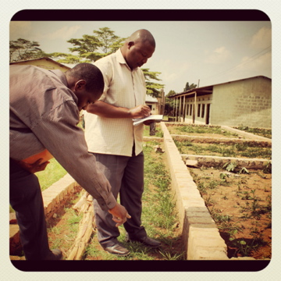
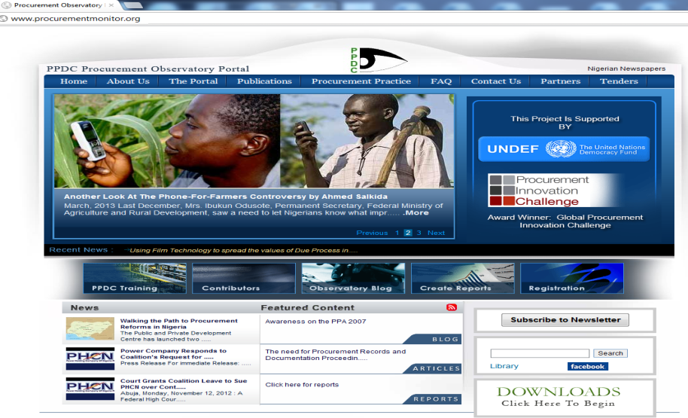
Feedback loops for citizens
Building satisfaction & trust
UGANDA
Notes:
Constructive engagement: between citizens and government to work jointly to achieve better performance of public contracts.
Monitoring and reporting: Supporting non-state actors to monitor public procurement through the analysis of the available data and reporting back to the government on their findings, advocating for action at contract and policy level where needed
Open Contracting help face issues like
Keeping within budget
On-time delivery
Compliance with specifications
Beneficiaries’ satisfaction

Slide 34
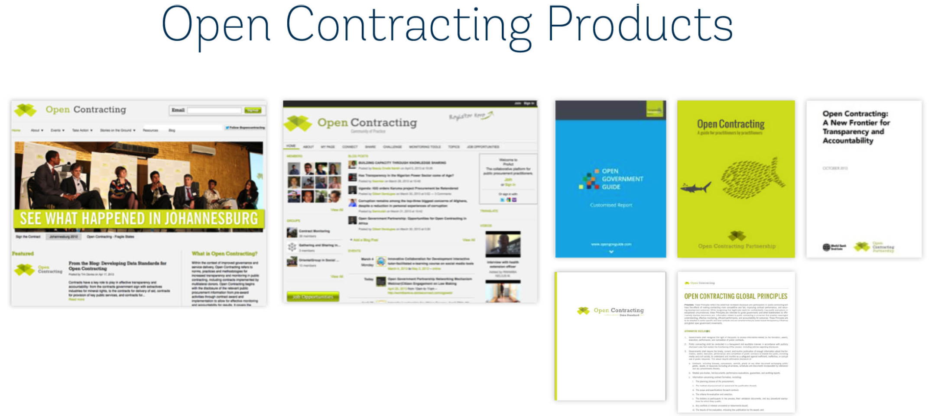
For more information about open contracting:
Website: www.open-contracting.org
OCDS: www.standard.open-contracting.org
Guide for Practitioners: www.bit.ly/OCBookSprint

Slide 35
Thank you!
LMarchessault@open-contracting.org

