Slide 1



Big Data and Urban Mobility
Cairo Transport and Big Data
Dr. Ahmad Ibrahim Mosa
Ministry Advisor for Transportation Planning
Director of Transportation Planning Center of Excellence –
Associate Professor, German University, Cairo

Slide 2
Mobility Figures for GCMA

Slide 3
The Socio-demographic Framework
Car Ownership will grow at 4.2% p.a.
  From 1.3 million (2010) to 2.5 million (2022)
Households without access to car
  From 70% (2001) to 55% (2022)
Per Capita Income Growth : 2.9%
GRDP and population estimates 2050 forecasts

Slide 4
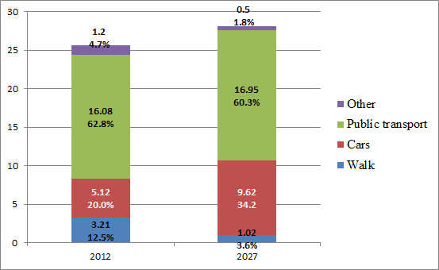
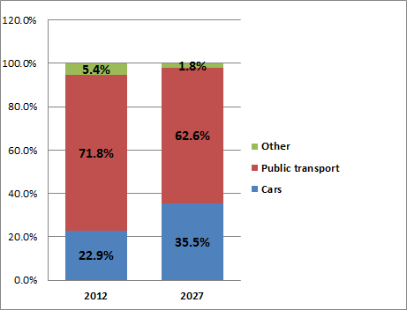
Travel Demand ( all modes) 2012 -2027
2012-2027
96.4%
87.5%
المصدر : مخطط النقل الشامل للقاهرة الكبري – جايكا 2002 & تحديث– مركز تميز تخطيط النقل –وزارة النقل 2013
Notes:
Population 18. 5 million
Increase at rate of 1.9 %
Car ownership 1.3 million 60% of households with no car access
Car increase at 4.5 %

Slide 5
Cairo Mode share 2012
قطار الضواحي
0.6 %
0.078 Mill Trips/Day
Shared Taxi
52.3 %
6.501Mill Trips/Day
الميترو
16.6 %
2.061 Mill Trips/Day
الاتوبيس التعاوني
1.0 %
0.126 Mill Trips/Day
ترام
1.4 %
0.175 Mill Trips/Day
Shared Taxi
52.3 %
6.501Mill Trips/Day
الميكروباص
52.3 %
6.501 Mill Trips/Day
Shared Taxi
52.3 %
6.501Mill Trips/Day
اتوبيس النقل العام
24.6 %
3.058 Mill Trips/Day
Shared Taxi
52.3 %
6.501Mill Trips/Day
التاكسي النهري
0.1 %
0.011 Mill Trips/Day
Shared Taxi
52.3 %
6.501Mill Trips/Day
الميني باص ( النقل العام)
3.4 %
0.426 Mill Trips/Day
Shared Taxi
52.3 %
6.501Mill Trips/Day
المصدر : مخطط النقل الشامل للقاهرة الكبري – جايكا 2002 & تحديث– مركز تميز تخطيط النقل –وزارة النقل 2013

Slide 6
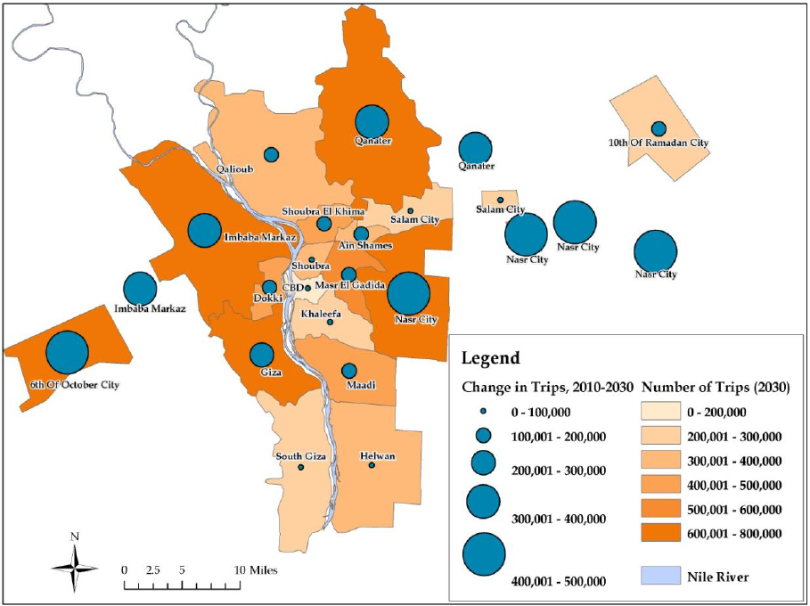
الزيادة المتوقعة في الرحلات المتولدة من مناطق النقليات المختلفة -2027
المصدر : دراسة مخطط النقل الشامل للقاهرة الكبري – تحديث مركز تميز تخطيط النقل –وزارة النقل 2013

Slide 7
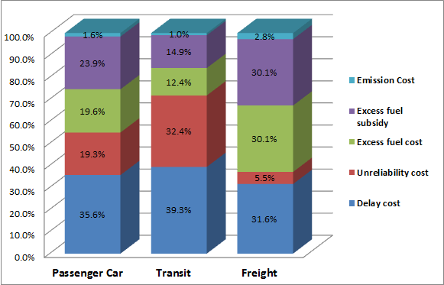
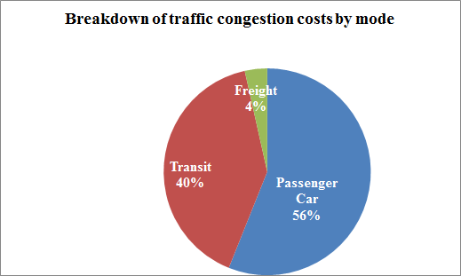
The Cost of Congestion in Greater Cairo
Cost Item | Value | Cost Bill/ Year | Cost / Individual / Year
Value of Travel Time | 2.2 Billion Hour/ Year | 14.7 | 1550
Reliability | 1.4 Billion Hour/ Year | 9.2 | 78
Excess Fuel | 1.9 Million lit./ Year | 6.6 | 56
CO2 Emissions | 7.1 Billion kg | 0.4 | 5
Total | – | 30.8 | 1689
المصدر : دراسة تكلفة الازدحام المروري –البنك الدولي 2011 & دراسة تكلفة النقل الحضري بالقاهرة الكبري – مركز تميز تخطيط النقل –وزارة النقل 2013
Notes:
تكلفة الازدحام المروري 4.5 جنية / رحلة /يوم

Slide 8
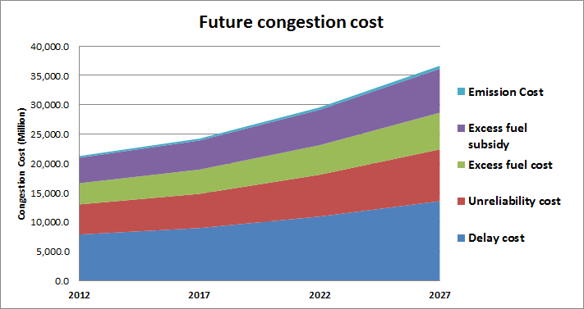
تكلفة الازدحام المروري في القاهرة الكبري
المصدر : دراسة تكلفة الازدحام المروري –البنك الدولي 2011 & دراسة تكلفة النقل الحضري بالقاهرة الكبري – مركز تميز تخطيط النقل –وزارة النقل 2013

Slide 9
The Development Corridors

Slide 10
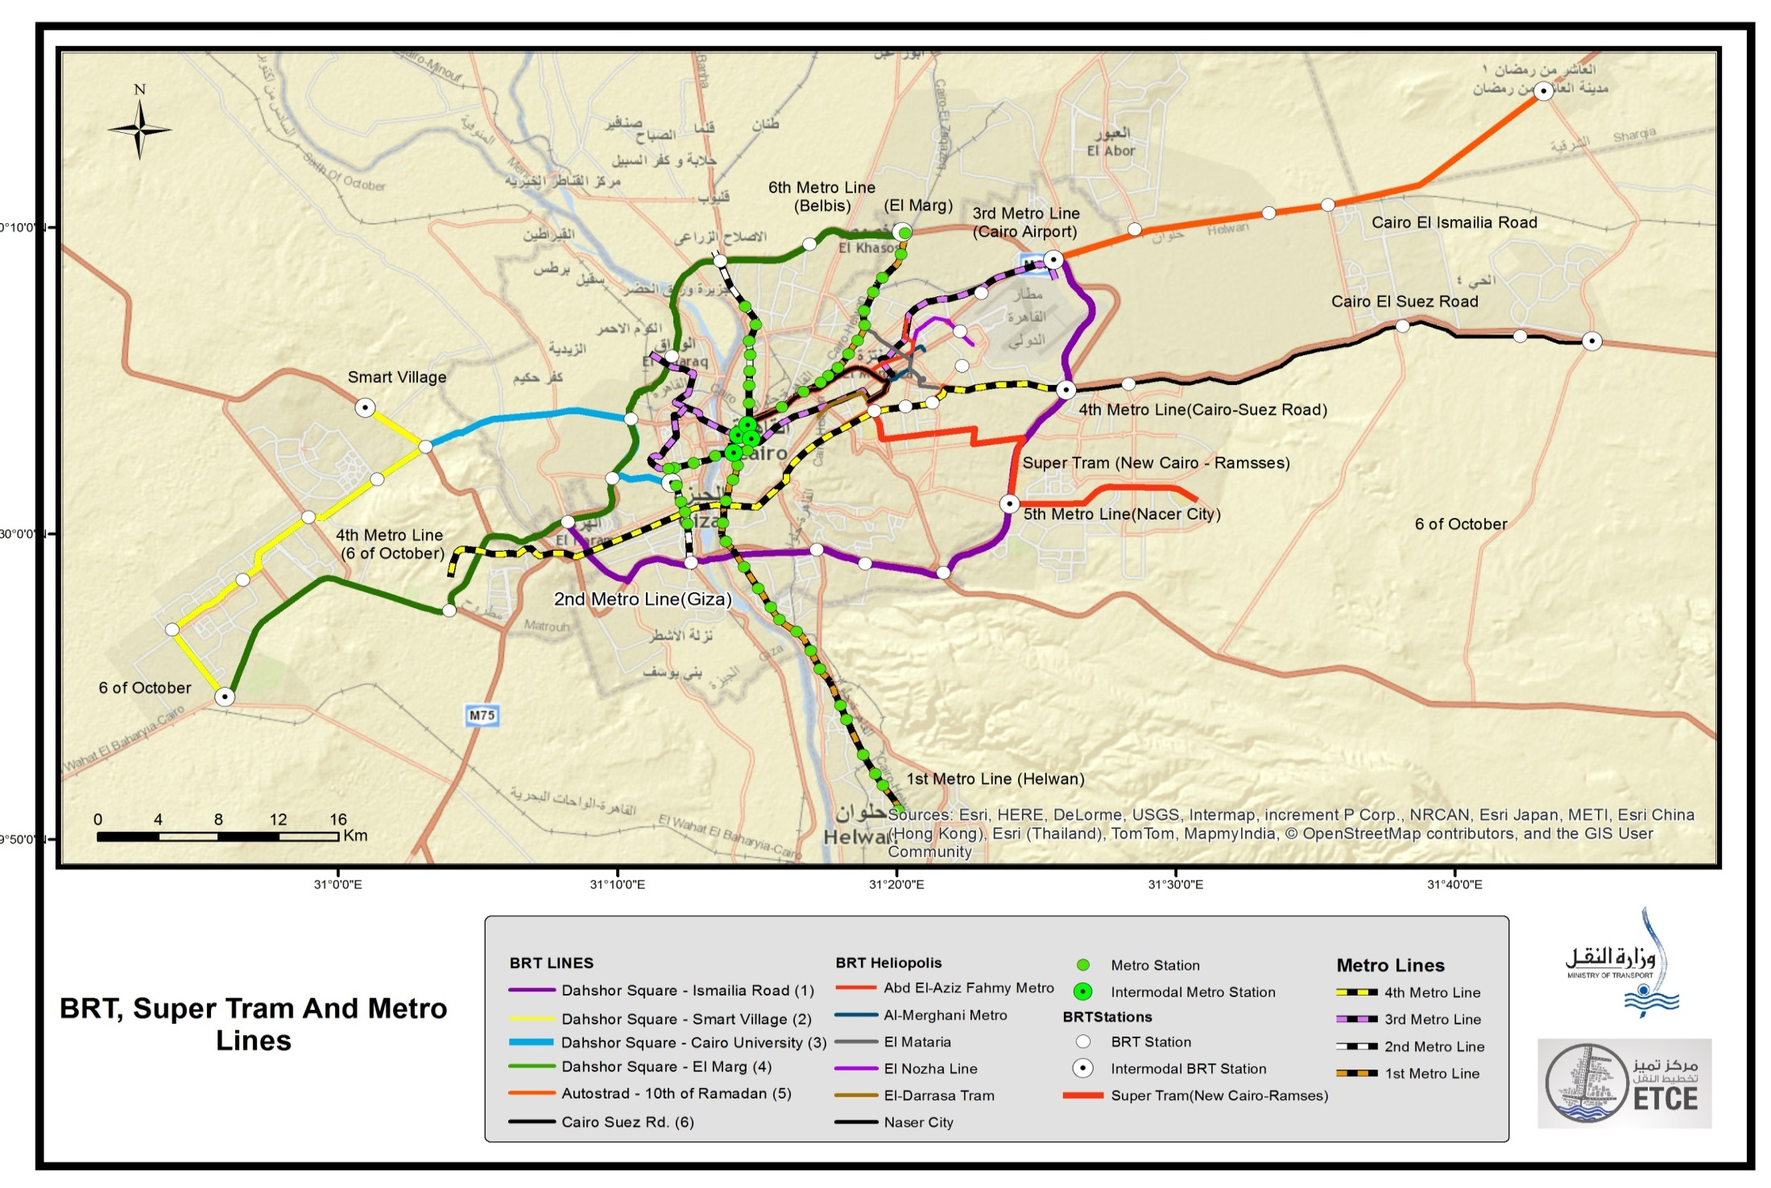
Optimized Scenarios

Slide 11
Types of Data Needed

Slide 12
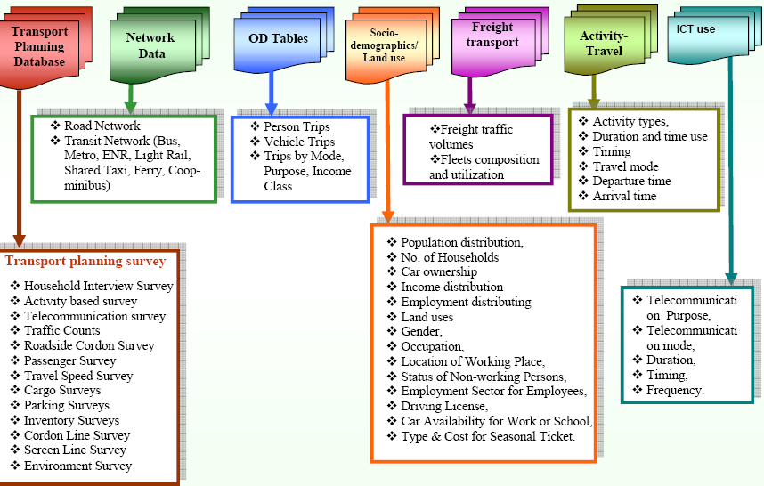
MOSA A. I., 2010.

Slide 13
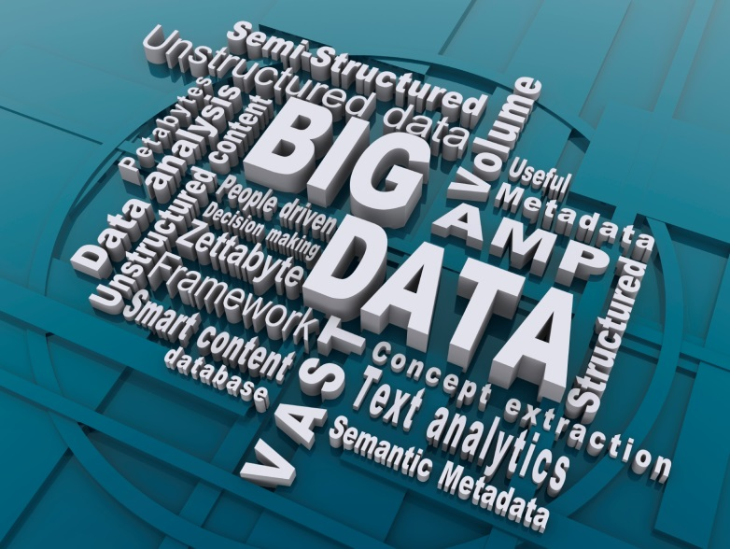

What are …?
Big Data
Significantly large volumes of data, particularly involving human activities and characteristics
The Three V’s
Big data is not only about the volume of data but also its velocity and variety
Analytics
High technology applied to data processing, complex calculations, and automation

Slide 14
Common Examples
Private/Public Sector
• Consumer behavior analysis
• Customer mailing lists/marketing
• Smartphone apps
• GPS
• Financial market trading
• Astronomical tracking/mapping
• Weather tracking/forecasting
• Genome mapping
• Crowd surveillance
• Monitoring electronic communications
• Data-mining online/wireless data (Emails, texting, social media)
• Robots
Public Transportation
• Ridership forecasting
• Train signaling/dispatching
• Route planning/scheduling
• Automatic Vehicle Location (AVL)
• Passenger Information Systems
• Automated Fare Collection (AFC)
• Automated Passenger Counting (APC)
• Driverless Automatic Train operation (ATO)

Slide 15
The phenomena of mobile positioning
Mobile positioning - locating (pinpointing) mobile telephones using radio waves
  Active mobile positioning - tracking the location of mobile phones in real time through a network of antennas
  Passive mobile positioning - uses location and activity information from historical log files stored by mobile service providers (for charging clients)
Activities in home network or when roaming
voice calls,
SMSes/MMSes,
mobile-net usage,
data transmission operations,
mobile supported GPS usage, etc.
Data file
SIM card ID (statistical pseudonym)
Date and time
Antenna ID with location data
Country ID

Slide 16


Collect, Integrate, Manage and Disseminate
Integrate data feeds from a wide variety of sources and have the tools to act on the assimilated information including:
    Traffic
    Transit
    Human Behavior
    O-D
    Construction
    Incidents
    Special Events
  Parking
  Toll
  Weather
  Signal Plans
  Scenarios
Then provide the tools to manage the information effectively including:
    Decision Support Tools
    Traffic Prediction, Simulation
    Inter Agency Communication
Then provide the dissemination platforms to deliver Real-time, predictive, location based, personalized information “proactively”

Slide 17
Big Data Is Needed For Cairo

Slide 18
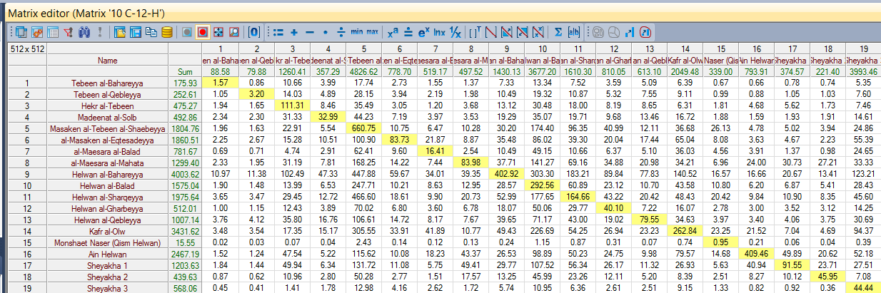
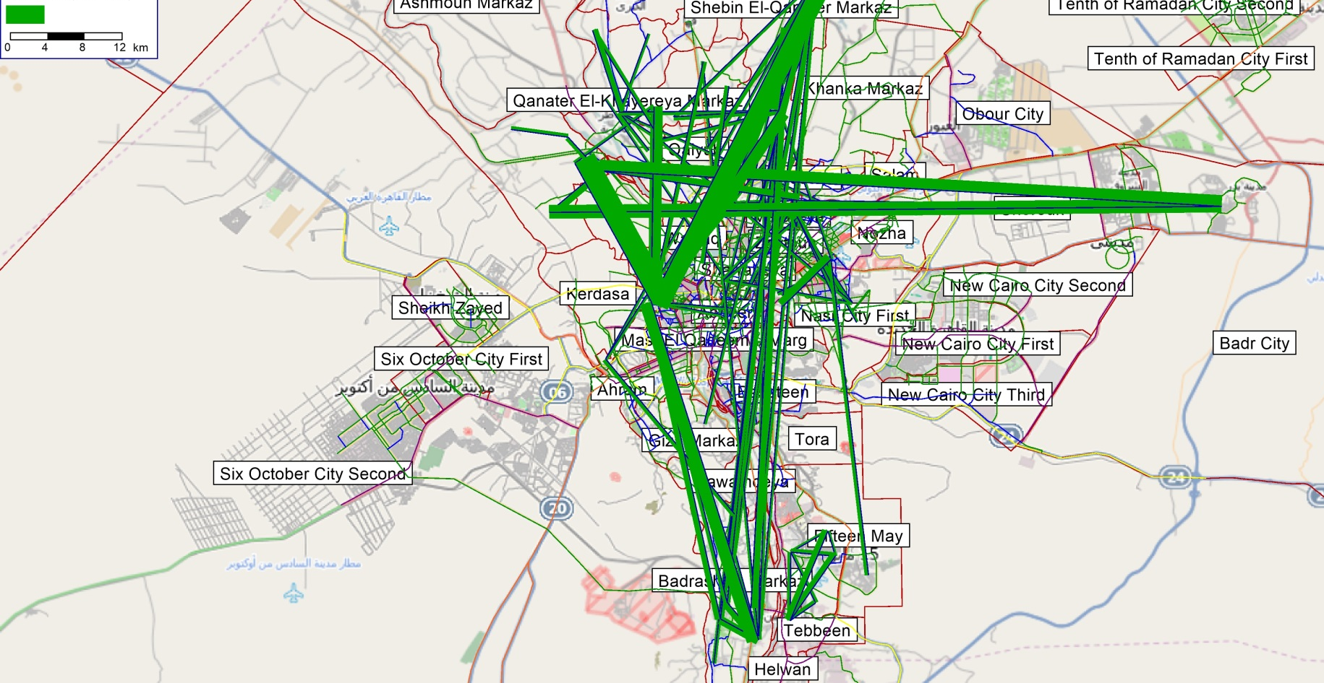
O-D – HBW Matrix (HBW) Sample Output

Slide 19
Customized Origin and Destination Demand
Trip Distribution Table: For given Origin- Destination boundary pairs, estimates trip counts by day or day-part.
Single Trip Frequency Table: For given Origin-Destination boundary pairs, estimates the number of people who made the trip with a certain frequency within a given time period.
2D Trip Frequency Table: A two-dimensional Trip Frequency Table correlates trip frequency counts from a single Origin to two different Destinations.
Trip Duration Table: Estimates the number of people who made trips of various durations between given Origin-Destination boundary pairs.

Slide 20
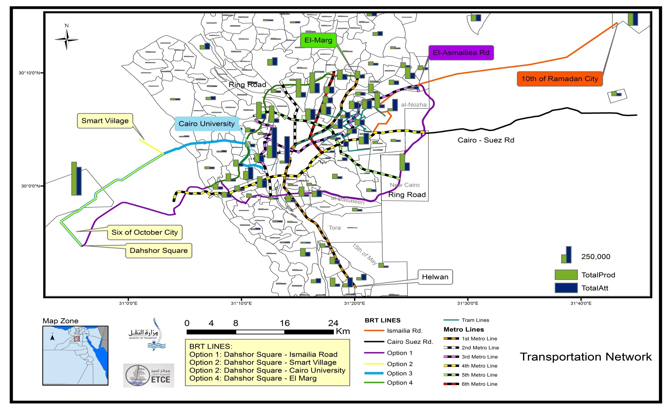
Trip Gerneation and Attraction

Slide 21
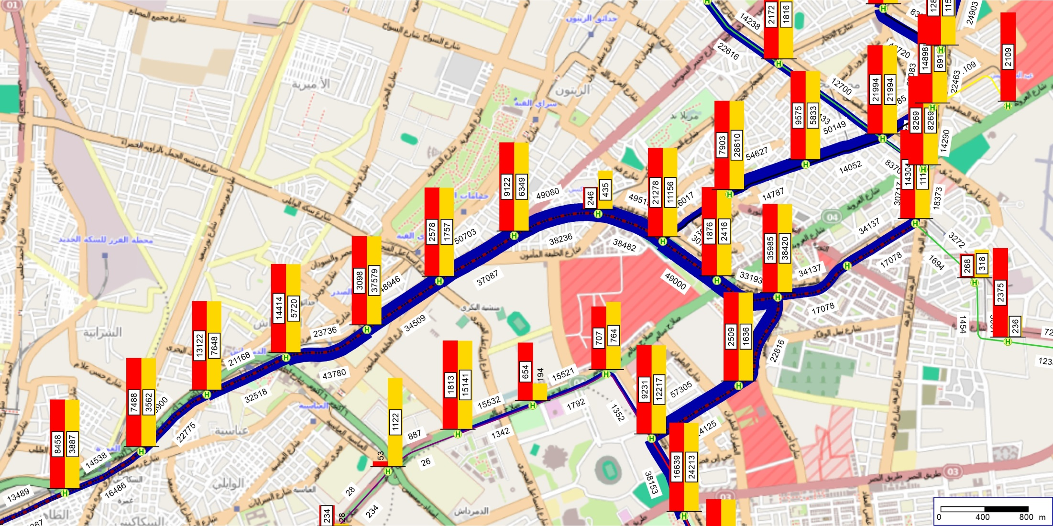
Demand on Public Transport
Passengers Boarding and Alighting at each station

Slide 22
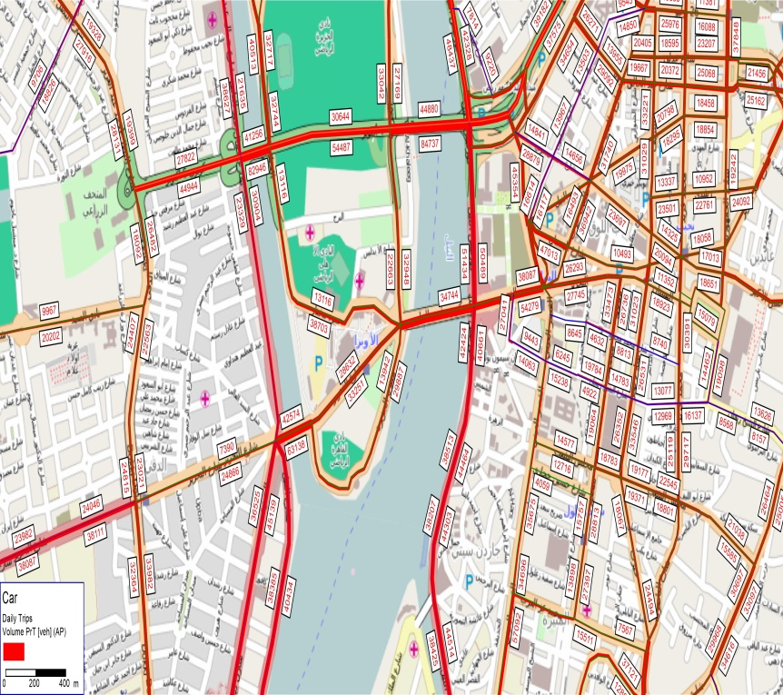
Hourly Traffic Mentoring
Link By Link data
Route Data (aggregated Segments)

Slide 23
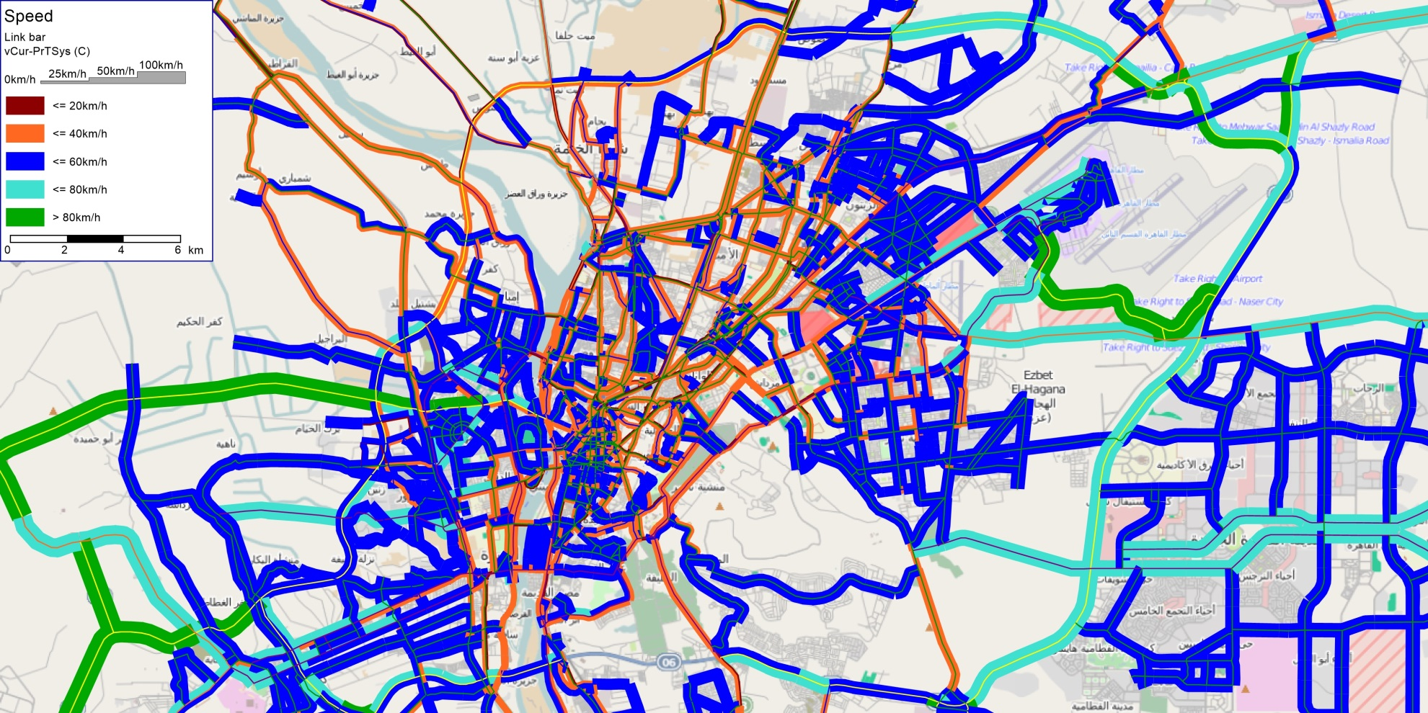
Speed Monitoring and Congestion analysis

Slide 24
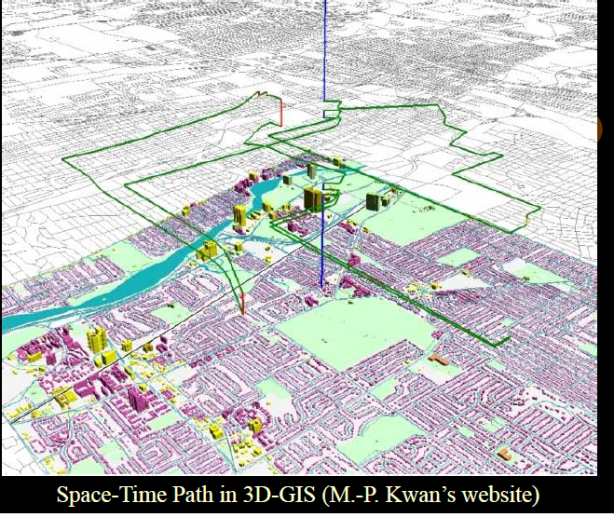
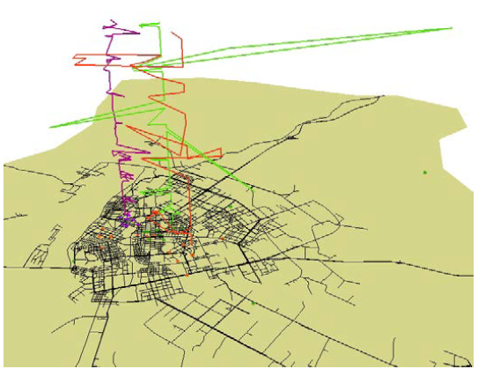

Slide 25
Unique Advantages for Transportation Planning
mobility data provides significant advantages over other mobile location and monitoring technologies.
More data and market coverage – by far – with data received continually from every active phone on every participating network.
Mobility data is derived from actual observations of traffic and consumer movement, as they happen – rather than a predictive “guess” based on limited data.
Measures mobility in an “organic” way, without the behavior biases inherent when using surveys, probe vehicles, or similar techniques.
Data is readily available when and as needed to support either planned or ad hoc project needs.
Big Data would offers significant cost savings – up to 60% or more – versus traditional mobility data collection.

Slide 26
Extracting Vehicular Data From Moving Cell phones on Highways
GUC- Ministry of Transportion Team
Ahmed Mosa, Fadwa Fawzy

Slide 27
Proposed Method
Our method will be explained as follows:
Traffic Data Generation.
Cell Phones Data Generation.
Dynamic Clustering Algorithm.

Slide 28
As mentioned before, obtaining vehicle/cell phone data in Egypt is extremely difficult due to security purposes.
We used " Simulation of Urban MObility" (SUMO) to generate traffic data.
SUMO is an open source, microscopic, multi-modal traffic simulation. It allows to simulate how a given traffic demand which consists of single vehicles moves through a given road network. The simulation allows to address a large set of traffic management topics. It is purely microscopic in which each vehicle is modeled explicitly, has an own route, and moves individually through the network.

Slide 29
Network Specifications
3 lanes highway segment
10 Km length
Max allowed speed 50 Km/sec
10 Km
In
Out

Slide 30
Vehicles Specifications
We simulated the behavior of four types of vehicles:
In this table each type of vehicle specified with its acceleration (accel), deceleration (decel), length, min-gap, max allowed speed(in Km/hr), and the driver behavior (sigma).
Types are (0,1,2,and 3) corresponding to (private car, truck, microbus, and bus) respectively.
Type | accel | decel | Length | Min-gap | Max-speed | sigma
0 | 3 | 6 | 5 | 2.5 | 100 | 0.5
1 | 2 | 6 | 7.5 | 2.5 | 60 | 0.5
2 | 1 | 5 | 5 | 2.5 | 65 | 0.5
3 | 4 | 5 | 7.5 | 2.5 | 80 | 0.5

Slide 31
SUMO Ins & Outs
The format of the output.XML file generated by SUMO is as follows
<timestep time="<COLLECTION_TIME>" id="<DETECTOR_ID>" vtype="<TYPE>">
<vehicle id="<VEHICLE_ID>" lane="<LANE_ID>" pos="<POSITION_ON_LANE>" \
x="<X-COORDINATE>" y="<Y-COORDINATE>" \ lat="<LAT-COORDINATE>"
lon="<LON-COORDINATE>" \ speed="<VEHICLE_SPEED>"/>
... further vehicles ...
</timestep>
... further time steps ...

Slide 32
XML Parser
To move on to the next step (cell phone data generation), we need to parse the vehicle data generated by SUMO.
We used MATLAB R2013a XML parser to get the data out of the XML file in the following table format.
Timestamp | Vehicle ID | X | Y | Speed | Vehicle Type

Slide 33
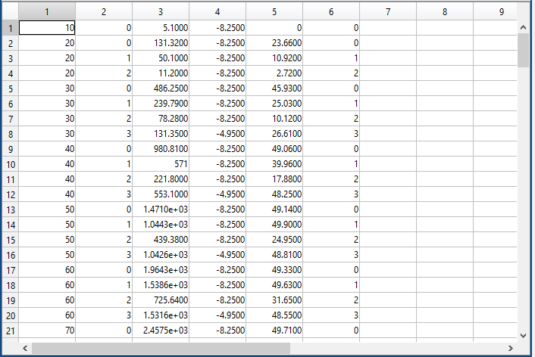
Samples of The generated Vehicles
Timestamp | Vehicle ID | X | Y | Speed | Vehicle Type

Slide 34
Generate Cellphones Locations
For each vehicle, cell phones are randomly distributed around its location (x,y) within a curtain diameter (D).
+
At each time stamp, the number of cell phones for each vehicle does not change,
but their locations around the vehicle are changed Within D.
(x,y)

Slide 35
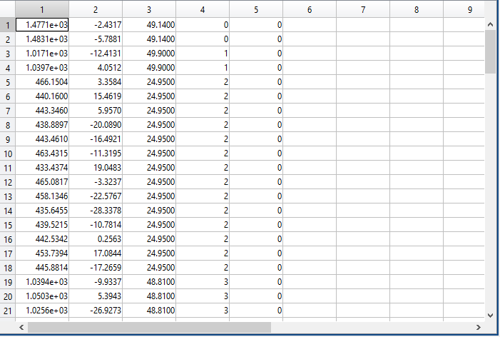
Samples of The generated Cell Phones
X | Y | Speed | Vehicle ID

Slide 36
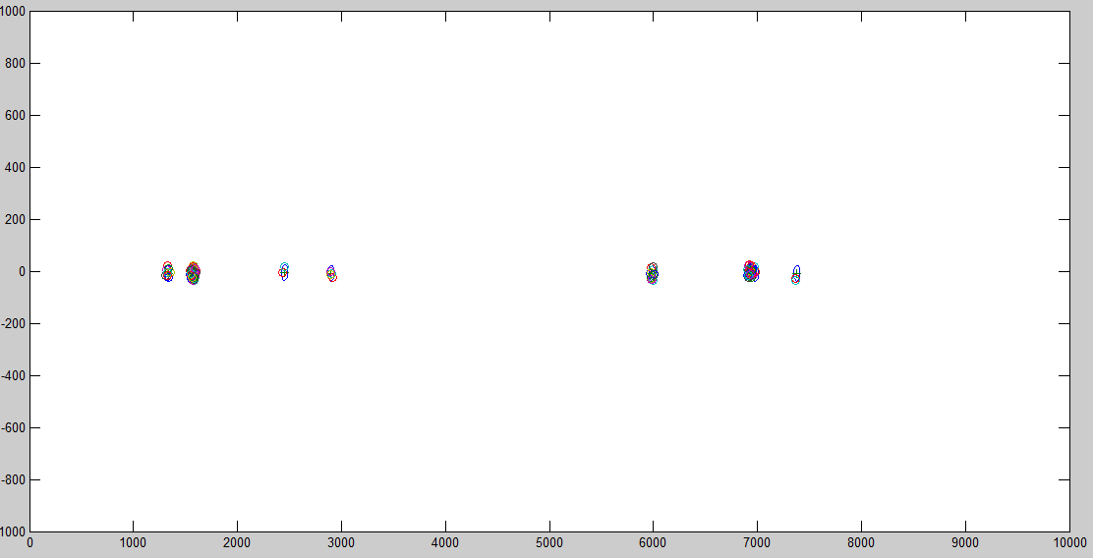
Snapshots

Slide 37
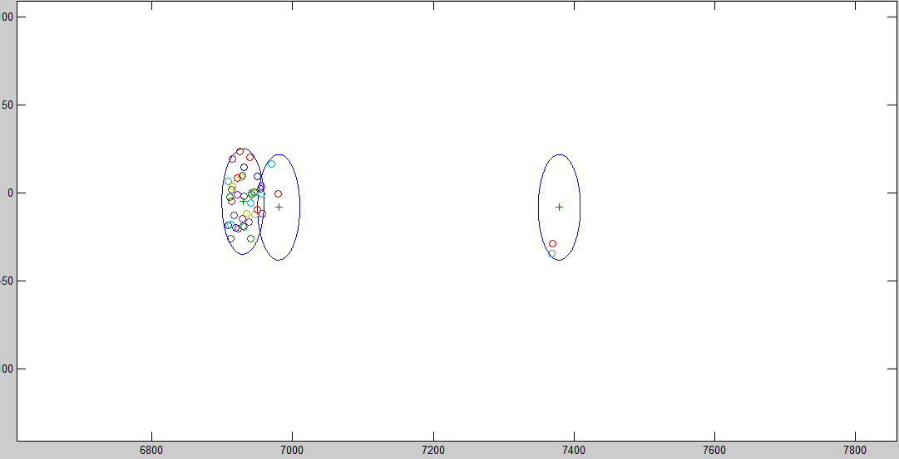
Snapshots (cont.)

Slide 38
Dynamic Clustering Algorithm
Continuous Clustering of Moving Objects.

Slide 39
In this work, a dynamic clustering algorithm is used to cluster the cell phones generated from the previous step.
The cluster behavior can then be estimated and used as a vehicle behavior (under the assumption : a cluster of cell phones is a moving vehicle).

Slide 40
How We Cluster
This clustering algorithm utilizes the cellphones location and speed at each time step to predict the cellphones positions in the near feature.
This method makes sure that in the near future cellphones will remain part of their clusters. In-addition, cluster split/merge actions can be predicted.

Slide 41
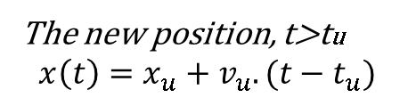

Object Modeling
Each cell phone(object) is capable of transmitting its current location and velocity to a central server every U units of time (10 sec in our experiment).
The server can use these data to predict the object location until the next update time.
Server
Every U units of time
The new position, t>tu
$$x\left(t\right)=x_{u}+v_{u}.(t−t_{u})$$
$$(OID,x_{u},v,t_{u})$$

Slide 42
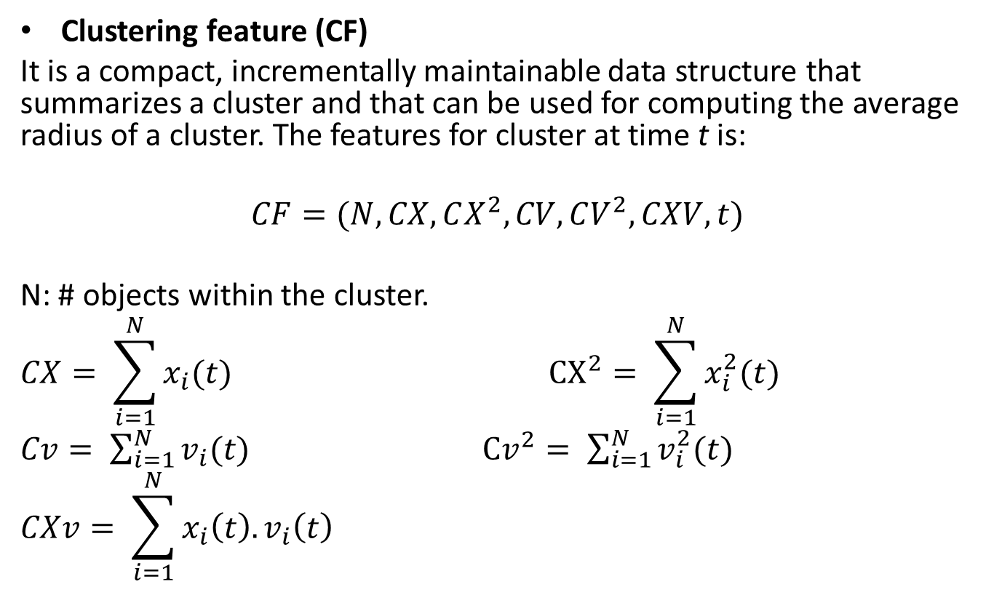
Cluster Modeling
Clustering feature (CF)
It is a compact, incrementally maintainable data structure that summarizes a cluster and that can be used for computing the average radius of a cluster. The features for cluster at time t is:
$$CF=(N, CX, CX^{2}, CV, CV^{2}, CXV, t)$$
N: # objects within the cluster.
$$CX= \sum_{i=1}^{N}{x_{i}(t)} {CX}^{2}= \sum_{i=1}^{N}{x_{i}^{2}(t)}$$
$Cv= \sum_{i=1}^{N}{v_{i}(t)}$ ${Cv}^{2}= \sum_{i=1}^{N}{v_{i}^{2}(t)}$
$$CXv= \sum_{i=1}^{N}{x_{i}\left(t\right).v_{i}\left(t\right)}$$

Slide 43
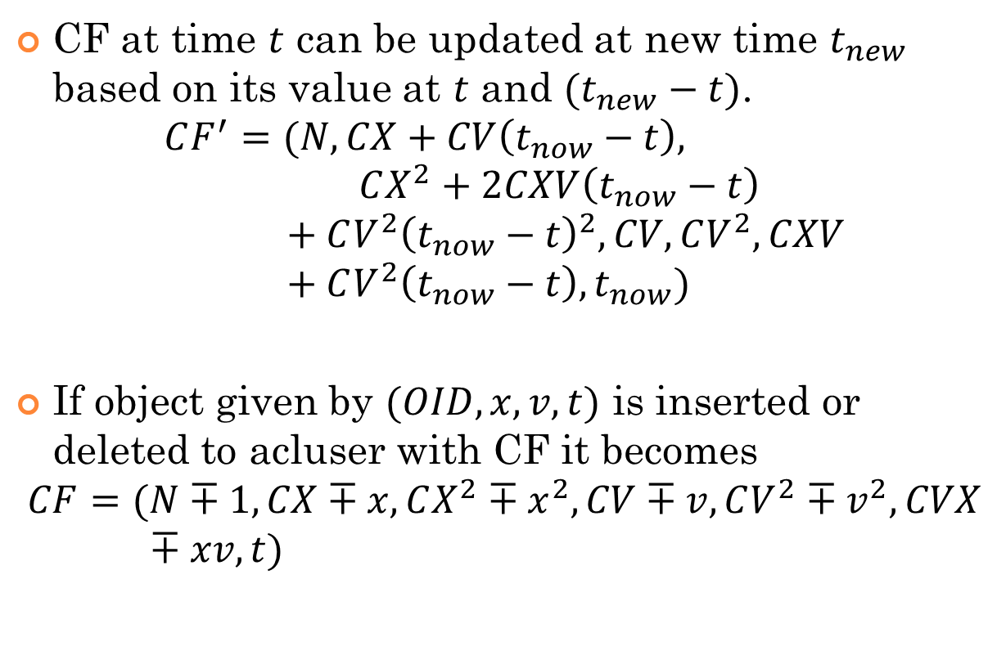
CF Claims
CF at time $t$ can be updated at new time $t_{new}$ based on its value at $t$ and $(t_{new}−t)$.
$$CF^{′}=(N, CX+CV\left(t_{now}−t\right), CX^{2}+2CXV\left(t_{now}−t\right)+CV^{2}{\left(t_{now}−t\right)}^{2}, CV, CV^{2}, CXV+CV^{2}\left(t_{now}−t\right),t_{now})$$
If object given by $(OID, x, v, t)$ is inserted or deleted to acluser with CF it becomes
$$CF=(N∓1, CX∓x,CX^{2}∓x^{2}, CV∓v, CV^{2}∓v^{2}, CVX∓xv, t)$$

Slide 44
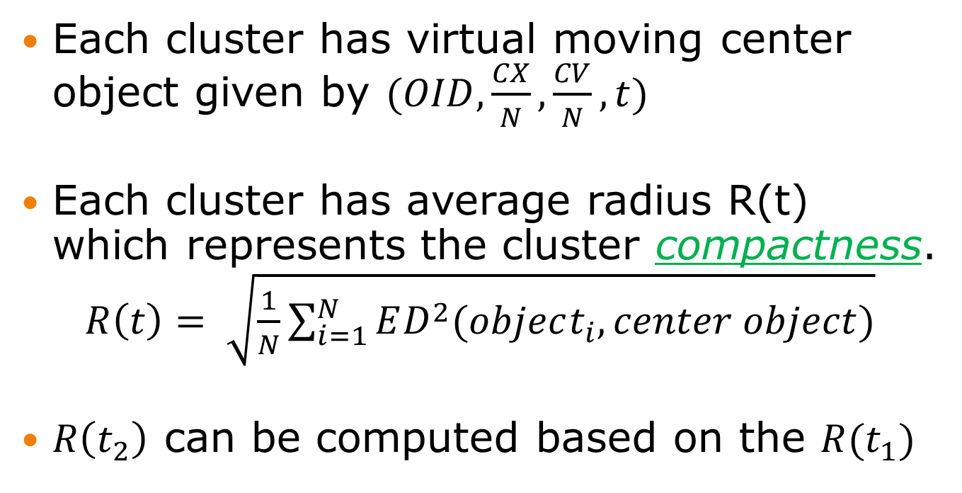
CF claims (cont.)
Each cluster has virtual moving center object given by $(OID,\frac{CX}{N},\frac{CV}{N},t)$
Each cluster has average radius R(t) which represents the cluster compactness.
$R\left(t\right)= \sqrt{\frac{1}{N}\sum_{i=1}^{N}{ED^{2}(object_{i},center object)}}$
$R\left(t_{2}\right)$ can be computed based on the $R(t_{1})$

Slide 45

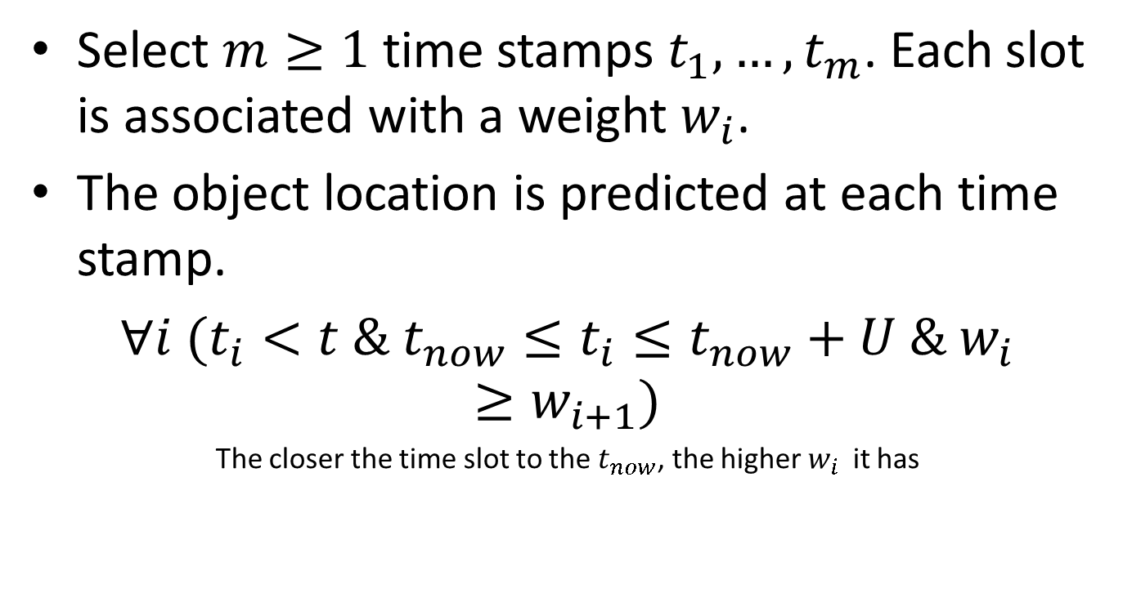
Measuring Object Movement Dissimilarity
Select $m≥1$ time stamps $t_{1},…,t_{m}$. Each slot is associated with a weight $w_{i}$.
The object location is predicted at each time stamp.
$∀i (t_{i}<t \& t_{now}≤t_{i}≤t_{now}+U \& w_{i}≥w_{i+1})$
The closer the time slot to the $t_{now}$, the higher $w_{i}$it has
i = 1,….,m
$$t_{now}$$
U
2U

Slide 46
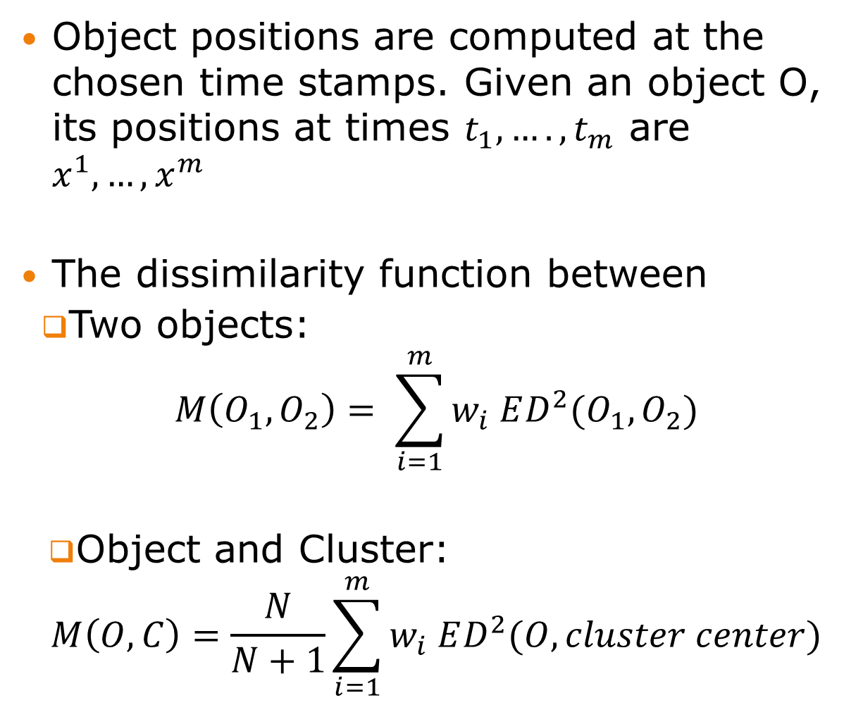
Object positions are computed at the chosen time stamps. Given an object O, its positions at times $t_{1},….,t_{m}$ are $x^{1},…, x^{m}$
The dissimilarity function between
Two objects:
$$M\left(O_{1}, O_{2}\right)= \sum_{i=1}^{m}{w_{i} ED^{2}(O_{1},O_{2})}$$
Object and Cluster:
$$M\left(O, C\right)=\frac{N}{N+1}\sum_{i=1}^{m}{w_{i} ED^{2}(O,cluster center)}$$

Slide 47
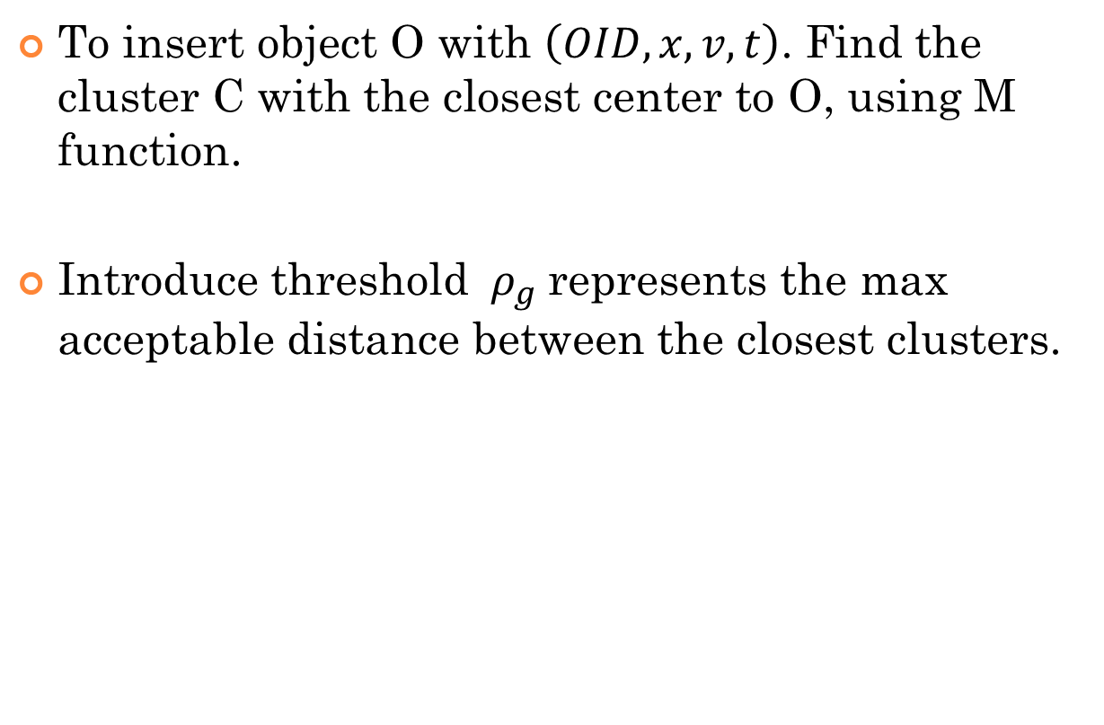
The Insertion Operation
To insert object O with $\left(OID, x, v, t\right)$. Find the cluster C with the closest center to O, using M function.
Introduce threshold ${ ρ}_{g}$represents the max acceptable distance between the closest clusters.

Slide 48

Calculate M
Create new cluster to O
yes
> $ρ_{g}$
No
Split needed for C after adding O
Add O to C, update CF
No
yes
Check any of the new clusters can be merged to others
Stop

Slide 49
The Deletion Operation
Next, to delete an object O, a hash table was used to locate the cluster C that object O belongs to. Then we remove object O, and we adjust the clustering feature for C.

Slide 50
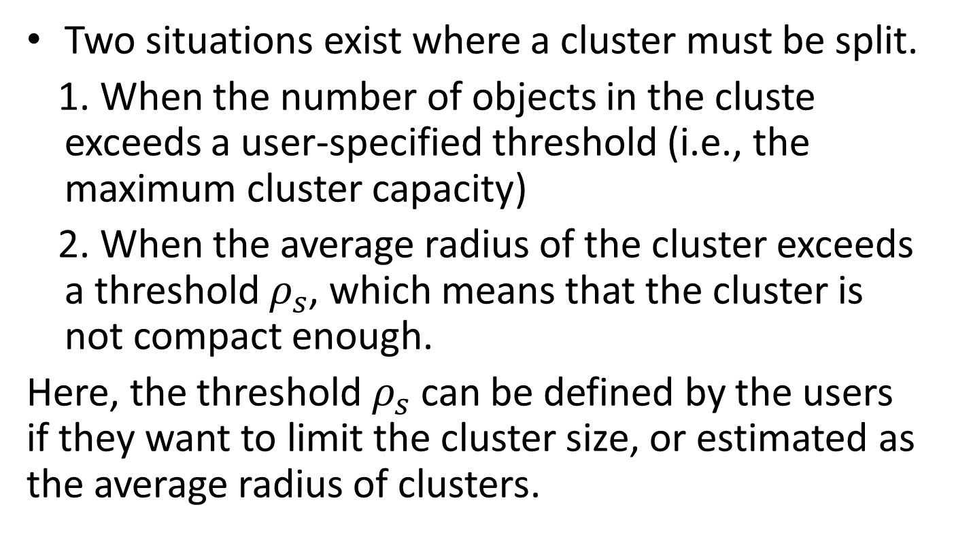
Split and Merge
Two situations exist where a cluster must be split.
When the number of objects in the cluste exceeds a user-specified threshold (i.e., the maximum cluster capacity)
When the average radius of the cluster exceeds a threshold $ρ_{s}$, which means that the cluster is not compact enough.
Here, the threshold $ρ_{s}$ can be defined by the users if they want to limit the cluster size, or estimated as the average radius of clusters.

Slide 51
Enabling high resolution traffic analysis from cellular Big data
EJUST team: Ahmed El-Mahdy, Tetsuji Ogawa, Essam Algizawy
Typical Cell Phone Service Provider Data:
  <Timestamp, UserID, AntennaID>
  … few billion records!
The resolution is in km!
Not suitable for measuring traffic at the road level

Slide 52
Approach/Methodology
Generate cellular big data via simulation
  SUMO simulator
  Consider the available city of Osnabrück
  Construct 2M records
Build Markovian Model form Simulator
Utilise Viterbi Decoding to Recover Actual Routes

Slide 53
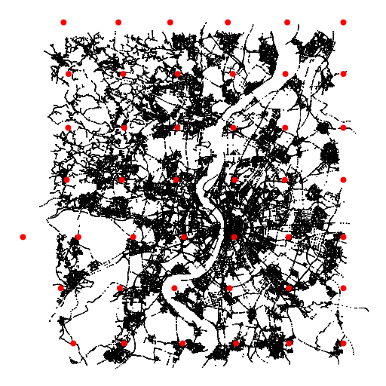
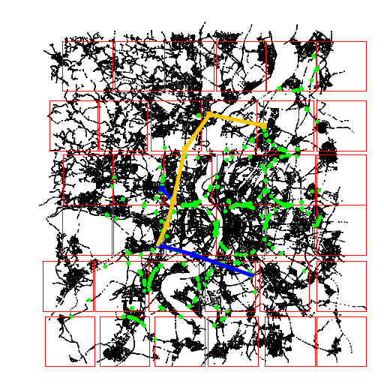
Cell Antennas
Viterbi paths, matching the simulation results

Slide 54
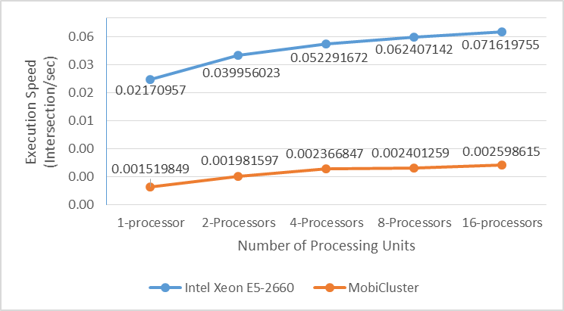
On-Demand High Performance Clusters on Mobile Phones
Joined Collaborative R&D Project between EJUST and IBM Center for Advanced Studies, in Cairo: Ahmed El-Mahdy (EJUST), Hisham Elshishiny (IBM), Essam Algizawy (EJUST)
Processing of big data is distributed and happens close to when the data is sensed
Mobile phones provides low-cost high performance computing
We utilise the concept of ‘expiring’ threads to ease migration issues
The concept of ‘micro-money’ is utilised

Slide 55
Thank you

