Slide 1


Big Data and Urban Mobility
Cairo Workshop
June 2, 2014
Jacqueline Dubow

Slide 2
The Problem
Between 2010 and 2050, the number of people living in urban areas worldwide is expected to grow by 80%—from 3.5 billion to 6.3 billion.
Increasing congestion, raising Green House Gas (GHG) emissions, and accelerating the deterioration of transportation infrastructure
Curb some of these trends by better planning?
What information is available for them to enhance the relevance and accuracy of their projections?

Slide 3
Au Gabon, à fin décembre 2013, la pénétration du service Internet à haut débit (fixe et mobile cumulés) s’élève à 38% et 11 villes sont couvertes en haut débit (Libreville, Port-Gentil, Gamba, Lambaréné, Mouila, Tchibanga, Makokou, Franceville, Moanda, Oyem, Bitam)^{[1]}. Le prix de détail d’un Mbits s’élève encore à 139 US$ par mois à fin décembre 2013^{[2]}.
Au Gabon, à fin décembre 2013, la pénétration du service Internet à haut débit (fixe et mobile cumulés) s’élève à 38% et 11 villes sont couvertes en haut débit (Libreville, Port-Gentil, Gamba, Lambaréné, Mouila, Tchibanga, Makokou, Franceville, Moanda, Oyem, Bitam)^{[1]}. Le prix de détail d’un Mbits s’élève encore à 139 US$ par mois à fin décembre 2013^{[2]}.
Is Big Data a Solution?
Result of the many innovations in technologies and greater affordability of digital devices.
Explosion in the quantity and diversity of high frequency digital data, still largely untapped in developing countries.
Potential to allow decision makers to track development progress, improve social protection, and understand where existing policies and programs require adjustment.
Come from mobile phone call logs, mobile-banking transactions, online user-generated content—blog posts and Tweets, online searches, and satellite images.
The public sector is also an important data user, and a source of data that can generate benefits across the economy. Evidence from Europe’s 23 largest governments shows that by fully exploiting public sector data, governments could reduce their administrative costs; some estimate potential savings of 15% to 20%—the equivalent of EUR 150 billion to EUR 300 billion in new value. Such benefits can be obtained from weather forecasts, traffic management, crime statistics, improved transparency of government functions (e.g. procurement) and educational and cultural knowledge for the wider population.

Slide 4
What is Big Data?
Turning data into actionable information is based on computational techniques that bring trends and patterns within and between extremely large datasets.
The Four “V”
  High-complex
  high-volume,
  high-velocity,
  high-variety and
  high-veracity
Not all of the four “V” are necessary to be present to result in Big Data. For example, a data set low in volume but high in veracity and complexity, still qualifies as Big Data.
Equally important, Big Data is not just about the size of the data, it has more to do with the way data are being processed .

Slide 5
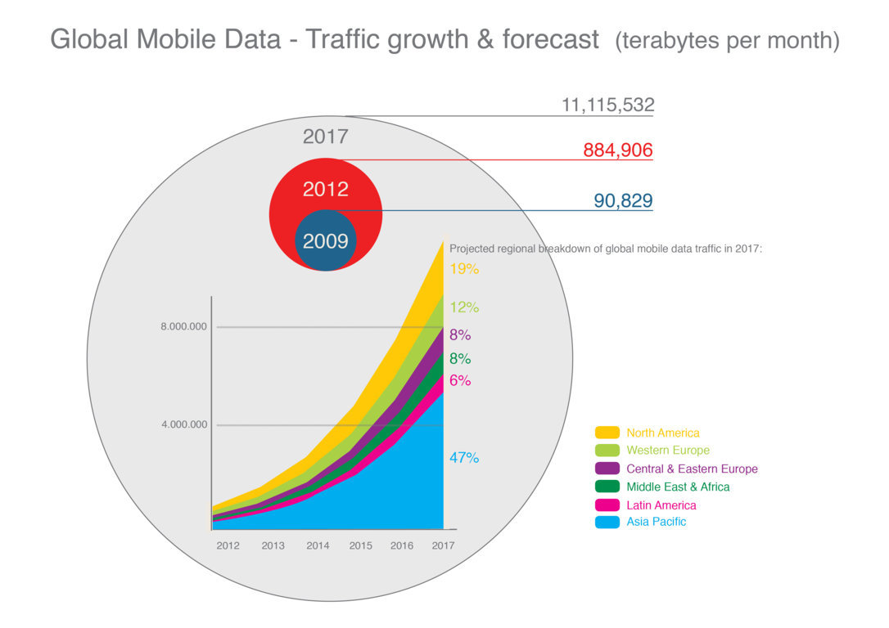
Mobile Traffic

Slide 6
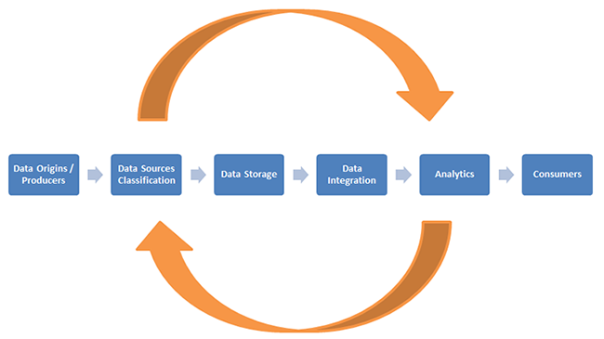
Big Data Value Chain

Slide 7
Open Data
Open Data supports and enhances Big Data’s availability and potential.
The concept behind Open Data is that data should be freely available to everyone to use as they wish, without restrictions from copyrights, patents,
The World Bank, the United Nations and the European Union are leading this effort, and give access to large amount of data .
The EU Open Data directive is expected to create 58,000 jobs in the UK through 2017, and add £216 billion to the country’s economy.
Open Weather Data in the US has created 400 companies employing 4,000 people.
A Spanish study found an increase of about €600m of business from Open Data—with the creation of over 5000 jobs.
An Australian study found a return on investment of 500% from Open Data.
http://data.worldbank.org
http://data.un.org
http://open-data.europa.eu/en/data/

Slide 8
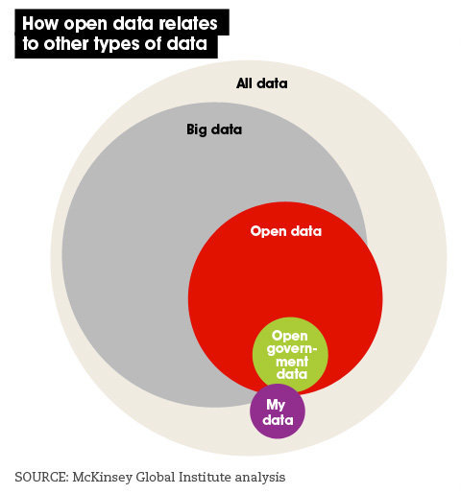
Data Ecosystem

Slide 9
Types of Big Data
Structured data containing numbers of facts. The most frequently used of this type of hard data is Call Detail Records (CDRs) collected by mobile phone operators. CDR data inform about the location of the phone tower (where the call was made), and the time and duration of the call. Large operators collect over six billion CDRs per day.
Unstructured data linked to social media content, such as videos, music, online purchases etc. Because of their unstructured and subjective nature, they are more difficult to analyze.
Data is gathered by digital sensors on road, satellite imagery, videos at toll roads, or water meters.

Slide 10
Challenges
Access to data
More than just numbers
Visualization
Reshaping the workforce

Slide 11
Access to data
Most crucial challenge. In many countries, access to data is still severely regulated by government bodies and is highly restricted.
Big Data also provides an economic boost and increased job creation.
However, in many developing countries, access to data—despite clear benefits—is still lagging behind, even if some countries have the skilled workforce and the technology to use Big Data.

Slide 12
Consider more than the numbers
Selection biais
  Lack of external validity
Too much on correlation and prediction
  Predictive policing in UK

Slide 13
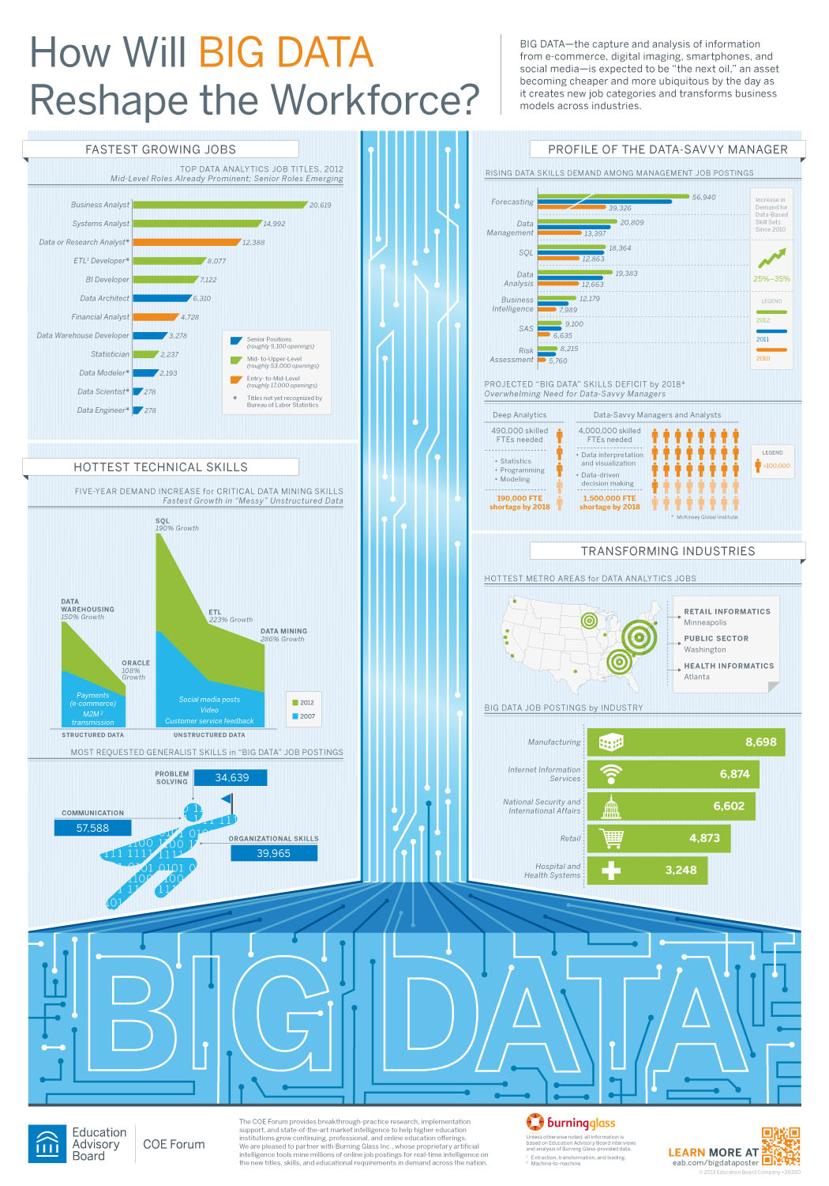
Reshaping the Workforce
Source: Education Advisory board

Slide 14
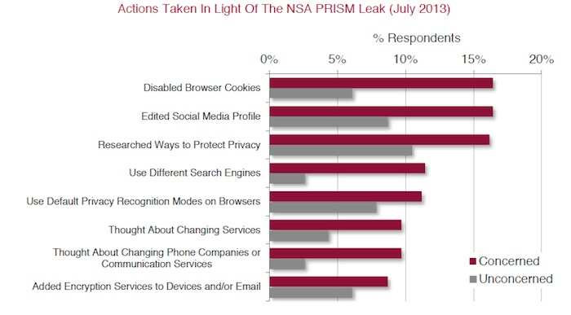
Privacy and Security

Slide 15
Transport Sector
Geolocalisation data are booming and help reducing CO2 emissions growth about 20% , could provide USD 500 billion in value worldwide in the form of time and fuel savings, or 380 megatonnes (million tons) of CO2 emissions saved.
Real-time traffic information. provide information to consumers on their daily commute using a mix of data sources—public data (such as construction schedules), private data (such as telecom companies tracking individual user devices to calculate time to work), and some passively-generated data (for example, a cluster of calls made from a similar location might indicate a traffic jam).
Instruments. These include smart phones, sensors, and onboard vehicle hardware that enable continuous collection, communication, and processing of mobility data—anything from traffic and weather conditions, to parking spots and rideshares.

Slide 16
Intelligent Transport Systems
Most cites in the US manage their traffic and transit data on private databases
Municipal staff to monitor system performance and implement improvements
By sharing the data, cities could tap into a larger pool of creativity4% of the 400,000 monthly trips on Bay Area Rapid Transit (BART) are planned using Embark, http://letsembark.com/
ParkMe, another smartphone app that specializes in predictive algorithms to direct drivers to the best available parking locations, http://www.parkme.com/

Slide 17
China’s Urban Transportation Management
platform designed to improve the timeliness and security of public transportation, and to deliver better taxi service for citizens in Beijing, Kunming, Chongqing, and Tianjin
Comprehensive traffic management: real-time insights into current urban situations and prediction of traffic conditions; real-time timing analysis of traffic lights, monitoring and prediction of traffic congestion; and overall traffic index, reachable time analysis and prediction for areas and paths
Dedicated management application groups: operational analysis for buses, taxis and rail transit, comprehensive analysis on capacity and pricing subsidy of public transportation, and labor intensity analysis.

Slide 18
Da Nang, Vietnam, Traffic Management System
Biggest seaport and fourth largest city in Vietnam with close to 1 million inhabitants. It is also Vietnam’s fastest growing metropolitan sprawl. Population of how many ?
Since 2013, as part of IBM’s Smart Cities Challenge, Da Nang’s traffic control center has had the tools it needs to predict and prevent congestion on the city’s roads, and to better coordinate responses to situations caused by adverse weather or road accidents.
Data are aggregated from multiple streams, which city planners can then analyze to detect anomalies and control flow of traffic.
Real-time information for its 100-strong fleet of buses—allowing to view details, such as the location of each bus, and their current speeds and predicted journey times.
Software and sensors are embedded in roads, highways, and buses, and synchronize stop lights to minimize traffic jams. This data can then be shared with passengers—either through video screens at bus stations or via mobile apps—thereby encouraging more people to use the buses and reduce the number of cars on the road.

Slide 19
Data Challenge on transportation
Cities can benefit from investing, at a fairly low cost, in standardizing and disseminating their transportation data.
Software developers can help them to make the most of these data to improve existing roads and parking lots, and to expand transportation options through shared cars or better taxi management, thereby enhancing mobility within the cities.

Slide 20
Big future
The future of Big Data will likely be shaped by three main strands: academic research, legal and technical frameworks for ethical use of data, and larger societal demands for greater accountability.
Research will continue to examine whether and how methodological and scientific frontiers can be pushed, especially in two areas: drawing stronger inferences, and measuring and correcting sample biases.
Policy debate will develop frameworks and standards—normative, legal and technical—for collecting, storing and sharing Big Data.
.

Slide 21
Thank you!
Cairo Workshop
June 2, 2014

