Slide 1
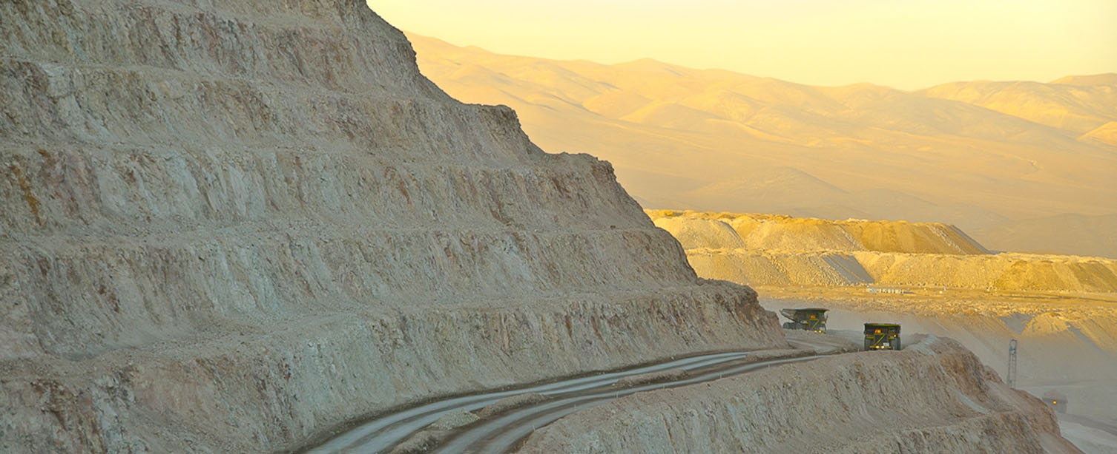
World-class suppliers to the global mining industry
Escondida - Chile
Osvaldo Urzúa
Government and Institutions Relations Manager, BHP Billiton Copper
30 September – 01 October 2013

Slide 2
Development and technological change
The challenge is to a very significant extent about learning
What are the drivers of learning in the mining industry and its suppliers? Where are learning opportunities?
How to exploit them? What efforts are required?

Slide 3
Accumulating higher level of capabilities
Technological capability level
Technological capability level
R&D and engineering capabilities for the creation and implementation of new technologies
Technological frontier
ACTIVE
Development and engineering capabilities to improve-update technologies and implement significant innovation
Technological capability level accumulated in firm/nucleus
Engineering capabilities to adapt technologies and implement incremental innovations
PASSIVE
Production capacities to use and operate technologies
5
10
15
20
25
30
Time(Years)
Source: Based on De Figueiredo E (2000)

Slide 4


World-class programme

Slide 5
Contents
Drivers, challenges and opportunities
Key component of a learning system: World-class supplier development programme
Examples
Industry level effort

Slide 6

1.1 Drivers, challenges and opportunities
Cu Mt
World Cu Production
Higher performance
=
Knowledge-intensive
mining suppliers (KIMS)
35
30
25
20
15
10
5
1900-2006
585 Mt
2007-2032
620 Mt
Mining companies
Suppliers
(KIMS)
Source: World Metal Statistics, March 2010 and
Yearbook 2008 – Producción Mundial.
2006
2032
Cu Grade
Collaboration + win-win
Mineral: Menor Ley, Mayor Profundidad y Dureza
Mining companies
Suppliers
Companies
Universities
R&D Centers
Source: Cesco
Global value chains

Slide 7
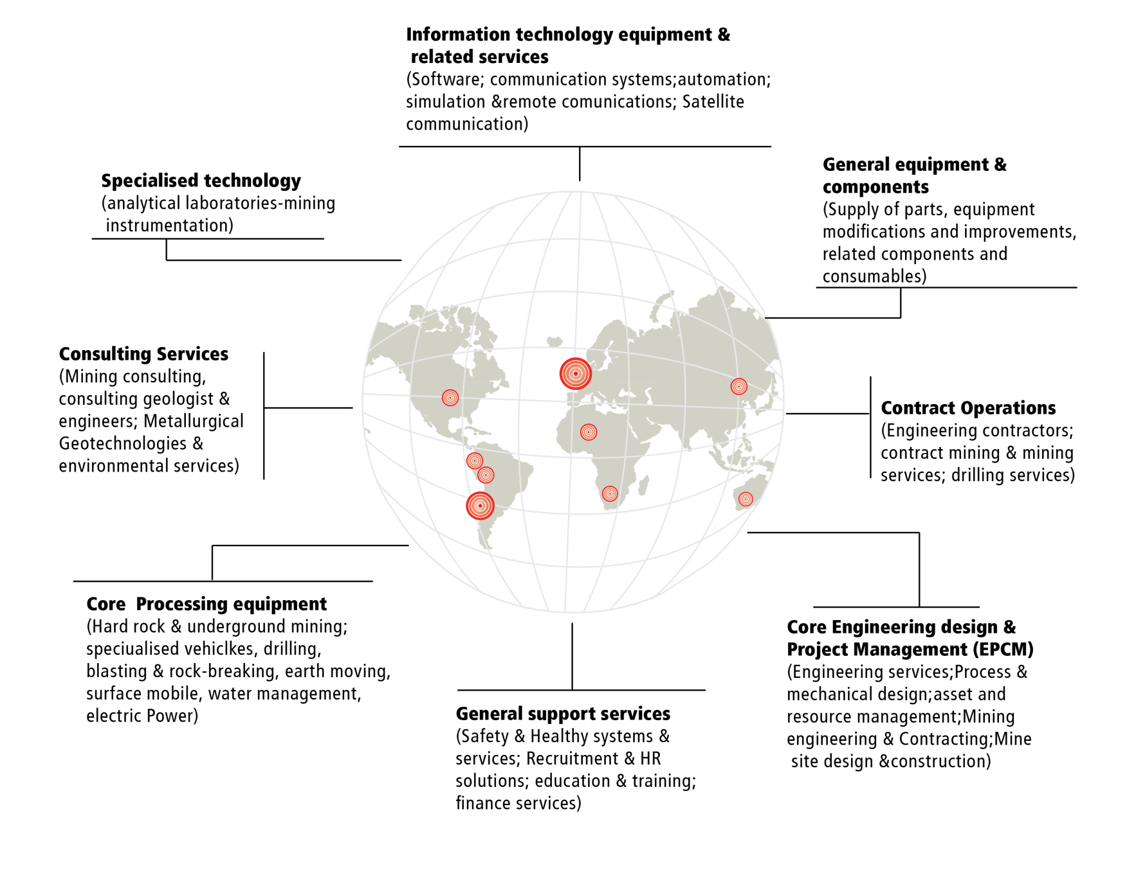
1.2 Knowledge-intensive mining suppliers
Linking developing mining economies with the global value chain

Slide 8
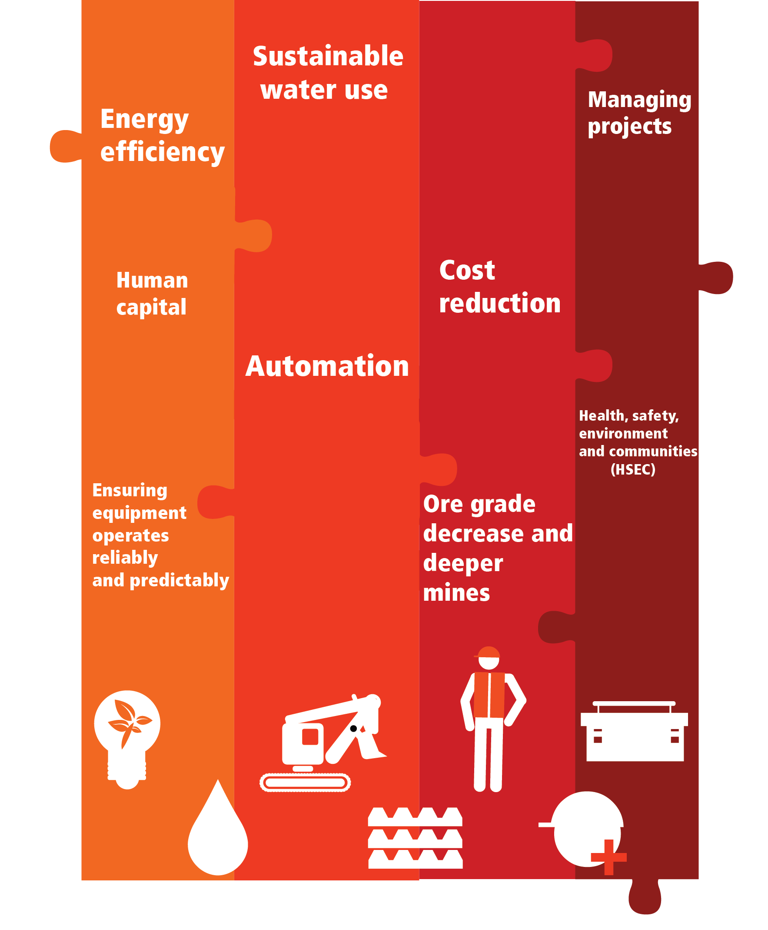
1.3 Drivers, challenges and opportunities
Challenges drive learning and innovation
Declining ore grades and deeper mines
Change of ore type
Rising investment costs
Higher prices for key inputs
More demanding environmental standards
Water scarcity
Expensive energy
Labour shortages

Slide 9
2.1 World-class suppliers development
Today
2020
4,000+ Suppliers
Few of them are
World-class
250 World-class
Suppliers in key areas
Developing
new
solutions
CREATING
THE FUTURE
CREATING
THE FUTURE
W-C Suppliers
Technological capability level
INNOVATOR
INNOVATOR
ADAPTOR
Other programmes
ADAPTOR
SIMPLE USER (Good User)
SIMPLE USER
Notes:
9

Slide 10
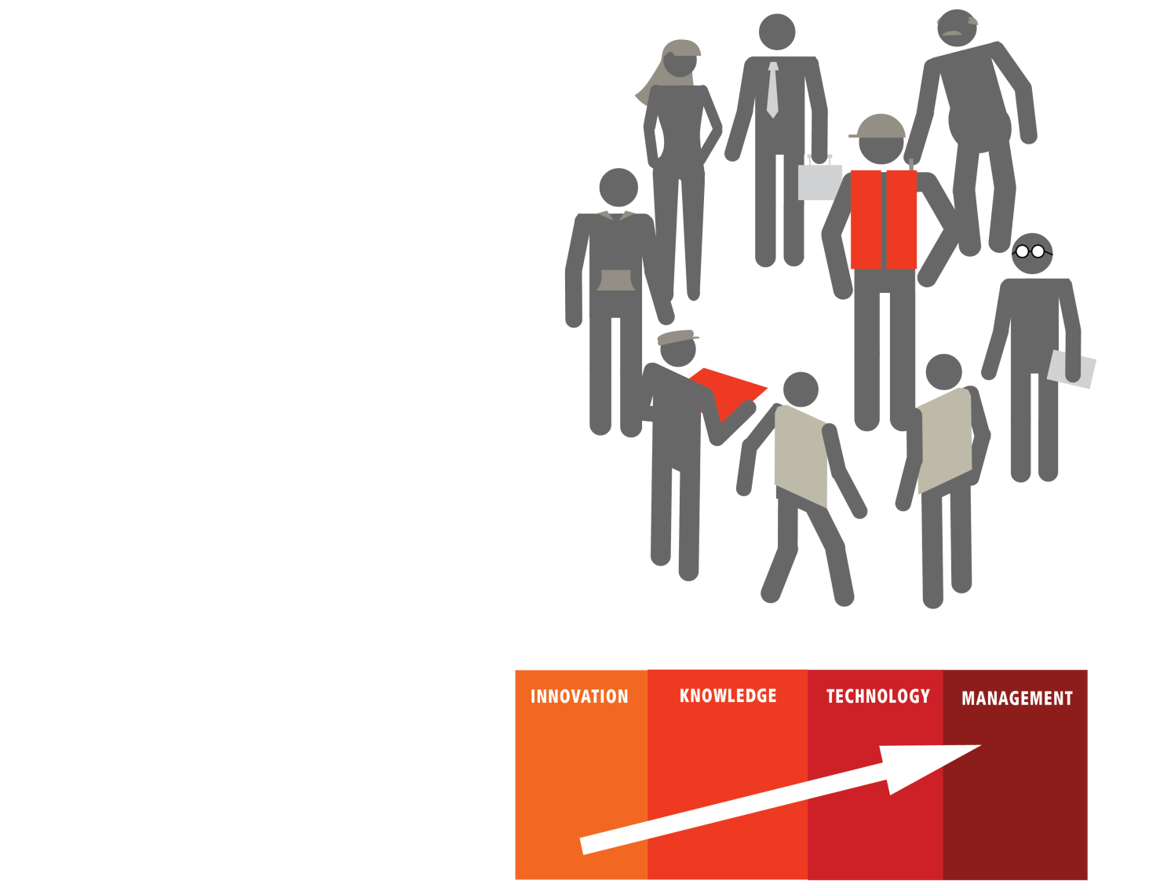
2.2 Non-traditional supplier development
Collaborative user-producer innovation and learning
Collaboration as a source of innovation and capabilities building
Win-win process through projects that accomplish:
  Solutions for operational challenges facing mining companies
  A reduction in the supplier´s gap regarding world-class standards
Strategic long-term relationships

Slide 11
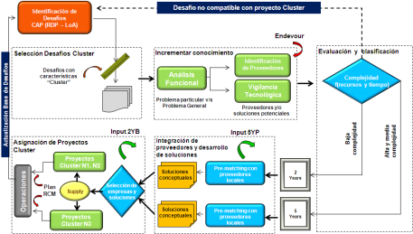
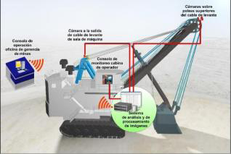

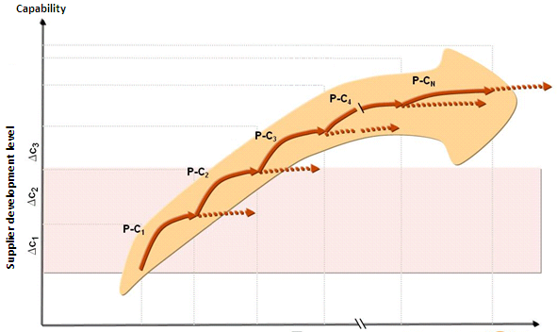


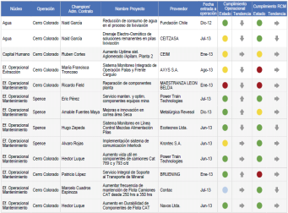

2.3 A structured and systematic process
Identify Challenges
(CAP process)
Selection process & portfolio management
Commercial escalation
Project
people
Infrastructure
Qualified
operators
Selection process:
Prioritize and clearly define the challenges aligned with Business needs
Find the right supplier (high potential)
Develop Innovative solutions
Within the mining company, the mining industry and other industries
Supplier starts the cycle all over again by solving new and more challenging problems
Equipment & Services
Power
Water
Word-class suppliers:
Supplier development (HSEC, Business model)
Oriented to technology portfolio development
Tailored contracts (Intellectual Property)
World Class Route
5YP & 2YB
Bottlenecks
in operations
Cost
Reduction
HSEC
Portfolio Management:
Team: Champion + Coordinators
Platform
Reporting: monthly review

Slide 12

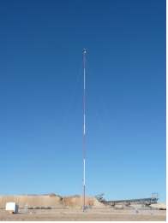
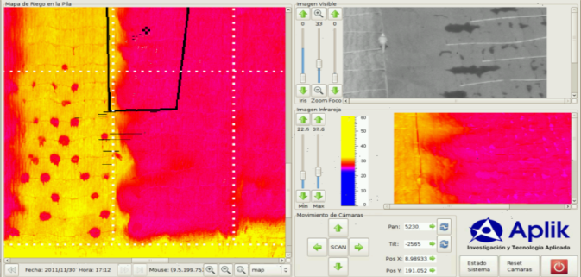
3.1 Aplik / Spence
1
Summary
2
Highlights
Goal:
“50% reduction in operational failures in leaching pads”
Nucleus | Leaching
Area | Production
NPV
Implementation | July 2013
Product developed
Online monitoring system, composed by radiometric and day/night vision cameras.
Results
Online detection of operational faults (day and night activity)
Removed exposure of people in monitoring activities over oxide pads.
3
World Class Route
Impact
18 highly qualified professionals. 2 pilots At least 2 technologies placed in the market. Develop spin-off strategy to support growth.

Slide 13

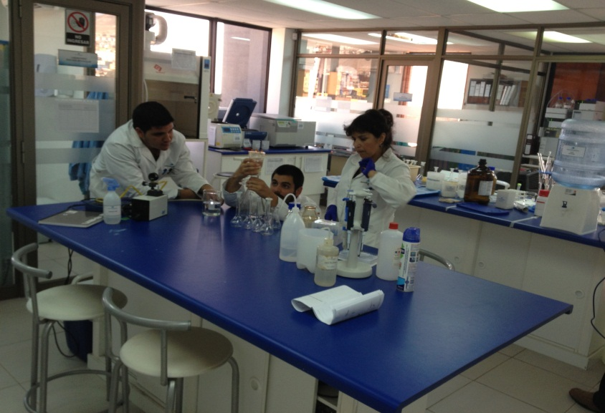
3.2 Aguamarina / Cerro Colorado
1
Summary
2
Highlights
Goal:
“85% reduction in particulate material from point sources ”
Nucleus | Sustainability (HSEC)
Area | Mine
NPV | HSEC Improvement
Implementation | December 2013
Results
Generation of partnerships with engineering companies
Successful results in laboratory scale (more than 85%)
Next Steps
Develop engineering of 2 pilots in dry area
3
World Class Route
Impact
35 highly qualified professionals. Focused on pilot scale 6 pilots highly attractive for investment (1.2 MM US$ in 2011) Board Strong organizational structure to support growth At least 3 technologies placed in the market.

Slide 14



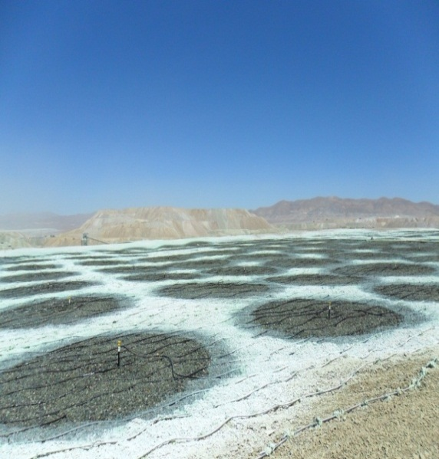
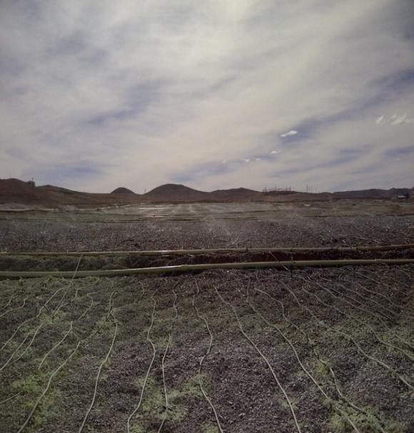
3.3 Mining Systems / Minera Escondida
1
Summary
2
Highlights
Goal
“Increase copper recovery by 2%”
Implementation:
Staff on site: 12 people.
Execution time: 8 months
Results:
2% increase in copper recovery
Safety incidents: None
Irrigation uniformity coefficient : 89,2%
Availability: 95%
Reliability: 99%
Nucleus | Leaching
Area | Cathodes
VPN
Implementation | May-2013 (OLAP)
3
World Class Route
Impact
Sales increase: US$1MM (2009) to US$7MM (2013) New Clients: Gaby, MV, MB, OLAP and peruvian market (2015). New strategic alliances to offer integral systems.

Slide 15
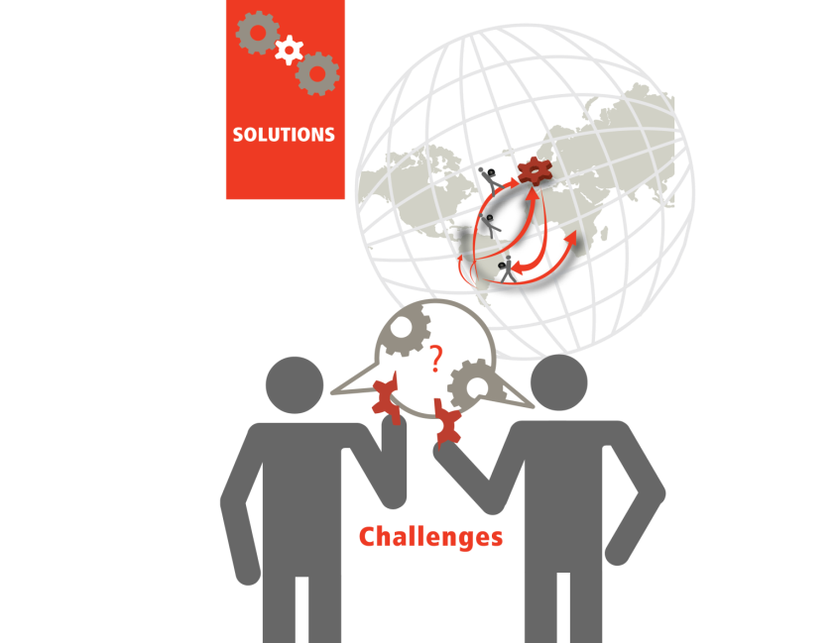
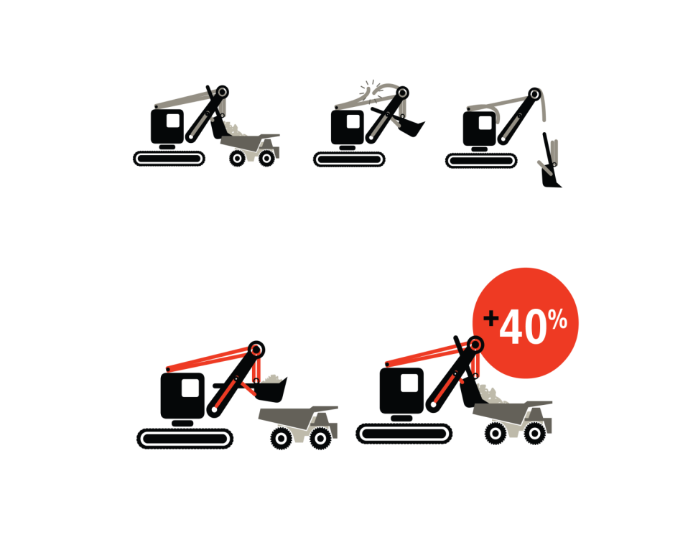
4.1 The collaborative agreement
Mining company
Provide challenges, technical counterpart and testing opportunities
Technical, managerial and financial support
Scale-up of solutions
Fostering internationalisation
Supplier
Provide solutions for challenges
Acquire intellectual property
Finance
Implement world-class path and closing gaps agenda

Slide 16

4.2 World-Class path
-
+
Knowledge and Interaction
Value:
Higher Performance
Mining Companies:
(Large Suppliers)
Have Challenges
Project 1
Project 2
Projects 3
…
Project N
COLLABORATIVE PROCESS
Suppliers:
Develop Solutions
Consecutive learning and innovation projects (technology strategy)
Each project builds new capabilities
Suppliers retain intellectual property
Internationalisation
Value:
Development partnership
TIME

Slide 17


4.3 Industry level effort
Accelerator 1: University 1
Accelerator 2: University 2
Accelerator 3: University 3
Mining Companies:
(Large Suppliers)
Mining Companies:
(Large Suppliers)
Mining Companies:
(Large Suppliers)
Mining Companies:
(Large Suppliers)
Mining Companies:
(Large Suppliers)
Mining Companies:
(Large Suppliers)
Project 1
Project 2
Projects 3
…
Project N
Project 1
Project 2
Projects 3
…
Project N
Project 1
Project 2
Projects 3
…
Project N
Mining Companies:
(Large Suppliers)
Mining Companies:
(Large Suppliers)
Mining Companies:
(Large Suppliers)
Project 1
Project 2
Projects 3
…
Project N
Project 1
Project 2
Projects 3
…
Project N
Project 1
Project 2
Projects 3
…
Project N
Suppliers
Mining Companies:
(Large Suppliers)
Suppliers
Mining Companies:
(Large Suppliers)
Suppliers
Mining Companies:
(Large Suppliers)
Project 1
Project 2
Projects 3
…
Project N
Project 1
Project 2
Projects 3
…
Project N
Project 1
Project 2
Projects 3
…
Project N
Suppliers
Mining Companies:
(Large Suppliers)
Suppliers
Mining Companies:
(Large Suppliers)
Suppliers
Mining Companies:
(Large Suppliers)
Project 1
Project 2
Projects 3
…
Project N
Project 1
Project 2
Projects 3
…
Project N
Project 1
Project 2
Projects 3
…
Project N
Suppliers
Mining Companies:
(Large Suppliers)
Suppliers
Suppliers
Mining Companies:
(Large Suppliers)
Project 1
Project 2
Projects 3
…
Project N
Project 1
Project 2
Projects 3
…
Project N
Project 1
Project 2
Projects 3
…
Project N
Suppliers
Mining Companies:
(Large Suppliers)
Suppliers
Suppliers
Mining Companies:
(Large Suppliers)
Project 1
Project 2
Projects 3
…
Project N
Project 1
Project 2
Projects 3
…
Project N
Suppliers
Mining Companies:
(Large Suppliers)
Suppliers
Suppliers
Project 1
Project 2
Projects 3
…
Project N
Project 1
Project 2
Projects 3
…
Project N
Suppliers
Suppliers
Mining Companies:
(Large Suppliers)
Project 1
Project 2
Projects 3
…
Project N
Suppliers
Suppliers
Project 1
Project 2
Projects 3
…
Project N
Suppliers
Suppliers
Mining Companies:
(Large Suppliers)
Project 1
Project 2
Projects 3
…
Project N
Suppliers
Accelerator platform
Capital
Public goods
Government

Slide 18
4.4 Diverse supply industry
OPERATIONS + PROJECTS
Down stream activities
Exploration
Mining
Processing
Intermediate
Products
Manufacturing
Alto Valor Agregado
Alto Valor Agregado
Sideways development:
Supply chains
Exploration
Dust
Automation and Robotics
Blasting
Hauling & Transporting
Water
Acid mist
Processing -Leaching
Others
Maintenance
Investment projects
Human Capital
Energy

Slide 19
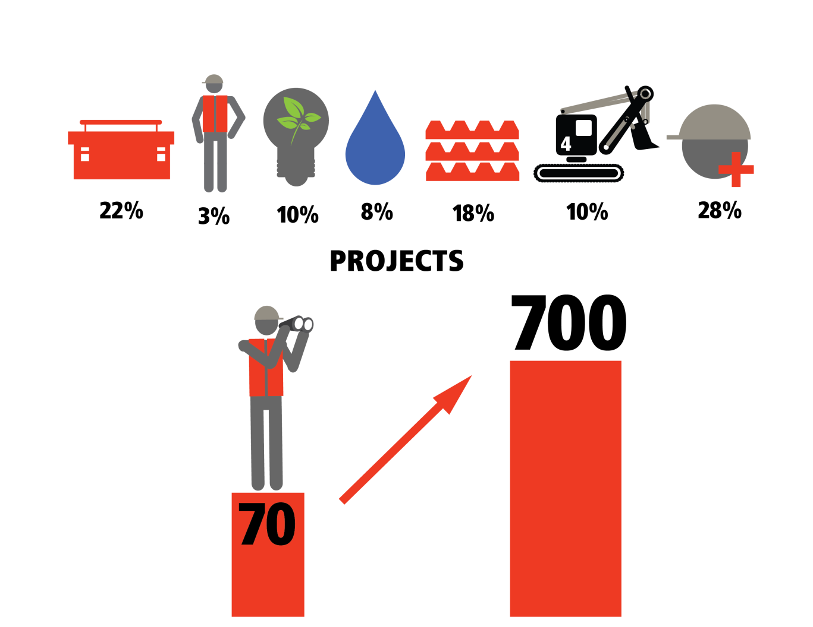
4.5 Wide-ranging portfolio of projects
Portfolio (Number of projects)

Slide 20
Summary
The main driver behind this program and our focus: The challenges the mining industry faces demand higher availability of world-class suppliers close to the operations and able to tackle them
The link to the country's development challenge: The country needs to transition to a knowledge-based economy and the development of world-class suppliers or knowledge-based organisations play a key role
The strategy: Higher capability levels are built up by developing a portfolio of Collaborative Projects of increasing complexity, which should simultaneously accomplish two requirements:
- To solve a problem currently not being satisfactorily tackled
- The supplier progresses toward international competitiveness by reducing the gap with world-class standards and exporting

