Slide 1

Global conference - Local content policies in the oil & gas and mining sectors
Brazilian Local Content Regulation Framework in the Oil & Gas Activities
Marcelo Mafra Borges de Macedo – Head of Local Content
Sept/2013

Slide 2
Brazilian experience
Diagnosis – local features:
  Economy & Policy
  Potencialities & gaps (supply chain, infrastructure, HR, technology)
  Knowledge of sedimentary basins
Strategy definition:
  Focus on potential segments
  Conception of LC structure
Implementing strategies:
  LC regulation framework: monitoring & auditing
  Maturity of the model: updates & adjustments
  Strong work over the assimetry of information
Stakeholders Forum
Local Content
Government
NOC
Society
University
IOC
Suppliers

Slide 3
Brazilian experience
Current agenda: key points
  Focus on segments: high potential demands;
  Supply chain integration;
  Development of logistics infrastructure (roads, highways, ports, airports, rails...)
  Reduction of production/services cost
  Incentives to promote R&D and Innovation;
  Improve the relationship between univertities and supply chain.
Sustainability & competitiveness
Local Content
Innovation
Planning
R&D

Slide 4
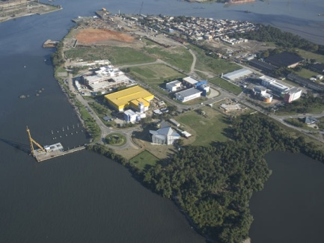
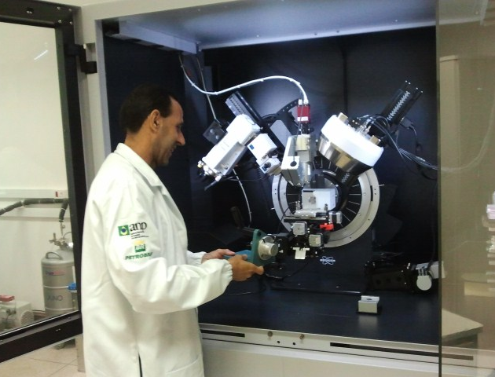
15 years of history
The success of the concession regime
Research & Development
Compulsory investments in R&D (1999 - 2012)
US$ 3.7 billion
Cumulative investment forecast (million US$)
More than 100.000 people trained since 2007
US$ 1,5 billion for universities infrastructure (labs, equipments, computers…)
3D training centers

Slide 5
Why Invest in Brazil?
Next decade, the demand for goods and services should reach R$ 900 billion (US$ 400 billion)
Investments 2013-2016 (R$ billion)
Source: BNDES. Study: Perspectivas do Investimento – February, 2013

Slide 6
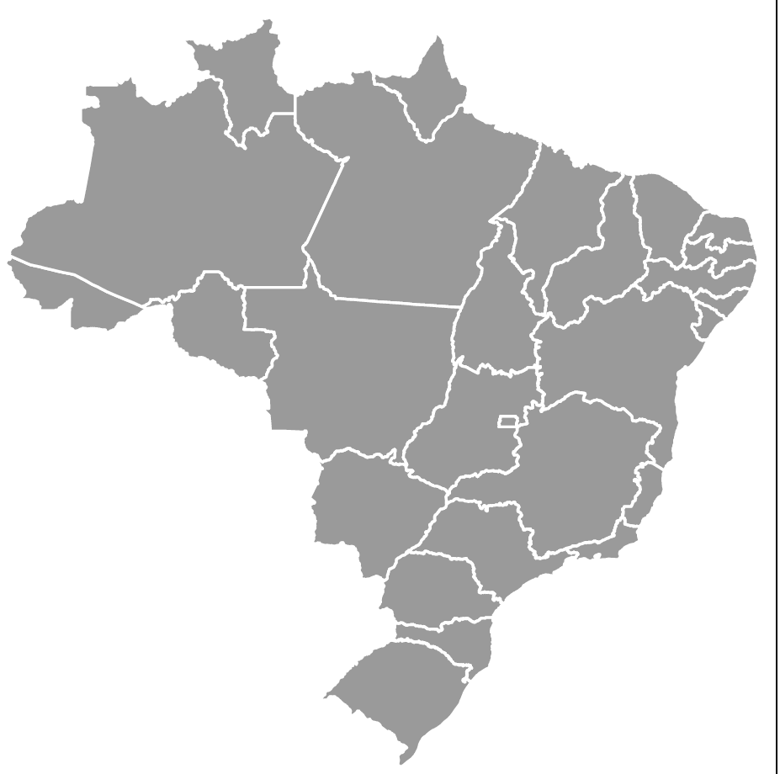
Naval industry
Atlântico Sul Shipyard | 6 rigs
 | P-62 | P-55 - hull
28 drilling rigs 6 in PE, 6 in BA, 7 in ES, 6 in RJ and 3 in RS
São Roque Shipyard | P-59
 | P60
Enseada do Paraguaçu Shipyard (under construction) | 6 rigs
Jurong Shipyard (under construction) | 7 rigs
 | P-68 and P-71 - modules and topside
OSX Shipyard (under construction) | P-67 and P-70 - modules and topside
Inhaúma Shipyard | P-74 and P-75 - hulls
 | P-76 and P-77 - hulls
Brasfels Shipyard | P-57 (Jubarte)
 | P-56 (Marlim Sul)
 | P-61
 | 6 rigs
 | P-66 and P-69 - modules and topside
Techint | P-76 - modules and topside
Rio Grande Shipyard | P-55 – modules and topside
 | P-66 and P-67 - hulls
 | 6 replicants – hulls
 | 3 rigs
 | Action completed/operation
 | Running
 | Already auctioned
Rio Grande Harbor Shipyard | P-63
 | P-58
Source: Adapted from the 7th balance of PAC 2, 2013
Brasil Shipyard (under construction) | P-74 - modules and topside

Slide 7
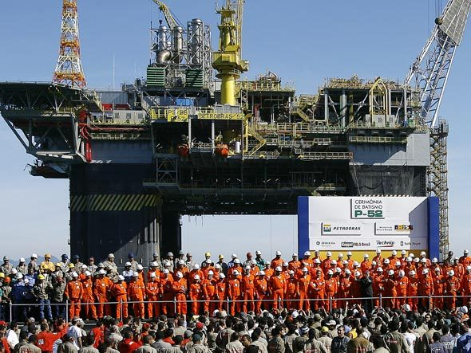
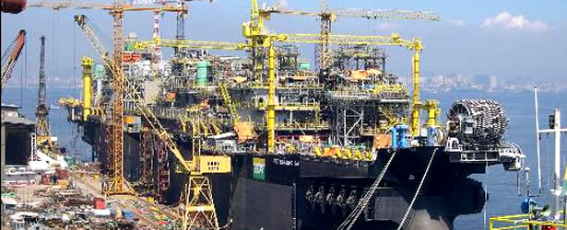
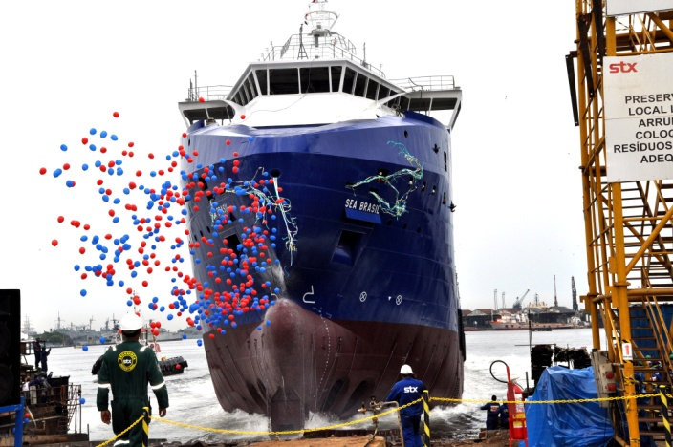
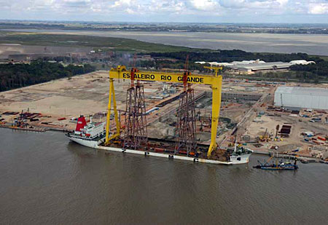
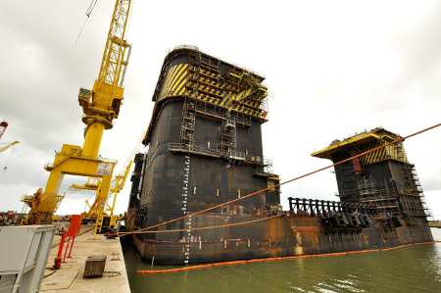
Naval Industry with LC
Platforms, drilling rigs, supply vessels
BrasFels Shipyard – RJ (P-52)
Mauá Shipyard – RJ (P-50)
Sea Brasil – STX - RJ
Rio Grande Shipyard - RS
Atlântico Sul Shipyard - PE

Slide 8
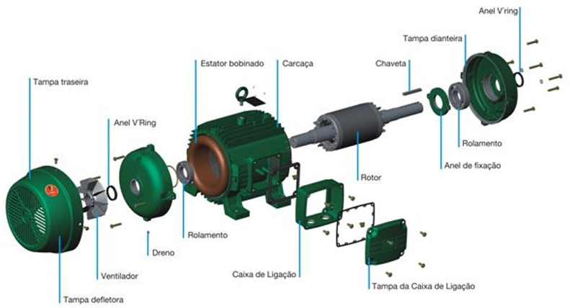
Brazilian experience:
How to Measure Local Content
Bids 7 to 10
LC calculation: 3rd part
(companies accredited by ANP)
Compulsory certification to prove local investments
2005
2006
2007
2008
Formula
∑
X
X = price of imported component
GOODS
CLb = 1 - * 100
Y
Y = Product sale price

Slide 9
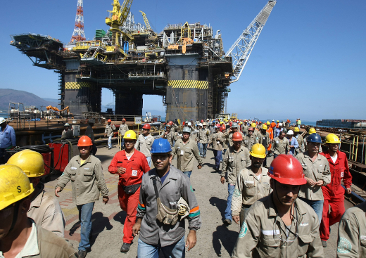

Brazilian experience:
How to Measure Local Content
SERVICES: (only workforce)
List all employees joining the service
Check who is local/foreing
Check the salaries of all emplyees
Apply the formula:
Y = salaries of local people
X = total salaries

Slide 10
15 years of history
The success of the concession regime
Certificates issued – US$ 13billion of LC
Per quarter
total

Slide 11

Agência Nacional do Petróleo, Gás Natural e Biocombustíveis
Coordenadoria de Conteúdo Local (CCL)
Av. Rio Branco, 65 - 16º andar - Rio de Janeiro – RJ – Brasil
Tel.: (55 21) 2112-8550 / (55 21) 2112-8535
mmacedo@anp.gov.br
ccl@anp.gov.br
www.anp.gov.br

Slide 12

What is Local Content? And why?
Definition:
Contractual commitment to purchase a percentage of local goods and services, in competitive basis for the exploration and for the development of the procuction. (to be cosidered as LC, goods & services must have the LC certificate)
Objectives:
Development of local suppliers & technology;
Creation of employment in large scale;
Development of local economy (GDP)

