Slide 1
National/Local Content Development seen from a donor perspective
Svein Olav Svoldal, adviser
Section for Private Sector Development
Norwegian Agency for Development Cooperation (Norad)
Notes:
My name is Svein Olav Svoldal and I am working at the Norwegian Agency for Development Cooperation (Norad), which is a directorate under the Norwegian Ministry of Foreign Affairs. Norad’s is mainly a technical advisory body to the Ministry and Norwegian embassies with respect to international development assistance. Our grant grant management includes only 20 % of the total aid budget of approx. $5 billion.
My work is related to private sector development, in particular local content development. At the time being, this is an area of engagement we are looking strategically into. But it is a challenging priority area, where role/added value of the donor and other stakeholders is not completely clear. As such, we would like to thank the World Bank for holding this conference, as it comes very timely and provides an opportunity to learn and discuss. Further, we would like to honor SEGOM, and in particular Silvana and her team, for conducting the comprehensive study “Local Content Policies in the Oil and Gas Sector”. This is a very helpful contribution to our work.
In terms of local content development engagement, Norad is in particular focusing on Sub-Saharan Africa and the oil and gas sector, which this presentation to a large extent reflect. Although the local content challenges in this region are very different from those faced by countries in other regions when developing a new extractive sectors (including Norway), we do believe that the experience is relevant.

Slide 2
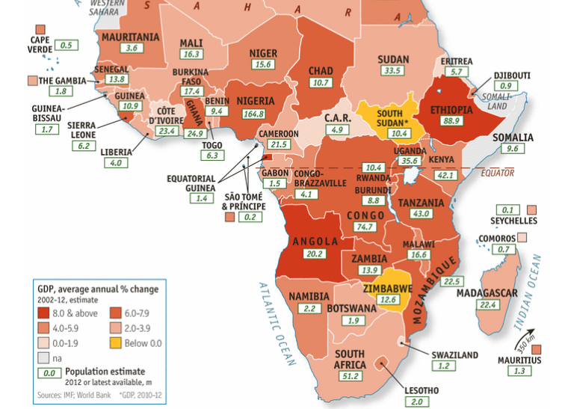
Notes:
We all know the story of the “African Cheetahs”: Six out of the worlds ten fastest growing economies the last 10 years are African, and since 1995 there has been a positive real growth per capita on average. The growth is both impressive and sustained. There are several reasons for this, and to mention some: Better macroeconomic policy, growth in both ODA and private investments, fewer conflicts, improved business climate and a positive political development.

Slide 3
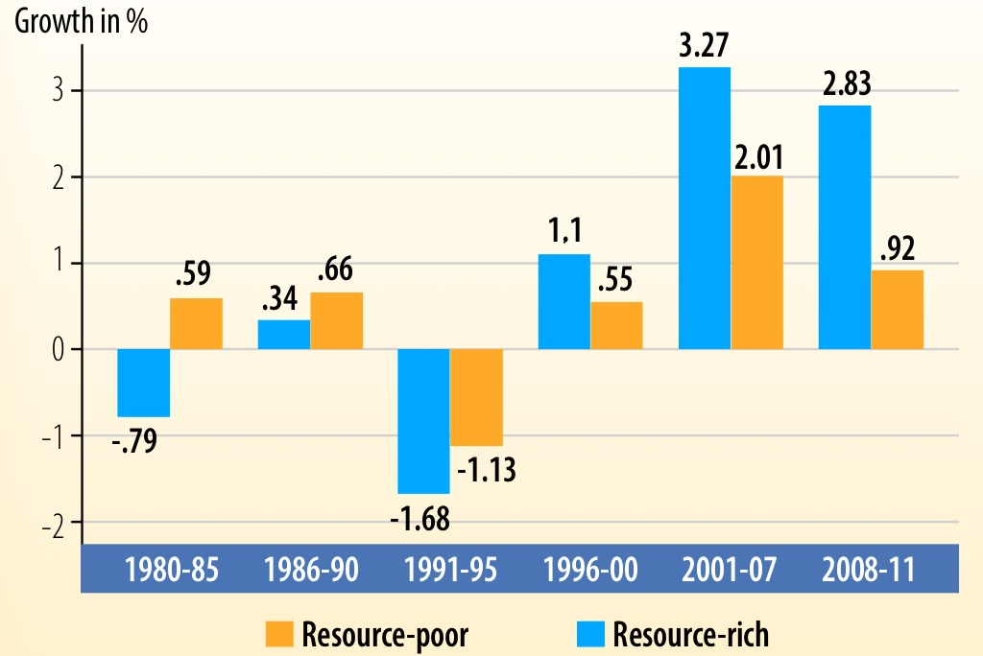
Notes:
… but natural resources do play a role. African countries that are categorized as resource rich has had a significant stronger economic growth between 2001 and 2011. Comparing this to the period 1980 and 1995, it is no doubt positive that that resources to a greater extent is associated with economic growth, which do indicate that parts of the “resource curse” (as it traditionally has been defined) is less evident.

Slide 4
Notes:
This map seek to illustrate the “total natural resource rent world wide” as percent of GDP between 2008 and 2012 - as the world bank define the resource rent: the sum of oil rents, natural gas rents, coal rents (hard and soft), mineral rents, and forest rents.
The extractive industry do play a significant role world wide when it comes to economic outcome. It may be more evident in Africa, but also countries at the east, west and in the north do have a the resource rent as significant part of their gross domestic product. To Norway, the resource rent constituted to 21,7% of GDP in 2008 and 13,6 % in 2011

Slide 5
Notes:
Whether this has been transformed into human development varies. A general observation is that Africa lies behind.

Slide 6
Converting resource wealth into human development is challenging!
Human Development Index
HDI | HDI ranking | 1 | 64 | 85 | 136 | 153
Income | GNI per capita in PPP (constant $) | 48 688 | 13 676 | 10 152 | 21 715 | 2 102
Health | Life expectancy at birth (years) | 81,3 | 74,5 | 73,8 | 51,4 | 52,3
Health | Under-five mortality (per 1000) | 3 | 6 | 19 | 121 | 143
Education | Mean years of schooling (years) | 12,6 | 9,5 | 7,2 | 5,4 | 5,2
Education | Public exp. on education (% of GDP) | 7,3 | 5,8 | 5,7 | 0,7 | n.a.
 | Resource rent in 2011 (% of GDP) | 13,6 | 10,3 | 5,7 | 44,7 | 35,6
Notes:
Converting resource wealth into human development is challenging – which may be evident from this table – also indicating it is possible. Coming from the private sector development side, my view is strongly in line with the World Development Report 2013 which suggests that jobs is a key factor in promoting development along several dimensions.
An issue with the extractive industry however, is that it is not labour intensive due to its technology and capital intensity, of which limits its potential to create both direct and indirect jobs. Further, commodity export has a tendency to weaken the competitiveness of sectors exposed to competition via exchange rate appreciation (so-called “Dutch Disease” – what remains of the “resource curse”) and hence, represent a barrier to general job creation.
The above table do indicate that a high resource rent as share of the total economic outcome does not necessary create the development needed – of which do make sense. Broad-based (but also higher) growth – across several sectors – is needed in order to create jobs. And this is a challenging task.

Slide 7
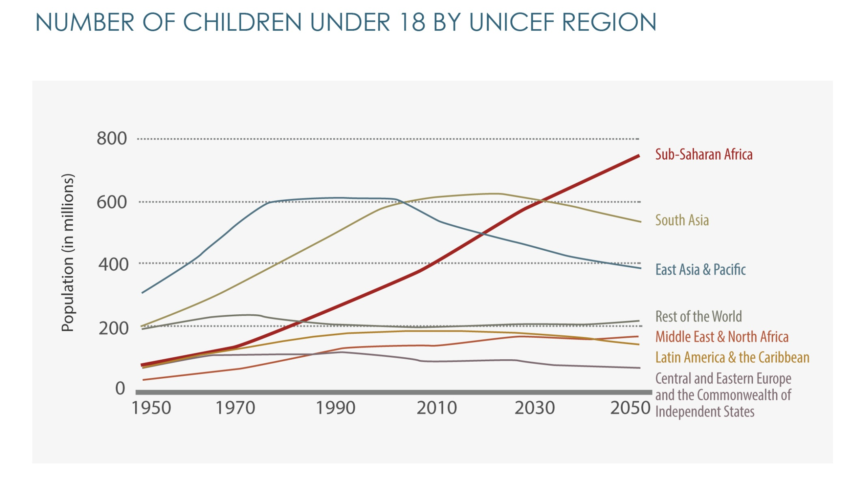
Notes:
Out of Africa’s 200m aged between 15 and 24, only 10 percent is employed in the formal sector, while 70% lives on less than $2 a day. As seen from this graph, the future is not less challenging, as the African work force is estimated to increase with some 10-15 million each year the next 10 years (and further on).
Africa's labour market and youth unemployment challenges are often seen in the context of the continent's rapid and steady economic growth. It is not difficult to understand the increased attention towards those sectors where the growth has been concentrated.

Slide 8
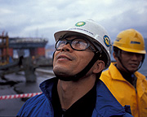
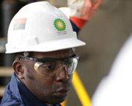
Local Content Development
The extractive industry may generate benefits to the national economy beyond its direct contribution - through links with other sectors.
→ Using the extractive industry as a “mechanism” to enhance:
Job creation
Knowledge & technology transfer
Local based private sector development
National income mobilisation
Notes:
Moving towards the core topic of this conference, I would like to emphasise that natural resources can lead to what what I would call a sustainable and overall positive result for a country. Where proper account is taken for economic, environmental and social factors within an intergenerational perspective – nations can benefit enormously. Local content development may be a part of this, but there is much more to it – for instance how the government share is invested in economic infrastructure and institutional strengthening in order to improve the business climate for other sectors.
Also, there is no “Norwegian model” (or any other model for that sake) to export to other countries regarding the already mentioned or with respect to local content development. All one can do is to share experience. The Kingdom of Norway is a totally different entity compared to say the Republic of Uganda. Each country must develop its own development approach and policies based on its unique set of conditions and circumstances.
In terms of local content, a country's technological and industrial starting point is an important factor. For example, Norway had well-established process, shipping, shipbuilding and engineering industries before the oil extraction began in the early 70s. This was reflected in the workforce and at the enterprise level, as well as in terms of institutional capacity and regulatory framework. Local Content Policy measures were put in place, and probably they where important – but the existing capacity probably much more! In Tanzania, 3% of the workforce is classified as "highly qualified" while less than 84% are "low-skilled".
Success in the development of local content requires the recognition that the development of institutions and capacity building at the individual and corporate level is no "quick fix". This is not always recognised by the different stakeholders, including both politicians and the extractive industry. Is it realistic for Ghana to require 90% local content in 2020, when the Jubilee Field has been producing oil for 10 years? Nigeria, in its 40th year of major production averages 30% annually.
Further, there are several pitfall with high ambitions and strong local content requirements, and these are not always in line with an economical rational intention of maximising the government share of the resource rent.
This is not to say there is no potential for local content development – or that such policy can have a positive national and local impact. The African Progress Pannel states in its 2013 report “Equity in Extractives” that “Africa's growth surge over the past decade has driven by extractive industries that operate in enclaves with few links to the local economy and that export largely unprocessed oil and minerals. These are weak foundations for sustained and inclusive economic growth. The challenge for African extractive industries over the next decade is to climb into higher value-added areas of production and to operate beyond their current enclaves. This will require the integration of extractive industries in a wider industrial policy.”

Slide 9
Extractive industry’s
responsibilities
Government responsibilities
Donors
Shared
Developed a skilled workforce
Build national competitive suppliers
Develop a competitive local infrastructure
?
Notes:
Donors and governments should consider ways to engage with industrial actors at the individual and enterprise level, such as within TVET and local enterprise development
The industry’s incentives to engage in local content development may be:
Increased long term profit by utilizing local competitive resources
National local content requirements and political ambitions/expectations
Corporate Social Responsibility (CSR)
Benefits seen from the donor and government perspective:
Increased funding to finance expensive activities/investments
Access to non-financial contributions along qualitative dimensions
Better coordination

Slide 10
Is local content development a sufficient priority area for the extractive industry to get a “social licence” to operate?
How does one make sure the relevant measures are initiated at the right time by and the relevant stakeholders?
Which value added may different stakeholders have at the early stage and in general?
How could LCP possibly trigger impact beyond the traditional supply chain in order to stimulate broad-based economic development?
Notes:
In our dialogue on local content development far, there are some “hurdles” which could be useful to point out to the panel:
The first one is related to the expectations towards the extractive industry and reflected in Governments’ /communities’ ambitions and actions. These tend to go beyond local content development and further towards chartable donations (i.e. to local hospitals, orphanages, churches, primary schools etc.) – which are not really connected to their industrial actors operations in terms of being social investments that may generate long term income to the companies. This may also be partly due to the already pointed out fact that enhancing local content is not a quick fix, and that the industry needs a social licence to operate.
The second is also related to the time consuming process of enhancing local content. Early attention to critical issues (such as individual skills, enterprise capacity and institutional strengthening) may be of significant importance. Some of these measures may be within the so called “shared responsibility”, but are not free (in general terms, though making up to a marginal share of the total operating cost) . The extractive industry will be reserved to take on such measures before the final investment decision is made, they may mobilise such engagement and demand local resources immediately. How do one eliminate this time derivation /trade off that may occur before the final investment decisions ("FID") by companies are made.
The last one is more general. A focus on traditional upstream local content development has its limitations - the spillover effects included. When Ghana’s Oil discoveries was made public in 2007, Ghana’s president John Kuffour said “The discovery can turn Ghana into an “African tiger” (…) With oil as a shot in the arm, we’re going to fly”. Now, how does one make the extractive industry a drive for economic activity? Can LCP be relevant in this matter?

