Slide 1

Current Challenges in the Joint Delivery of Labor Market Services and Social Assistance in Germany: Institutions, Services and Programs
Western Balkans Activation and Smart Safety Nets Conference
Ulrich Hoerning
Senior Social Protection Economist
Vienna, 4th March 2014
The World Bank
Europe and Central Asia Region
Human Development Unit, Social Protection Sector

Slide 2
Germany’s federal political structure is a key framework for labour market policy and social safety net design
Federal Republic of Germany
Level | Key Figures | Responsible for …
Federal (“Bund”) | 82m population (79m by 2030)* €2,400bn Total GDP (2009) €363bn total federal budget (2009) (15% GDP) | Labour market policy and Federal Labor Agency Unemployment Benefit I (social insurance) and II (tax-financed base benefit) Public pensions and health …
States (“Länder”) | 16 states €309bn total state budgets (2009) (13% GDP) | Schools (teachers) Child-care (w/ mun.) Police Culture …
Municipalities (“Städte, Kreise und Kommunen”) | 11,300 Municipalities “Kommunen”, of which … … 111 large cities ”Kreisfreie Städte” … 1,951 cities (“Städte”) 301 Counties (“Kreise”) outside of “large cities” €186bn total municipal budgets (2009) (8% GDP) | Unemployment Benefit II (housing cost) Social Assistance (SGB XII) Schools (buildings) Child care (w/ states) …
BERLIN
Sources: Destatis, Wikipedia, SVR Wirtschaft, authors calculations (* Estimate by SVR Wirtschaft)
Note: All financial indicators as gross expenditure. Additionally, the Public Social Insurance Schemes (Pension, Health, Unemployment (Social Insurance) add €506bn (2009) (21% GDP) expenditure. Total gross public expenditure is 57% of GDP in 2009. Total public debt is 73% of GDP (2010 notification to EU).
Current Challenges in the Joint Delivery of Labor Market Services and Social Assistance in Germany
Ulrich Hoerning – 04-March 2014
2

Slide 3
Current Challenges in the Joint Delivery of Labor Market Services and Social Assistance in Germany
Labor-market and reforms in Germany
All together now: governance of labor market and social inclusion programs
Linkage to social assistance: joint delivery of income support with municipalities
Beyond payments: labour market services and programmes
Current developments and challenges
3

Slide 4
Pre-reform labour market policy focused on “passivation”, low work-requirements and extension of benefits
In 2002, one third of Germany’s labour force potential was not utilized
Status-maintenance as main social safety net goal: contribution-financed “Unemployment Benefit” (Arbeitslosengeld) and tax-financed “Unemployment-Assistance” (Arbeitslosenhilfe) maintained earnings at ∼65% for more than 3 years (in some cases even longer)
Work requirements were low: (1) new job had to yield at least as much as Unemployment Benefit, (2) almost no requirement of spatial mobility
“Passivation” as core strategy: early retirement, shifting of unemployed out of statistics into other forms of maintenance (household-members, etc.)
Post 1990, unification-induced adjustment costs were loaded on contribution-financed insurance systems (East German industrial restructuring and retraining), increasing non-wage labour-costs and contributing to unemployment
Attempts for public management reform at Federal Labour Office “Arbeitsamt 2000” initiated in late 1990s but stunted by lack of political support
Source: Gut gerüstet. Fundamente und Perspektiven einer modernen Arbeitsmarktpolitik, FLA 2009
4

Slide 5
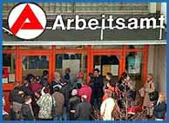
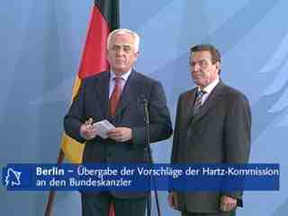
Forging of statistics at PES Bundesanstalt für Arbeit provides the window of opportunity for labor market reforms in 2002
2002 „Placement Scandal“
„Hartz“ – Commission and Laws 2002-2005
Federal Audit Court discovered in 2002 that Federal Labour Office had forged placement statistic
Chancellor Gerhard Schröder installs a government commission to propose changes in labor market policy
What started to redesign the institutional setup of the Federal Labour Office …
… became a big change in welfare state design
Commission named after former Volkswagen board member Peter Hartz. Commission results led to 4 laws:
Hartz I: Redesign of new ALMP measures (2003)
Hartz II: Reform of mini-jobs and introduction of “Me-Inc.”, Deregulation of Temp-Agency Work (2003)
Hartz III: Re-Organization of Federal Labor Office into Federal Labour Agency (2004)
Hartz IV: Merging of tax-
financed, means-tested
benefits into “Basic Income
Support” (2005)
Source: Konle-Seidl (2008)

Slide 6
The ambitious Hartz reform package has been continuously amended politically and constitutionally since 2005
“Hartz” Reform Package
(2002-2005)
Law | Regulation Area
Hartz I (2003) | Temp-Labour law relaxation Public temp-labour agencies | Training vouchers Reform of professional training
 | Stronger work-requirements More flexible sanctioning | Early UnE notification requirement Higher maintenance requirements of family members for beneficiaries
Hartz II (2003) | Self-Employment (“Ich-AG”) Mini-(<400€) and Midi-(<800€) Jobs | Introduction of Job-Center Joint Delivery Structure of FLA/Municiapal.
Hartz III (2004) | Restructuring of Federal Labour Office into Federal Labour Agency
Hartz IV (2005) | Merging of Unemployment Assistance and Social Assistance into Basic Income Support for Unemployed Jobseekers (Unemployment Benefit II)
Post-“Hartz” Adjustments
(2006-today)
2008: Extension of maximum duration of social insurance Unemployment Benefit I for 58+ year-olds to up to 24 months
2007: Constitutional Court (CC) declares joint delivery units unconstitutional
2010: Constitutional amendment to allow joint operation / greater role for Länder
2011: Reduction of ALMP-spending in light of evaluation results
2011: Inclusion of “Education and Cultural Inclusion” package (after CC ruling)
2014: Likely expansion of independent (“Option”) municipal delivery model
6

Slide 7
The 2003-2005 reform package: Re-organized Federal Labour Agency, merged benefits, more activation, labour law reform
(1) Redesigning the
Federal Labour Office
(2) Merging and Shortening of Benefits /
Focus on Activation
Reorganization of public employment services (Federal Labour Agency)
Improved service standards
Joint delivery structures with municipalities for Basic Income Support
Comprehensive evaluation scheme (increasing relevance to policy makers)
Shortened duration of initial UnE-insurance benefit to 12 months*
Merged tax-financed benefit into single lump-sum transfer (with in-work allowance) and defined broad eligibility base (all 18-65 year-olds, able to work > 3h / day)
Linked benefits and sanctions to matching, activation and training services
Required mutual responsibilities – proactive behaviour of the unemployed
(3) Labour Market Reform / Self-Regulation
Deregulation of the temporary work sector
Allow exemptions from restrictions on fixed-term contracts and dismissal protection
But: No fundamental switch away from German cooperative capitalism model, e.g. flexible handling of work hour accounts agreed within collective-bargaining system
* Duration extended to 24 months for over-58 year old workers in 03/2008
7
Notes:
7
7

Slide 8
Post-2005 model was simplified to a two-tier system between social insurance and social assistance
Federal
Labour
Agency
(FLA, “Bundes-
agentur”)
(24)*
(insurance-
financed)
Federal
Labour
Office
(“Bundes-
anstalt”)
SGB III
Primary Focus of this presentation:
Basic Income Support (BIS)
Basic Income
Support /
391
FLA
110
SGB II
FLA
Continuation of old „Social Assistance“ as SGB XII for recipients not-capable of working and 65+years traditionally funded by municipalities. **
Note: SGB II, III and XII refer to the respective chapters of the German Social Code
(SGB = “Sozialgesetzbuch”)
* Over-58 workers receive 24 months of UB I
** Funding of SGB XII for > 65 years to be covered increasingly by federal government
(full payment in 2014)
8

Slide 9
Post-reform labour-market performance: resilience and agility in the 2008/2009 economic crisis
External benefit: Labour market reforms coincided with pre-crisis growth period of 2004-2008
Today: Highest number of employed persons in post-war history
During crisis: Labour hoarding by businesses during crisis (anticipation of qualified labour shortage)
Economic cycle, demographic shift and stronger activation policies explain positive labour market performance in Germany
Source: SVR 2014
9
Notes:
Note: Main crisis year (GDP declined in 2009 by 4,7 %)
9

Slide 10
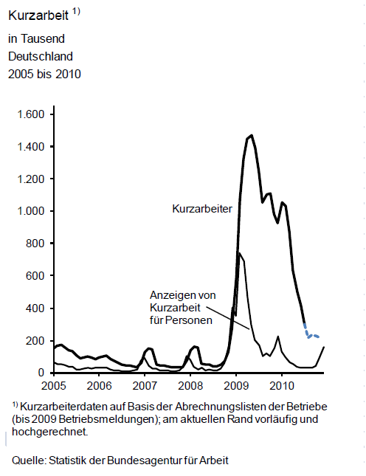
Federal Labor Agency was able to quickly scale-up short-shift scheme in 2009 and complement other adjustment channels
„Short-Shift“ in Germany
2005-2010
(thousands)
Short-shift-scheme Participants (“Kurzarbeiter”)
Short-shift program has been in place since 1950s, wide-spread use in East Germany in 1990s, by 2008 “an almost forgotten instrument”
During crisis, ease of application process & active outreach to employers, subsidization of social security contributions and extension of eligibility
Short-shift scheme > €10bn in 2008-2010 from FLA (additional cost borne by businesses)
Wide-spread use of work-hour accounts
(available to 51% of German workers)
Despite the headline-role of short-shift-scheme, intra-firm adjustment levers played a greater role in the 2008-2009 crisis (amount of hours reduced):
∼ 25% short-shift scheme
∼ 40 % work hour accounts and reduced overtime
∼ 40% employer-initiated work-reduction
Total Persons in „Short-Shift“
New Additions to „Short-Shift“
Source: Federal Labour Agency (BA)
Note: Survey responses allowed for overlapping categories, answers add to > 100%
Source: EU 2011 / IAB 2009
10
Notes:
Note: Main crisis year (GDP declined in 2009 by 4,7 %)
10

Slide 11
Despite all-time labour force participation high, long-term unemployment and low-paid jobs feed into income inequality
Of a total population of 82m, 41m were participating in the labour force in Q2/2011. Highest post WWII absolute number. Amongst other factors …
  Improved matching / activation via reforms
  Improved Labour Force Participation of 55+ and women
  7.3m “Minijobs” (≤400€) in labour force*
Increase of inequality and poverty
Integration difficulties of long-term unemployed
Of 1.17m labour market entrants from Unemployment assistance (UB II) benefit in 2008
  > 50% entered jobs with in-work benefits
  13% returned to benefit within 6 months
2000→2005: strongest increase of inequality in OECD
Gini Germany (1985→2005:
0.257 → 0.298)
Source: OECD (2008)
* IAB 2012: Monthly earnings below 400€, limited taxes and social insurance contributions paid, approx. 5m Minijob only, approx 2m combination of full employment with Minijob
11
Notes:
Increase of inequality and poverty mainly attributable
… to knock-on effects of structural unemployment (→ prior to LM reforms), and
…to generally stalling or falling wages since mid-1990s (→ German wage competitiveness!)
Note 1: OECD denotes OECD24
Note 2: 1985 and 2005 denote “mid-80s” and “mid-2000s”
11

Slide 12
Current Challenges in the Joint Delivery of Labor Market Services and Social Assistance in Germany
Labor-market and reforms in Germany
All together now: governance of labor market and social inclusion programs
Linkage to social assistance: joint delivery of income support with municipalities
Beyond payments: labour market services and programmes
Current developments and challenges
12

Slide 13

Policy making and agency steering:
Federal Ministry of Labour and Social Affairs
Minister:
Andrea Nahles
Minister
DG Political Coordination
2 Political- /
2 Administrative- State Secretaries
Mission
Responsible for policy and legislation in labour market policy, labour law, occupational safety and health, pensions, social security at large, disabilities.
Steering of agencies: Federal Labour Agency, Federal Social Court, Federal Labour Court, Federal Insurance Office, Federal Institute for OSH
DG Central Services
(HR, Budget, Organisation, ESF)
DG II
(LM Policy, UnE-Insu-rance, SA for Jobseekers)
DG IV
(Social Insurance, Pensions, SA in general)
DG VI
(European and International Affairs)
DG I
(Basic Issues of the Social State)
DG III
(Labour Law, OSH)
DG V
(Disabilities, Rehabilitation)
Budget and Core Staff
∼ € 130bn p.a.
(∼ 40% of fed. budget)
∼1.000 Staff
Main DG’s tasked with Labour Market Policy / Steering of FLA
13

Slide 14

Federal Labor Agency employs 600+ staff in HQ and directs services, products, standards and core processes
Simplified View
Research Institute IAB
Executive Board
Staff council
Board of Governors
FLA University
Staff Functions, Press, Internal Control,
Berlin and Brussels Offices
“BM”
Cooperation Management Basic Income Support
“PEG”
Product Development Basic Income Support
“CF”
Controlling and Finance
“POE”
Personnel and Organi-zational Development
“IT”
IT-Steering
“OS”
Operational Services
“MI”
Labour Market and Integration
Cooperation models with municipalities
Joint Delivery of Basic Income Support
Management support for Joint Delivery Unit heads
ALMP design for UBII clients
Product develop-ment payment and legal solutions UBII
Medical and Psychiatric Service
Controlling, impact
evaluation
Finance
Statistics
Labour market analysis
Infrastructure
HR policies and development
Leadership development
HR law
HR Service
Organizational development
IT strategy
IT demand management
IT security
Payment-related services
Electronic file and work-flow management
ALMP design for UB I clients
ALMP for youths
Management support and labour market analysis
Family Benefit Offices
Real Estate Manage-ment
BA Service House
IT Systems House
Intl. Placement Service
14

Slide 15
Post-2011 governance model for joint local delivery units introduces a stronger role for state government
Simplified Model View
Federal Ministry of Labour and Social Affairs (BMAS)
Targets
Executive Agency
Co-operation Committee
Federal-State Committee
Legal Framework
Federal Court of Accounts
State Ministry of Labor & Social Affairs
Assembly of Owners (Local)
Joint Agency (LOCAL)
Control / Audit
Representatives
Representatives
Targets
Managing Director
Targets
City Government
Local Staff
FLA Staff
Federal Labour Agency
Advice
Advisory Board
(Academia, Chartered Charities, City Council members, Trade Unions, Chamber of Commerce, …)
15

Slide 16
Background information: High-level financing flows for Social Insurance and Social Assistance in Germany (€bn, 2010)
Federal Government
Federal Labour Agency /
Joint Delivery Units (ARGE/gE)
ALMPs -8,0
UB I
(SI)
Federal Support of ALMPs +8,0
Payor Contributions +23,0
Other +6,0
Revenue SI +37,0
ALMPs (incl. job-placement) -20,0
Unemployment Benefit I -17,0
“Integration”-Payment -5,0
Other -3,0
Spending SI -45,0
Deficit SI - 8,0
Payroll Contributions
Employees / Employers
„Compensation“ for transition from SI to SA
+5,0
Break with contribution / fiscal logic
UB II
(SA)
Joint Delivery Units ARGE/gE
Unemployment Benefit II 19,5
Housing Cost* 14,5
ALMPs** 5,0
Admin-Cost 3,8
Total Spending 42,8
Municipalities
Benefit 19,5
11,7
Housing Cost 2,8
ALMPs 5,0
1,1
Admin 2,7
* Measure of total-system housing cost not consistent with local 26% federal / 74% municipal cost share owing to “Option/zkT” delivery model in some localities
** of which: Public-Employment-Schemes 33%, Employer-Subsidies 20%, Training 16%, Job-Placement 12%
16

Slide 17
Hartz reform increased the number of SA beneficiaries in 2005 –
share of Social Insurance beneficiaries now in decline
Number of “classical” unemployed in constant decline
“Hardening” of stock of hard-to-serve cases in Basic Income Support population
6,71
6,84
6,36
Share of Social Insurance Beneficiaries
5,93
5,49*
25%
15%
3,91
4,04
Million Beneficiaries
3,59
Basic Income Support covers 5.7% of population in Germany (including 1.4m in-work-benefits)
In addition: 2.6m recipients of “Sozialgeld” and “Sozialhilfe” not able and required to work (3.1% of population)**
3,16
3,21
50% of which registered as unemployed
Source: Konle-Seidl 2009, BMAS 2010, OECD 2010, FLA 08-2011, Federal and State Statistical Offices 2010
* 90,000 cases of double-benefits UB I and UB II eliminated from summation
** Sozialgeld (SGB II transfer for dependents not able and required to work) 1.8m beneficiaries, Sozialhilfe (SGB XII transfer mainly for old-age income support) 0.8m beneficiaries (2008 data)
17

Slide 18
Current Challenges in the Joint Delivery of Labor Market Services and Social Assistance in Germany
Labor-market and reforms in Germany
All together now: governance of labor market and social inclusion programs
Linkage to social assistance: joint delivery of income support with municipalities
Beyond payments: labour market services and programmes
Current developments and challenges
18

Slide 19


Basic Income Support mainly delivered via cooperation of Federal Labour Agency (FLA) and municipalities
Model for majority of localities
Approx. 330 “ARGE/gE”* joint delivery units established between FLA and municipalities
  110 “option” municipalities deliver services by themselves (without FLA)
ARGE/gE merges two logics:
  Central: labour market, integration, training, standards, controlling, etc.
  Local: social worker logic, focus on individual, neighbourhood work, etc.
Central data and controlling systems supposed to ensure results-orientation of the organization (but often resisted from local / state level!)
Evaluation shows success factors:
  Intensive and activating case management
  company-based training / activation measures
  linkage to social services (with problems!)
Joint
Delivery Structure
Municipalities and
local job FLA office
working together on:
Benefits
Training Schemes
Job Placement
Additional Social Services
…
* ARGE = Arbeitsgemeinschaft (pre-2010 term), gE = gemeinsame Einrichtung (post 2010 term)
19

Slide 20
Despite two parallel local delivery setups, federal regulations ensure a minimum compatibility via joint base systems
Municipalities fear too much central steering …
Conceptual
low
335 Joint
Agencies “gE”
110 “Option”-Municipalities
Municipalities and
local job centers (FLA)
work together
Municipalities / counties deliver all services and
all placement services
on their own
Degree of Centralization
… and continuing lack of transparency and accountability in “Option” municipalities
… while federal level fears too much deviation.
Benefit Calculation & Payment
Registers, IT-Systems (Verbis/A2LL) & Operating Standards
high
Data / Statistics Standards (X-Sozial)
20

Slide 21
Job-Centres are embedded into an increasing web of accountability …
Financial
Outcomes
Procedures
Joint
Delivery Structure
Political Decision Makers
Superior Administrations
Legal Rules
Corporatist Governance
Professional Standards
… driving more municipalities to the stand-alone “Option” model and challenging the limit of 110 “Option” municipalities
Note: Adopted from Jann (2012)
21

Slide 22
Split benefit payment responsibility between federal and local level can lead to load-shifting incentives
BIS recipient /
not working
but able to work
BIS recipient with
in-work benefit
Payment Responsibility
(2) Municipality has incentive to maintain “able to work” status in order to prevent shifting to 100% municipally financed Social Assistance
Work-Income
(1) Split payment can reduce incentive for FLA to move in-work benefit recipients to full employment …
100% Federal
Government
(through Federal
Labour Agency)
Basic Income Support
(364€ / month)*

Basic Income Support (In-Work)
(2) … but stronger activation regime in FLA-driven Joint Delivery Units overplays this effect on the macro level
Housing and Heating Allowance
(depending on
housing cost)
Housing and Heating Allowance
(depending on
housing cost)
26%* Federal Government
74% Municipality
** Note: 26% federal cost share in housing and heating allowance is average number, varies slightly by state.
22
Notes:
* Note: Formerly 359€/month. Raise of 5€ introduced in 03/2011. Raise of 3€ agreed for 2012.
** Note: 26% federal cost share in housing and heating allowance is average number, varies slightly by state.cc
22

Slide 23
Inter-level cooperation … complicated, but an institutional reflection of German “coordinated capitalism” model
Governance model driven by constitutional framework of Germany
  … no direct cooperation allowed between municipal and federal level
  … Federal Government could not pass on money directly to municipalities
  (→ second best solution: federalize some expenditure blocks altogether)
Governance and management model coordinates among …
  … levels of government (federal, state, local)
  … different political and labour market actors (local employers associations, chambers of commerce and crafts, unions, semi-public welfare-providers, local elected representatives, etc.)
Joint delivery model is not without risks. Cases of institutional deadlock, management burnout and failure have been wide-spread initially. What worked in the Mannheim case: De-facto alignment of local ARGE along FLA work standards and outcome monitoring, combined with targeted involvement / co-optation of local semi-public welfare providers.
23

Slide 24
Activation regime covers the social assistance population in Germany only partially
Indicative numbers 2010
# of persons | UnE Insurance UB I (SI) |  | Basic Income Support UB II (SA) |  | Other
In-Work Benefit |  |  | 1.4m
Unemployed (able (and required)* to work) | 1.0m |  | 2.0m
Inactive (able, but not required to work) |  |  | 1.4m
Totals UB I and UB II | 1.0m |  | 4.8m
“Social Money” (SGB II) (unable to work but living with UB II recipient) |  |  | 1.8m
“Social Assistance” (SGB XII) (unable to work or >65years) |  |  |  |  | 0.8m**
Asylum benefits / war veterans |  |  |  |  | 0.2m***
Total Basic Income Population |  |  | 7.6m (=9.3% of pop)
other: Youth Benefits (SGB VIII) **** |  |  |  | N.N. [6.4bn€ / 0.27% GDP]
other: Handicapped (SGB XII) |  |  |  | 0.8m [11.2bn€ / 0.48% GDP
Core Area of Activation Regime
35bn€
4.3bn€
1.1bn€
40.4bn€
∼1.7% GDP
* UB II only
** 85% of whom are >65years
*** 127k Asylum Seekers, 46k War Veterans and spouses
**** HzE-Benefit. No federal-level case numbers available, spending data only.
Sources: Destatis 2010, FLA 2008 and 2010
24

Slide 25
Segmenting the target group:
A closer look to the activation target group
Indicative numbers 2010
# of persons | UnE Insurance UB I (SI) |  | Basic Income Support UB II (SA)
In-Work Benefit |  |  | 1.4m
Unemployed (able (and required)* to work) | 1.0m |  | 2.0m
Inactive (able, but not required to work) |  |  | 1.4m
Core Area of Activation Regime
In-work beneficiaries / “Aufstocker”
55% earn <400€
93% employed
#’s increased +43% 2005/2009
“Limited Activation”
Contribution-based UnE insurance payment provides more “social rights”
Core Unemployed Basic Income Population
41% Long-Term Unemployed (> 12 months)
Male/Female-ratio 50:50
20% of households with children are in BIS / UB II
(54% of which single-parents, mostly mothers)
East / West Germany-ratio 35/65 (pop-ratio is 20/80)
Of total BIS / UB II population (4.8m) …
  2.1m Entries (of which 50% returnees (in 12 month period))
  2.4m Exits
“Not required to work”
e.g. mothers with children in first three years (→ hum-cap loss leads to dependency lock-in)
25

Slide 26
In between social assistance and jobs: rising number of “in-work” benefit recipients strains administrative resources
Number of In-Work Benefit Beneficiaries (million)*
Basic Income Support acts as a de-facto in-work benefit via generous initial earnings disregard
Numbers of in-work beneficiaries have increased in absolute and relative terms
Majority in “Minijob”, not paying taxes and social insurance contributions
Anecdotal evidence suggests combination of “Minijob” with undeclared income / grey-economy work and intention to avoid further activation measures
In-work benefit administration / calculation often crowds out job-placement work of case-officers
29%
23%
xx%
Share of in-work beneficiaries in total
Basic Income Support population
In-Work Benefit Beneficiaries by Income Group (2008)**
** 2011 data follows similar distribution Jobs with
Social Security (Health, Retirement, Care)
contributions can be full or part time
Source: FLA Statistics 2010
* 2007 annual average, 2011 June data
26
Notes:
Increase of inequality and poverty mainly attributable
… to knock-on effects of structural unemployment (→ prior to LM reforms), and
…to generally stalling or falling wages since mid-1990s (→ German wage competitiveness!)
Note 1: OECD denotes OECD24
Note 2: 1985 and 2005 denote “mid-80s” and “mid-2000s”
26

Slide 27

Local job-centre example: clients, staffing (ratios) and budget
62
U25
Expenditures 2010 (approximate)
Basic Income Support / Social Assistance: € 66 m
Housing and Heating Allowance: € 65 m
Total: € 131 m
7,398
Unemployed
14,658
Communities of Need
Job-Centre staff: 356 total
148 Federal Labour Agency
(of which 58 case managers)
191 Municipality
(of which 132 case managers)
17 Vivento (Dt. Telekom personnel agency) – 3 case managers
Case Managers: 193 total
Average of 100 cases per manager
Case load U25: < 75
Case load “intensive” parts of city: ~30
Case load >55: ~200
19,691
Needy persons capable of gainful employment
27,850
Total number of persons in need
Approximately 1 in 11 Mannheim residents receives Basic Income Support
Source: FLA Mannheim, Monthly Reports 12/2010 and 03/2011
Note: U25 = “under 25 years” | >55 = “Over 55 years”
27

Slide 28
Typical service arrangement for employment service delivery in local job-centre
Case management jointly organized across placement and benefit calculation (separated functions in majority of German ARGE). Now teams being aligned to neighbourhoods.
4
Young Mannheim (<25 years)
1
Welcome Zone
3
Anchoring importance of labour market integration in local neigh-bourhoods. Providing accessible offices in suburbs.
2
MEAS – Initial Application
General business rule: Every applicant leaves the ARGE with a concrete offer / task.
5
Neighbourhood Job Marts
28

Slide 29
Current Challenges in the Joint Delivery of Labor Market Services and Social Assistance in Germany
Labor-market and reforms in Germany
All together now: governance of labor market and social inclusion programs
Linkage to social assistance: joint delivery of income support with municipalities
Beyond payments: labour market services and programmes
Current developments and challenges
29

Slide 30
FLA and joint delivery units operate client handling via a single four-phase segmentation model for SI and SA clients
Phase 1
Profiling
Phase 2
Set Targets
Phase 3
Plan Action and ALMP Deployment
Phase 4
Action and follow-up
Segmentation of client into one of six client groups
Unified segmen-tation logic for UB I (social insurance) and UB II (social assistance) clients
Labour market integration
Publicly supported employment (outside of LM)
Secondary Education, Apprenticeship, Tertiary Education
Stabilization of current employment
Depending on targets, map out action plan for jobseeker …
… and plan deployment of ALMPs
“Integration agreement” written and signed
Action items defined for case manager and client
Follow-up and reporting points agreed
30

Slide 31
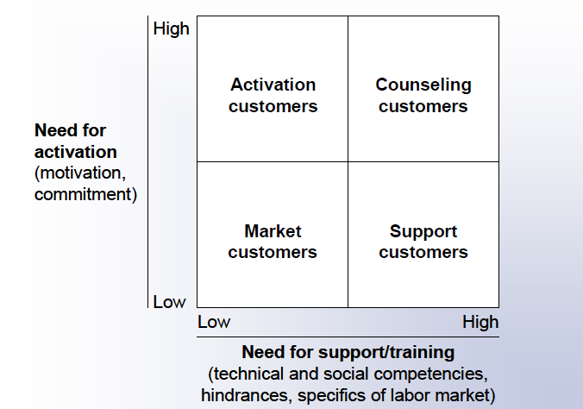
Profiling and job counselling 1/2: Initial FLA segmentation relied on a four-field model for customers (2005)
Experience has shown that further differentiation was needed to support clients with high activation and training needs.
31

Slide 32
Profiling and job-counselling 2/2: segmentation methodology was further differentiated for Basic Income Support (2010)
Further Differentiation
of Segmentation
32

Slide 33
Scale-up and professionalization of employer service function has been essential for job placement activities
Sample publications / services / events
of Employer Service
FLA Employer Service
From passive “collection of vacancies” to active canvassing and outreach to employers
Key account management structure enables FLA to serve large employers with multiple sites and differentiated HR needs
Employer service actively markets jobseekers to employers and facilitates placement with limited wage subsidies
Improved employer service allowed swift scale-up of crisis-response ALMPs (e.g. short-work scheme) and active information especially of SME employers about possibilities for crisis-response
Future: greater emphasis on partnering with employers to fill human resource needs
(→ still to be developed!)
Networking Events for HR Professionals
Monthly Employer Magazine
International Promotion Campaign for Skilled Staff
33

Slide 34
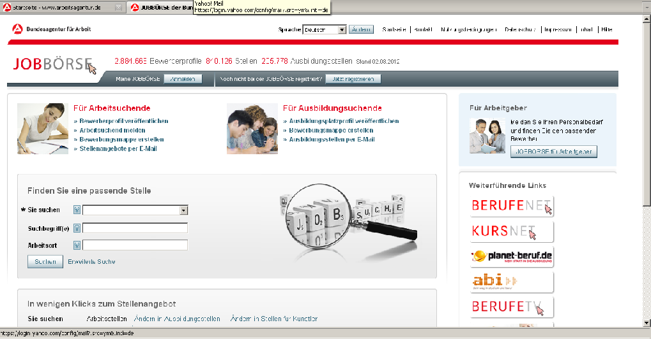
Online Job Portal “Jobbörse”: Over 1m jobs entered via FLA or direct employer entry p.a.
Number one employment portal in Germany
Approx. 1m jobs in system
Employers are encouraged to enter jobs directly
Self-help tutorials with video and audio support teach employers and job-seekers to use “Jobbörse”
34

Slide 35
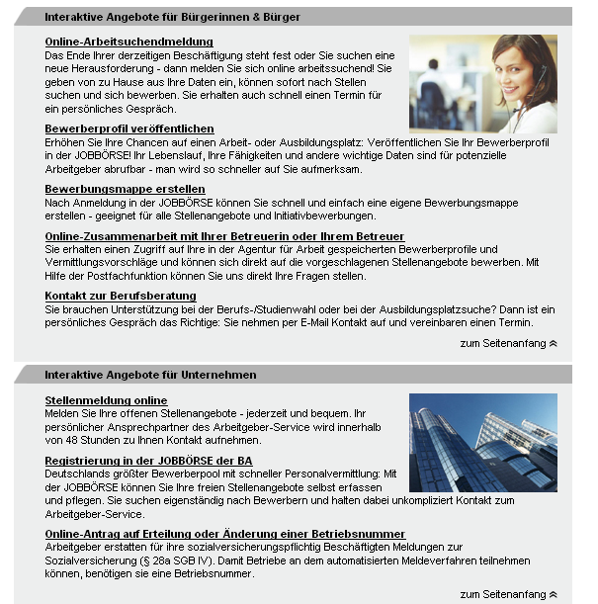
FLA website provides high-volume transactions as e-services to jobseekers and employers
Jobseeker
e-services
Online registration as jobseeker / unemployed
Register jobseeker profile in “Jobbörse” online portal
Online collaboration space with case managers – direct application to proposed jobs
Employer
e-services
Register employment opportunity in “Jobbörse” online portal
Update / register company to receive FLA “employer number”
35

Slide 36
Selected examples for ALMPs of Federal Labour Agency (2011) and indicative cost-per-person in ALMPs
Program | Description | Number of Participants (‘000) | Indicative Annual Budget Spent (€m)
Placement Budget | flexible use of funds to support take-up of employment (e.g. initial mobility grant, work-equipment) | 1,980 | 254
Activation Seminars and Temporary Work Placements | participation in training, motivation and orientation activities depending on personal situation (35% of programs employer-based) | 1,040 | 634
Wage subsidies | Temporary subsidization of wages for hard-to-place jobseekers | 177 | 786
Self-employment grant | Former “Me-Inc” benefit / phased down in 2011 ALMP realignment | 144 | 1,730
Early retirement grant | Program being phased out since 2010, current beneficiaries remain | 87 | 1,300
…
130€ p.p.
610€ p.p.
4,400€ p.p.
12,000€ p.p.
15,000€ p.p.
Note: Participant numbers for Unemployment Insurance (UB I) and Basic Income Support (UB II) clients cumulated. Cost-per-person based on author’s calculation and rounded.
Source: FLA Annual Report 2011
36

Slide 37
Outsourcing concerns approx. 10% of job matching and below 20% of ALMP spending in Germany
Although fraud (false statistics) and placement underperformance (only 10% of FLO staff engaged in “placement” prior to 2003) were the triggers to the Hartz reforms …
… these functions have not been subject to outsourcing on a major scale
  Private providers / vouchers accounted for approx. 13% of placements recorded within the FLA statistics in 2006 (no different dynamic today).
  Use of private placement providers mainly capacity-driven, not capability-driven
  Overall spend on subcontracted ALMPs in Germany is below 20%, compared with approx. 2/3 in United Kingdom or Netherlands
While Hartz I-III impact evaluations have shown some positive effect of voucher systems, there was and is no political support for “privatized” employment services
Outsourcing mainly concerns delivery of ALMPs (Training, Job rotation and job sharing, Employment incentives, etc.) vs. core job placement functions
Delivery of social services in municipalities via semi-public welfare providers (“Wohlfahrtsverbände”) cannot be classified as outsourcing owing to generally collusive buyer/provider relationship
Sources: FLA 2010,, PolicyExchange (Hilmar Schneider) (2008), Dan Finn (2011)
37

Slide 38
Current Challenges in the Joint Delivery of Labor Market Services and Social Assistance in Germany
Labor-market and reforms in Germany
All together now: governance of labor market and social inclusion programs
Linkage to social assistance: joint delivery of income support with municipalities
Beyond payments: labour market services and programmes
Current developments and challenges
38

Slide 39
Labor market / social safety net reforms in Germany: main axes of action and general lessons learned
From status maintenance and long benefit durations to labor market integration
(from “worker citizenship” → “social citizenship”)
From labour market reforms only to parallel changes in labour market governance AND intra-firm flexibilization and new HR practices
From segmented populations to one pool of beneficiaries and delivery channel
From flexibility at the margins (pre-2005: mini-jobs) to flexibility at the core of the labour market (erosion of collective bargaining, deregulation of temp-labour)
From old-school bureaucracy to applied New Public Management
Invest into case management and placement-oriented activation measures
Invest into capability of the Public Employment Service (PES)
Allow for local variance via cooperation-model with municipalities while keeping central systems (data standards / reporting) strictly central without compromise
Be prepared for a jump in recipients when including the inactive
Make evaluations a mandatory piece of policy and bank on long-term secondary effects (data availability, better ALMPs) even without immediate policy-advice impact
39
Notes:
- FLA proposed 10-point plan in early 2011
39

Slide 40
THANK YOU / VIELEN DANK!
The World Bank
Europe & Central Asia Region
Human Development Unit / Social Protection Sector
Ulrich Hoerning
Senior Social Protection Economist
uhoerning@worldbank.org
Tel: +1 202 473 4972
40

