Slide 1
Advanced Profiling of Unemployed in Public Employment Services
A Critical Review of OECD Experiences and Applications for Western Balkans
Vienna, March 4, 2014
Artan Loxha
Social Protection Unit
Europe and Central Asia Region

Slide 2
Outline
    Profiling in the context of activation
    Best practice profiling methods in OECD
    Statistical profiling and applications
    Relevance for Western Balkans

Slide 3
Outline
    Profiling in the context of activation
    Best practice profiling methods in OECD
    Statistical profiling and applications
    Relevance for Western Balkans

Slide 4
Key elements of activation
Activation models
Mutual obligations principle
Key elements of effective activation
PROFILING
Liberal model
Social democratic model
Continental corporatist model
Enhanced responsibilities of the unemployed
- Active job search and availability for work in return for income support
Provision of income support
- Access to income support and to public employment services
Individualized action-planning
Focus on high risk prioritization
Service integration between PES and SA
Enhanced performance-based sub-contracting
Restricted ALMPs to incentivize jobseeker
Operationalizing legislation through 4 main elements of activation
Extensive services and high benefit levels and coverage
Individual responsibility to mobilize own assets, with key state role
Notes:
Activation is based on mutual obligation. It is revolutionary in the senste that many countries before provided support, but no respobsile, ro no support because they were concered with incentives.
The mutula obligation is legislation based, but how to get there in practice?
There are 4 main elements
Liberal model, hard/punitive activation (USA, UK)
Relationship of jobseeker with labor market by itself yields social equity and efficiency
ALMPs/social policies restricted to incentivizing the individual to seek work through provision of quick information and matching services, and investment in short-term vocational training
Universalistic social democratic model, soft/reward-based activation (Sweden, Denmark)
Concerned with provision of complex and extended services, and guaranteeing relatively high living standards and benefit levels to lower paid sections of labor force close to minimum wage
Continental corporatist model (France, Germany)
Individuals responsible for mobilizing their own assets, while state has role to play to allocate such assets that encourages individuals to do so

Slide 5
The traditional role of the PES
Interventions
HIGH
Intensive counseling and special ALMPs

Vocational training
Level of prioritization by caseworker
Self-service and job matching

Traditional PES client: the unemployed
LOW
1
Income support/Job matching
Time

Slide 6
Reinventing the role of PES in the context activation
Early interventions
PROFILING
Interventions
HIGH
2
HIGH

Intensive counseling and special ALMPs


High risk group


Work-able vulnerable population
1
Vocational training
Level of prioritization by caseworker


Middle risk group
Distance from labor market

Self-service and job matching

Low risk group
Traditional PES client: the unemployed
LOW
LOW
1
Income support/Job matching
Time

Slide 7
Main uses of profiling
Caseworker
Interventions
$
HIGH
2
HIGH

Intensive counseling and special ALMPs


High risk group


3
Vulnerable work-able population
1
Referral
Vocational training


Middle risk group
Level of prioritization by caseworker
Redistributing resources based on severity of profile
Distance from labor market

Self-service and job matching
Low risk group
LOW
LOW
Client segmentation
Targeting
Resource planning

Slide 8
Profiling involves certain information asymmetries
Caseworker
Interventions
HIGH
2
HIGH

Intensive counseling and special ALMPs


High risk group


3
Vulnerable work-able population
1
Referral
Vocational training


Middle risk group
Level of prioritization by caseworker
Distance from labor market

Self-service and job matching
Low risk group
LOW
LOW
Information asymmetries
Notes:
Jobseeker interested only on benefits and may not reveal key information in interview;
PES caseworker: may be critical of having profiling tools prescribe choices; may strategically categorize easy to place with hard to place
Provdiers: attempt to cream-skim easy to place by miscategoizing

Slide 9
Outline
    Profiling in the context of activation
    Best practice profiling methods in OECD
    Statistical profiling and applications
    Relevance for Western Balkans

Slide 10
Approach for studying OECD best practices
1: Stock-taking
Identify models that could be applicable to Europe and Central Asia (ECA) PES, and test them through analysis of administrative data
Share knowledge with PES in ECA region and explore possible pilots
4: Dissemination
Partner with Public Employment Services (PES) in OECD countries to capture best practices on jobseeker profiling
3: Sharing with clients
Enhance knowledge of all stakeholders through a Knowledge Brief, analytical paper, and conference
2: Adaptation

Slide 11
Methodology
Countries
Study tour
Desk research
PES material
Australia
Canada
Denmark
Finland
Germany
Ireland
Netherlands
Slovenia
South Korea
USA
Sweden
Switzerland
OECD activation country notes
EU PES-to-PES dialogue papers
Country-specific papers on profiling
Selected academic papers
Methodological notes on statistical profiling
(selected examples)
Technical description of JSCI (AUS)
Employee-focused Integration concept (GE)
The Dutch Work Profiler (NL)
Slovenian profiling system (SL)
Ireland, Department of Social Protection
Denmark, National Labor Authority
Sweden, Public Employment Service

Slide 12
Key approaches to profiling in OECD
Approaches | Description | Pros/Cons | Country examples
Caseworker-based segmentation | Profiling and referral done primarily by the caseworker | Pros: individual needs Cons: subjective assessment | German 4-phase model
Time-based segmentation | Segmentation based on threshold in length of unemployment spell | Pros: straightforward Cons: resource waste, ignores heterogeneity. | Ireland’s “wait-and-see” approach prior to the crisis
Demographic segmentation | Segmentation based on eligibility criteria | Pros: straightforward Cons: ignores heterogeneity | Swedish Youth Job Program
Statistical segmentation | Segmentation based on statistical analysis using MIS data | Pros: ex-ante equal treatment, early interv., resource rationing Cons: misidentification | USA’s Worker Profiling and Reemployment Services Irish profiling system
Behavioral segmentation | Evaluation using behavioral assessment tools | Pros: greater private information Cons: subjective | German Kompetenzdiagnostik (competence diagnostics)
Notes:
Time base segmentation: Administrative rules stipulate the threshold in length of unemployment spell required for referral of jobseekers for services
Demographic seg: Administrative rules stipulate eligibility conditions based on observables such as age or gender for activating employment programs
Stats seg: Statistical methods analyze registry and survey data to segment jobseekers based on their predicted risk score of expected unemployment spell
Behiv seg: Use of psychometric evaluation techniques to maximize extraction of jobseekers’ private information related to their behavioral characteristics and attitudes
***********
European Commission papers have sought to differentiate among profiling systems largely based on purposes of profiling (client segmentation versus targeting and resource planning)
One way to regroup these methods in a coherent framework is to see how they interact in the case management process.
A need to develop a more systematic framework Profiling systems differ based on two broad variables: caseworker discretion and data sophistocation

Slide 13
Classifying profiling systems
Degree of caseworker discretion
Complexity of data flow and processing
Notes:
Having reviewed what the main approaches are in OECD, we embarked in a classification exercise to better understand the trade-offs involved in moving from one profiling category to another. Also to capture profiling methods diversity through two key institutional variables.

Slide 14
1. Data availability and processing
  Basic demographics
Labor market data
Complex data
Personal ID
Age
Gender
Children
Education level
Employment status
Duration
Special needs
Qualifications
Soft and hard skills
Motivation
Behavior
Health
Complexity of data and processing
Notes:
The firs axis considers the complexity fo ifnormation: the easier are those you already have, administratively, at the center you have those that you tend to collect for profilign the unemployed for matcihg, and the right side are information that are very specifica and will require a lot of new data collectin

Slide 15
2. Degree of caseworker discretion
HIGH
Degree of caseworker discretion
More likely to rely on caseworker-based diagnostics for segmenting jobseekers
Caseworker resistance to automation may be higher
More time-intensive and resource intensive
Requires higher capacity
However, caseworker’s discretion can be curtailed depending on how binding data processing is to their decision-making
More likely to rely on administrative rules and regulations for segmenting jobseekers
Less caseworker resistance to introducing other analytical tools may help address different constraints
LOW

Slide 16
Classifying profiling systems
HIGH
Caseworker-based profiling
Data-assisted
profiling
Degree of caseworker discretion
Rules-based
profiling
Data-only
profiling
Complexity of data flow and processing
LOW
LOW
HIGH

Slide 17
Key trade-offs
HIGH
Caseworker-based profiling
Data-assisted
profiling
Degree of caseworker discretion
Invest in more caseworkers
Invest in caseworkers and data
Higher caseworker resistance to automation
Rules-based
profiling
Data-only
profiling
Invest in data acquisition
Complexity of data flow and processing
LOW
LOW
HIGH

Slide 18
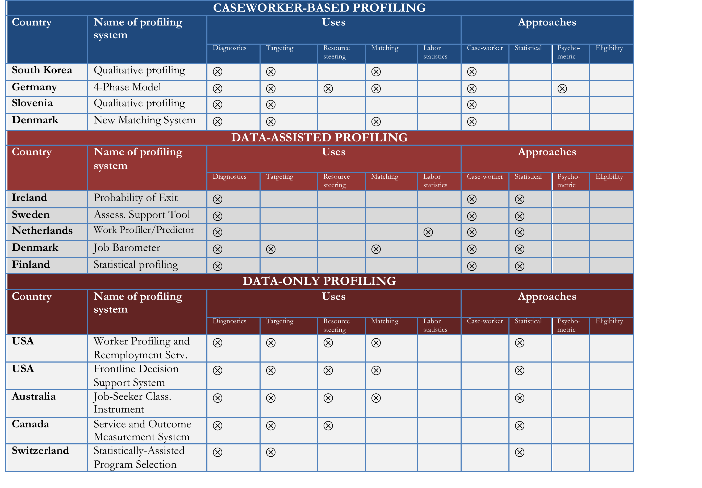
Profiling systems in OECD
Notes:
When caseworker discretion is high, and information flow is low, it gives rise to what we term caseworker-based profiling. The caseworker takes a lead role in diagnostics and treatment assignment, but the relatively limited availability of information does not readily permit individualized profiling. Assessment methods to profile jobseekers are largely qualitative and they require relatively less complex jobseeker information. OECD countries falling in this category include Germany, Denmark, South Korea, and Slovenia.
When caseworker discretion is low, but the information flow is high, it gives rise to data-only profiling. Under this typology, statistical profiling not only is the main and central tool for client segmentation/diagnostics, but also for automatically assigning treatment. It therefore plays a combined profiling and targeting function. The caseworker is constrained in her ability to the statistical recommendations. OECD countries falling in this category include USA and Australia, with Denmark (Job Barometer), Canada, and Switzerland having experimented before abandonment.
When caseworker discretion is high, and so is the information flow, it gives rise to data-assisted profiling. Caseworkers retain their central role in customer segmentation and treatment assignment, but where there is more intensive use of data for prior diagnostics of clients, which aids, but does not overrule, the caseworker who makes the final decision. Assessment tools include statistical profiling, psychometric/attitudinal screening, and soft-skills profiling. OECD countries falling in this category include Ireland, Sweden, Netherlands, but to the extent that psychometric screening is concerned, it also includes Germany.

Slide 19
Outline
    Profiling in the context of activation
    Best practice profiling methods in OECD
    Statistical profiling and applications
    Relevance for Western Balkans

Slide 20

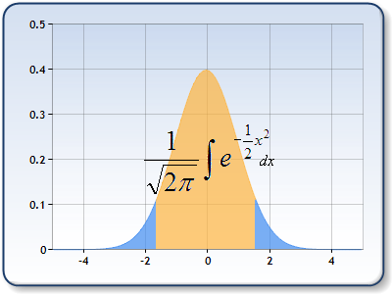
Statistical profiling: segmenting clients based on
likelihood of work-resumption
work-resumption
Outcomes
HIGH
Profiling model:
Binary or duration models
100
Little chance of reemployment
Data input:
MIS
Ad-hoc extra data
Risk of remaining long-term unemployed
Better chance of reemployment
2
Improved chance of reemployment
1
Best chance of reemployment
LOW
Notes:
This makles sense for many cleitns
We will go through the mecahnics and then discuss the why
Most common types used are probit/logit models
Dependent variables depend on policy objectives (LTU)
Basic regressors dependent on MIS – demographic, contribution and benefit history
But richer models needed ad-hoc surveys to capture other aspects (language skills, literacy, access to public transport, employment history, motivation)
Types of dependent variables depend on policy objectives (i.e. case of Ireland: the dependent variable is the “risk of remaining unemployed for 12 months”)
Types of commonly used independent variables: age, marital status, education, apprenticeship training, literacy skills, English proficiency, health, size of labour market, geographic location, access to public transport, employment history, job duration, previous unemployment claim history, etc.
Data
Administrative data (i.e. Live Register in Ireland): marital status, spousal earnings, location, occupation, etc.
Special supplementary questionnaires to collect information on possible covariates (claimant population for a year)

Slide 21

Intervention strategies by client profile and support intensity
Far
Missed
opportunities
Better chance of reemployment
Directive Guidance
Client Distance from Labour Market
Frequency of Intervention
Improved chance of reemployment
Reference to Personal Development
Job Search
Wasted
resources
Best chance of reemployment
Near
Self-Serve
Low
Intensity of Support
High

Slide 22
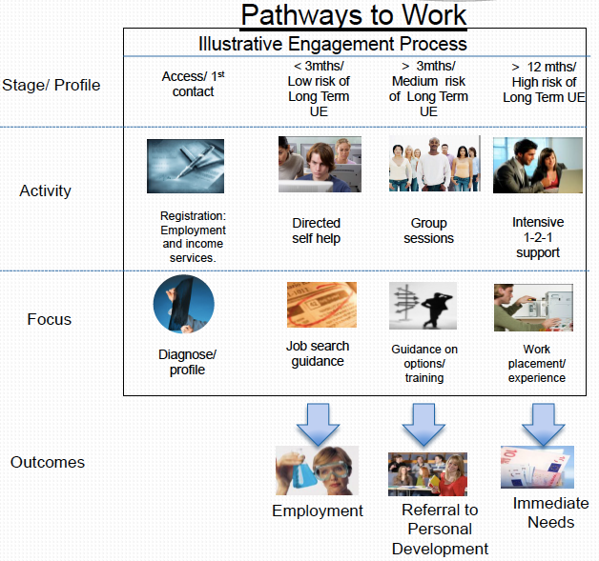
Ireland: statistical profiling for case management intensity
Notes:
Previously in Ireland:
Systematic referral from social assistance department to PES only after initial duration threshold crossed i.e. at 6 months
More than half of new entrants would exit by the 6th month
Actual interventions would materialize only after 8-9 months
Limited staff capacity to handle the largely undifferentiated inflow
With new reforms in Ireland:
Segmentation profiling allowing early identification of high-at-risk groups
Intensity of support dependent on level of unemployment risk
Ex-ante equal treatment and individualized support
Better utilization of scarce resources, reduction of dead-weight loss

Slide 23
Sweden: statistical profiling for ALMP prioritization
Registration and initial interview
Statistical profiling model
Segmentation based on risk groups
Final caseworker decision
Registration
GROUP 1
Very good employment prospects
GROUP 3
Weak employment prospects
GROUP 4
At high risk of LTU; early ALMP measures needed
GROUP 2
Good employment prospects
Assessment Support Tool
Caseworker likely to override regular procedures and provide early ALMP interventions
1
2
3
Notes:
Should have very good chances to find work
Should have good chances to find work
Consider more intensive support to enhance possibilities to work
Early ALMP measures needed to enhance possibilities to find work
Full-time activity for youth aged 16-24 years
Enter after 90 days of unemployment
Running for up to 15 months
First 3 months
In-depth assessment
Vocational guidance
Coaching (incl. private actors)
There after
Work experience
Vocational Training
Occupational rehabilitation
Job and Dev Prog
Phase 1 (0 – 150 days)
In-depth assessment
Job-search activities with coaching
Employment preparatory activities
Other programmes
Phase 2 (150 – 450 days)
Work experience
Occupational rehabilitation
Other programmes
Employment phase (Day 451 - )
Employment at provider
(Training)
AST
Opens up the possibility of early intervention (before entering the guarantees), including:
In-depth assessment and more frequent meetings
Vocational training
Work experience
Occupational rehabilitation
Employment preparatory activities
AST specifics
Variables:
Age, Functional impairment, Country of birth, Educational level, Unemployment Insurance, Month of registration, Years of last unemployment spell, Duration in last spell, Occupational classification, Work experience in occupation, Skills in occupation, Local unemployment rate,
Data:
Register data from public employment Service administrative records
Model specification:
Binary regression (probit-model) of the probability of becoming long term unemployed (six months)
Model usage:
Questionnaire filled while interviewing a job seeker at the first meeting

Slide 24
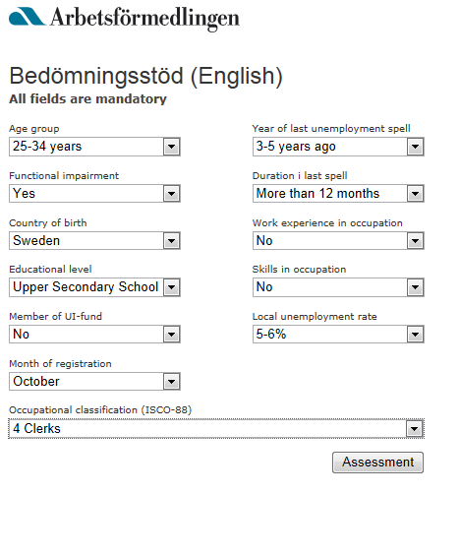
Assessment Support Tool

Slide 25
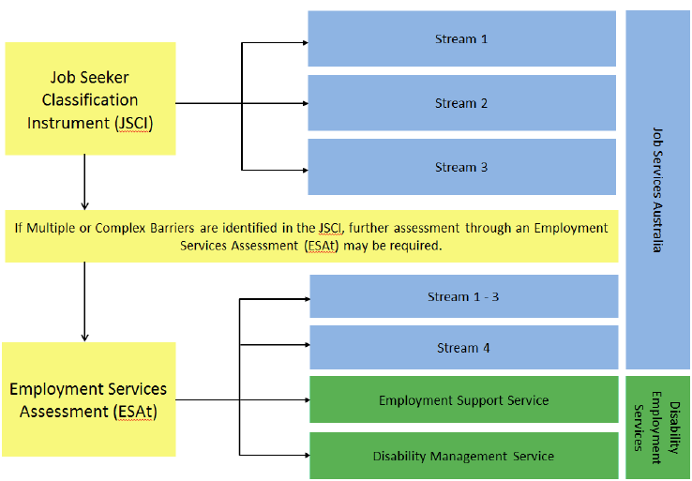
Australia: statistical profiling for steering private contractors
Notes:
Commonwealth Employment Service unresponsive, inefficient and costly
A contestable market offered a more efficient and cost effective employment model
Jobs Services Australia: 4 streams based on assessed level of disadvantage and more flexibility for providers to tailor services to the needs of jobseekers
Change: reduced complexity; flexibility of servicing; better targeted assistance (individualized servicing)
A tool called Job-Seeker Classification Instrument (JSCI) has been in existence since the 1990s, which is a statistical diagnostic and targeting tool assessing the potential risk of long-term unemployment based on differently weighted predictors such as age and gender, recency of work experience, jobseeker history, educational attainment, vocational qualifications, English proficiency, country of birth, indigenous status, indigenous location, geographic location, proximity to labor market, access to transport, phone contactability, disability/medical conditions, stability of residence, living circumstances, criminal convictions and personal factors (ADE, 2013). An 18-49 question-long questionnaire is administered which determines stream eligibility and need for further assessment. A JSCI score is determined based on information that is gathered by Centrelink upon registration on the mentioned covariates. The JSCI score measures a person’s relative labor market disadvantage and the higher the score the greater is the likelihood of longer-term unemployment. The client groups, or service streams, are the following: (a) stream 1, or jobseekers most job-ready; (b) stream 2, or jobseekers with moderate employment barriers; (c) stream 3, or jobseekers with relatively significant employment barriers; and (d) stream 4, or jobseekers with severe employment barriers.
One important reason why JSCI is critical for determining stream eligibility is related to the fact that profiling is used to steer private providers. The Job Services Australia is a large provider network, which assists over 750,000 jobseekers at any point in time (ADS, 2013). Through the network, 1.7 million placements have been carried out until the fall of 2013 (Ibid). Upon registration JSCI segments clients in four different eligibility streams, which is used as a steering node to direct jobseekers to Job Services Australia. In cases when JSCI identifies serious barriers, a further employment services assessment is conducted.
DES – Disability Management Services (DMS)
For job seekers with disability, injury or health condition who need assistance to find a job and occasional support to keep a job
DES – Employment Support Services (ESS)
Provides employment assistance to job seekers with permanent disability and with an assessed need for regular, ongoing support to keep a job

Slide 26
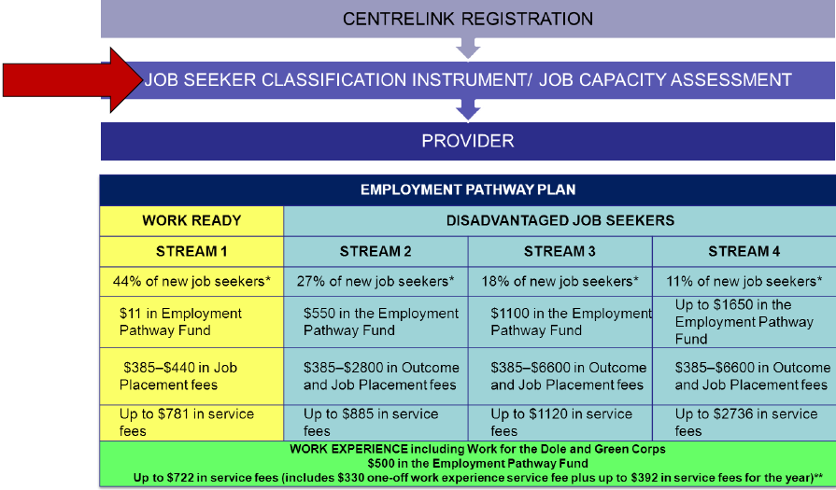
Australia: statistical profiling for steering private contractors
Notes:
With JSA there was a shift toward measuring performance and paying based on outcomes: (value for money and effiiency; improvement in quality of sevices; star ratings
Providers are paid on employment outcomes
Contracting providers: mix of orgs, competitive process, wide geo coverage
Help all eligible jobseekers, no cap
Fees
Service fees,, jobseeker placement fees
Jobseeker outcome fees

Slide 27
Outline
    Profiling in the context of activation
    Best practice profiling methods in OECD
    Statistical profiling and applications
    Relevance for Western Balkans

Slide 28
Relevance to the Western Balkans
New focus on activation
Descriptive profiling revealed high heterogeneity of clients in PES
Need to manage and focus scarce resources
Already have a functioning (little exploited) MIS
Can be integrated as part of a larger reform
Main challenge: define specific ALMPs for each client segment (taking heterogeneity into account)

Slide 29
Key implementation lessons
Data availability and nature of unemployment determine accuracy and feasibilty of profiling tool
Apply to critical spot in process management where profiling adds value, not just “another tool”
Pilot a lot on the ground, prepare clear guidelines to manage implications of tool on day to day case management
Reduce/manage perceptions of “de professionalization” of case workers, find where it adds value to their work

Slide 30
Contacts
Artan Loxha
Labor Market Consultant, World Bank
aloxha@worldbank.org
Matteo Morgandi
Economist, World Bank
mmorgandi@worldbank.org

