Slide 1
Cities in the Developing World
Ed Glaeser
Harvard University

Slide 2
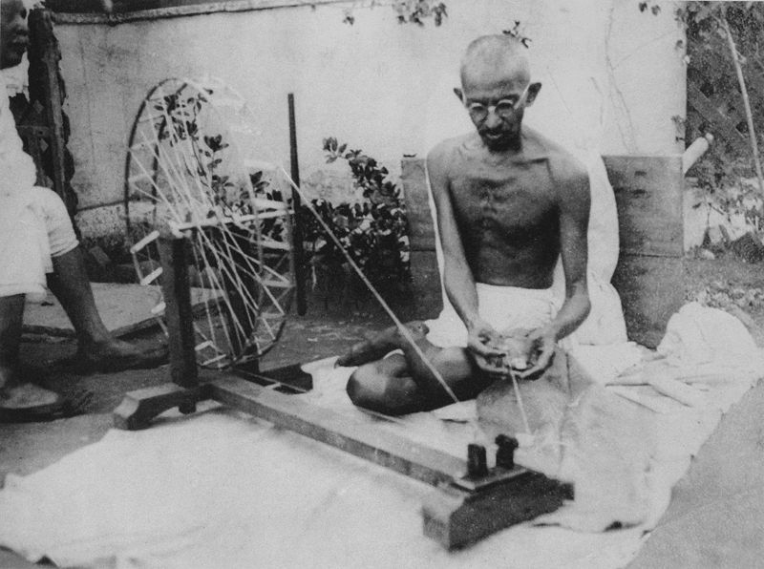
“I regard the growth of cities as an evil thing, unfortunate for mankind and the world. ”

Slide 5
Poor (under $1200 p.c.), Populous Countries that are one-third urban,
Country | Largest City (Population) | Percent Urbanized | Percent in Million+ Agglomeration> | GDP P.C. 2010$ (PPP Adjusted)
Congo (Dem. Rep) | Kinshasa (9 Million) | .34 | .17 | 210 (330)
Zimbabwe | Harare (1.6-2.8 Million) | .38 | .12 | 625 (missing)
Mali | Bamako (1.8 million) | .34 | .13 | 650 (1100)
Haiti | Port-au-Prince (1 – 2.4 Million) | .52 | .21 | 700 (1000)
Pakistan | Karachi (23.5 Million) | .36 | .19 | 1100 (2400)
Senegal | Dakar (1-2.5 Million) | .42 | .24 | 1100 (1700)

Slide 8
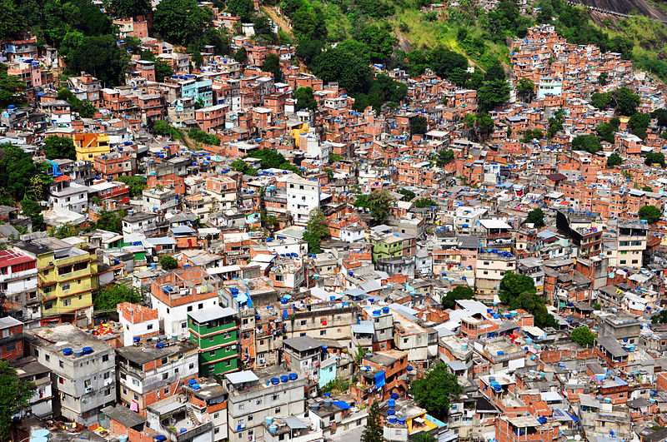
The Strength of Urban Poverty?

Slide 10
Happiness across the United States

Slide 11

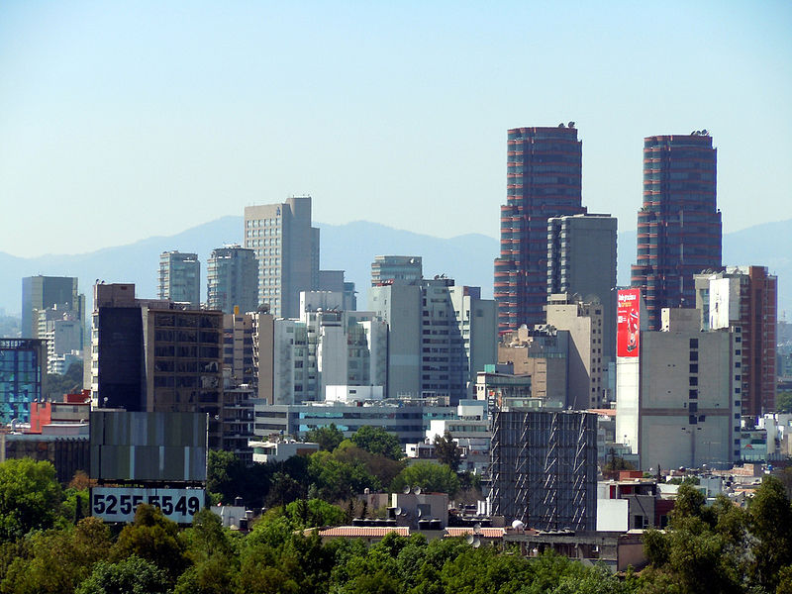

The Urban Triad
The Economic Magic of Human Interaction by חדוה שנדרוביץ
Government battling the Demons of Density
The Physical City by rulto

Slide 14
Do Cities Increase Productivity?
Random Shocks to Location for Individuals
  Roots in the individual fixed effect literature
  Similarities with Randomizing Across Peers
  Doesn’t deal with omitted place level factors
Random Shocks to the Density Level
  If long term, these must be orthogonal to current productivity (Combes et al. 2010)
  Or taking advantage of high frequency variation (Greenstone, Hornbeck, Moretti)
An alternative is to estimate the flow of ideas within a network (Duflo and Saez, 2003)
Real estate prices as a sign of WTP for proximity

Slide 15
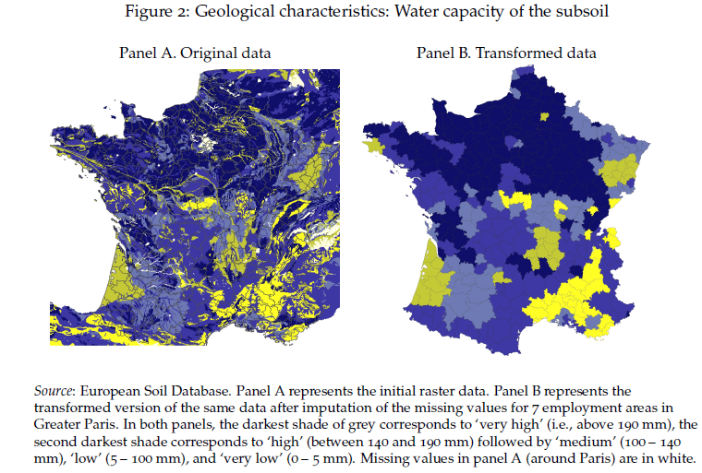
Combes, Duranton, Gobillon and Roux

Slide 16
Human Capital and Urban Success

Slide 20
Relocation of Departments in the 50s
(joint with Lu Ming)

Slide 21
Joint with Yueran Ma

Slide 22
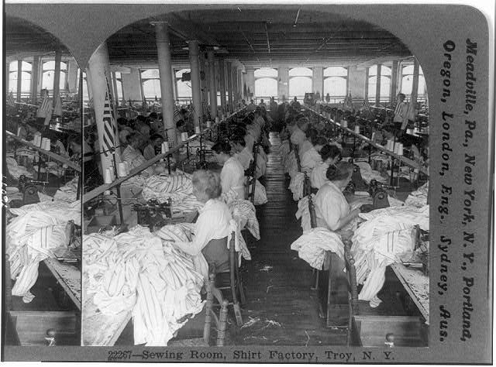
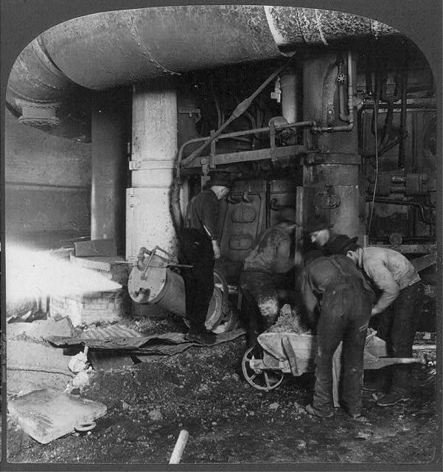
Chinitz: Contrasts in Agglomeration: New York and Pittsburgh

Slide 24
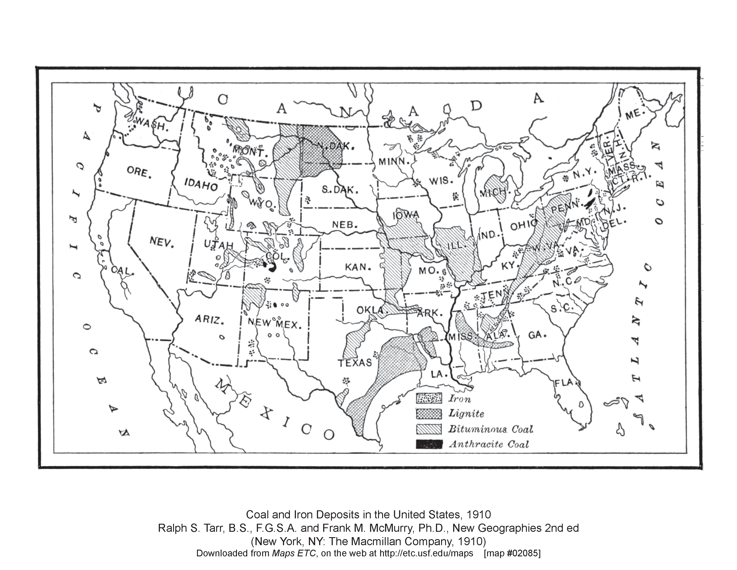
Copper Mines and Entrepreneurship

Slide 25
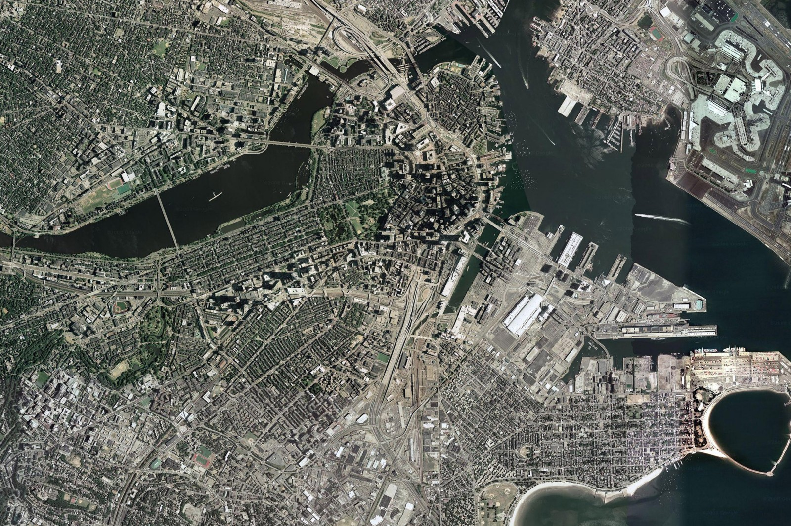
Logan
Airport
Downtown
South Boston
Waterfront
Innovation District
Notes:
Original Image path: C:\wei_Boston Data\jpg export\South Boston_20090910\00_Aerial Context.jpg
Original Size: 2.1MB W:2,691px H:1,794px
Compressed Size: 0.8MB W:1,600px H:1,066px (62.2% using JPEG compression of 90)
Last Updated: 9/10/2009 2:06:22 PM by TsengC via Sasaki PPT Image Manager

Slide 26
Policy Related Questions
Explicit Spatial Policies
  Should be city sizes be limited? Optimal city size?
Investment in Infrastructure
  Roads and railroads but endogeneity is difficult
Education and human capital spillovers
  Old questions remain (primary vs. secondary)
  New crop of great experimental work.
Regulation, credit market, labor market matching questions all relate to cities.
Encouraging Entrepreneurship in Cities
  One Stop Permitting

Slide 27
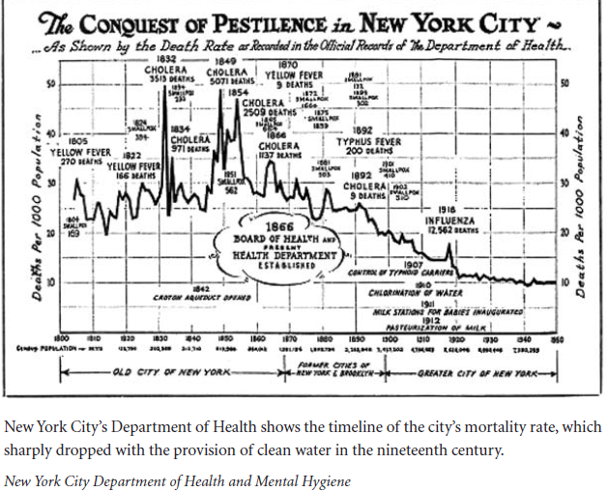

Slide 28
Government Effectiveness and Urbanization

Slide 29
GDP Under $1500, Pop>2 Million

Slide 30
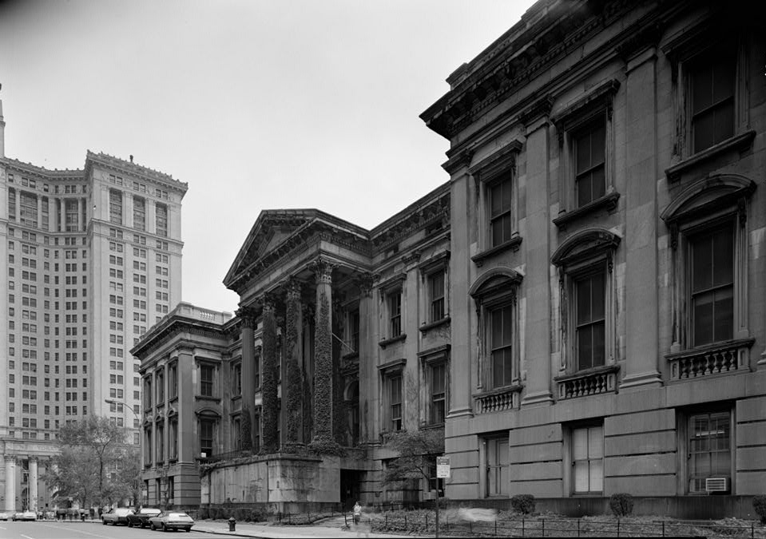
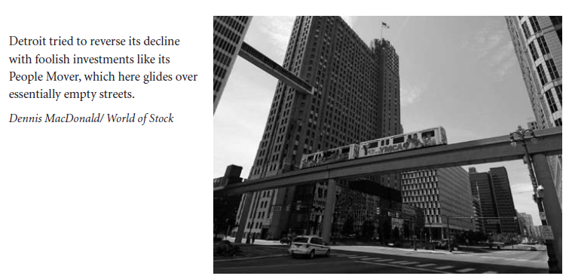
Waste and Fraud in Infrastructure:
The Institutional Challenge

Slide 31
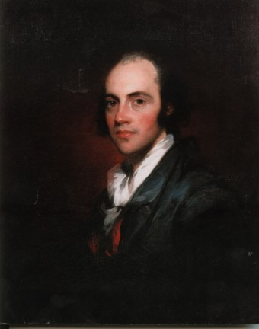
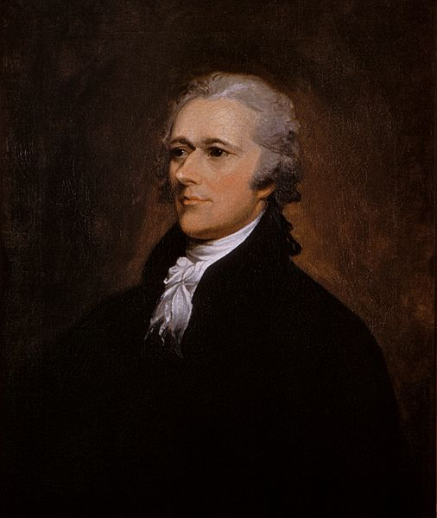

Slide 32
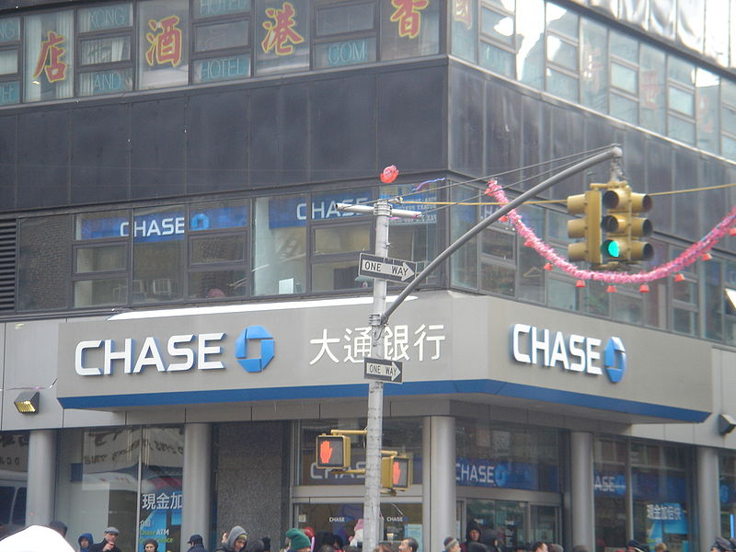
Author: Branille

Slide 33
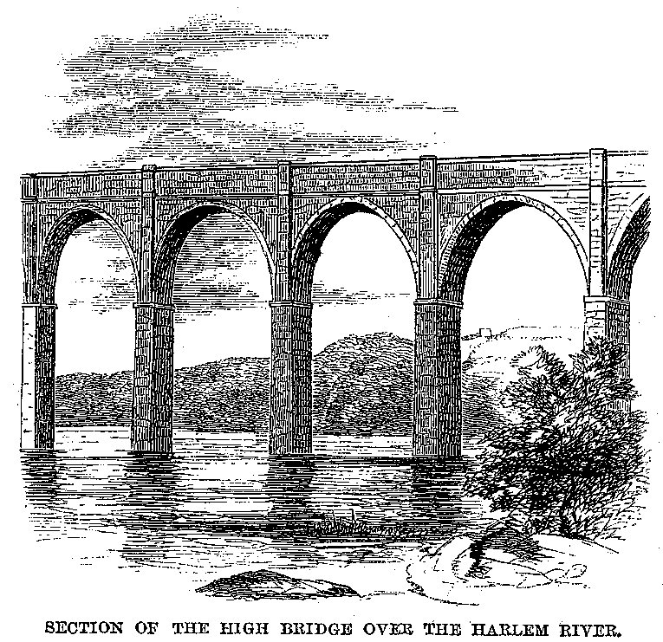
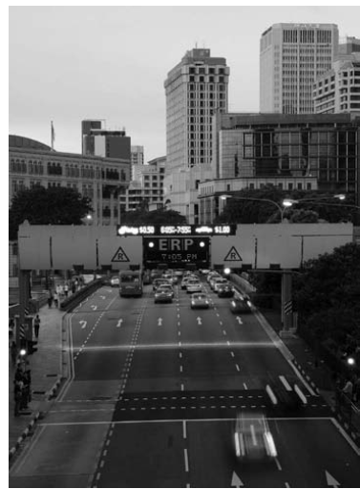
Engineering vs. Economics

Slide 34
Transportation and Congestion
The traditional literature used engineering estimates and engaged in cost-benefit analysis
  Fundamental conclusion is “bus good; train bad”
A newer literature uses cross-metropolitan area estimates to determine the impact of new infrastructure projects.
  Baum-Snow (military map) on suburbanization
  Duranton-Turner on the fundamental law of highway traffic and impact of roads on MSA gdp
A parallel literature in developing economies
  Banerjee, Duflo and Qian (2012).
Requires the exogenous location of infrastructure

Slide 35
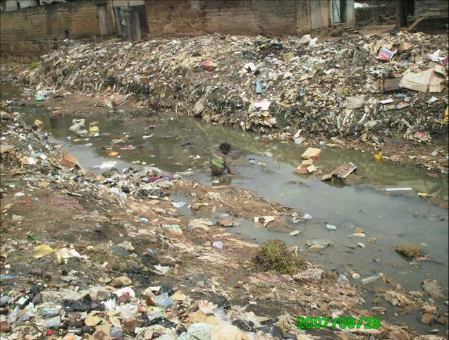

Anarchy vs. Authority
RayKelly by David Shankbone
Photo by SuSanA Secretariat

Slide 36
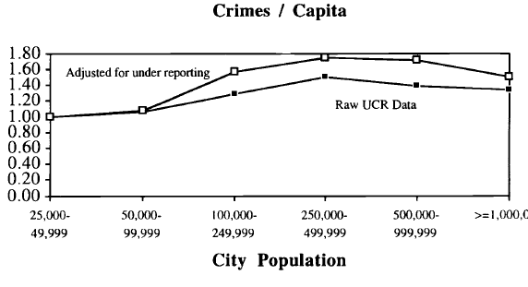
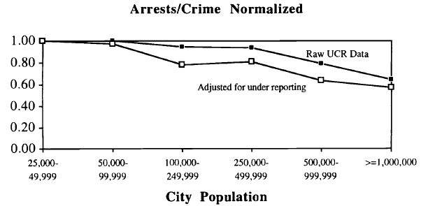

Slide 37


The Brazil Model:
The Dentist and the Supermarket
Supermarket by Wonderlane

Slide 38
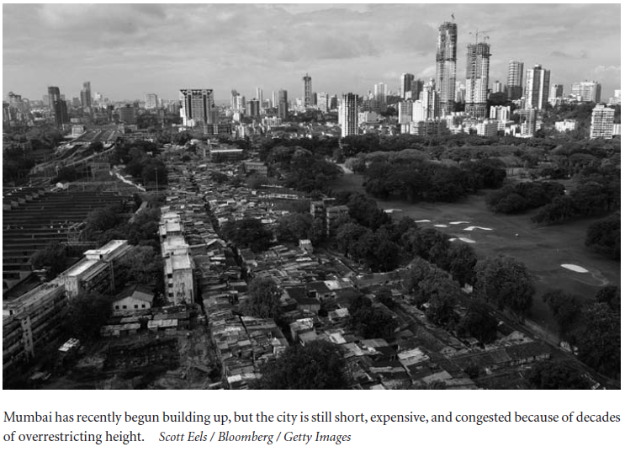
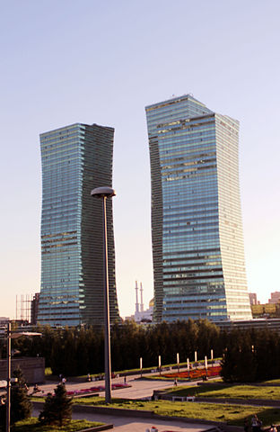
NIMBYism vs. Monumentalism
Astana by ChelseaFunNumberOne -

Slide 39
Housing Markets,
Property Rights and Regulation
Successful cities have high land costs which translates into high costs of living.
  Housing costs are mediated by levels of regulation
Impact of property ownership on outcomes (DeSoto, Erica Field) through self-protection or ability to finance new investment.
Impact of structure on outcomes through health– the bore holes problem and the Tenements law.
The Western pattern was that property rights were developed first (12th-18th centuries) but regulation followed. Not so in the developing world.
Large unregulated communities with dimly defined property rights.

Slide 41
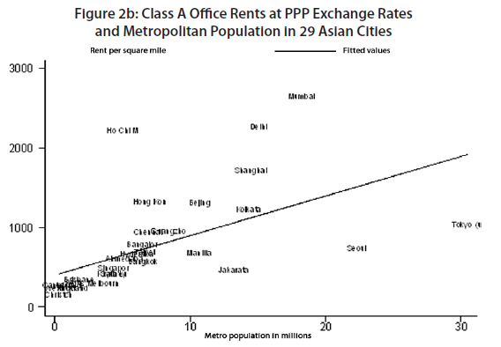

Slide 43
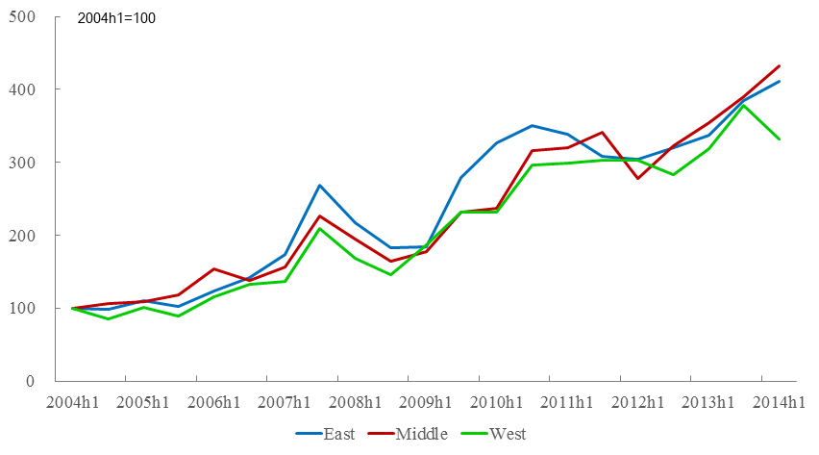
Fact 1 (obvious one):
Price increases are spectacular
Source: Wharton/NUS/Tsinghua Chinese Residential Land Price Indexes

Slide 44
Fact 2 (relatively obvious):
Prices are not cheap compared to income
A conservative estimate: In many of the 35 major cities by 2005, average annual disposable income is worth around 2-3 square meters (20-30 square feet) of housing ☹. It is even worse now.

Slide 45
Fact 3 (not so obvious):
Prices are way higher than physical costs of construction

Slide 46
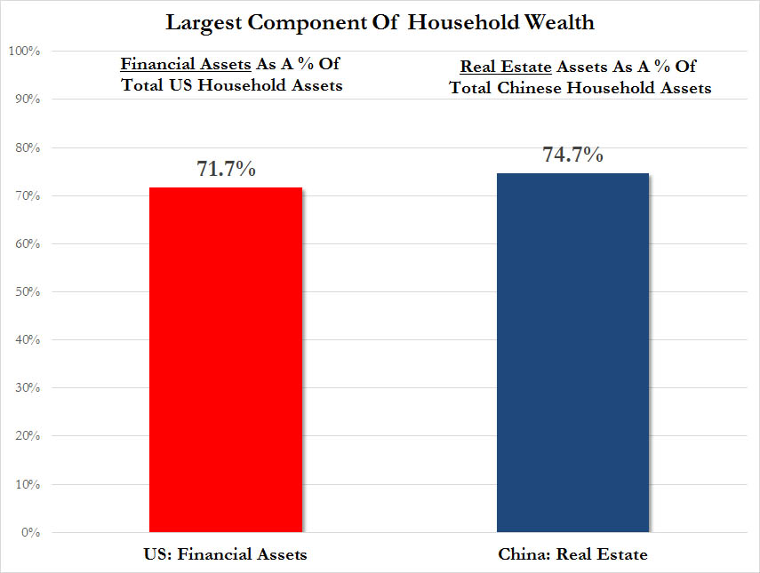
Fact 4: Real estate is the largest component of household wealth in China
Not an entirely fair comparison as real estate asset is perhaps the largest component of household wealth for US households outside of the highest income brackets. But in China, even rich households have a lot of their assets in real estate as well.

Slide 47
Fact 5: Even when things turn sour, prices don’t adjust immediately
Some moderate correlation between area not sold and price declines as of 2012, but literally no correlation before 2011.

Slide 48
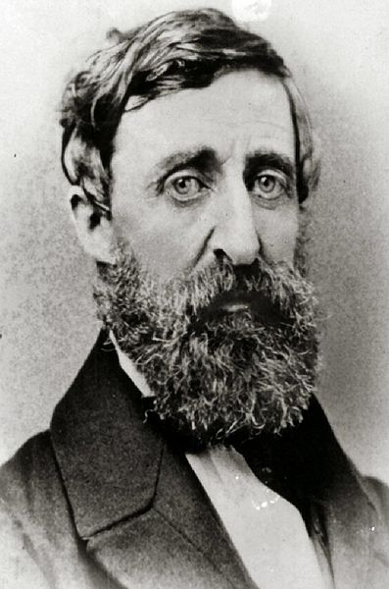

Image by QuarterCircleS

Slide 49
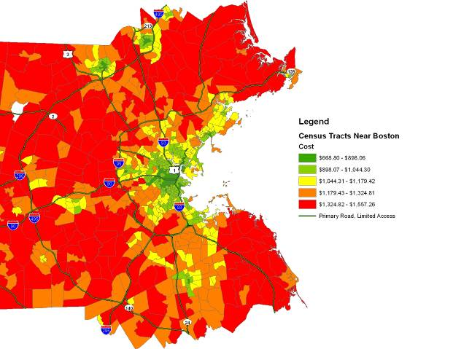

Slide 50
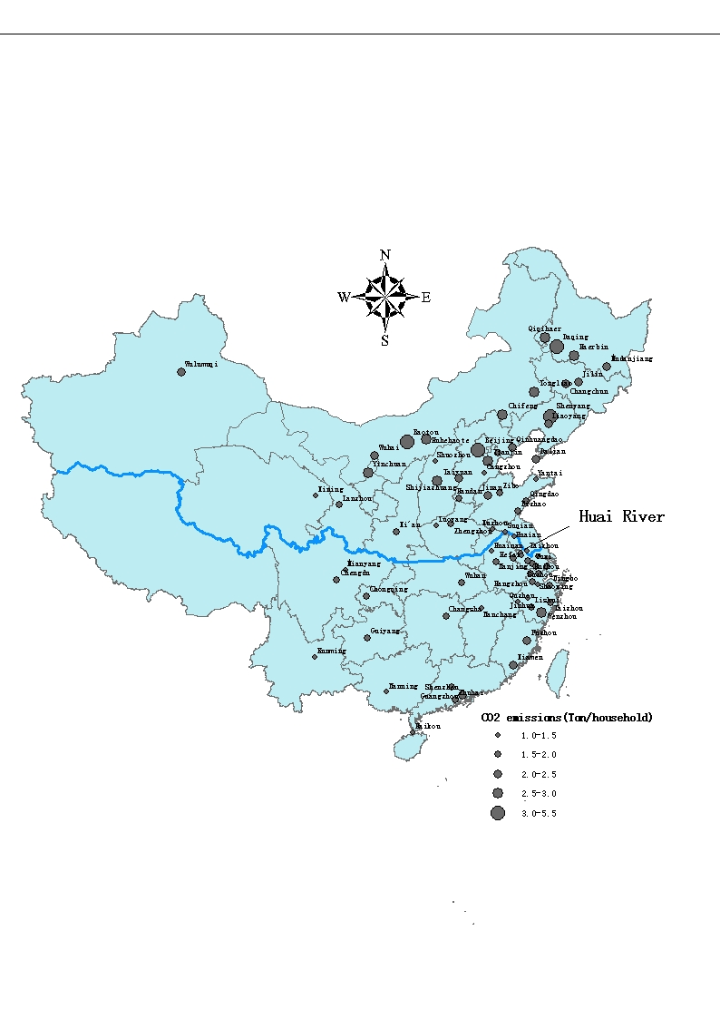

Slide 51

The Boston Hypothesis
Image by Ramy Raoof

