Slide 1
Capital Cities, Conflict and Misgovernance:
Theory and Evidence
Filipe Campante
(Harvard Kennedy School & NBER)
Quoc-Anh Do
(Sciences Po & CEPR)
Bernardo Guimaraes
(Sao Paulo School of Economics - FGV)
Urbanization and Poverty Reduction Research Conference
November 12, 2014

Slide 2
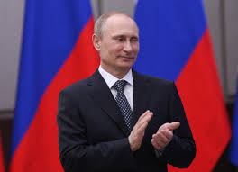
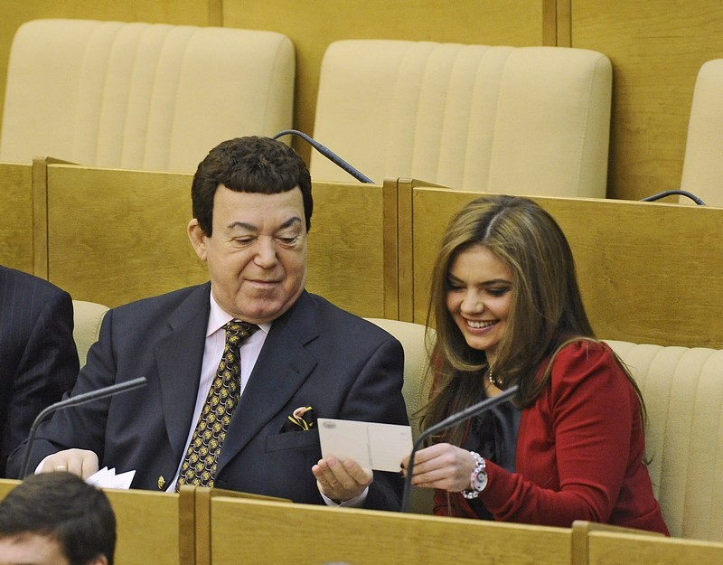
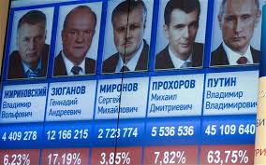
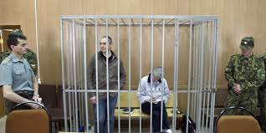
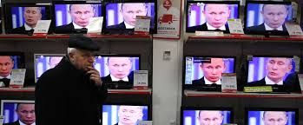
Motivation
Understanding Governance:
What constraints governments?
Elections
Legislature
Courts
Media

Slide 3
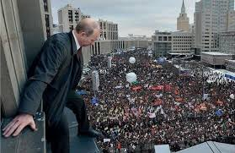
Motivation
Understanding Governance:
What constraints governments beyond “formal”
checks and balances?

Slide 4
Motivation
Understanding Governance:
What constraints governments beyond “formal”
checks and balances?
Important Element: (The Threat of) Conflict/Insurrection
Understudied Connection: Spatial Distribution of Population
Where you are matters for your political influence
Spatial proximity to power increases political influence
Especially so when it comes to that threat

Slide 5
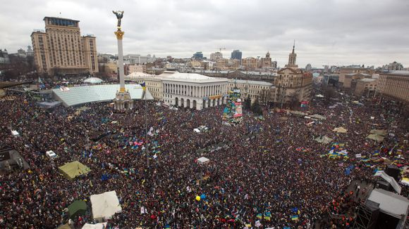
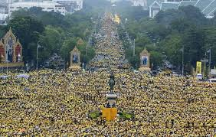

Slide 6
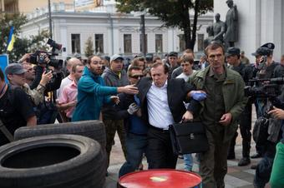
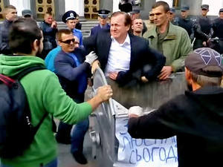


Slide 7
Motivation
Revolutions and Capital Cities
As the capital goes, so goes the country…
Historical example: 18th-19th century France
Contemporaneous examples: Ukraine, Thailand
Guess who have figured that out? Incumbents!
Many examples of proposed and undertaken relocations
  Versailles, Brasilia, Naypyidaw

Slide 8
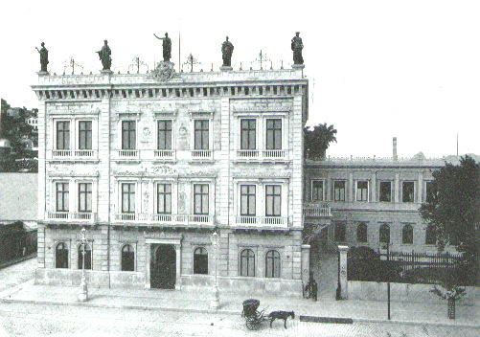

Slide 9
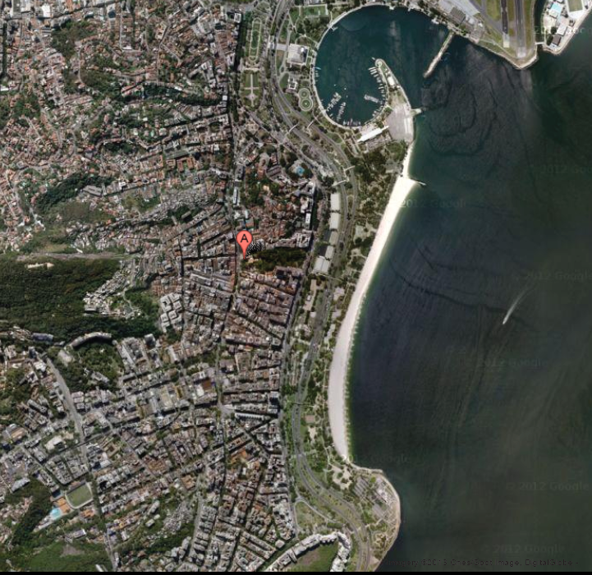

Slide 10
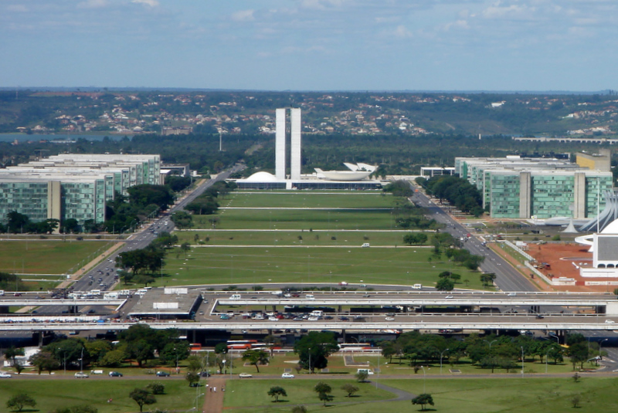

Slide 11
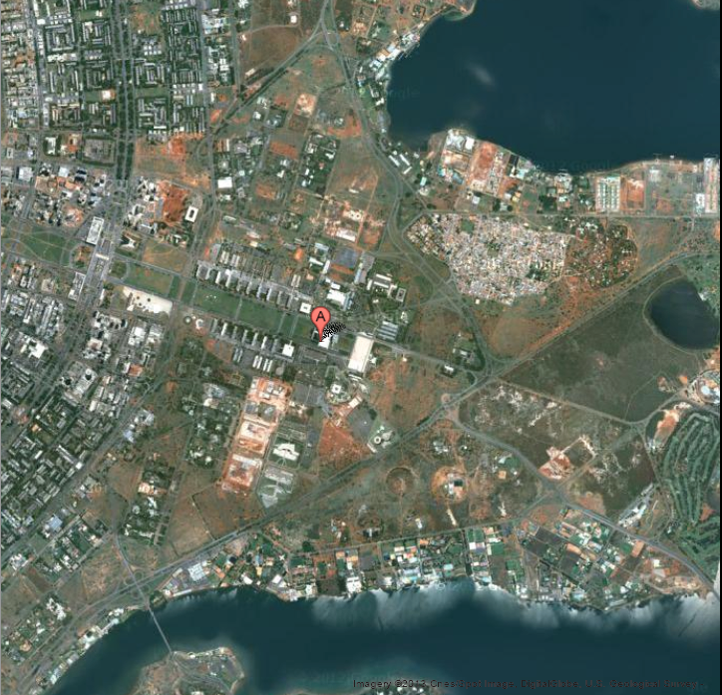

Slide 12
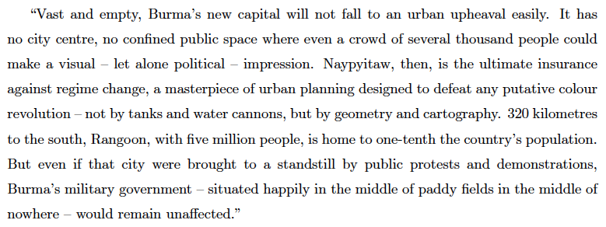
Varadarajan, S., 2007, “Dictatorship by Cartography, Geometry”

Slide 13
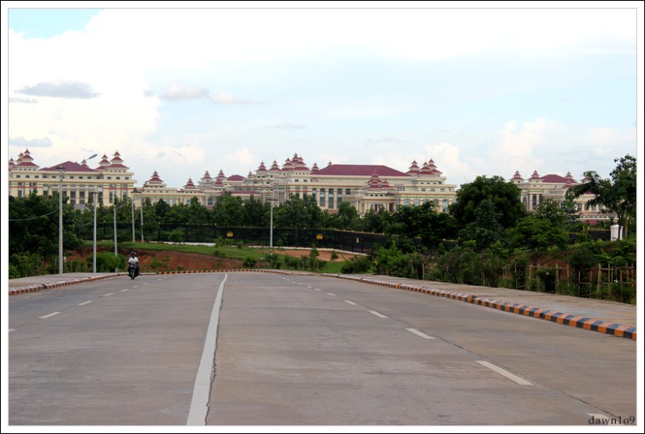

Slide 14
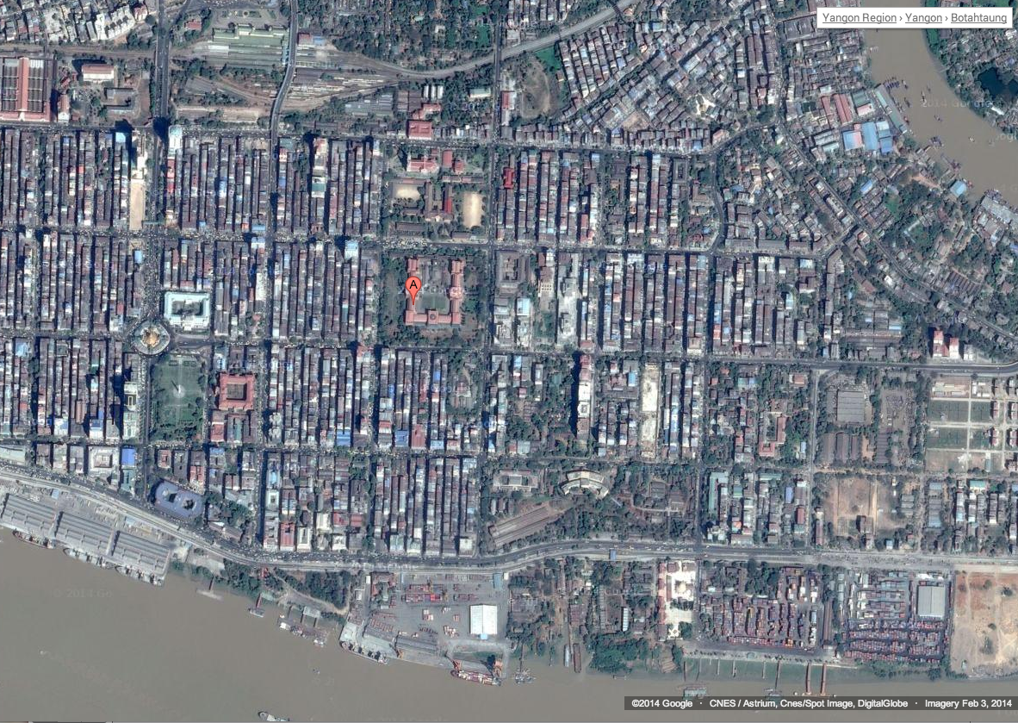

Slide 15
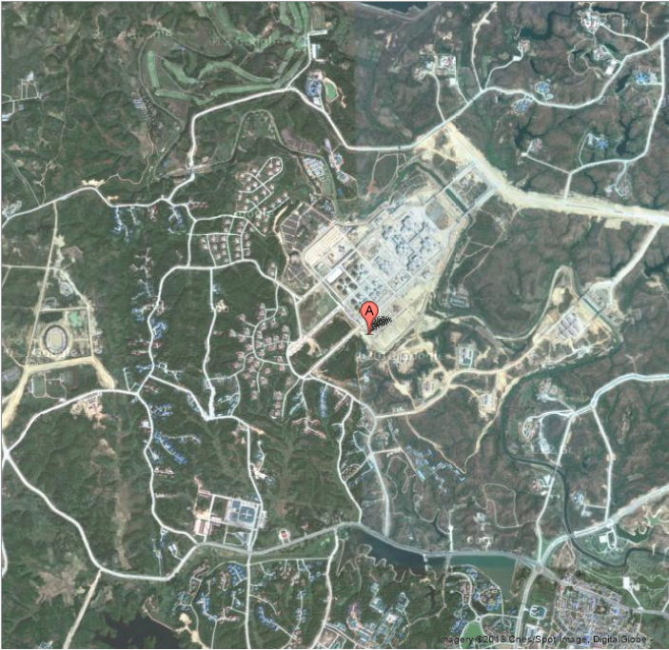
Golf

Slide 16


Slide 17
Motivation
Revolutions and Capital Cities
As the capital goes, so goes the country…
Historical example: 18th-19th century France
Contemporaneous examples: Ukraine, Thailand
Guess who have figured that out? Incumbents!
Many examples of proposed and undertaken relocations
  Versailles, Brasilia, Naypyidaw
In general, protection is an (explicit or disguised) goal
Policies discouraging migration to cities are also common
  Vietnam, China, Cambodia (under the Khmer Rouge)

Slide 18
What We Do
We study the link between capital cities, conflict, and governance
  Key assumption: proximity to the capital increases the threat posed by rebellions
Part of a broader agenda looking at the impact of the spatial distribution of people (relative to the seat of political power) on quality of governance

Slide 19
Capital Cities and Conflict
Prediction 1:
Conflict is more likely to emerge closer to the capital city.
Why?
It is cheaper to buy stability from those in faraway places: small amount of extra rents keeps them quiet.
Note:
This goes against what one would expect from a “state capacity” view

Slide 20
Capital Cities and Conflict
Prediction 2:
Conflict that emerges close to the capital is more dangerous to incumbents.
Note:
Elite optimally chooses to live with a higher probability of conflict close to the capital, even though it is more dangerous.

Slide 21
Capital Cities and Misgovernance
Prediction 3: Isolated capital cities are associated with misgovernance.
Why?
More isolation lets incumbents grab more rents, hence increases cost of sharing power
Worse governance decreases output, and reduces the cost of further (inefficient) isolation
In sum: more isolation is associated with less accountability and worse governance

Slide 22
Data
Conflict:
PRIO-GRID data (Tollefsen Strand & Buhaug 2012) at 0.5° x 0.5° cells (55km x 55km at equator)
  Each grid cell is assigned to one country
Conflict dummy 1989-2008: In conflict zone (Hallberg 2012)
  Old variable (Raleigh et al 2006): less precise over time
Conflict onset: Initial battle of intrastate conflict (Holtermann)
Other:
Gross Cell Product (luminosity) & population (90-95-00-05), climate & terrain.

Slide 23
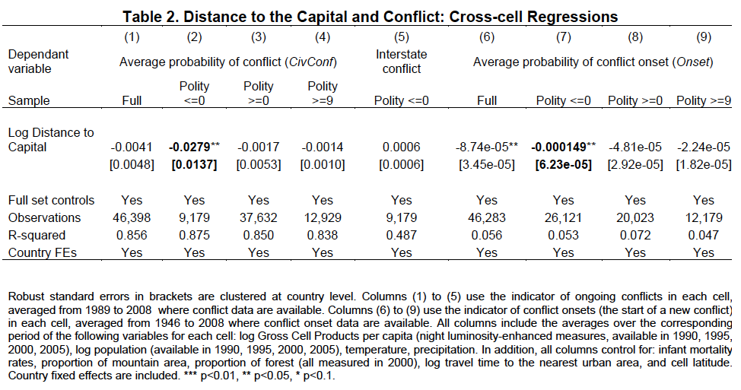
Conflict is more likely closer to the Capital
Only in relatively non-democratic countries
Half the distance → 11% increase over avg probability
Notes:
Polity <=0 : “Autocracies” + “Closed Anocracies”
Mean of onset variable: similar size

Slide 24
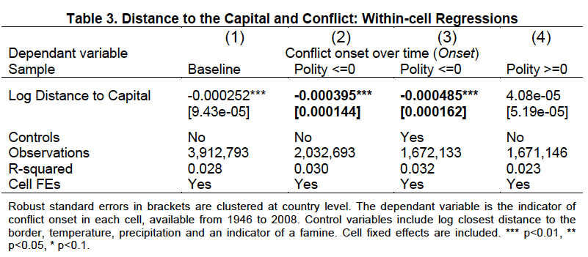
Conflict becomes more likely when the Capital is moved closer
Only in relatively non-democratic countries
Notes:
Polity <=0 : “Autocracies” + “Closed Anocracies”
Mean of onset variable: similar size

Slide 25
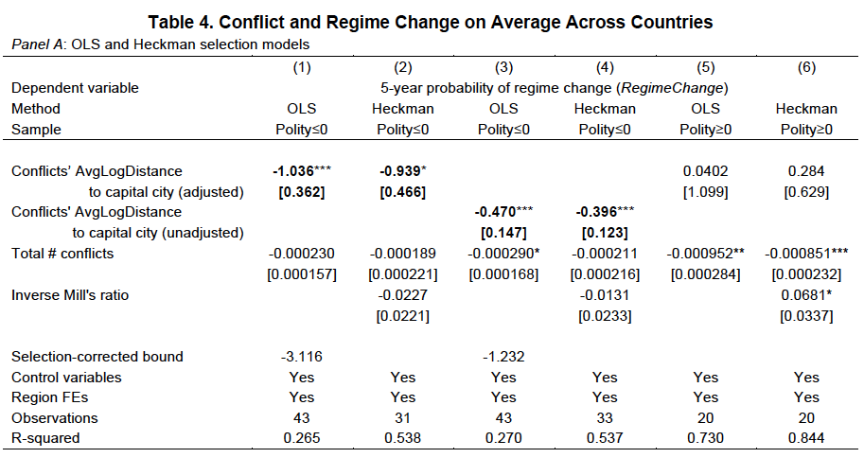
Conflict closer to the Capital is more likely to lead to Regime Change
Only in relatively non-democratic countries
Notes:
Polity <=0 : “Autocracies” + “Closed Anocracies”
Mean of onset variable: similar size

Slide 26
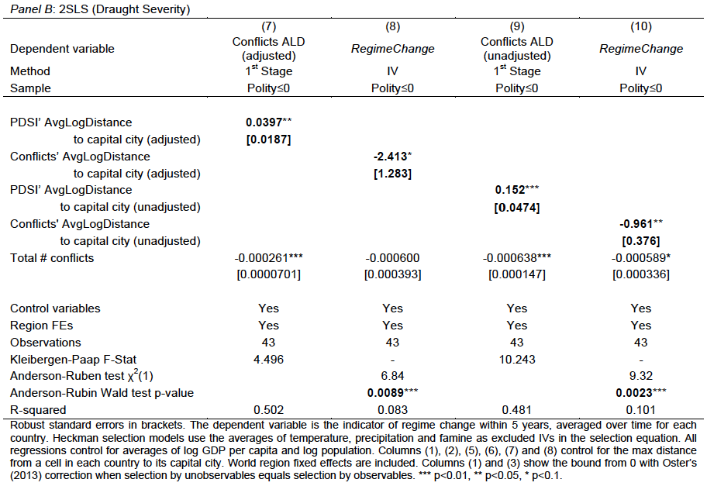
Conflict closer to the Capital is more likely to lead to Regime Change
Only in relatively non-democratic countries
Notes:
Polity <=0 : “Autocracies” + “Closed Anocracies”
Mean of onset variable: similar size

Slide 27
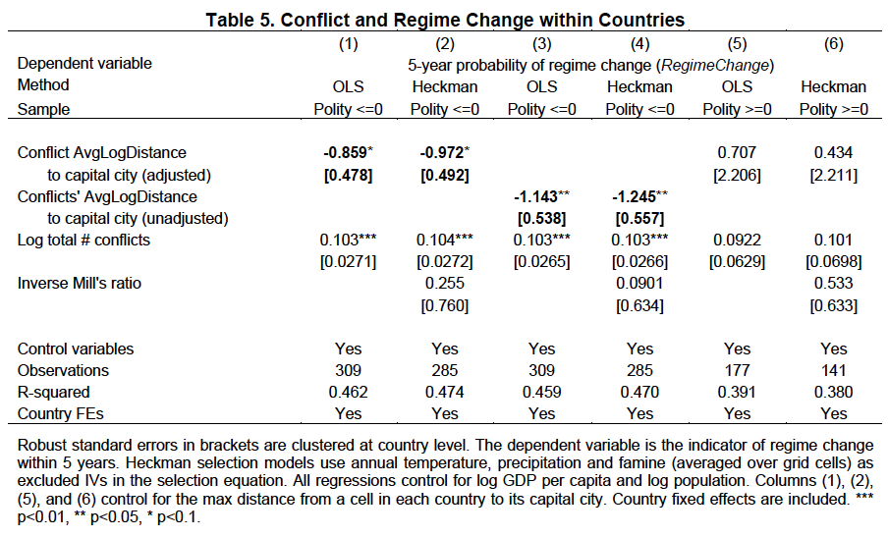
Conflict closer to the Capital is more likely to lead to Regime Change
Notes:
Polity <=0 : “Autocracies” + “Closed Anocracies”
Mean of onset variable: similar size

Slide 28
Capital Cities and Conflict: In Sum
Conflict is more likely to emerge closer to the capital city
Conflict in a given location becomes more likely when the capital is moved closer
Regime change is more likely when conflict is closer on average to the capital
Regime change becomes more likely when conflict moves closer on average to the capital
All of these results hold for relatively non-democratic countries only

Slide 29
Data
  Governance:
  World Governance Indicators (1996-2006, avg.)
    Rule of Law
    Government Effectiveness
    Control of Corruption
    Voice and Accountability
    Regulatory Quality
    Political Stability

Slide 30
Data
  Isolation of the capital city:
  Average log distance of population to the capital (Campante and Do 2010, 2014)
    Our measure:
    We adopt the version normalizing by country size
    Data from Gridded Population of the World (1990), 2.5’ x 2.5’ cells (5km x 5km at the equator)
    Distance from cell center to capital

Slide 31
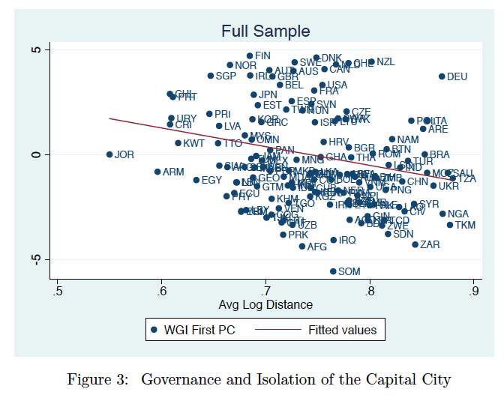
Governance x Isolation of the capital

Slide 32
Difference is roughly like going from Bolivian to Bulgarian governance
Less Isolated Capitals
(below median Avg Log Dist)
More Isolated Capitals
(above median Avg Log Dist)

Slide 33
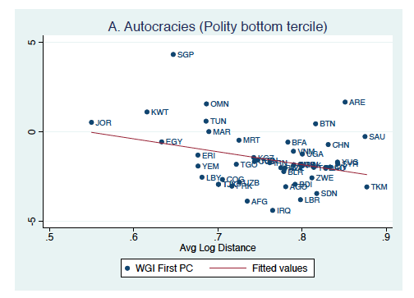
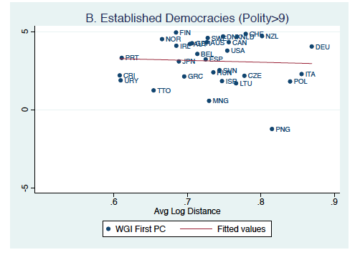
Democracies vs Non-Democracies

Slide 34
Democracies vs Non-Democracies
“Autocracies”
(Polity <=0)
“Democracies”
(Polity>9)

Slide 35
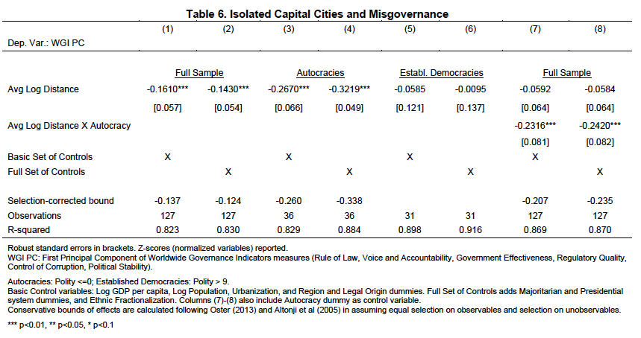
Governance x Isolation of the capital
Quantitatively: going from Nairobi (average isolation) to Khartoum (one s.d. above) explains about 40% of the difference in governance between Kenya (average governance among autocracies) and Sudan (one of the worst in the world)

Slide 36
Democracies vs Non-Democracies

Slide 37
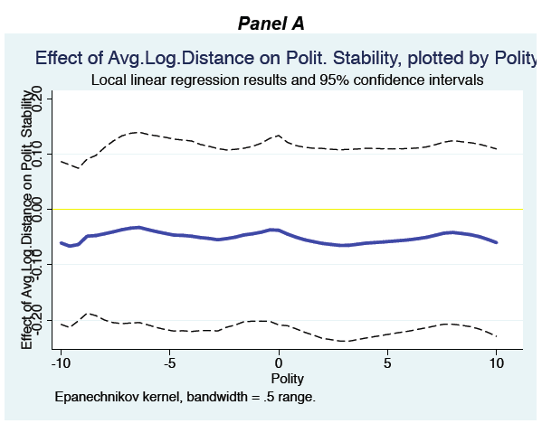
Unpacking Governance: Stability

Slide 38
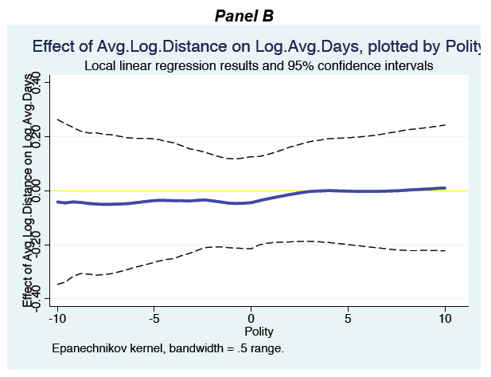
Unpacking Governance: State Capacity

Slide 39
Capital Cities and Governance: In Sum
Isolated Capital Cities are associated with Misgovernance
  Not with instability or weak state capacity
All of these results hold for relatively non-democratic countries only

Slide 40
Final Thoughts
Spatial distribution of population is important for understanding institutions and governance in non-democratic contexts
  It conditions the threat of conflict/insurrection
    Conflict is more likely and more threatening closer to the capital
  It conditions the quality of governance
    Isolated capital cities are associated with misgovernance
Isolated capitals flag situations of high risk for misgovernance
  Persistent factor, but influenceable and monitorable.

Slide 41
Extra Slides

Slide 42
Democracies vs Non-Democracies

Slide 43
Unpacking Governance: Power Sharing
  Data: “Polity” score components (Polity IV), avg. 1975-2010
    Related to power sharing:
        “independence of executive authority” (ExecutiveConstraints): “the extent of institutionalized constraints on the decision making powers of chief executives”, ranging from “unlimited authority” to “executive parity or subordination”
        “political competition and opposition” (ParticipationCompetitiveness): “the extent to which alternative preferences for policy and leadership can be pursued in the political arena”, ranging from “repressed” to “competitive”
    Not so related:
        “executive recruitment” (RecruitmentCompetitiveness and RecruitmentOpenness): whether there is access to executive positions through a regularized process.
          Ex.: USSR had perfect score in Openness, simply because succession was not hereditary.

Slide 44
Unpacking Governance: Power Sharing

Slide 45
Unpacking Governance: Power Sharing
Notes:
Polity <=5: “Autocracies” + “Closed Anocracies” + “Open Anocracies”
We extend the definition because there is relatively little variation in the Polity components when we look at the <= 0 subsample (by definition!).

Slide 46
Additional Predictions
Table 9. Individual Opinions and Distance to Capital Cities
Panel A: Corruption and Politics
 | (1) | (2) | (3) | (4) | (5) | (6)
 | Perceptions of Corruption |  |  |  | Views on politics:
Dependent variable | President | Parliament | National Officials | 1st Principle Component | People are treated unequally | Careful about what you say
Log Distance to Capital | 0.0190** | 0.0128** | 0.0176*** | 0.0352*** | 0.0307*** | 0.0177**
 | [0.00776] | [0.00523] | [0.00495] | [0.00828] | [0.00791] | [0.00689]
Log Distance to Largest | -0.0357*** | -0.0333*** | -0.0217** | -0.0617*** | 0.00463 | 0.0163
Non-Capital City | [0.0108] | [0.00952] | [0.0109] | [0.0174] | [0.0172] | [0.0141]
Full set controls | Yes | Yes | Yes | Yes | Yes | Yes
Observations | 14,557 | 14,893 | 14,985 | 13,514 | 16,688 | 17,464
R-squared | 0.238 | 0.202 | 0.181 | 0.254 | 0.129 | 0.183
Region FEs | Yes | Yes | Yes | Yes | Yes | Yes
Robust standard errors in brackets are clustered at region level. Dependent variables in columns (1) to (3), (5), and (6) are from AfroBarometer 3's questions Q56a, Q56b, Q56d, Q53D, Q53A respectively. Column (4) uses the first principal component of the dependent variables in columns (1) to (3). Control variables include all control variables used by Nunn and Wantchekon (2011): age, age squared, gender, urban, district's ethnic fractionalization, proportion of ethnic group in district, log of total historical slave export per land area, ethnic group average malaria ecology measure, total Catholic + Protestant missions per land area, dummy for historic contact with European explorers, dummy for historical into the colonial railway network, dummy for existence of city among ethnic group in 1400, pre-colonial jurisdictional hierarchies beyond the local community, and fixed effects for categories of the following variables: education level, occupation, religion, living conditions, pre-colonial settlement patterns of ethnicity. In addition, region fixed effects are included. *** p<0.01, ** p<0.05, * p<0.1.
Notes:
The point here is that people who live far from the capital have worse perceptions of the national political system, and of how it treats them. In the paper we have a placebo table that shows that no difference emerges when it comes to other factors that may affect corruption perceptions (trust, interest in politics).

Slide 47
Additional Predictions

