Slide 1
Transport Infrastructure, Urban Growth and Market Access in China
Nathaniel Baum-Snow, Brown University
Loren Brandt, University of Toronto
Vernon Henderson, LSE
Matthew Turner, Brown University
Qinghua Zhang, Peking University

Slide 2
Questions of Interest
How have new highways and railroads influenced urban growth in Chinese prefectures and cities?
  Mechanisms internal to cities
  Improved access to domestic markets
  Improved access to international markets
To what extent are these influences reflected in growth versus redistribution?

Slide 3
Motivations
Important Policy Questions
  Developing countries are making huge investments in highways and railroads - about $200 billion per year in China since 1990
  The impacts of new transport infrastructure in developing country contexts are just starting to receive serious research attention
  About 20% of World Bank lending is for transport infrastructure
Little is known about the relative importance of various classes of mechanisms through which transport infrastructure may drive urban growth
  New highways typically influence internal city transport costs, those between cities and international transport costs simultaneously

Slide 4
Potential Channels
Mechanisms internal to cities
  Free up low agglomeration spillover land intensive activities to decentralize
  Enhance agglomeration spillovers across firms conditional on locations
    Lower cost access to shared intermediate inputs
    Easier flow of ideas across firms
  Allow cities to accommodate greater population, thereby enhancing their productivity through agglomeration economies
Improved access to domestic markets and international markets
  Ricardian gains from trade
  Knowledge spillovers
  Innovation through tougher competition
  Promote structural change

Slide 5
Preview of Results
New highways promoted more GDP growth in prefectures that became better connected to more populous and prosperous domestic regions
  We find less robust commensurate effects for population
New highways promoted population growth in prefectures that became better connected to international ports
  Because we find no commensurate effects for GDP, most of this looks like redistribution rather than growth
  Still represents welfare gains for many people because of higher GDP levels in regions with improved port access
Radial railroads serving prefecture cities promoted population growth but not statistically significant GDP growth
  Once again, looks like welfare enhancing population redistribution

Slide 6
Relationship to the Literature
A burgeoning literature investigates effects of transportation on regional growth in developing countries
  Alder (2014), Banerjee, Duflo & Qian (2014), Bosker (2014), Donaldson (2014), Donaldson & Hornbeck (2014), Faber (2014), Fajgelbaum & Redding (2014), Ghani, Goswami & Kerr (2014), Storeygard (2013)
Another literature examines how within city transport infrastructure improvements can promote urban growth
  Duranton & Turner (2012), Baum-Snow (2014), Baum-Snow et al. (2014)
This is the first study to examine both classes of explanations simultaneously, and with a new identification strategy

Slide 7
Context
Our primary analysis starts in 1990:
  China is still a planned economy, except for a small amount of within-prefecture free trade in agriculture
  Inter-prefecture trade proscribed by provincial authorities
    Almost all inter-prefecture shipments by rail, mostly between prefecture cities and the provincial capitals
  Mostly unpaved roads used only for within-prefecture transport of agricultural goods from farms and manufacturing goods to farms
By 2010:
  Largely a free market economy, with land and trade flows allocated by the market
  Largely complete national express highway system

Slide 8
Trends in Outcomes of Interest
Very rapid GDP growth everywhere
Despite relative per-capita GDP in rural versus urban areas of 2.4 in 1990 and 2.1 in 2010, only 38% of the population lives in prefecture cities
Hukou migration restrictions are an important element of the context

Slide 9
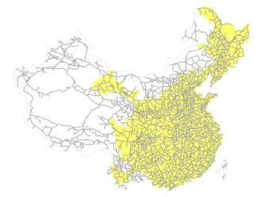
1990 Road Network

Slide 10
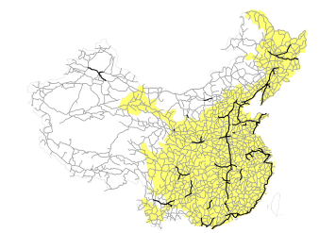
1999 Road Network

Slide 11
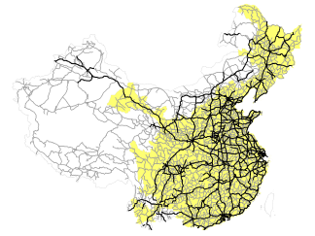
2010 Road Network

Slide 12
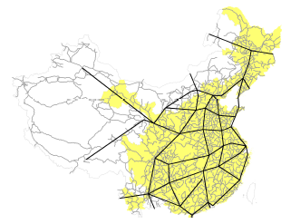
1962 Road Network and 5-7 Plan

Slide 13
Expansions in Transport Infrastructure Serving Cities

Slide 14
Measures of Explanatory Variables
Intuitive variants of “Market Potential” based on Fujita, Krugman & Venables (1999)
  GDP within 6 hours by road (excluding own prefecture)
  Employment within 6 hours by road (excluding own prefecture)
  Travel time to the nearest international port
GDP and employment variants of “Market Access” based on Eaton & Kortum (2002) and Hornbeck & Donaldson (2014)
  Smooth measure of connection to other markets that incorporates recursion and transitivity of linkages between regions
  Domestic component
  International component
Radial highways and railroads serving prefecture cities

Slide 15
Correlation Across 2010 MP and MA Measures
All MA measures mutually highly correlated
MA and MP measures are capturing something somewhat different

Slide 16
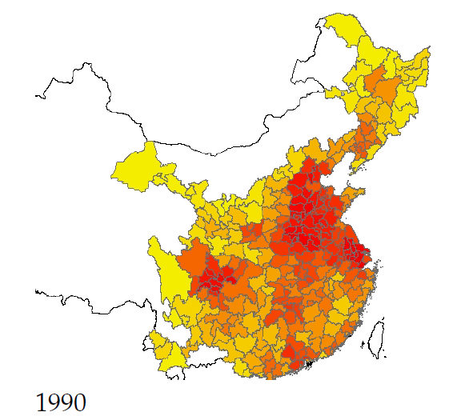
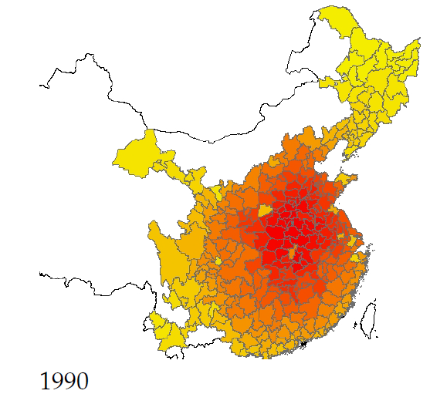
Population MP and MA
Market Potential
Market Access

Slide 17
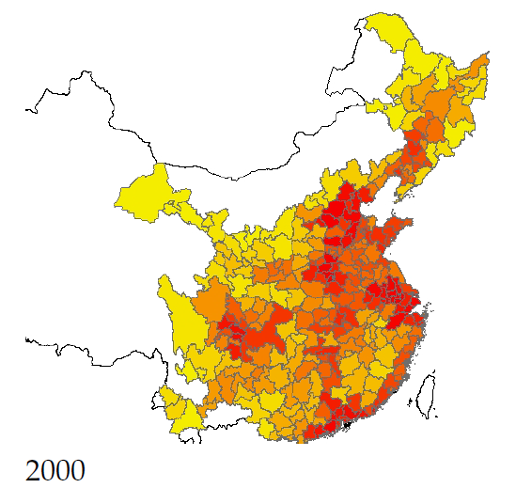
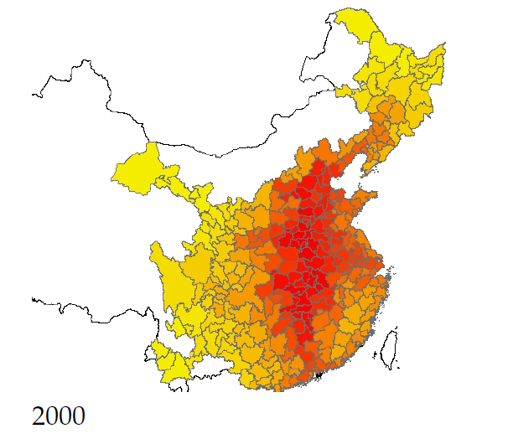
Population MP and MA
Market Potential
Market Access

Slide 18
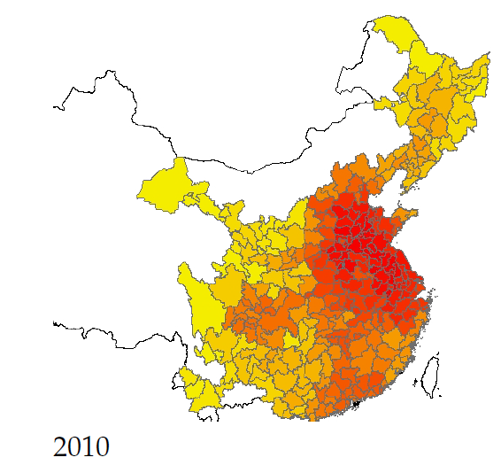
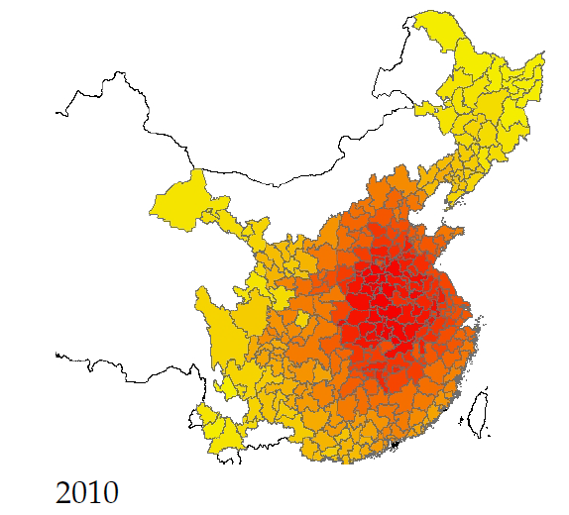
Population MP and MA
Market Potential
Market Access

Slide 19
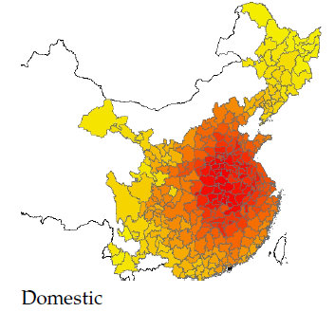
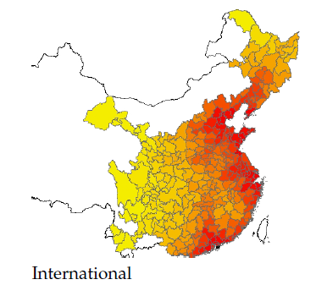
Components of 2010 Market Access

Slide 20
Growth of MP and MA
Average prefecture GDP growth of 3.0 log points
Average prefecture population growth of 0.13 log points
Versions of MA and MP built using 2010 roads and 1990 quantities are quite similar to 2010 numbers
Therefore, most of the MP and MA growth is from improvements in the road system

Slide 21
Empirical Strategy
Think about a world with no trade and no highways in 1990, but some unobservables about prefectures that influence growth but are fixed over time
This implies estimating coefficients in a regression equation like the following:
Still a potential problem of unobservables (not in X) correlated with R, A and E that drive growth
population
or GDP
growth rate
radial highways
and railroads serving prefecture city
access to domestic markets
access to international markets
pre-determined control variables

Slide 22
Identification Challenges
Highways built to serve growing cities
Highways built to connect more productive or export oriented cities
Unobservables that drive regional growth also predict modern highway construction
Cities with more railroads have more industry

Slide 23
Instruments
2010 radial highways and railroads serving prefecture cities
  1962 radial roads and railroads serving prefecture cities
Measures of market potential and market access along the 2010 road and highway network
  1962 roads and the 5-7 Plan interacted with 1982 expenditure or 1982 employment
Road travel time to nearest port
  1962 roads and 5-7 Plan travel time to nearest port
International market access
  External market access along 1962 roads and the 5-7 Plan with 1990 exports

Slide 24
Instrument Validity
1962 roads
  Existence of these rights of way made subsequent highway construction less costly
  Less than half of such roads were even passable by truck, and the ones that were passable had top speeds of about 25 kph
  Mostly unpaved and existed almost exclusively for local transport of agricultural goods
    Controls for variables correlated with the amount of prefecture agricultural activity are therefore crucial
1962 railroads
  Existed for shipping manufactures and agricultural products mostly between prefecture cities and provincial capitals
5-7 Plan
  Developed in the early 1980s to link 38 nodal prefecture cities in our study area
  Idea is to look at cities in between which ultimately got linked into the network only for this reason

Slide 25
Sources of Identifying Variation
Compare prefectures receiving more limited access highways between 1990 and 2010 because of having had more unimproved roads serving the city in 1962 relative to those with fewer unimproved roads in 1962
Compare prefectures better linked to larger cities because they were intermediate locations on the 5-7 Plan or central in the 1962 road network to others
Compare prefectures better linked to international ports because they were intermediate locations on the 5-7 Plan or central in the 1962 road network to others not linked well to ports on these networks
All of these are comparisons conditional on controls for
  provincial capital indicators
  1982 prefecture population
  1982 prefecture industry mix
  1982 prefecture education
  distance to the coast

Slide 26
Population MP and MA
Market Potential
Market Access

Slide 27
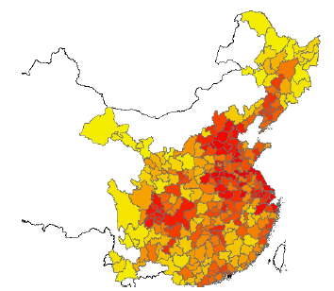
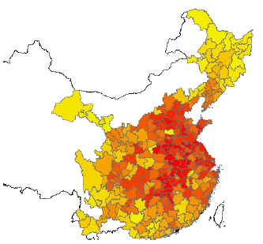
Instruments for Population MP and MA
uses 1962 road network+5-7 plan and 1982 employment or population
Market Potential
Market Access

Slide 28
First Stage Results – Highways, Railroads and MP

Slide 29
First Stage Results – Market Access
MA instruments are a bit weak, especially for domestic and international components

Slide 30
Main Outcomes of Interest
Prefecture and prefecture city GDP growth
Prefecture and prefecture city population growth
  Important to take into account that hukou migration restrictions makes it unlikely to find migration effects

Slide 31
Results for Prefecture GDP
Estimated effects of market access are consistent with those of market potential
Results for prefecture cities are also similar, though a bit smaller in magnitude

Slide 32
Results for Prefecture Population
Estimated effects of market access are consistent with those of market potential
Results for prefecture cities are also similar, though a bit smaller in magnitude

Slide 33
Main Conclusions
Expansions of highways and railroads in China have promoted regional and urban growth through mechanisms internal to cities and through improved trade integration
Each radial railroad serving a prefecture city allowed it to accommodate an estimated 7.3 percent more population (6.5 percent more in the full prefecture)
The estimated elasticity of prefecture GDP with respect to GDP market potential is 0.11 and with respect to employment market potential is 0.17
  No similar effects for prefecture or city population
The estimated elasticity of prefecture population with respect to travel time to an international port is about -0.08
  No similar effects for prefecture or city GDP
  May be driven by special economic zones set up to promote foreign investment
It is important to consider the extent to which these results imply increases in per-capita GDP versus its redistribution

Slide 34
Thank You

