Slide 1
Highway to Success: The Impact of Golden Quadrilateral Project for the Location and Performance of Indian Manufacturing
Ejaz Ghani, Arti Grover Goswami & William R. Kerr

Slide 2
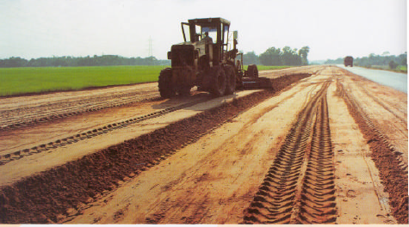
Highways in India, 2000 Snapshot

Slide 3
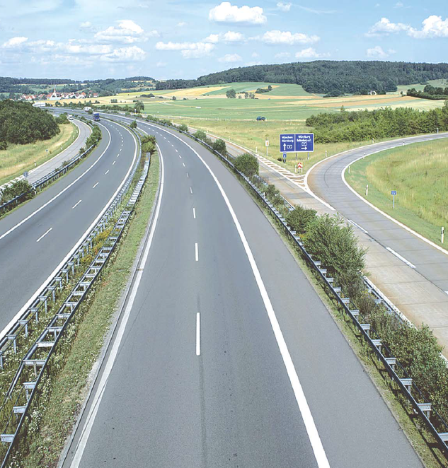
Highways in India, 2007 Snapshot

Slide 4
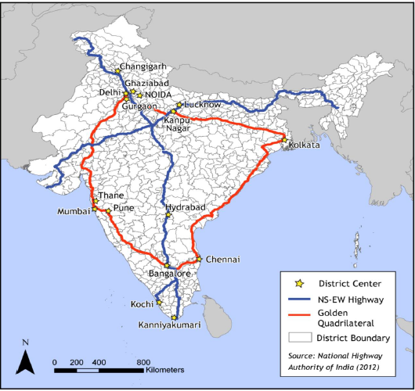
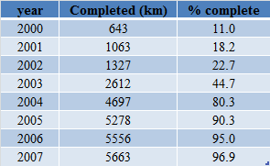
Highways in India: GQ and NS-EW

Slide 5
GQ and the Organization of Manufacturing
We study how proximity to GQ in non-nodal districts affected the organization of manufacturing activity: 1994-2009
Sources of variation
  Distance from GQ (e.g., 0-10 vs 10-50 km from network)
  Sequence in which districts were upgraded
  Industry traits within the manufacturing sector
  Non-nodal districts traits within 0-10 km
Measures of economic activity:
  Establishment counts, employment and output levels, average labor productivity and TFP
  Industry-level allocative efficiency

Slide 6
Our Contribution
Use plant-level data to analyze highway impact
  Entry and exit outcomes
  Productivity consequences
  Entrant vs. incumbent growth
  Allocative efficiency
Quantify the impact from investments into improving networks
  [vs. the existence of transportation networks]
  Comparison to the NS-EW placebo highway
  Dynamics around upgrades

Slide 7
Data Preparation
Annual Survey of Industries (ASI)
  Repeated cross-sectional surveys of organized sector
Sample size: 311 districts
  Reductions based upon ASI coverage
  Consistent sample across 5 or 12 surveys
  Accounts for >90% of activity during period of study
  About twice the size of a US county
Distance from GQ Highway: ArcMap GIS software
  Focus on distance to district edge
  Manual collection of segment-level details

Slide 8
Output

Slide 9
Young Output

Slide 10
Methodology
Non-parametric approach using long-difference estimations
Treatment:
  Indicator variables for distance ranges to the GQ network, with focus on non-nodal districts
  Comparisons to districts farther away, with excluded group typically being 50+ km from the GQ network
  Counts: 9 nodal, 76 0-10 km, 42 10-50 km, 236 50 km+
  The 0-10 km groups accounts for ~40% of activity

Slide 11
Methodology
Non-parametric approach using long-difference estimations
X_{i} controls include:
  Measures of initial levels Y_{i}
  Access to national highway, state highway, or railroad in terms of log distance
  Traits from 2000 Census: population, age profile, female-male ratio, urbanization rate, SC/ST rate, literacy, and within-district infrastructure measure

Slide 12
T2: Main Results
Sample counts by distance band: 9, 70, 42, and 196

Slide 13
T2: Main Results

Slide 14
T2: Main Results

Slide 15
T2: Main Results

Slide 16
Robustness Checks
Consider distance bands, new segments vs. upgrades, etc.
Endogeneity can lead to an upwards or downwards bias
  Infrastructure to growing places
  Bridges to nowhere
Approaches:
  Placebo test: the portions of the NS-EW networks that were scheduled for Phase 1 upgrades but delayed
  Straight line (with kink) IV based upon nodal districts
  Dynamic estimations and completion dates

Slide 17
Dynamic Specifications: Young Activity
Parallel work with average spread in states of completion times is 6.4 years

Slide 18
Dynamic Specifications: Total Activity

Slide 19
Entrants and Incumbents
Growth in entrants & incumbents, with the former stronger
Analyze differences in incumbent productivity adjustments
Normalize each plant by industry-year weighted average
Compare incumbents and entrants back to initial values

Slide 20
Allocative Efficiency
Evaluate district-level sorting around land intensity
Compare overall changes in allocative efficiency by initial industry positioning along GQ network

Slide 21
Conclusions
GQ upgrades appear to have increased allocative efficiency, facilitated a more natural spatial sorting of industries, and encouraged decentralization to intermediate cities
Ballpark calculations with many assumptions:
  GQ increased manufacturing output by 15%-19%
  A little less then a fifth of total organized sector growth
  Almost all of it in immediately adjacent districts
Stop short of a cost-benefit calculation, but the cost side was pretty small in this case
The process also appears pretty capped at the levels estimated

