Slide 1
Comments on Optimal trade and storage policies: Issues for the concerned policy advisor
Donald F. Larson
Food Price Volatility, Food Security and Trade Policy Conference
September 18, 2014
Washington

Slide 2
Disclosure: Big Fan
Long history, but short list of practitioners
  Gustafson, Robert L. 1958. “Implications of Recent Research on Optimal Storage Rules.” Journal of Farm Economics 40(2): 290–300.
  Gardner, Bruce L. 1979. Optimal Stockpiling of Grain. Lexington, Massachusetts: Lexington Books.
  Wright, Brian D., and Jeffrey C. Williams. 1982. “The Economic Role of Commodity Storage.” The Economic Journal 92 (367): 596–614.
  Miranda, Mario J., and Joseph W. Glauber. 1995. “Solving Stochastic Models of Competitive Storage and Trade by Chebychev Collocation Methods.” Agricultural and Resource Economics Review 24 (1): 70–77.
  Makki, Shiva S., Luther G. Tweeten, and Mario J. Miranda. 1996. “Wheat Storage and Trade in an Efficient Global Market.” American Journal of Agricultural Economics 78 (4): 879–890.
  Wright, Brian D., and Carlo Cafiero. 2011. “Grain reserves and food security in the Middle East and North Africa.” Food Security 3 (Supplement 1): 61–76.
  Larson, Donald F. , Julian Lampietti, Christophe Gouel, Carlo Cafiero, and John Roberts. 2014. “Food security and storage in the Middle East and North Africa.” World Bank Economic Review 28(1), 48-73.

Slide 3

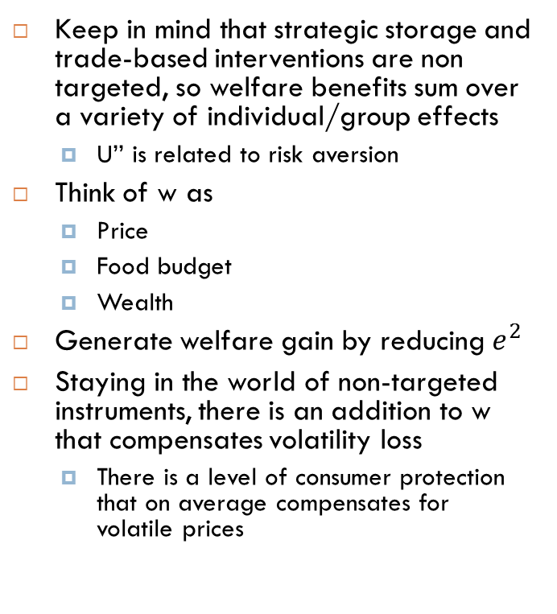
How significant are the benefits?
Keep in mind that strategic storage and trade-based interventions are non targeted, so welfare benefits sum over a variety of individual/group effects
  U’’ is related to risk aversion
Think of w as
  Price
  Food budget
  Wealth
Generate welfare gain by reducing $e^{2}$
Staying in the world of non-targeted instruments, there is an addition to w that compensates volatility loss
  There is a level of consumer protection that on average compensates for volatile prices
Utility based evaluation a la Newberry and Stiglitz (1981)
  Taylor expansion
$U\left(w+e\right)≅U\left(w\right)+\frac{1}{2}{U′}^{′}(e^{2})$
Utility = Level - volatility effect

Slide 4
What is the right price to stabilize around?
What triggers stabilization instruments?
Is an index value of 140 high?
Judgment based on 2005-2009
Judgment based on 2007-2012

Slide 5
Model can formalize a solution to the right price problem, but a validated model should replicate a sensible distribution
Conversely, the validity of the model is anchored to the implicit price distribution it generates as a baseline
Three nominal price distributions from consecutive 20 periods
Three US CPI distributions

Slide 6
Exchange rates matter too
IMF’s real exchange rate index for India

Slide 7
More problems…
Limitation of resources
  Sooner or later a string of high prices low prices will exhaust stocks, exhaust funds for buying stocks, or exhaust capacity to store
Political economy
  Given the uncertainty of what the “right price” is, policy makers have to resist groups pushing the intervention instruments in their favor
  Corollary: If policy makers feel compelled to pick second-best solutions, will they run the stabilization program in accordance with model principles
  Co-ordination failures
No sunset clause
  Disorderly demise – due to resource failure – causes its own chaos

Slide 8
Tough lessons on global coordination:
International agreements to stabilize commodity prices

Slide 9
Tough lessons on national and hedged programs:
Headlines from past commodity stabilization schemes
Cheese Giveaway Churning USDA Weighs Ways of Slicing Surplus
  “The government is considering giving away 225 million pounds of surplus American cheese -- a pound apiece for every man, woman and child in the country.” Washington Post December 5, 1981 (Ward Sinclair)
Tin Council In Crisis As London Trading Is Halted / Price support funds run out
  “Over the years, the buffer stock manager has defended the tin price by building up a stock pile of tin which now stands at more than 62,000 tonnes….” Financial Times October 25, 1985 (Stefan Wagstyl)
  “The ITC had incurred liabilities of …$1.4 billion to a host of bank and metal brokers.“ Ian Mallory (1990) American University International Law Review
  Malaysia Braced to Close Mines - Financial Times October 31, 1985
Moscow Buys EC Butter at One-Fifteenth Its Cost
  “The European Commission yesterday announced that 200,000 tonnes of unwanted butter had been sold to the Soviet Union and predicted that the EC’s notorious butter ‘mountain’ would be cut in half this year.” Financial Times November 1987 (Tim Dickson)
PM Signals End to Wool Price Scheme
  “The Prime Minister has signaled an end to the wool reserve price scheme.. Which ha seen the Australian Wool Corporation … run up a Government-guaranteed debt of $2.8 billion” ($US 2.1 billion) “We’ve now got 4.8 million bales….” Prime Minister Hawke
    The Sydney Morning Herald February 11, 1991 (Paul Chamberlin)
Notes:
GDP of Sierra Leone was 1.2 billion in 1985

Slide 10
Final thoughts on the benefits of managing consequences of volatility rather than managing prices
…
Safety nets are a general tool to address multiple sources of income risk
  Risks originating from a single commodity leaves households exposed to remaining risks
Targeting usually makes safety nets much cheaper to operate than public storage
Targeting also mitigates crowding out of private storage and private insurance

