Slide 1
Comments on presentation by Ruslan Yemtsov and Ugo Gentilini
Antoine Bouët– IFPRI and University of Bordeaux
The World Bank – Washington DC, September, 18-19 2014
Food Price Volatility, Food Security and Trade Policy

Slide 2
Food Price Volatility, Food Security and Trade Policy
The State of Social Safety Nets 2014
A brilliant contribution to the debate
An amazing piece of work
Point of departure: key questions
Several questions
Characterization of countries
Superiority of cash transfers and economic environment
Permanent SSN: cost/impact on agents

Slide 3
Food Price Volatility, Food Security and Trade Policy
Debate with respect to export restrictions
SSN: 1st order policy
Export restrictions have recently received consideration:
They have a negative impact on local production in the short term… and in the long term
Export taxes interesting in countries with small fiscal base: not a valid point
Beggar-thy-neighbor policy;
Process of retaliation and counter-retaliation: increased export taxes/reduction of import duties
SSN may also amplify supply shocks but by a much lesser extent

Slide 4
2. An illustration with MIRAGE
Additional export taxes (%)
Country | ET | ETIT | ETIT0
Australia | 16 | 47 | 19
India | 19 | 46 | 21
Canada | 18 | 52 | 25
United States | 20 | 52 | 27
Argentina | 19 | 50 | 25
Russia | 25 | 57 | 37
Ukraine | 20 | 50 | 50

Slide 5
2. An illustration with MIRAGE World prices (% changes compared to baseline)
Sector | Base | ET | IT | IT0 | ETIT | ETIT0
Wheat | 10.84 | 16.76 | 27.31 | 12.62 | 41.10 | 20.58
Dairy products | 0.04 | 0.05 | 0.00 | 0.02 | 0.03 | 0.04
Livestock | 0.19 | 0.21 | 0.18 | 0.13 | 0.24 | 0.17
Meat | 0.07 | 0.08 | 0.06 | 0.06 | 0.07 | 0.07
Oilseeds | 0.09 | 0.06 | 0.09 | 0.08 | 0.05 | 0.04
Other crops | 0.16 | 0.17 | 0.18 | 0.12 | 0.18 | 0.13
Other food | 0.04 | 0.08 | -0.04 | 0.00 | 0.04 | 0.04
Paddy and processed rice | 0.21 | 0.13 | 0.32 | 0.20 | 0.10 | 0.11
Plant fiber | 0.13 | 0.11 | 0.14 | 0.10 | 0.13 | 0.09
Sugar | 0.14 | 0.12 | 0.20 | 0.12 | 0.16 | 0.10
Vegetable and fruits | 0.20 | 0.21 | 0.25 | 0.14 | 0.27 | 0.14
Vegetal oil | 0.01 | 0.01 | -0.01 | 0.00 | 0.00 | 0.00

Slide 6
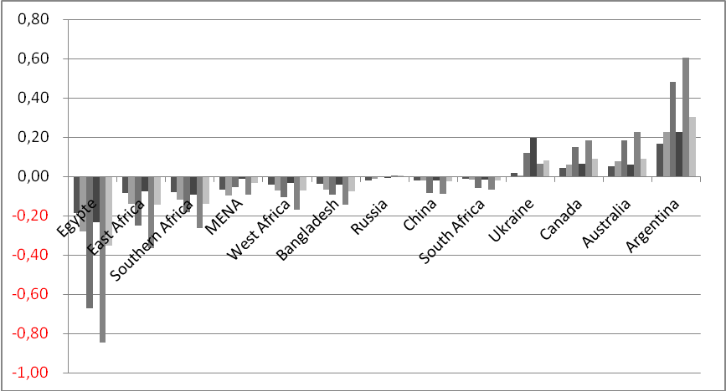
2. An illustration with MIRAGE Welfare impact of various scenarios (% changes compared to baseline)
For each country/region the columns represent successively the following scenarios:
1 - Base; 2 - ET; 3 - IT ; 4 – IT0; 5 – ETIT; 6 – ETIT0

