Slide 1

A Case Study :
New Zealand Government Procurement
John Ivil, General Manager Government Procurement
Second South Asia Regional Public Procurement Conference
Islamabad, Pakistan 25-27 March 2014

Slide 2
Key facts & figures
Landmass - 268,021 km2
Population - 4.4 Million
Government spend - ~$30 Billion (16% GDP)
~ 95% of businesses are SMEs
Government agencies - 200+ (2500 schools)
Agency pareto (85% spend) - 40 Agencies
Decentralised procurement
No specific procurement legislation –Rules of sourcing

Slide 3
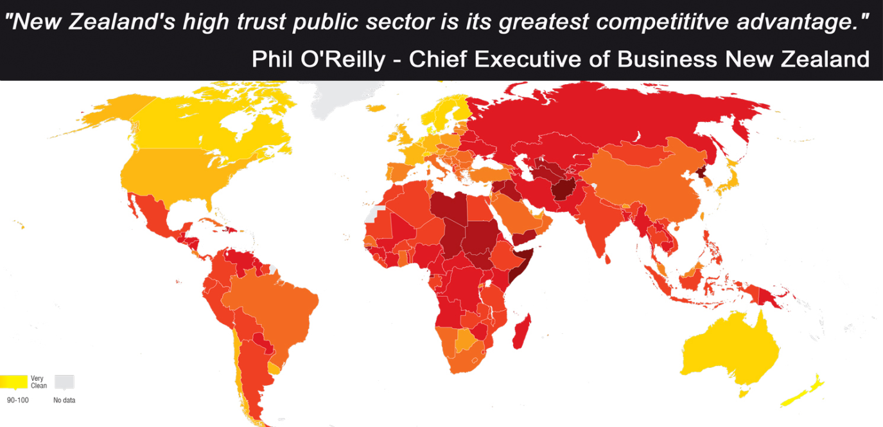
Transparency and Accountability in New Zealand
Decisions made by government are highly visible and transparency is one of the key mechanisms that ensures government accountability in New Zealand.
The media, legislation (such as the Official Information Act 1982) and the Public Service Code of Conduct, ensure that the government is accountable and responsive.

Slide 4
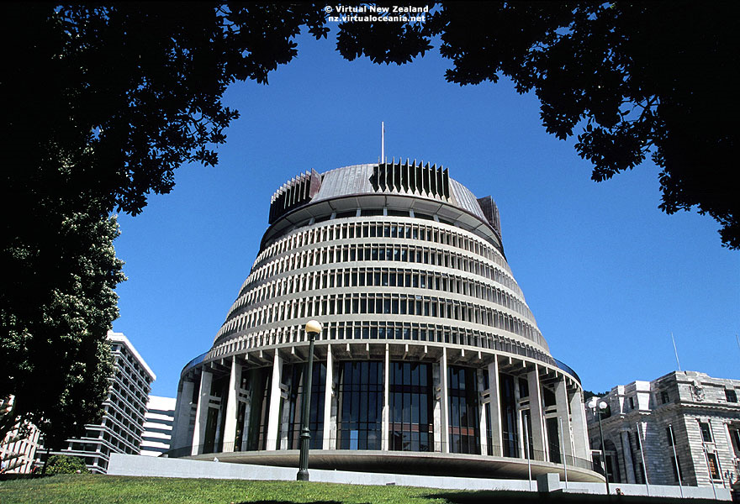
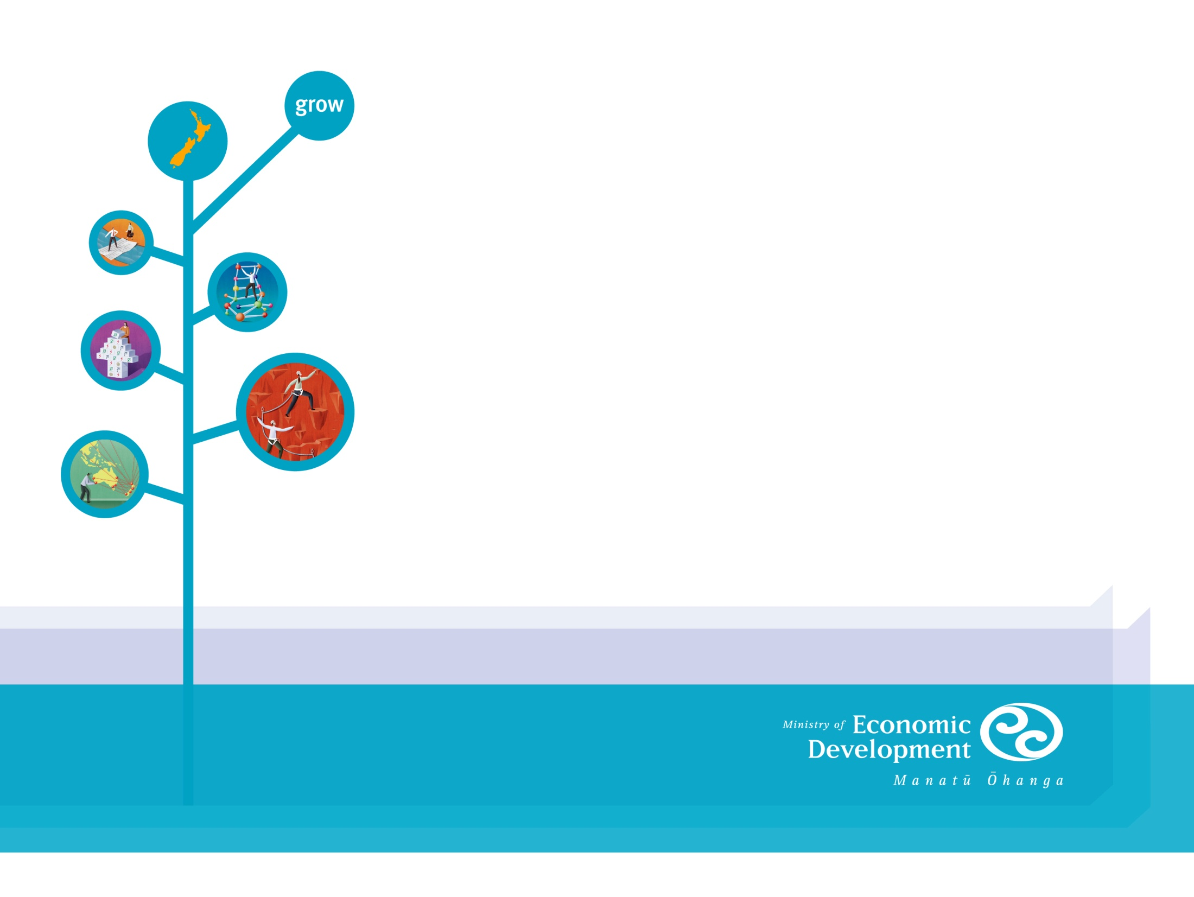
Cost savings
Support value for money
Machinery of Government
Future Activity
The next steps.....

Slide 5
NZ Government structure
Public Sector
State Sector
State Services
Electricity
Mining
Defence
Research
Regional Councils
Public Service
Local Councils
Police
Ministries
Arts, TV & Radio
Schools
Gas
Hospitals
Post
Universities

Slide 6
NZ Government Procurement - Context
Very tight fiscal environment - reduce cost and risk
Canterbury rebuild
Culture of risk aversion in government procurement
A need to professionalise procurement
Shortfall in procurement capability (agency & individual)
Support free trade negotiations
Support economic growth
A need to be fast, agile and flexible

Slide 7

Government Procurement Reform - 2009 to 2012
Procurement Functional Leadership (PFL)
– from 2012 until Present

Slide 8

Procurement reform – What did it achieve?
Established the business case for change – demonstrated value
Cost savings of over NZ $350M
Procurement Academy
Encouraged investment in procurement capability

Slide 9
Procurement Functional Leadership
Increase performance, add value, maximise results
Develop procurement profession & leadership
Build confidence in government as a trusted partner
Strengthen commercial acumen & build sustainable outcomes
Benchmark performance & improve results
Simplify policy & standardise good practice


Create environment for NZ businesses to succeed
Make it easy to do business with government
Foster relationships responsive to business
Stimulate supplier performance - drive efficiency & productivity
Seek innovation & increase competitiveness
Improve access to international markets

Unlock cost savings
Integrate procurement strategies with government’s objectives
Establish what we buy, how much we spend & with whom
Aggregate areas of common spend
Change buyer behaviour

Slide 10

Increase performance, add value, maximise results
opportunities
actions
confusing procurement policy
35+ policy documents
variable application
excessive focus on compliance
operationally inefficient
strong leadership
clarify what is expected of agencies
create single policy statement across government
publish in plain English
immature profession
few qualified practitioners
limited commercial acumen
variable results
limited strategic capability
strengthen leadership
promote change through capability reviews
boost education & training
implement standard results measurement
inconsistent practice
every agency buys differently
processes unnecessarily complicated
unpredictable, slow & costly for supplier to participate
roll-out practical how-to guides
develop plain English templates
standardise government contracts

Slide 11

Create environment for NZ businesses to succeed
opportunities
actions
government is an unattractive customer
difficult to work with
perception that lowest price always wins
no incentive for suppliers to improve performance
little engagement with suppliers
lack of understanding of business needs
facilitate early market engagement
remove barriers & cut red tape
promote a fairer allocation of risk
encourage constructive contract management practices
reward innovation & improvement
push for payment on time
promote benefits of working with government
limited market access
trade barriers
restricted export opportunities
align Mandatory Rules with WTO Government Procurement Agreement
negotiate increased market access for NZ businesses

Slide 12

Unlock cost savings
opportunities
actions
inefficient government spend
fragmented spend
information gaps
poor forecasting
lacks strategic approach
expand aggregation of spend (e.g. All of Government contracts)
identify demand management opportunities
encourage strategic planning & require regular forecasting
Note - circa $350M in cost savings achieved to date in 14 contact areas

Slide 13

PFL – what does it really mean?
Capability development highest priority
Centre-led, not centralisation
Strong leadership and support – including commercial pool of procurers to help agencies and support for collaborative opportunities
Recognises the value procurement can add
We now strive to deliver great outcomes rather than just good process

Slide 14

The tightrope – Its never easy
Meeting the needs of both government + suppliers
Reducing costs for government + suppliers: not a zero sum game
Ensuring government procurers can ‘walk the talk’
Changing a culture developed over generations

Slide 15

Capability building
Significant investment in procurement capability
Leadership support & training
Procurement training for non-procurers
Agency capability reviews
Graduate programme
Immigration (MCIPS on Skills Register)

Slide 16
Approach – the value add

Slide 17
Driving collaboration across government
MBIE manages and/or facilitates a number of collaborative contracts across government.
Syndicated contracts.
Common capability contracts.
All of government contracts.
All of these contracts are openly tendered in the market.

Slide 18
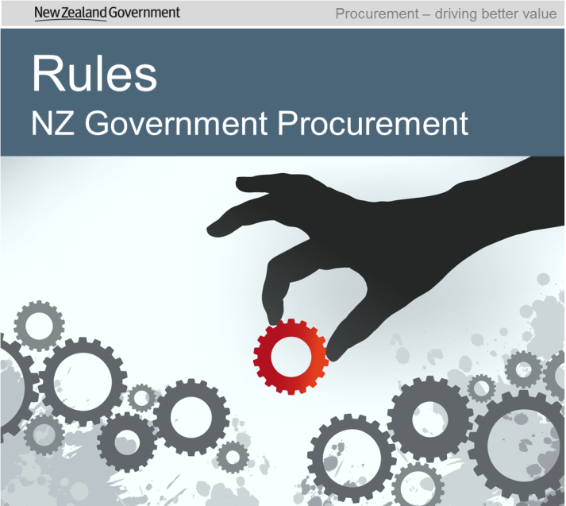
Establishing minimum standards of procurement practice
The Government Rules of Sourcing came into force in October 2013. They set minimum standards of procurement practice and align with international best practice.

Slide 19
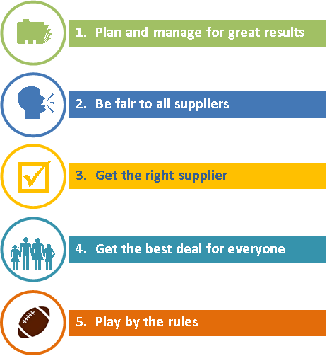
Application of the Government Rules of Sourcing
The Government Rules of Sourcing shape the way that agencies approach the market and assess responses.
All agencies must have polices in place that incorporate the five Principles of government procurement.
Notes:
These principles clearly define – in some detail – the governments expectations from procurement.
Plan and manage for great results – This is about actively planning procurement activities – ie Plan, Check, Go, Review
Be fair to all suppliers – This is about giving all suppliers a chance to respond – either as a prime or sub contractor. We need to make it easy for suppliers to do business with govt.
Get the right supplier – This is about choosing the right supplier and being confident that they will successfully deliver.
Get the best deal for everyone - This is about achieving best value for money – not the lowest price
Play by the rules – This is about building trust with suppliers and keeping a reputation as a trusted partner
Category Reviews
Best practise contract management
Supplier and Customer Satisfaction
Buyer Behaviour

Slide 20
Conclusion
Massive amount achieved in 4 years !
Currently in phase two (PFL) of a 10 year programme
Inspired by achievements in other jurisdictions…..but fast, agile and flexible
Political support
Cost of Procurement Reform Programme/Procurement Functional Leadership is fiscally neutral
Strong Agency commitment over 400 agencies participating on a voluntary basis
NZ procurement academy established
From scepticism to positivity
The key to success is investment in capability

Slide 21

Cost savings
Support value for money
Questions ?

