Slide 1
Modern public procurement: From compliance to performance
SARPS

Slide 2
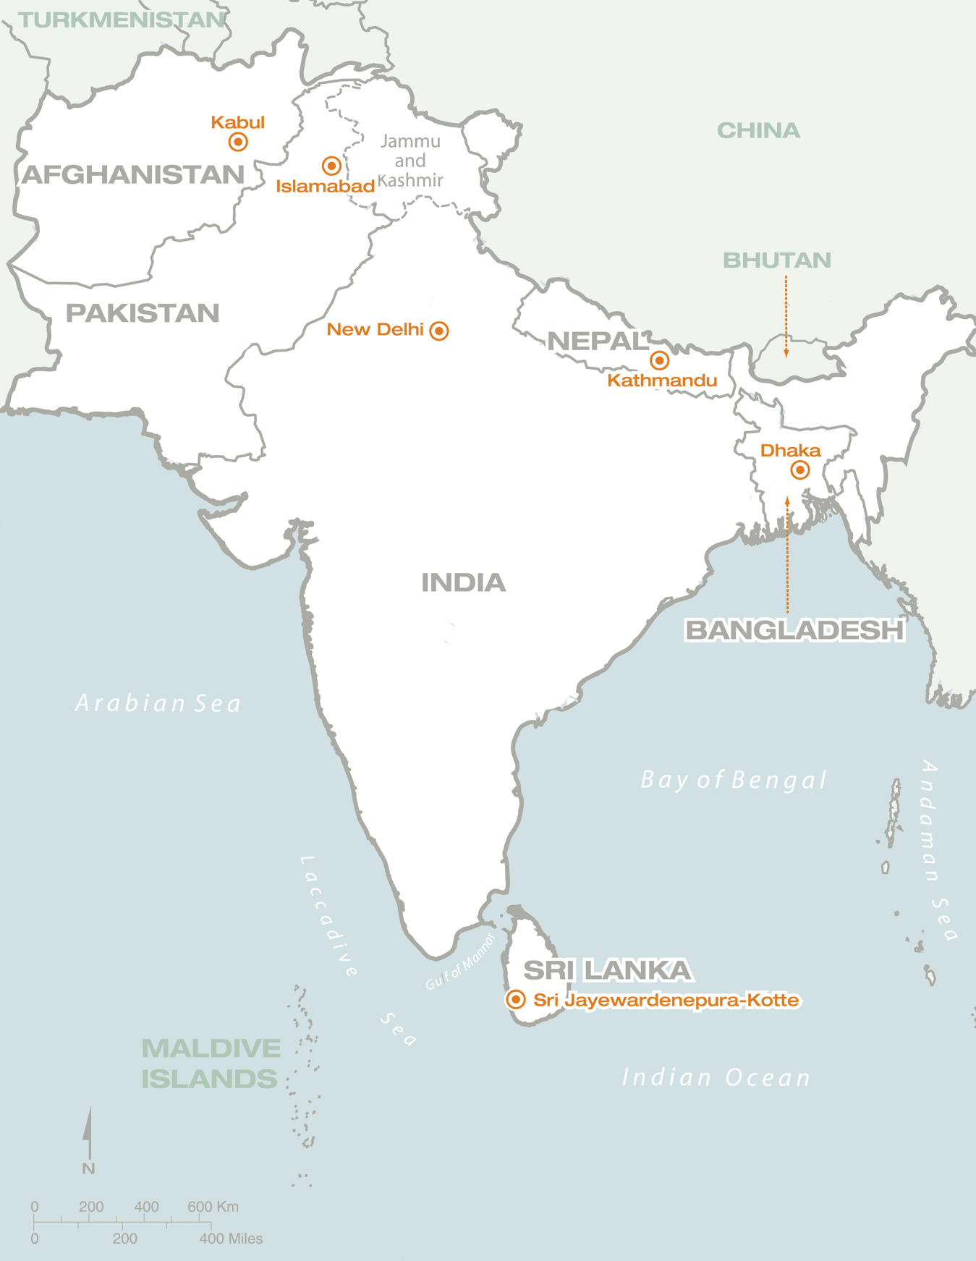
Public Procurement could reach up to 16% of the GDP (1) and in some cases even more
We are talking about USD 400 BB
SAR GDP is around USD 2.500 BB
Sound procurement systems are key to development
(1) OECD

Slide 3
SAR countries’ procurement systems are slowly adopting new practices
Although there are differences between countries, all of them are far from what it can be achieved

Slide 4
The basic challenge is to measure the performance (value for money, integrity, efficiency) and then improve
Agencies
Policy maker
?
X
?
Transactions
Transactions
Action plans to improve
Indicators
Transactions
Transactions

Slide 5
Where to improve? What is the next step? It will depend on the indicators but some areas to consider are …

Slide 6
General environment
Regulatory Framework
Dispute resolution mechanisms
Information access policies

Slide 7
E procurement
Suppliers registry
Framework agreements
Training
Reverse auction
Certification
Capacity building
Procurement
Methods
Support
Auction theory analysis
Core Procurement Process
Indicators
Records
Spend analysis
Contract management
Benchmarks
Systems
Processes and systems
Standardization
Information flows
Indicators
Capacity building

Slide 8
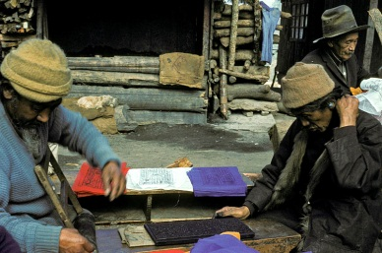
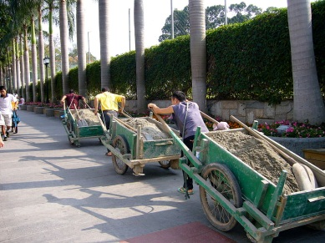
Policies
Sustainable procurement
SME
Local preferences
Gender
Others

Slide 9
We can support bringing state of the art technical expertise
SARPS

