Slide 1
Country Presentation Bhutan
March 2014

Slide 2
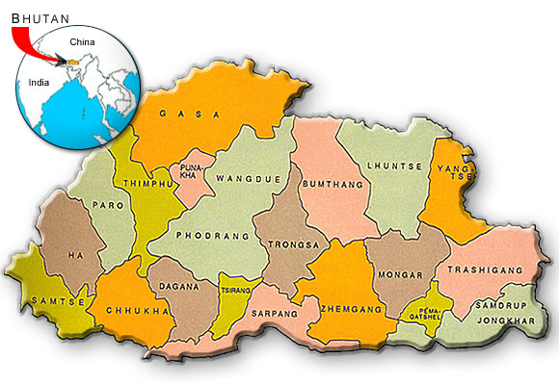
Bhutan

Slide 3
Procurement System in Bhutan

Slide 4
Background on PPPD
Significant development since 1999 when PRR are created and incorporated in Financial Manual 2001.
Ministry of Finance established the Public Procurement Policy Division (PPPD) in August 2008.
Following are the mandates:
Independent Policy Unit
Overall co-ordination of procurement related issues
Oversight & monitoring body
PPPD website act as common place for
advertisement

Slide 5
Reform Areas
Established Public Procurement and Policy Division (PPPD)
Procurement Rules and Regulation (PRR) 2009 and Standard Bidding Document (SBD)
Capacity Building
Independent Review Mechanism (IRM)
Electronic Government Procurement (e-GP)

Slide 6
Current activities of PPPD
PPPD continuously conduct awareness programme on procurement nationwide,
Till date more than 783 procurement related personnel are trained in Certificate in Procurement Compliance (CPC) as part of Institutional Capacity Building Project for Procurement in Royal Institute of Management which is also a CIPS examination centre,
Provides pre-service and in-service procurement training.
PPPD is working closely with CIPS to develop a national framework of procurement qualifications.

Slide 7
Way Forward
Strengthen PPPD (manpower, website, specific SBDs and user manuals, procurement compliance training, qualifications)
Up gradation of PPPD to Department Level,
Propose Procurement Act,
Compliance monitoring
E-GP operational,

Slide 8
Capacity Building

Slide 9
Capacity Building
In order to provide PPPD with implementation support to embed the new systems, raise the profile of procurement and introduce professional qualifications, the Institutional Capacity Building Project for Procurement (ICBPP) was designed jointly between RGoB and the World Bank (WB).

Slide 10
Capacity Building
The ICBPP has three objectives:
To establish and embed procurement benchmarks and standards which are based on international good practice
To establish and professionalize a procurement community through a national people development strategy
To strengthen and support the wider roll out of procurement practices, in order to create a ‘Body’ of procurement knowledge for the Kingdom

Slide 11
Capacity Building
Stakeholder involve:
Strategic approach to capacity building on a sustainable level.
To assist in professionalization of the procurement cadre (Royal Civil Service Commission)
To build institutional capacity to provide procurement training (Royal Institute of Management and Royal University of Bhutan)
To design and deliver training to stakeholders
The overarching goal is to create an institutional set up for certified procurement training on a sustainable level in Bhutan for all levels of required certification.

Slide 12
Capacity Building
Outcomes of ICBPP:
Procurement Qualification and competency framework developed
Procurement module included in PGDFM course for pre-service candidates from 2012
Royal Institute of Management (RIM) as CIPS examination center
One RIM, one RUB and two PPPD staffs fast track to MCIPS qualification

Slide 13
Competent staff do not remain competent forever.
Skills deteriorate and becomes obsolete overtime.
Very competent leader with strong procurement knowledge is desired in public agency.

Slide 14
Procurement Grievance Mechanism (PGM)
Independent Review Body (IRB) established to address any grievances of supplier, contractor or service providers.
Detail working procedures laid down in the IRB.

Slide 15
Debarment Rule (2013)
Came into force in 2013,
PPPD as Secretariat to the Debarment Committee,
Seven Members all director level and above,
One year to five years debarment,

Slide 16
Electronic Government Procurement (eGP)
Designed a website for PPPD (www.pppd.gov.bt), which acts as common place for advertisement,
First phase of e-GP completed which includes basic data capturing of bidders and contractors,

Slide 17
Other Government Initiations to Streamline Procurement

Slide 18
Other Government Initiations to Streamline Procurement
Government Procurement and Property Management (GPPM) Established under the Department of National Properties on 14th April, 2011

Slide 19
GPPM
The division, among others, conduct research in procurement of the government, explore ways to introduce more efficient procurement methods and where necessary standardize goods/services
Also undertake central procurement of widely used goods, either by itself or through other specialized agencies of the government, and wherever relevant, procure directly from the manufacturer

Slide 20
GPPM
Major construction materials – cement, steel and bitumen already enforced,
Widely used office equipments and office supplies

Slide 21
Standardization vs Savings
Centralized tendering
Collate demand across agencies and tender centrally
Ease of implementation
Consolidate vendor base
Standardized specs
Give large volume orders to fewer set of vendors, resulting in more competitive price ceiling
Fix standard specs for laptops and desktops
Revise price ceiling
Savings potential

Slide 22
THANK YOU

