Slide 1
Sub-national Fiscal Rules as an Institution for Fiscal Discipline: International Practices and Lessons
Anwar Shah, SWUFE, China and Brookings Institution, Washington DC,USA (shah.anwar@gmail.com)
World Bank Seminar on International Experience with Fiscal Rules
Islamabad, Pakistan
24 April 2014

Slide 2
Outline
Institutions For Fiscal Discipline
Legislated Ad hoc Fiscal Rules
Fiscal Responsibility Framework Legislation
Empirical evidence on the Impact of Sub-national Fiscal Rules
Lessons

Slide 3
Institutions for sub-national fiscal discipline
Market Discipline: Well developed credit markets and independent credit rating agencies; Fiscal transparency and Local Fiscal Autonomy
Examples: Sole reliance for provincial fiscal discipline in Canada
Cooperative arrangements: Examples: The Australian Loan Council, High Finance Council of Belgium, Association of regional/local governments in Denmark and the Council for Fiscal and Financial Policy, Spain
Administrative controls and Financial regulations: Prudent regulatory regime, sanctions for non-compliance control boards and insolvency mechanism
Rule based controls: Legislated fiscal rules
Legislative Framework for Fiscal Responsibility

Slide 4
Fiscal Rules : How defined?
Constitutional or statutory limitations on fiscal policy aggregates e.g. expenditures, taxes, deficit, debt and net worth.

Slide 5
Motivation for Fiscal Responsibility Legislation
Fiscal populism leading to unsustainable fiscal policies. Electoral pressures – short time horizon – threat to macro stability
Political institutions systematic bias towards larger projects although SMC may be higher
Public debt as an instrument to bind future governments to current choices

Slide 6
Special problems arising in federal countries
Agency problems with incomplete contracts and undefined property rights (taxing, spending and regulation) – lack of accountable governance
Intergovernmental bargaining with high transaction costs.
Tragedy of commons with common pool resources - universalism and pork-barrel politics

Slide 7
Special importance of sub-national fiscal rules in federal countries
Large vertical fiscal gaps filled by gap filling, “manna from heaven “ (NFC type) fiscal transfers create incentives for fiscal imprudence. Fiscal rules may help restrain such behaviors.
Mitigating the tragedy of commons associated with the “common pool problem”.
Avoiding moral hazard associated with soft budget constraints and expected bailouts.

Slide 8
Golden Rule for Sub-nationals
How defined?
Borrow only to invest
Current budget in balance or in surplus
Judged over a defined period (annual: most countries; 2years: Nova Scotia, Quebec ; 3 years: Netherlands and Spain; 4 Years: New Brunswick and Saskatchewan, Canada; economic cycle: Austria, Australia, UK)
Usage: wide – most OECD countries and a large number of developing countries

Slide 9
Golden Rule: Pros and Cons
Pros
Simple, rational and easy to monitor and enforce.
Requires comprehensive capital (development) and operating (current) budgets.
Cons
Less useful if segmented budgets with large off budget expenditures.
Some potential for fiscal gimmickry through reclassification of expenditures.
Operating budget balance judged over the economic cycle difficult to enforce because of inconsistency with political cycles.
Structural balance, if used, open to debate.

Slide 10
Sustainable Sub-national Investment Rules or Debt Limitations
How defined?
Borrowing prohibitions
Domestic and abroad: China, Thailand, Azerbaijan, Belarus, Bosnia; Indian states and Pakistan provinces require central approvals if current debt to central govt.
Overall debt limits expressed as a proportion of Local Revenues. Examples: Brazil (states: 2 times and Municipalities 1.5 times current revenues), Albania, Estonia (<75% of revenues), Poland (<60%)Kazakhstan (<25% of revenues), Colombia (<100% of revenues).

Slide 11
Sustainable Sub-national Investment Rules …………………………continued
Overall debt limits expressed as a proportion of Local GDP. Hungary, Slovakia (< 60% of local GDP); Russia (<30% for oblasts and <15% for rayons) ; 9 US states for LGs as varying % of personal income, 7 US states per capita debt.
Debt Service limits expressed as a % of revenues: <40% Colombia; <25% Italy, Spain, Peru; <20% Armenia, Estonia, Kazakhstan, Japan;<15% Russia, Poland, Argentina; varying rates by 12 US states for local govts.
Restraints on new debt typically expressed as a % of revenues: Kazakhstan<10% of revenues

Slide 12
Sustainable Investment Rules: Pros and Cons
PROS
Important signal for adherence to fiscally sustainable policies
Helps restrain populist politics and the growth in the size of the public sector
Requires arms length relationships with financial sector and state owned enterprises.
CONS
Pro cyclical fiscal policy. Could hurt growth of severely depressed economies
May encourage creative accounting ala Turkey, Pakistan and Greece
Potential for “creative accounting” greater under modern accrual budgeting and accrual accounting systems
Too restrictive debt limitations rules may lead to serious infrastructure deficiencies. Examples of Brazil and China (off budget borrowing to overcome)
Difficult to enforce on large provinces e.g. Punjab and Sindh
Problematic if provinces own and regulate financial institutions as in Pakistan

Slide 13
Fiscal Adjustment gone too far ?

Slide 14
Tax Limitations
How defined?: Revenue to GDP, revenue to taxable capacity, tax rate caps, limiting new taxes. Example: California Proposition 29 limitations on property tax rates, Swiss requirement for referenda on tax increases and new taxes
PROS
Helps restrain size of the public sector
Countercyclical if limits on tax rates
CONS
Greater deficits if no spending restraints

Slide 15
EXPENDITURE LIMITATIONS: WHY?

Slide 16
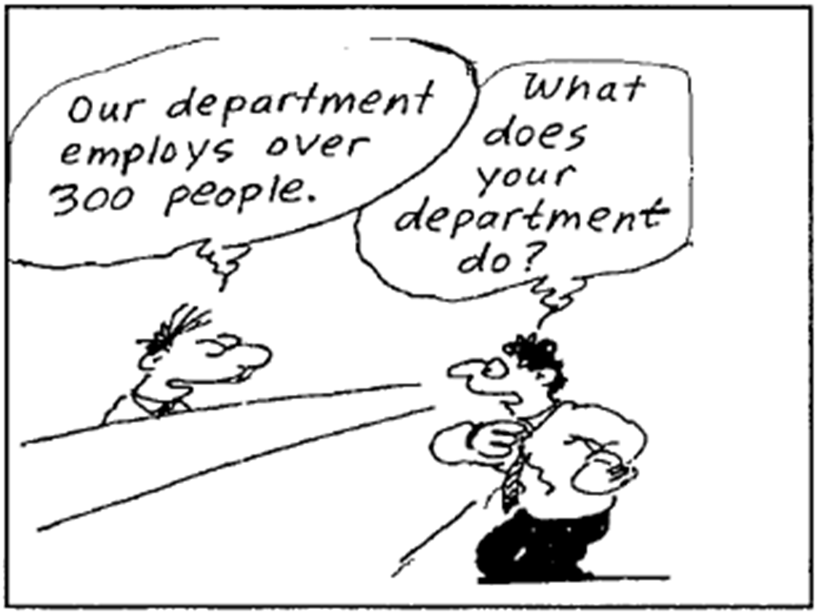

Slide 17
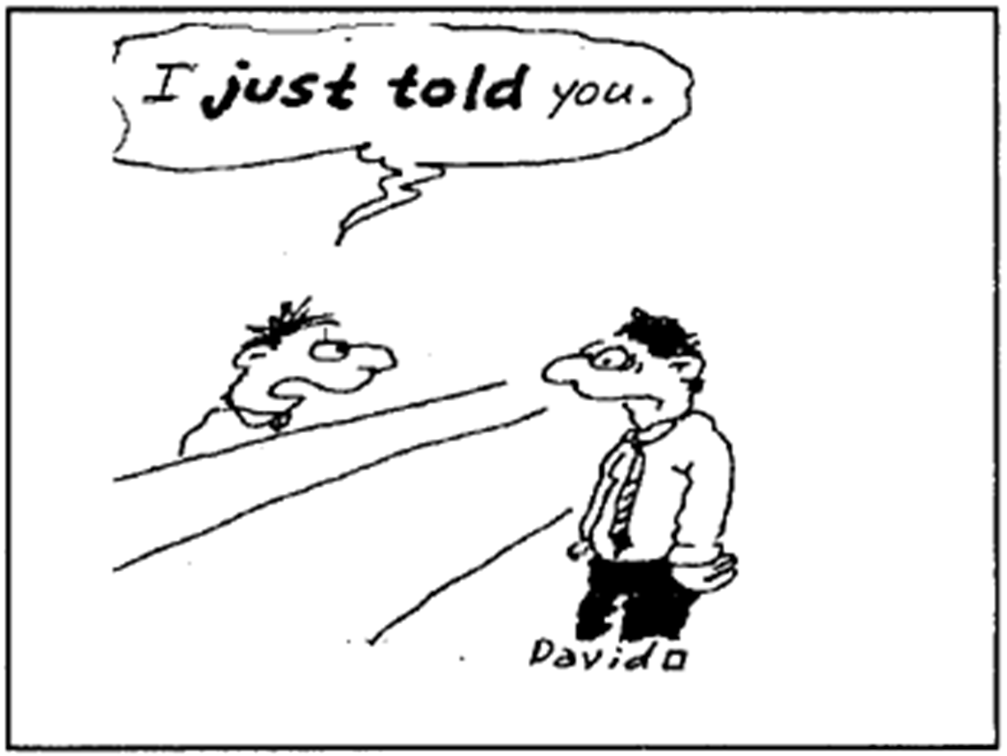

Slide 18
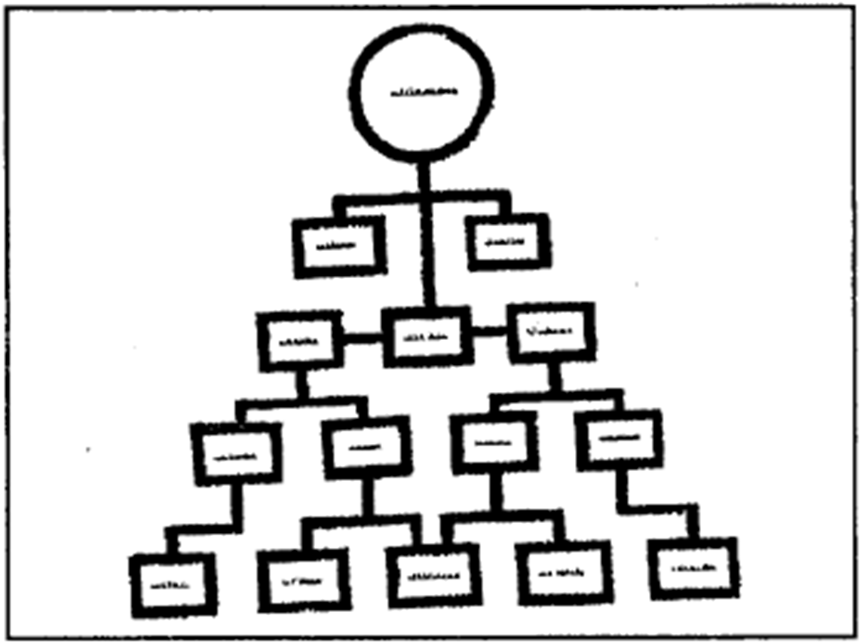

Slide 19
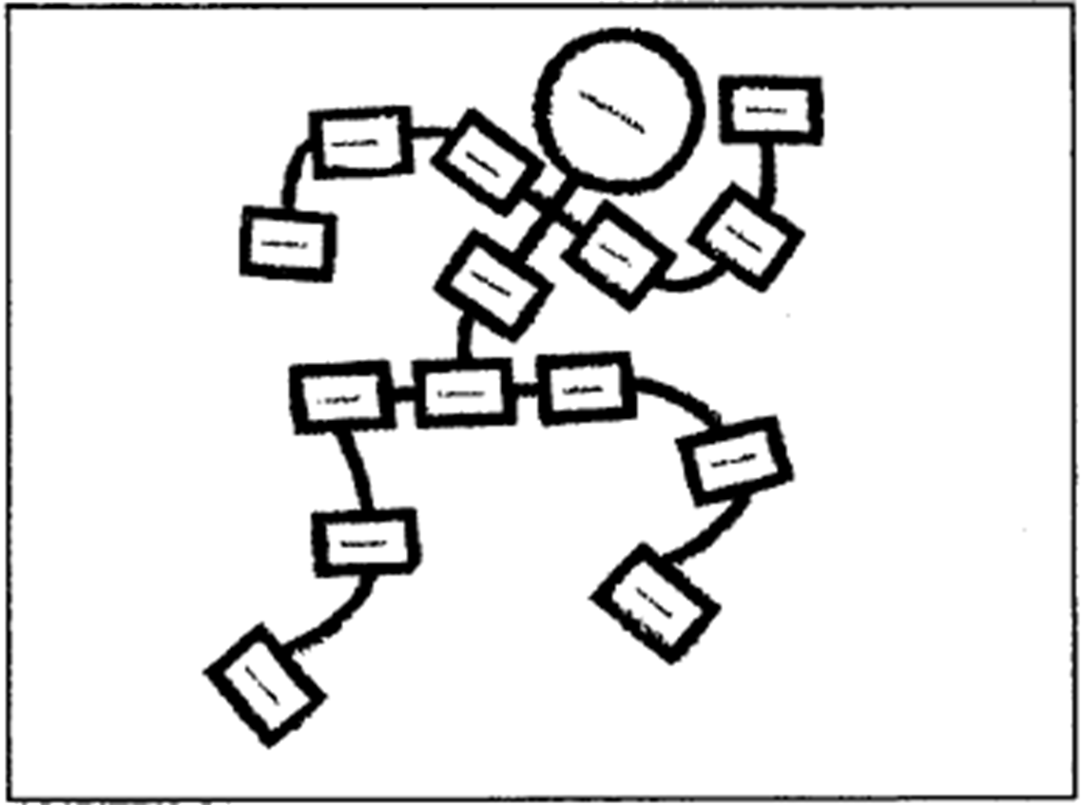
Goals of rightsizing the government

Slide 20
Expenditure Limits
How defined? Minimum (Brazil, Vietnam and Thailand: at least 25% of total local expenditure on education) and maximum as a share of total spending, limits on wage expenditures (Brazil: Max of 60% for state and local, Vietnam – at least 50% of revenue surplus). Limits on rate of growth of public spending (Argentina:< GDP growth; Peru:<3% in real terms)
PROS
Helps restrain public sector size and restore fiscal sustainability
Limits patronage politics by restraining public employment
CONS
Rationalization of expenditures more desirable than expenditure limits
Specific expenditure requirements limits budgetary flexibility and distorts local priorities. Example Vietnam Science and technology R&D expenditure requirements and use of revenue surplus for provincial-local governments

Slide 21
Lessons from expenditure reductions in past fiscal consolidations
Across the board cuts not effective or sustainable (OECD, 2010)
Cuts in public investments not conducive to success. Larch and Turrini (2008).
Spending cuts in public sector employment, wages, social security and transfers matter more than tax increases. Alsenia and Perotti (1995, 1997), Zaghini (1999), Hagen et al (2002), Larch and Turrini (2008), Bertelsmann Found. (2006).
New Pubic Management (NPM) reforms can be helpful. (OECD, 2010)
Deeper the crisis, greater the opportunity for fundamental reforms. Aldagna (2004), Briotti (2004), Ahrend et al (2006), Alesina and Ardagna (1998)
Sustained political commitment matters Alsenia and Perotti (1995). Hallberg, Strauch and Hagen (2009)
Fiscal governance matters. Hallberg, Strauch and Hagen (2009),

Slide 22
Maintaining Positive Net Worth
What is net worth? : Total assets (physical and financial assets) minus total liabilities (debt, payables and provisions, explicit and implicit liabilities). Example. Externally audited quarterly financial statements required of all local governments in Canada.
PROS
Comprehensive view of the fiscal situation
Difficult to manipulate
Provides an early warning system of fiscal distress
CONS
Initial valuation of assets and liabilities – a large task

Slide 23
Fiscal Responsibility Legislation (FRL)
A Comprehensive approach to fiscal transparency and fiscal discipline. Embodies:
Procedural and fiscal rules with few non-discretionary escape clauses
Prudent financial and intergovernmental regulations, no borrowing from state owned banks and no intergovernmental lending
Fiscal transparency provisions
Internal and external monitoring for compliance
Credible and enforceable sanctions for non-compliance
Practice: Strong and unique FRL: Brazil; Moderate: Peru and Colombia; weaker national laws in USA, New Zealand, UK, India, Pakistan, Argentina, Ecuador, RSA. Strong provincial legislation in 3 Canadian provinces. Weaker Indian states

Slide 24
Fiscal Responsibility Legislation: Sanctions for non-compliance
Brazil:
Sanctions:1-4 year prison term for elected and civil service and Bank officials; Fines for all officials – for civil service up to 30% of annual salary; removal from elected and appointed offices and ineligibility for election or public employment plus institutional sanctions.
Enforcement: Independent public prosecutor; the Fiscal Council and citizens’ legal empowerment to petition courts.
Argentina: Suspension of membership of Fiscal Council, limits on borrowing, reduced fiscal transfers
Colombia: Central MOF supervision of debt and adjustment program, personal sanctions
Peru and Ecuador: Suspension of central transfers, personal sanctions
Canada (British Columbia, Manitoba and Ontario provinces’ FRLs): 20-25% of annual salary of executive council for first year; 40-50% for the second year of non-compliance.

Slide 25
Fiscal Responsibility Legislation: Some Conclusions
Political consensus a must.
Comprehensiveness desirable. Must be enforceable
Credible sanctions and self reinforcing enforcement mechanism critical – explains the success of Brazil and failures in the USA and the European Union
People empowerment to hold the government to account through the judicial process for non-compliance, as done by Brazil, helpful
Fiscal rules must not be rigid but flexibility should be tied to broader economic conditions such as economic recession

Slide 26
Impact of sub-national fiscal rules on fiscal performance: empirical evidence
Cross-country studies:
Little or no impact of borrowing constraints. Webb and Zou (2002).
Positive impact. Rodden (2002); Singh and Plekhanov (2005) .
Country case studies: Mixed evidence in OECD countries. Greater success in developing and transition economies.
No impact: rules subverted at state level in Argentina, and Australia (till mid 1990s), at local levels in China (In 2013,US$ 2 trillion local debt with prohibition) and Italy
Mixed evidence: At state level in the USA; at local levels in Norway, Sweden, Finland, Spain.
Positive impact: at state level in Brazil, India,Canada; at local levels in Brazil, Colombia and Peru (Crivelli and Shah, 2009)

Slide 27
Lessons………………………………1
Fiscal rules must not be too restrictive and must be designed with care to avoid unintended adverse consequences.
State level fiscal rules alone are neither necessary nor sufficient for fiscal discipline under single party majority rule but helpful in fiscal retrenchment under coalition regimes. Fiscal rules may be helpful in constraining corrupt political deal making.
Local level fiscal rules more helpful for local fiscal discipline.
A comprehensive legislative approach with credible sanctions desirable and more successful.

Slide 28
Lessons………………………………..2
Maintaining positive net worth a better fiscal rule.
Across the board expenditure reductions not desirable.
Inflexible fiscal rules may impede countercyclical fiscal policy. In severely depressed economies, temporary expansionary fiscal policy may be helpful in stimulating output and reducing deficits and debts.
Fiscal rules should apply to budgetary outcomes and not to fiscal projections.
Monitoring by an independent fiscal council, think tanks and citizens desirable.
Enforcement by an independent prosecutor and also citizen empowerment to request court action helpful.

Slide 29
Selected References
Boadway, Robin and Anwar Shah (2009). Fiscal Federalism. Principles and Practice of Multiorder Governance. New York and London: Cambridge University Press
Crivelli, Ernesto and Anwar Shah (2009). “Promoting Subnational Fiscal Discipline: A Review of Budget Institutions and Their Impact on Fiscal Performance”. Unpublished paper, World Bank, Washington, DC
OECD (2014). Fiscal Federalism 2014. Making Decentralization Work. Paris: OECD

