Slide 1
Subnational Fiscal Rules and Debt Control in Brazil Islamabad, April 24th, 2014
Rafael Barroso
Economist, World Bank

Slide 2
Outline
Context
Subnational bail-outs in Brazil
The current subnational fiscal rules and debt controls in Brazil
Performance of subnational finance
What worked and what did not work

Slide 3
Context
Federative country with 27 states and 5,570 municipalities.
Municipalities are not creature of the states.
Highly decentralized federation:
32.1 % of revenues collected by Subnational Governments (SNG); and
43.1 % of available revenues (after transfers) to SNG in 2012.

Slide 4
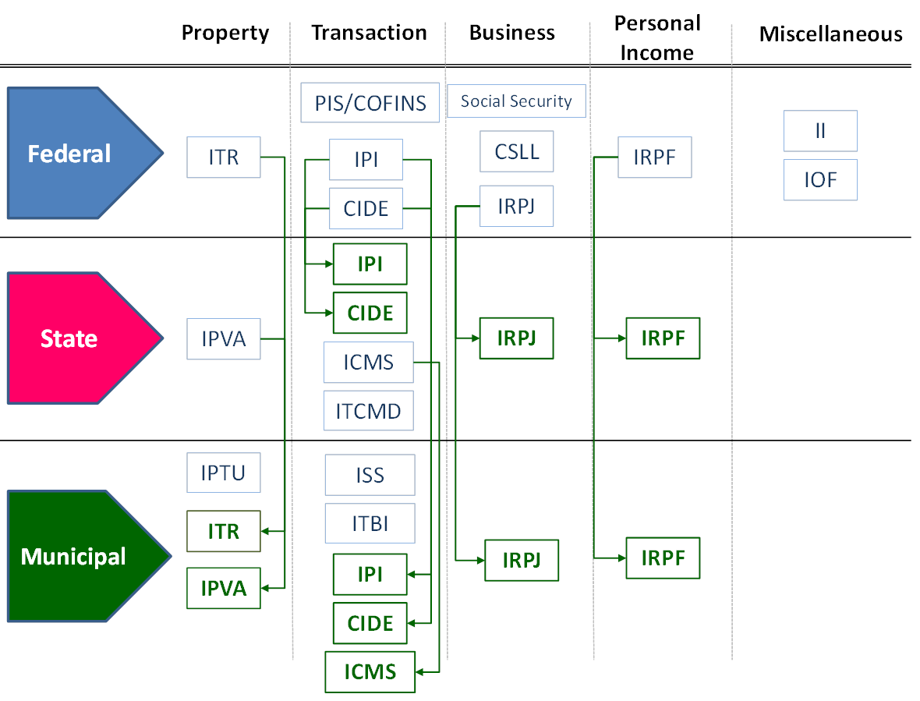
Context – Revenue Assignment

Slide 5
Context – Expenditure Distribution
Source: STN

Slide 6
Outline
Context
Subnational bail-outs in Brazil
The current subnational fiscal rules and debt controls in Brazil
Performance of subnational finance
What worked and what did not work

Slide 7
1st and 2nd Subnational Bail-Out
 | 1st Bail-Out (1989) | 2nd Bail-Out (1993)
Debt Refinanced and Cut-off Date | LT external debt contracted until Dec 1988 Domestic debt service in arrears Budget deficits until 1987 | Contractual domestic debt held before Jun 30, 1993 External debt Excluded bonds
Terms | National currency, 20 year final maturity, 5 year grace period, interest rate and index equal to Federal Government | 20 year final maturity, no grace period, indexed to General Price Index and interest rate equal to average of contracts (6.5%)
Cost | USD 8.7 Billion (Dec-98 prices) | USD 32.7 Billion (Dec-98 prices)

Slide 8
3rd Subnational Bail-Out (1997)
Bail-out comprised bonds, domestic and external contractual debt held by 1994, whose refinancing had been authorized until Jun 30th, 1999.
Initially, it was thought of only to states, but it was extended to municipalities in 2000 with similar conditions.
Innovations:
Withhold of transfers and own source revenues as guarantee;
Refinancing in exchange of a fiscal adjustment program with objective targets and penalties in case of non compliance;
Refinancing conditions tailored to each state;
SNGs supervised by the National Treasury.

Slide 9
3rd Subnational Bail-Out (1997)
Establishment of a Fiscal Adjustment and Restructuring Plan (PAF) with targets for:
Total Debt/ Net Real Revenue ratio;
Primary Balance;
Payroll Expenditure;
Own source Revenue;
Public Sector Reform/ operating expenditures; and
Investment expenditures
Greatest beneficiaries were the four largest states: SP, RJ, MG and RS.

Slide 10
3rd Subnational Bail-Out (1997)
Final maturity: up to 30 years;
Interest rates: 6%, 7,5% or 9% + IGP-DI
Debt service cap: 13% to 15% of Net Real Revenue.
Value: USD74,2 billions (Dec-98 prices)
Initial Subsidy: difference between the interest rate in the original contracts and the refinancing rate from the cut-off date to the contract signing date.
Subsidy: difference between the interest rate charged to SNG and the rate paid by the Federal Government on the bonds issued to refinance the SNG debt.

Slide 11
3rd Subnational Bail-Out (1997)
Total Value of the Debt Refinanced (BRL billions)
States – Refinancing | 117.5
States – Subsidies | 14.3
States – Total | 131.8
Municipalities | 16.4
PROES | 54.0
* Values in Dec/2000 prices, except for municipal debt which are the current value of the date of the contract signature.
Source: (Mora, 2002) e Federal Senate Economic Affairs Committee Report

Slide 12
Why the 3rd bail-out worked?
3rd bail-out was the most comprehensive. It encompassed the majority of the debt stock, including bonds
No one-size fits all approach
It dealt with the root cause of the debt overhang – SNG fiscal imbalances by demanding fiscal adjustment through a rolling 3 year fiscal plan, including privatization of SOEs and extinction of public banks.
It created capacity and a special unit at the National Treasury to supervise SNG
It was credible – sanctions were established and used and money could be withheld from SNG Treasury Single Account

Slide 13
Outline
Context
Subnational bail-outs in Brazil
The current subnational fiscal rules and debt control in Brazil
Performance of subnational finance
What worked and what did not work

Slide 14
The Three Mutually Reinforcing Rules of the Current Subnational Fiscal Framework
Debt Renegotiation Law (9.496)
Supply side constraints
(CMN)
FRL
Borrowing Space

Slide 15
Fiscal Responsibility Law
FRL is an all encompassing law of public finance, that has introduced fiscal rules in Brazil but has gone beyond that
The most well known fiscal rules are the limits on payroll expenditures and on net debt
Net Consolidated Debt/ Net Current Revenue is capped at 200% for states and 120% for municipalities
Debt limits were never set for the Federal Government
SNG were prohibited from issuing bonds until 2020
Payroll Expenditures/ Net Current Revenues is limited at 50% for the Federal Government and 60% for SNG, with sub-limits for each Power
However, the limit on payroll is the only one inserted in the law, all others are called for in the law, but set by Federal Senate Resolutions and therefore more easily changed if needed

Slide 16
Fiscal Responsibility Law
The FRL institutionalized fiscal discipline at all levels of government.
Incorporates hard budget constraints into a single unifying framework
Prohibits debt refinancing operations between different levels of government
introduces more stringent requirements on fiscal targets in the preparation of the Budget Guidelines Law
It also introduced other innovations such as estimation and disclosure of tax expenditures and fiscal risks as well as the requirement for frequent reporting
Is complemented by a Fiscal Crimes Law applicable to cases of non-compliance with the FRL

Slide 17
Debt Renegotiation Agreement
It foresees a rolling three-year fiscal plan (PAF) with measures and targets to be agreed between the state and the Federal Government
Federal Government has total control over new debt for bailed-out SNG
Until 2007, few new loans were authorized
After 2007, the Government introduced a rule in which states whose actual Total Debt to NRR ratio were below the agreed trajectory would have fiscal space to contract new loans
The so-called fiscal space is the difference between the agreed and the actual debt to revenue trajectory

Slide 18
National Monetary Council Resolution
The National Monetary Council set also a supply-side restriction by determining that the outstanding domestic bank credit to the whole public sector be limited to BRL 1 billion.
However, the original resolution provided for some exceptions and the list of exceptions just grew over time
Thus, this limit has become the least binding one and has served more for the Federal Government to direct the loan proceeds to its areas of priority

Slide 19
Federal Government Guarantees to SNG
The Federal Government can extend guarantees to SNG debt, as requested by some lenders, but SNG have to offer counter-guarantees (transfers, own source revenues) in exchange
In order to give the guarantee, the Federal Government rates SNG in 4 categories (from A+ to D-) in accordance to 8 criteria: debt, debt service, primary balance, operating balance, etc.
SNG with A or B rating will receive the guarantee.
Exceptions can be made to SNGs with a C rating by the Treasury Secretary and by the Ministry of Finance for SNG with a D rating
Since 2005 there was no guarantee that needed to be honored by the Federal Government

Slide 20
Recent Developments
The Federal Government sent a proposal to Congress to reduce the interest rate charged on the renegotiated debt.
The rate would be lowered to 4% to all SNG and the index would be changed from the General Price Index to the CPI or the benchmark interest rate, whatever is lower.
Congress changed the draft law to make the interest rate reduction retroactive to the contract initial date.

Slide 21
Summary (1/2)
In order to borrow a SNG has to comply with the following rules:
Golden rule (loans can only be used to finance capital expenditures)
Net Consolidated Debt/ Net Current Revenues < 200% for states and 120% for municipalities
Payroll expenditure < 60% of Net Current Revenues
Guarantees < 32% of Net Current Revenues
Loan proceeds in a given year < 16% of Net Current Revenues
Short term debt (less than 1year) < 7% of Net Current Revenues
Total debt service < 11.5% of Net Current Revenues on average during the life of the appraised loan

Slide 22
Summary (2/2)
In order to borrow a SNG has to comply with the following rules:
States must have achieved their Total Debt/ Net Real Revenue and primary balance targets and have an actual debt to revenue ratio lower than the contracted trajectory and show that new loan will not cause the debt to revenue ratio to go over the agreed trajectory
Municipalities with debt renegotiation contracts with the National Treasury can only borrow if Total Debt/ Net Real Revenue < 100%.
Federal Senate approval (only for external loans)
SNG must have legal authorization from its legislative body.
SNG should not have any pending payment or document owed to the Federal Government
SNG should give a counter-guarantee to the Federal Government if sovereign guarantee is required by the lender

Slide 23
Outline
Context
Subnational bail-outs in Brazil
The current subnational fiscal rules and debt control in Brazil
Performance of subnational finance
What worked and what did not work

Slide 24
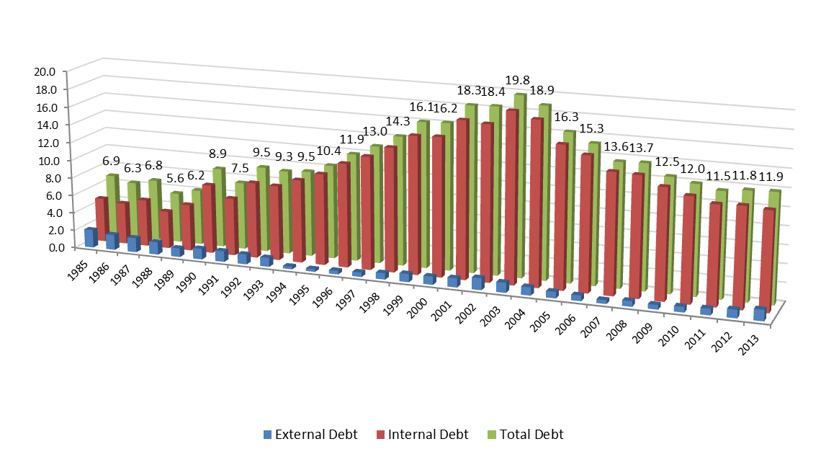
Performance of Subnational Finance
Evolution of Subnational Governments Net Debt: 1985-2013
(% of GDP)

Slide 25
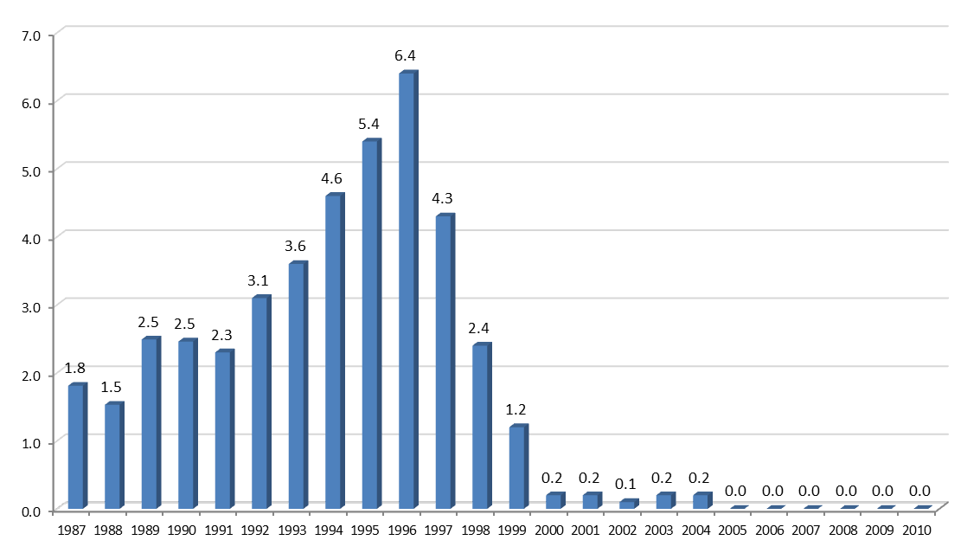
Performance of Subnational Finance
Evolution of Subnational Governments Bonds (Net): 1987-2013
(% of GDP)

Slide 26
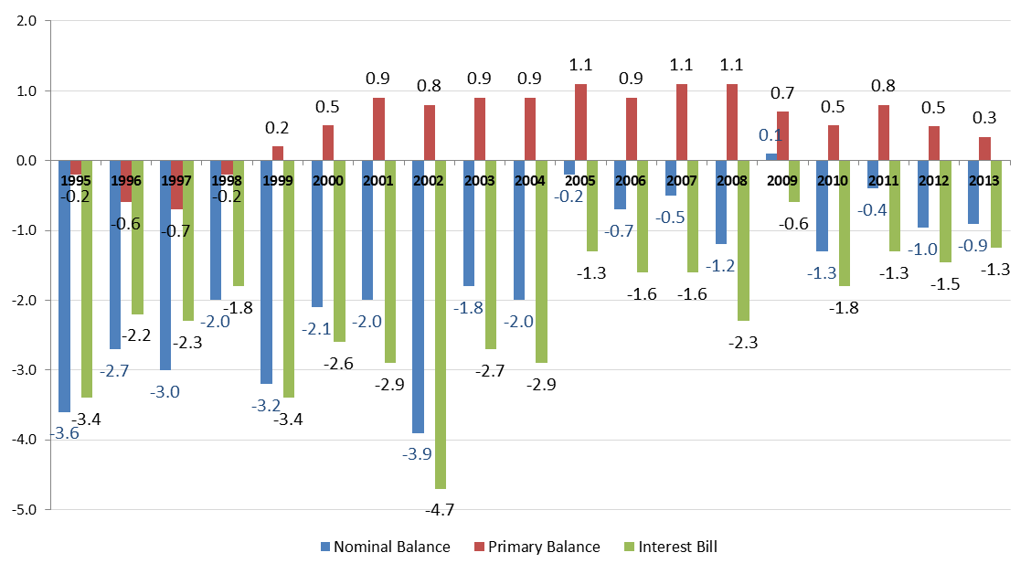
Performance of Subnational Finance
Evolution of SNG Public Sector Borrowing Needs: 1995-2013
(% of GDP)

Slide 27
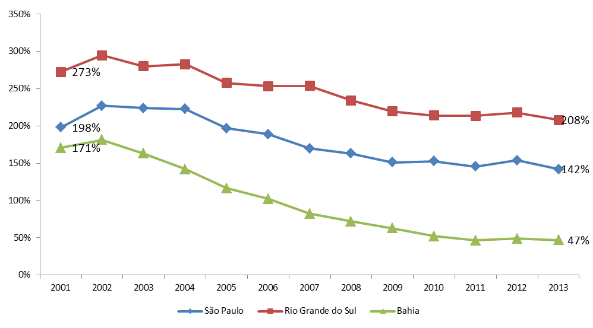
Performance of Subnational Finance
Evolution of Net Consolidated Debt for Selected States: 2001-2013
(% of NCR)

Slide 28
Outline
Context
Subnational bail-outs in Brazil
The current subnational fiscal rules and debt control in Brazil
Performance of subnational finance
What worked and what did not work

Slide 29
What worked …
Fiscal adjustment strategy for SNG addressed the root cause of the imbalances
Supervision by the National Treasury helped reduce information asymmetry between the Federal level and the SNG
Fiscal responsibility was a value embraced by society.

Slide 30
And what did not work
Debt concept and Quasi-debt exceptions
The concept of debt in the FRL is very broad and encompassing, however some states found ways to contract quasi-debt instruments outside of the control of the National Treasury
Weakness of the enforcement by the Court of Accounts
The enforcement of the framework is a task shared by the National Treasury and the Court of Accounts
However, the enforcement by the Court of Accounts is some jurisdictions proved to be weaker, specially in terms of payroll expenditures in which they accepted a looser definition, which ended up benefiting them as well

Slide 31
And what did not work
The fiscal adjustment requested for SNG proved to be somewhat perverse in the sense that initially it implied in a reduction in public investments, due to the rigidity of other expenditures
After the recent crisis, the Federal Government responded by allowing the states to contract more debt to leverage public investments. The result however has been disappointing: loan proceeds have increased 92% from 2010 to 2013, but investments only grew by 4%
Since the estimation of the fiscal space is a forward looking calculation it depends on assumption for revenues and optimistic assumptions can generate more fiscal space
Therefore, there needs to be clear rules to project government balances
Lack of transparency in the fiscal space calculation as well as on the rating assessments on SNG

Slide 32
Conclusions
FRL was successful in changing SNG fiscal behavior
However, the success can not only be attributed to the FRL, but rather to the whole SNG fiscal framework
Even more, it is hard (almost impossible) to disentangle the contribution of each factor to the change in SNG fiscal behavior
The framework has showed to be relatively flexible to accommodate the changes needed over time and to respond to challenges posed by the economic environment
Administrative controls cannot last forever
They do not incentivize SNG to perform better than the minimum threshold
Over time, they become more prone to political pressure and patronage
There need to be a transition strategy

