Slide 1
Debt Reduction in Small States: Is there a Role for Debt-for-Nature Swaps?
Zeinab Partow
PRMED
The World Bank

Slide 2
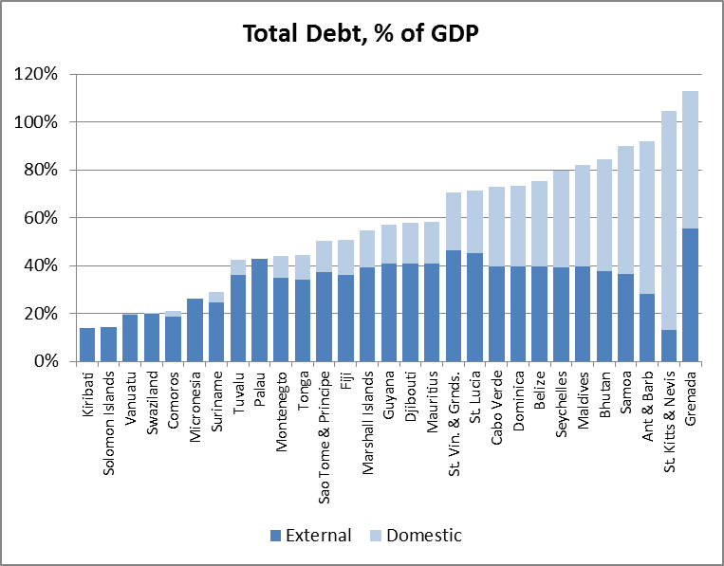
Small States: High Debt Levels Overall
But spanning a wide range of debt-to-GDP and debt service burdens
Data are latest available, 2011-2013
Sources: WB-IMF DSAs, WDI database, country authorities

Slide 3
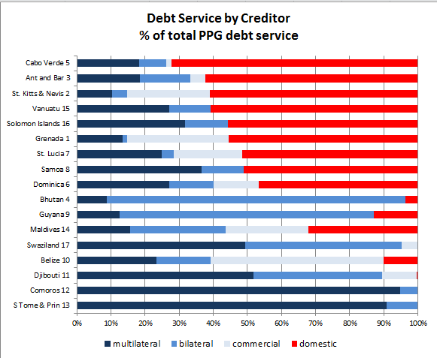
Substantial variety among countries in composition of debt service burdens
Which debt to focus on?

Slide 4
A Role for Debt-for-Nature Swaps / Debt Relief-for-Climate Finance?
DFN swaps seen as an innovative way of addressing small states’ debt challenges and for providing small states with debt relief
What has been the contribution of DFN swaps to debt reduction to date?
What is the volume of financing available?
What elements need to be in place to take advantage of the DFN mechanism?

Slide 5
What are Debt-for-Nature Swaps?
Environmental conservation financing mechanism
Exchange by a creditor and a debtor country, converting debt into local currency and using proceeds to fund conservation activities in-country
Often a third party, e.g. a conservation NGO, purchases debt
A debt swap is only worth doing if commercial banks, investors or creditor governments are willing to sell a country’s debt at less than full face value
Preconditions: - funds to reduce/cancel the debt
- cost of the debt, and
- existence of institutional structure
DFN swaps have potential to multiply and extend duration of ODA funding for programs related to climate change

Slide 6
Contribution of DFN Swaps to Debt Reduction
DFNs have generated very significant additional funds for nature conservation but have not been an important source of debt reduction in developing countries
DFN swaps have involved debt reduction of about US$1 billion, and have generated the equivalent of about US$3.5 billion for conservation
The nominal value of all debt-for-development swaps implemented by members of the Paris Club is US$ 5.6 billion, or 1% of the total debt cancelled by members of the Paris Club (some US$ 503 billion)

Slide 7
What is the Volume of Financing Potentially Available ?
Large headline figures. Green Climate Fund (channel through with most future climate finance will flow) : pledges of $100 billion per year by 2020
Implementation to Date:
Mitigation represents 2/3 of total current climate finance
Adaptation: large gap between approved and disbursed funds, which are highly concentrated in small number of developing countries
Over first 21 years of GEF (through 2012), funds of $4 billion for climate change have included US$358 for climate adaptation, leveraging $1.86 billion in co-financing
Adaptation Fund ($78 million disbursed), REDD ($35 million 1st phase), Climate Investment Funds ($6.1 billion in pledges; none to small states)

Slide 8
What elements need to be in place to take advantage of/scale up the DFN mechanism?
DFN swaps make sense only if debt is discounted, i.e. in countries facing some difficulty in making timely debt service payments
Financial ability and political willingness of donors to allocate additional funding
Political willingness in recipient countries to earmark funds for climate-related activities
Fiscal capacity in debtor country to meet repayment obligations in local currency
Strong organizational capacity to execute DFN swaps – transaction costs are high
Supportive broader context – environmental policies and conservation efforts as well as debt management capacity
Existing implementation vehicles/governance structures for use of conservation funds in debtor countries– e.g. CTFs

Slide 9
Governance Structures: Conservation Trust Funds
Mobilize resources from diverse sources; direct grants to conservation programs (70 CTFs globally; assets: few million US dollars to US$200 million)
Sinking Fund and Endowment models
Best practices exist; evaluations indicate that vast majority of CTFs function effectively and achieve intended purposes
A number of DFN swaps have been managed and disbursed by an already existing CTF
15 small states have already established functioning CTFs/agreed to do so within the next year
Spreading out climate-related spending over a longer period through a CTF can help build absorptive capacity

Slide 10
Scaling-Up DFN Swaps for a Major Impact on Debt Service?
Considerations:
A variety of debt profiles with large variety of creditors
Large domestic debt in the most highly indebted countries – less amenable to DFN swaps
Relatively little debt reduction associated with DFN swaps in the past
Uncertainty regarding volume and additionality of climate change adaptation funds
Potential mismatch between debt volumes to be reduced and capacity to absorb climate change adaptation funds
Implementation and governance structures for conservation programs need to be in place

Slide 11
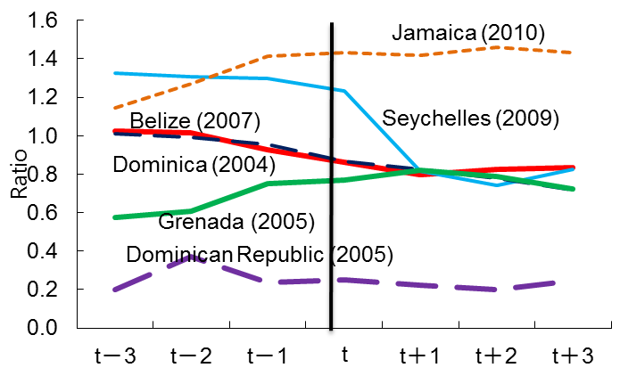
Food for Thought: If debt reduction is the primary motive, why not consider a traditional debt restructuring
Source: IMF – WEO
Note: Three year average before and after the debt restructuring
Source: Jahan, S in IMF (2013 ) and staff estimates
Note: t indicates the launch of the debt restructuring.
The benefit of debt restructuring has usually been in reducing debt service. In terms of reducing the ratio of public debt to GDP the impact has been less.
Nevertheless, debt restructuring episodes have been widespread globally, with more than 600 cases in 95 countries during the past 60 years (IMF, 2012)

Slide 12
Some Conclusions:
DFN swaps can form part of a strategic country approach to address heavy debt burdens, but unlikely to provide a comprehensive solution
Impact of DFN swaps on conservation finance far greater than impact on debt reduction
Traditional debt restructuring has often led to significant reduction in debt service
DFN swaps do not usually involve new net resource transfers, just a redistribution of existing resources
Large headline figures for climate finance, but share available to small states for adaptation is far smaller
Country capacity to use conservation funds needs to be built
Swaps may begin to address debt stock issues; debt flows will build again in the absence of macroeconomic reforms and fiscal adjustment

