Slide 1
Update on the HIPC/MDRI Initiatives
Leonardo Hernandez
PRMED, World Bank
Multilateral Development Banks Meeting
Washington DC - May 6-7, 2014

Slide 2
Outline
What has been achieved
What are the current challenges

Slide 3
1. What has been achieved

Slide 4
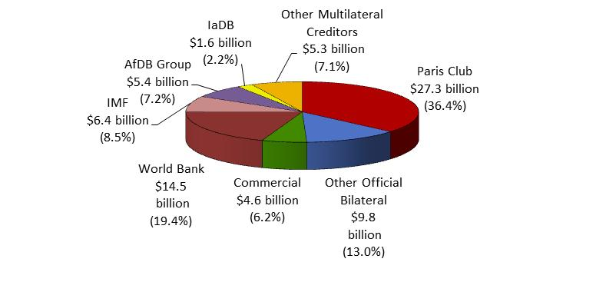
1. What has been achieved Substantial debt relief has been committed
to 39 HIPC eligible countries:
Estimated US$116 billion have been committed under the HIPC (US$75 billion) and the MDRI (US$41 billion) Initiatives.
Paris Club (36.4%) with Multilaterals – IDA (19.4%), other MDBs (16.5%) and the IMF (8.5%) – account for 4/5 of the HIPC debt relief costs.

Slide 5
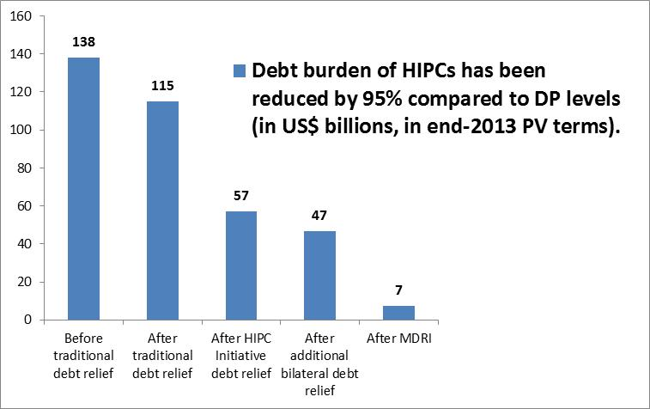
1. What has been achieved The HIPC/MDRI Initiative is Almost Fully Implemented
%GDP
Considerable progress has been achieved under HIPC Initiative
35 out of 39 HIPC eligible countries have completed the Initiative
Chad aims to reach HIPC Initiative’s completion point by end 2014
Only three eligible HIPCs that wish to avail to the Initiative (Eritrea, Somalia and Sudan) have not reached the decision point
Zimbabwe’s eligibility is being assessed

Slide 6
1. What has been achieved Dealing with External Commercial Debt in LICs
The World Bank’s Debt Reduction Facility (DRF) has supported US$10 billion in buybacks in 21 HIPC countries
On average, buyback prices on DRF-supported operations have declined, while creditor participation rates have remained high.
Since 2004 formal link of DRF to HIPC, participation rates have increased, although further effort is needed to resolve the remaining stock of external commercial debt.

Slide 7
1. What has been achieved Risk of Debt Distress Has Fallen for HIPCs
Countries in debt distress or at high risk of distress fell from 18 to 8.
Countries at low risk almost tripled from 5 to 13.
Debt relief has opened space for countries to contract new debt, including non-concessional, and markets want to lend to LICs again.
Going forward, macro-fiscal policies and investment and growth strategies will matter the most for debt sustainability.
Changes in countries’ risks of debt distress: 2006-13
(post-DP HIPCs)

Slide 8
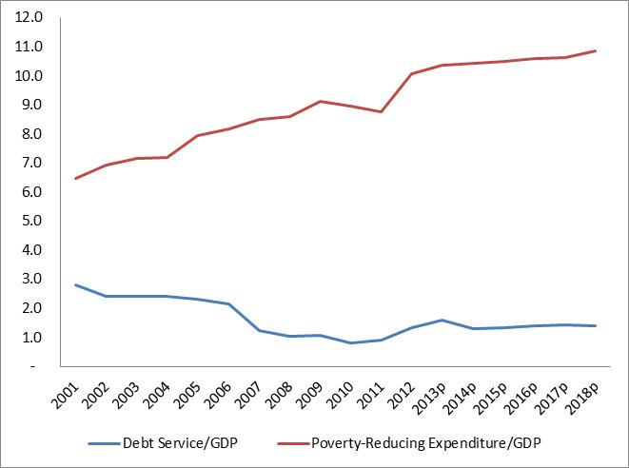
1. What has been achieved Poverty-reducing Expenditures are up, debt service is down
Poverty-Reducing Expenditure and Debt Service in 36 Post-Decision-Point HIPCs
(simple average; % of GDP)
Poverty-reducing expenditures by HIPC countries increased by more than three percentage points of GDP, on average, while debt service payments have declined.
Causality and additionally are harder to assess.
Notes:
The coverage of poverty-reducing expenditures varies across countries, but is generally consistent with the definition in the countries Poverty Reduction Strategy Program and the budget of each HIPC. In some countries, the definition of poverty-reducing expenditures has evolved over time to include more sectors; therefore, some of the increase in such spending over the 2001-2003 period may reflect changes in the definition. In the majority of countries expenditures on health and education are included but beyond that there are wide variations in the sectoral spending included.

Slide 9
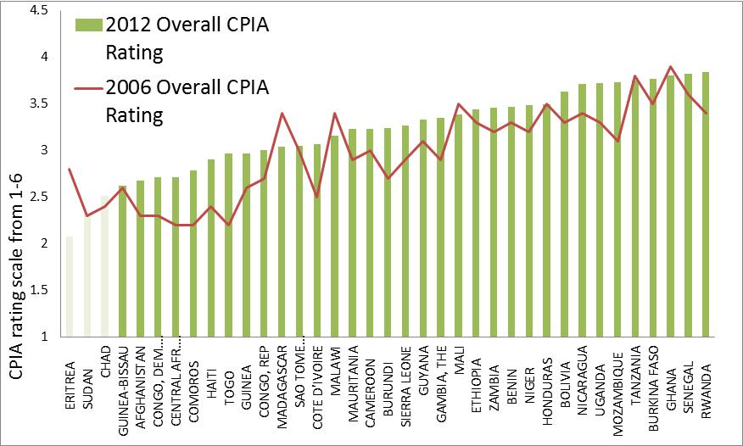
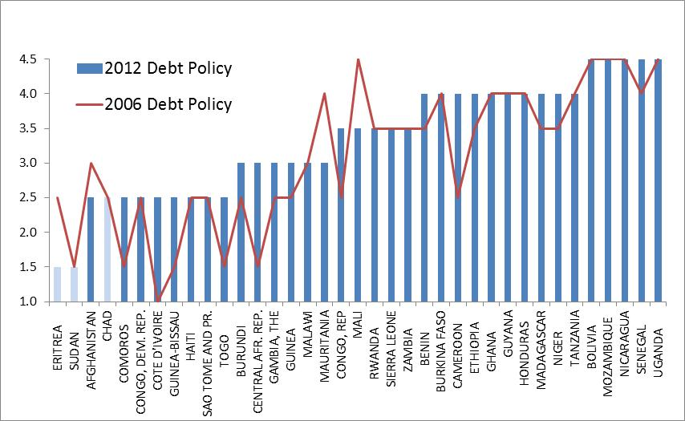
1. What has been achieved CPIA overall ratings and the debt policy ratings have improved in post-CP HIPCs between 2006 and 2012
Post-CP HIPCs’ policies and institutions are stronger than in pre-decision point and interim HIPCs
In almost 80 % of HIPCs the overall CPIA rating has improved
37% of post-CP HIPCs improved their debt policy (14 countries), against 11% which saw a deterioration (4 countries)
However, still countries have a long way to demonstrate the best practice – max rating 6

Slide 10
2. What are the current challenges

Slide 11
2. What Are Current Challenges Assisting remaining HIPCs to benefit from the Initiatives: HIPC/MDRI and DRF
Chad reached HIPC DP in 2001. Expected CP: December, 2014.
Remaining milestone: successful implementation of the IMF Program leading to the Initiative’s completion
A new IMF Extended Credit Facility (ECF) Program (April – Sept. 2014) was discussed with the Fund in April, 2014. Under the assumption that the ECF is well implemented during this period, the HIPC CP could be reached by December, 2014.
Eritrea, Somalia and Sudan have been unable to reach the HIPC decision point since 2006.
Zimbabwe faces severe debt situation, with eligibility under HIPC still uncertain
The World Bank and the IMF are undertaking a loan by loan data reconciliation and analysis. A joint debt reconciliation mission will visit Harare in May with the final assessment ready by end June.
Potential DRF clients (24), both big and small, representing an estimated US$11.2b in external commercial debt, could be eligible for relief, more than doubling the volume already provided (21 countries).
Notes:
The total estimated stock of external commercial debt for 24 HIPCs, which could be eligible for DRF support, is about US$11.2 billion, compared to about US$10.3 billion for 21 countries that was extinguished with the DRF support in the last 22 years.

Slide 12
2. What Are Current Challenges Uncertain external environment
Global growth has picked up from the weakness of mid 2012, but downside risks remain – big question mark is the reaction to the tapering of the QE.
Commodity prices boom is over.
Global financial conditions remain mild for developing countries, but those with large imbalances – credit booms and high exposure to capital inflows – will face a harder adjustment path.
Developing country fundamentals, policies and reforms, will play an important role on whether they will have an orderly or disorderly adjustment.
Political stability has deteriorated recently in some post- completion point HIPCs e.g. CAR, DRC, Mali, but it is paramount for economic growth and sustainable debt management.

Slide 13
2. What Are Current Challenges In this context it is critical to decide
How much to finance: Take into account initial conditions (debt situation), the global environment (volatility) and the country’s repayment capacity in the short and medium term (DSA).
What to finance: Choose feasible projects with the highest social return (Public Investment Management).
How to finance (choice of instruments): MTDS cost/risk trade offs among alternatives; look into macro implications of alternative debt instruments.

Slide 14
2.What Are Current Challenges Post-CP have benefitted from global low-interest environment by issuing Eurobonds, although conditions are tightening
Eurobond issuance by post-HIPCs (USD millions)
Eurobond redemption for post-HIPCs (USD millions)
Note: Senegal bought back its USD 200 million bond maturing in 2014

Slide 15
2.What Are Current Challenges Several low-income countries with high and rising government debt might be building up vulnerabilities
Source: Global Economic Prospects June 2013 and IMF
Notes:
IMF statistics suggest that gross general government debt exceeds 50 percent of GDP in 21 low- and middle-income ACP countries and increased in 9 of these ACP countries by 10 or more percentage points of GDP between 2007 and 2012.

Slide 16
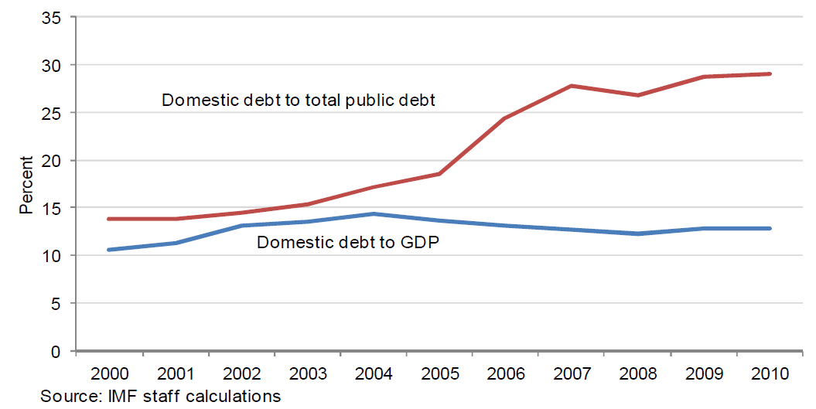
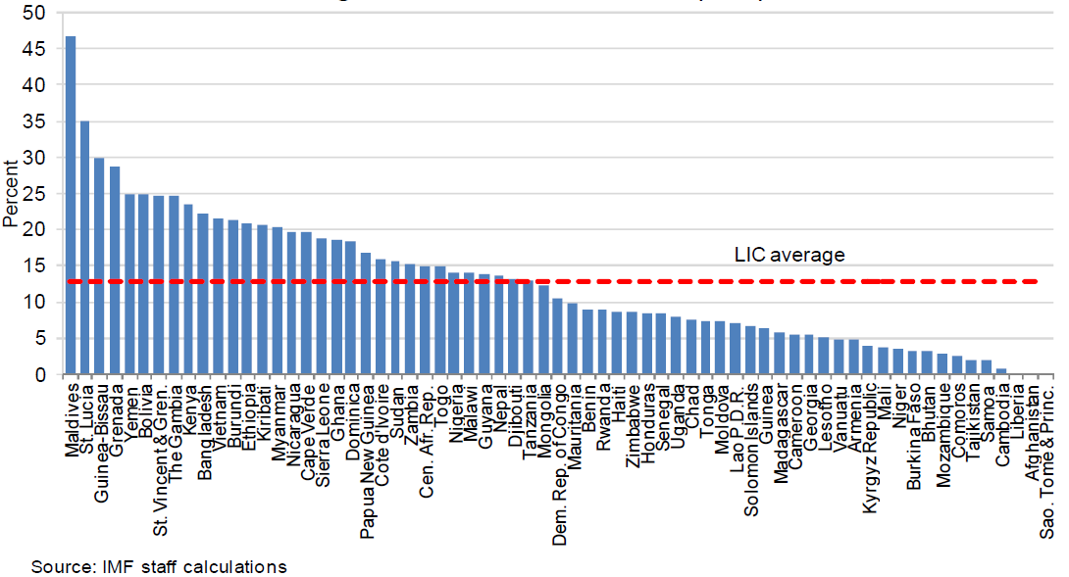
2.What Are Current Challenges Some LIC’s are accumulating high levels of domestic debt that tends to have high interest rates and short maturities
Domestic debt to GDP
Notes:
An analysis of 12 MTDSs elaborated by authorities of IDA-eligible countries in 2010–11 helps define the cost and risk indicators that characterize the domestic debt portfolio of LICs (see table). In the two years
considered, the median interest rate on domestic debt was 9 times higher than on external debt. The sample median of the average time to maturity of the domestic debt portfolio was only 2.5 years, compared to an
average time to maturity of more than 13 years for external debt, reflecting the latter’s concessional component. In addition, the share of domestic debt maturing within one year was much higher compared to
external debt. Although most of the domestic debt was issued at fixed rates, the short maturity structure implies that most interest rates would refix every year.

Slide 17
2. What Are Current Challenges How Countries Borrow Matters Increasingly: New Financing Instruments Bring New Fiscal Risks & Rollover Risks
LICs tend to have short average maturity for domestic debt:
Senegal 2.4 years
Ghana 1.6 years
Tanzania 5.1 years
Mozambique 2.6 years
Effective interest payments can be high on ST domestic debt:
Senegal 5.6 %
Ghana 18.5 %
Tanzania 8.9 %
Mozambique 15.4 %
Risky combination with sovereign bond spikes
Ghana: Redemption Profile
(2012, USD ‘000)
T-bills
Sovereign Bond
Multilateral Concessional

Slide 18
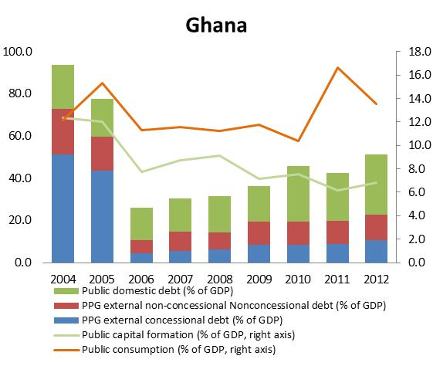
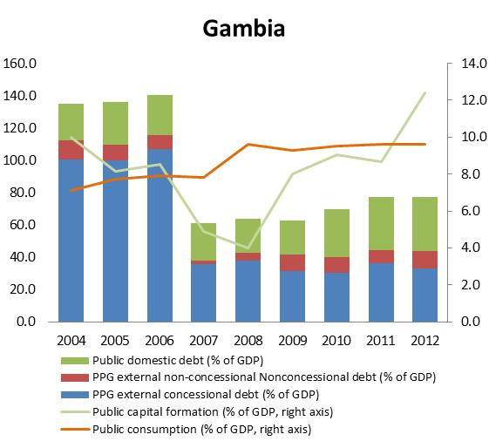
2.What Are Current Challenges What did countries do with increased borrowing space?
Ghana used new borrowing space to contract non-concessional debt and domestic debt and increased public consumption.
The Gambia maintained low external debt, but increased domestic debt while increasing public investment ➔ Are returns to investment high enough?

Slide 19
2. What Are Current Challenges Debt management capacity needs to be further strengthened
The results from 65 DEMPAs indicate deficiencies in the following DEM areas:
the quality of debt management strategies
performance audits of debt-management policies and functions
weak policies and procedures for external borrowings
operational risk management and cash balance management.

Slide 20
Thank You!
For more information:
http://www.worldbank.org/debt

