Slide 1
The impact of climate change on costs of food and its impact on poverty at subnational scale
Anne Biewald
Hermann Lotze-Campen, Ilona Otto, Nils Brinckmann, Susanne Rolinski, Benjamin Bodirsky, Isabelle Weindl, Alexander Popp, Hans-Joachim Schellnhuber
Notes:
1

Slide 2
Methodology
Notes:
Many things can not been seen on national level as on the one poverty distribution in a country and on the other hand the impacts of CC are equally distributed inside a country. We have therefore combined spatially explicite data on hunger spatial explicit model results. Namely indicators which can tell us something about how the impact of CC on agriculture affects poor people. impacts poor people through

Slide 3
Methodology
Combining three data sets:
Spatially explicit model based indicators: biophysical yield, production amount, costs of food
Spatially explicit hunger index
Spatially explicit population
Notes:
Many things can not been seen on national level as on the one poverty distribution in a country and on the other hand the impacts of CC are equally distributed inside a country. We have therefore combined spatially explicite data on hunger spatial explicit model results. Namely indicators which can tell us something about how the impact of CC on agriculture affects poor people. impacts poor people through

Slide 4
Methodology
Combining three data sets:
Spatially explicit model based indicators:
biophysical yield, production amount, costs of food
Spatially explicit hunger index
Spatially explicit population
Where are how many and what kind of poor people affected
by CC impacts on agricultural production?
Notes:
Many things can not been seen on national level as on the one poverty distribution in a country and on the other hand the impacts of CC are equally distributed inside a country. We have therefore combined spatially explicite data on hunger spatial explicit model results. Namely indicators which can tell us something about how the impact of CC on agriculture affects poor people. impacts poor people through

Slide 5
Structure of the presentation
Hunger index
Model description
Scenarios
Results

Slide 6
The Hunger Index

Slide 7
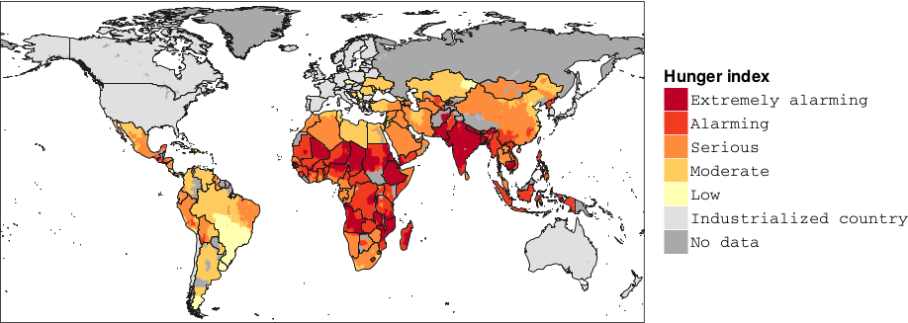
2000
The spatially explicit hunger index (SEHI) is calculated based on child undernourishment,
child underweight and infant mortality for the year 2000 (FAO 2015, CIESIN et al., 2005b).
Notes:
Which of the three comes from the FAO?

Slide 8
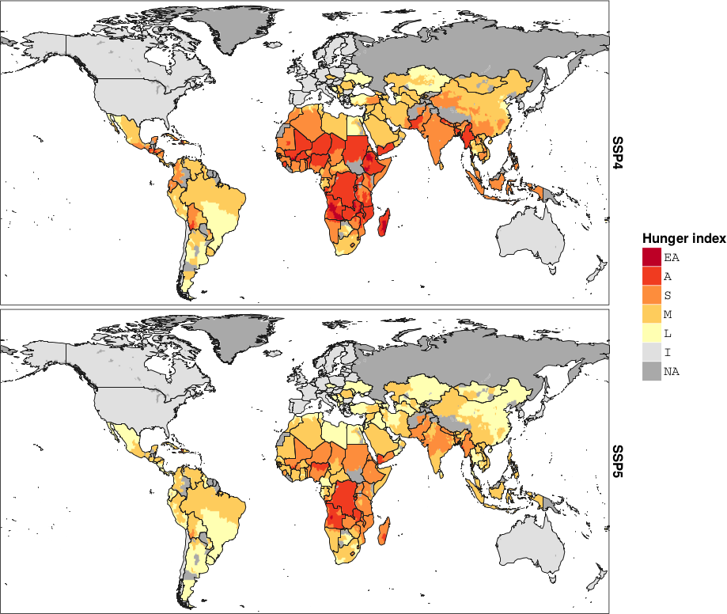
2030
Projection of the spatially explicit hunger index to the year 2030 for SSP4 and SSP5.
Notes:
Which are the data from the WB that we used?

Slide 9
Model description

Slide 10
Climate change (GCM)
Demography
Income and diet
Socioeconomic
inputs
Food demand, production costs
Crop yields
Land & Water constraints
MAgPIE
MAgPIE (Model of agricultural production and its impact on the environment)
Cost minimization
~ 60.000 grid cells (1000 aggregated clusters)
10 economic regions
13 crops, 5 livestock activities
international trade
Sugar beets
Bioenergy
Cereals
Pulses
Oilseeds
LPJ (50x50 km grid)
Biophysical inputs (LPJmL)
Lotze-Campen et al. 2008
Land use pattern
Notes:
Based on the interplay of demand & supply different land use patterns for the simulated crop and pasture activities.

Slide 11
Scenarios

Slide 12
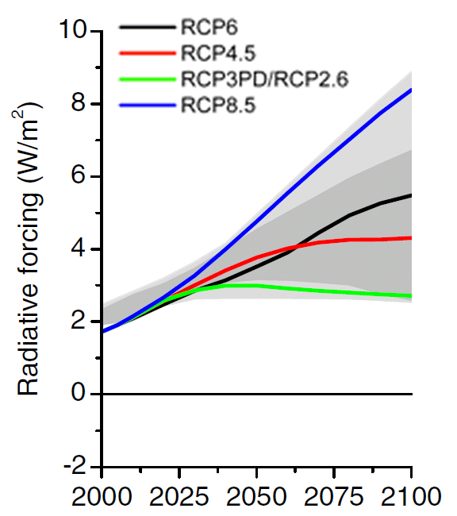
Representative Concentration Pathways
Notes:
2 degree warming in the middle of the century, 3.7 degree warming at the end of the century.

Slide 13
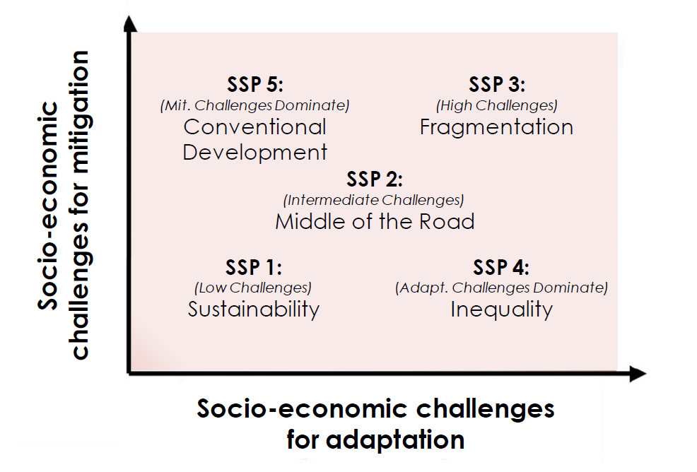
Socio-economic Pathways (SSPs)
Notes:
In the ssps there is no climate change included, for our runs we always used a scenario with and without CC in order to see the impact and we had a CC scenario with RCP 8.5

Slide 14
Relevant SSP specifications for MAgPIE
 | SSP4 |  |  | SSP5
 | MNA | SAS | SSA | MNA | SAS | SSA
Population in developing countries | High |  |  | Low
Kcal per capita in developing countries | Low |  |  | High
Regional food crop demand | High | High | About equal | Low | Low | About equal
Trade liberalization | Trade restricted |  |  | Trade liberalized
MNA: Middle East and North Africa
SAS: South Asia
SSA: Sub-Saharan Africa
Notes:
Die regionen-überetzungen überall machen wo barplots sind. We have concentrated on three economic regions where poverty is most prevalent.

Slide 15
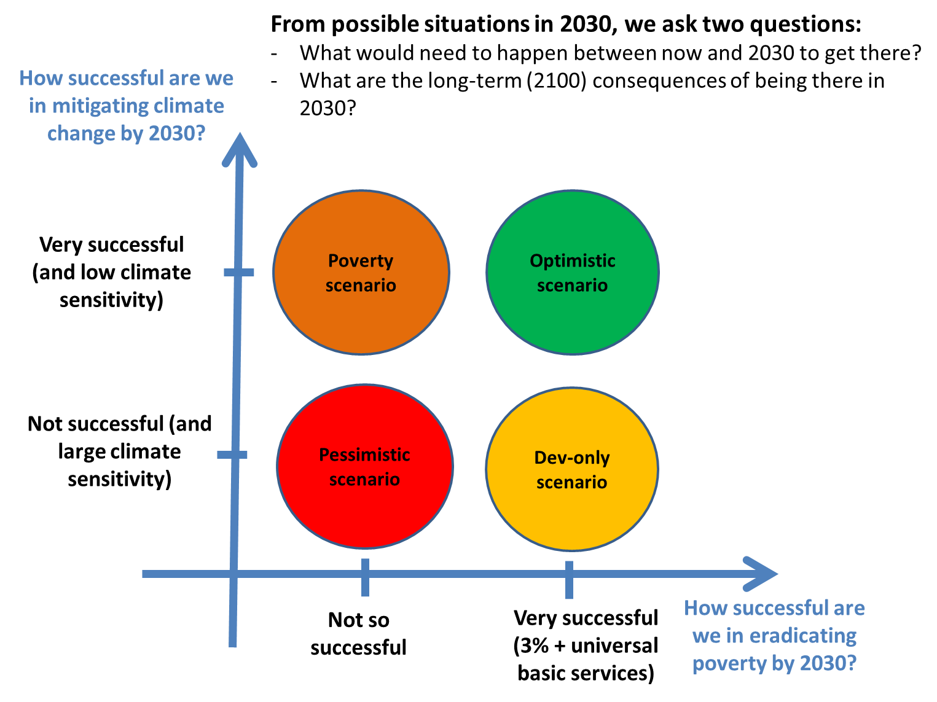
What kind of world will be affected by climate change?

Slide 16
What kind of world will be affected by climate change?
No CC
SSP4
No CC
SSP5
CC
SSP4
CC
SSP5

Slide 17
The agricultural indicators
Notes:
Difference between a scenario with CC and one without CC (CC-noCC)
RCP8.5
SSP4, SSP5
Year 2030
Median for 5 climate models,
Food crops: cereals, rice, soybean, rapeseed, groundnut, sunflower, oilpalm, pulses, potato, cassava, sugar

Slide 18
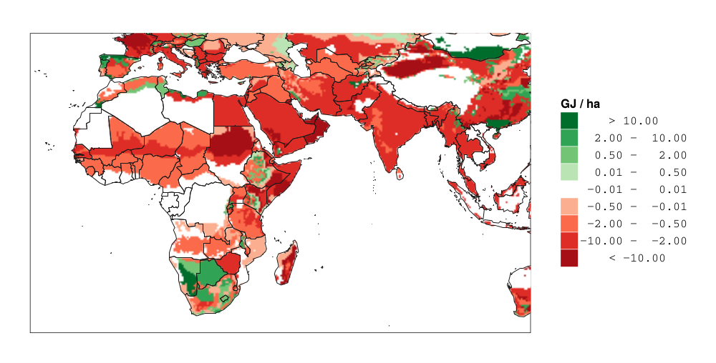
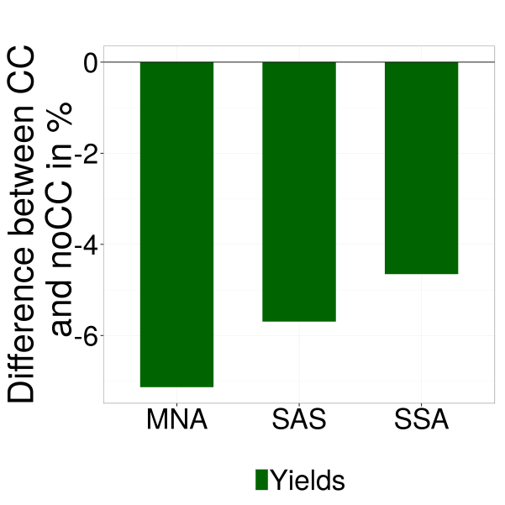
Yields
Difference in biophysical
yields (CC – noCC), 2030.
MNA: Middle East and North Africa
SAS: South Asia
SSA: Sub-Saharan Africa
Notes:
In GJ to make the crops comparable
Noch mal nachgucken wieviel ton fm eine GJ ist. Nachrechnen für weizen?
-production does not necesarily change with yields in the same direction since the same amount of people have to be fed.

Slide 19
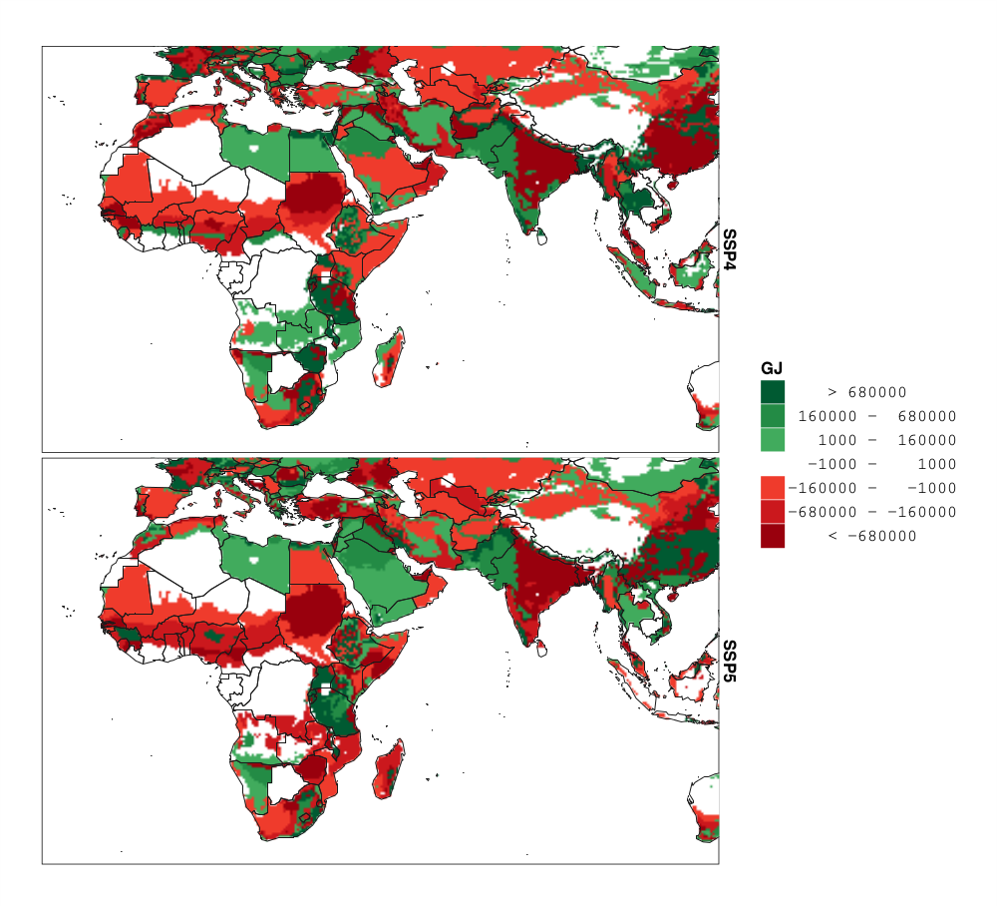
Production
Difference in production (CC – noCC)
year 2030
SSP4
SSP5
Notes:
The first adaptation measure of the model is the substitute irrigated areas by rainfed areas.
Regional food demand is exogenously given and constant
A decrease of yields and irrigation water can be compensated through:
Imports
Increase of production
Production can be increased by:
Expanding agricultural area
Investing in irrigation infrastructure or
Investing in R&D leading to higher yields

Slide 20
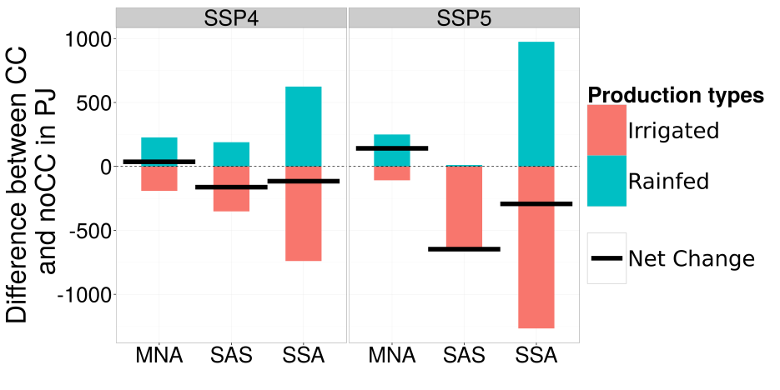
Production
Difference in production (CC – noCC)
year 2030
SSP4
SSP5
Notes:
The first adaptation measure of the model is the substitute irrigated areas by rainfed areas.

Slide 21
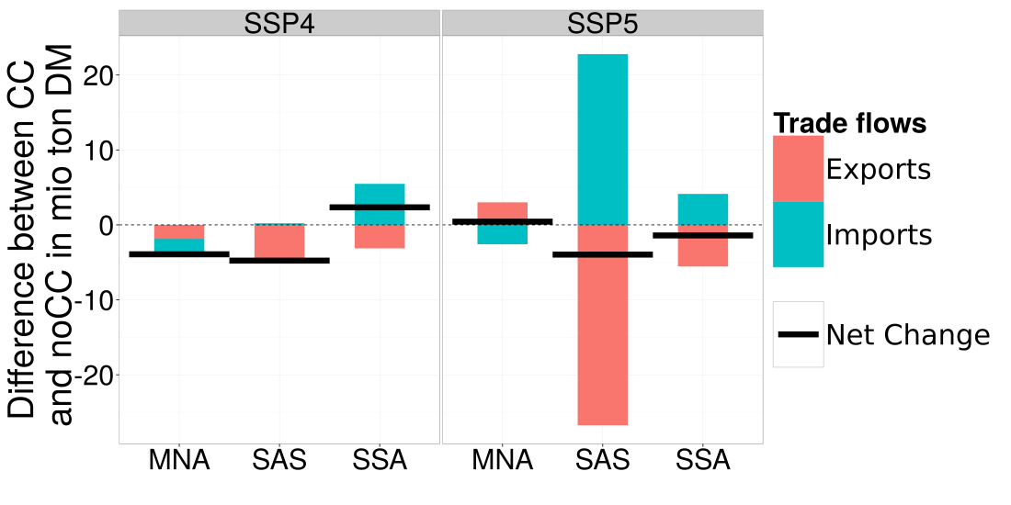
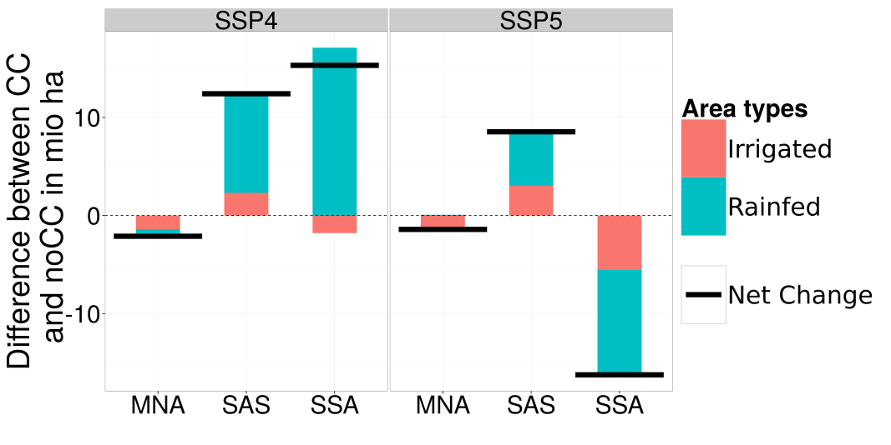
Regional specific processes to react to CC impacts: MNA
Trade
Area
Notes:
Area increase in SSP4 is relatively lower than in SSP5, but in absolute terms it is higher, since area in SSP4 has to be expaned already without CC.
Graph of yields !! Fläche ??? Hier noch mal ein bild mit den verschiednen food demands, zahlen
SSP4 yields are lower therefore more area expansion necessary.
Die barplots für yield are in MNA lower in SSP4 than in SSP5. This is because it is really necessary to have a high yield increase in SSP4 even without CC because of the many people. The costs are higher in SSP4 because at the higher level it costs also more to increase yields even more. The problem would be solved if you would show not the differences but the absolute yield. Than we would see that yields are already higher.

Slide 22
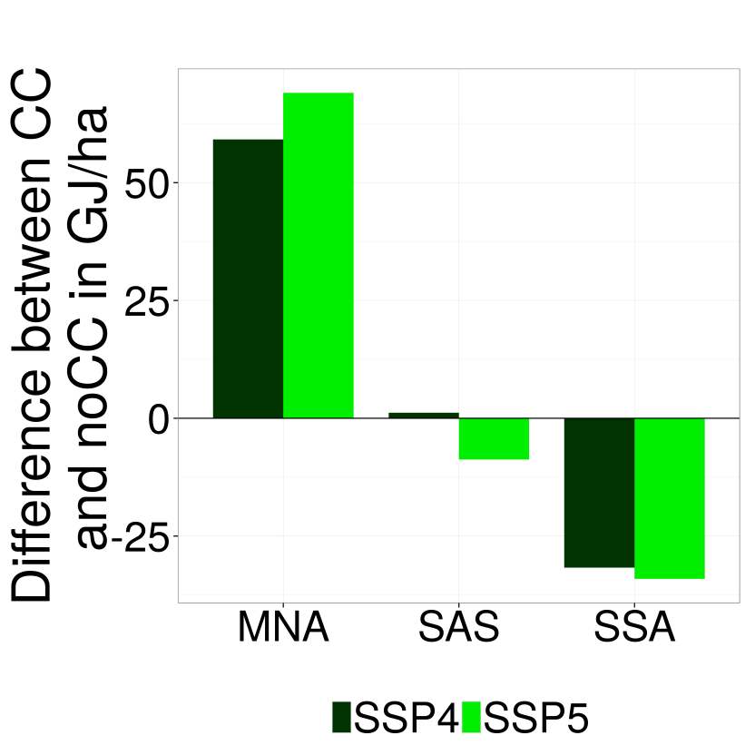
Regional specific processes to react to CC impacts: MNA
Trade
SSP4 + SSP5: increase of yields
Yield after
optimization
Area
Notes:
Area increase in SSP4 is relatively lower than in SSP5, but in absolute terms it is higher, since area in SSP4 has to be expaned already without CC.
Graph of yields !! Fläche ??? Hier noch mal ein bild mit den verschiednen food demands, zahlen
SSP4 yields are lower therefore more area expansion necessary.
Die barplots für yield are in MNA lower in SSP4 than in SSP5. This is because it is really necessary to have a high yield increase in SSP4 even without CC because of the many people. The costs are higher in SSP4 because at the higher level it costs also more to increase yields even more. The problem would be solved if you would show not the differences but the absolute yield. Than we would see that yields are already higher.

Slide 23
Regional specific processes to react to CC impacts: SAS
SSP4: expand agricultural land
SSP5: increase in imports, decrease exports
Area
Trade
Notes:
Area increase in SSP4 is relatively lower than in SSP5, but in absolute terms it is higher, since area in SSP4 has to be expaned already without CC.
Graph of yields !! Fläche ??? Hier noch mal ein bild mit den verschiednen food demands, zahlen
SSP4 yields are lower therefore more area expansion necessary.
Die barplots für yield are in MNA lower in SSP4 than in SSP5. This is because it is really necessary to have a high yield increase in SSP4 even without CC because of the many people. The costs are higher in SSP4 because at the higher level it costs also more to increase yields even more. The problem would be solved if you would show not the differences but the absolute yield. Than we would see that yields are already higher.

Slide 24
Regional specific processes to react to CC impacts: SSA
SSP4: expand agricultural land
SSP5: increase imports, decrease exports
Area
Trade
Notes:
Area increase in SSP4 is relatively lower than in SSP5, but in absolute terms it is higher, since area in SSP4 has to be expaned already without CC.
Graph of yields !! Fläche ??? Hier noch mal ein bild mit den verschiednen food demands, zahlen
SSP4 yields are lower therefore more area expansion necessary.
Die barplots für yield are in MNA lower in SSP4 than in SSP5. This is because it is really necessary to have a high yield increase in SSP4 even without CC because of the many people. The costs are higher in SSP4 because at the higher level it costs also more to increase yields even more. The problem would be solved if you would show not the differences but the absolute yield. Than we would see that yields are already higher.

Slide 25
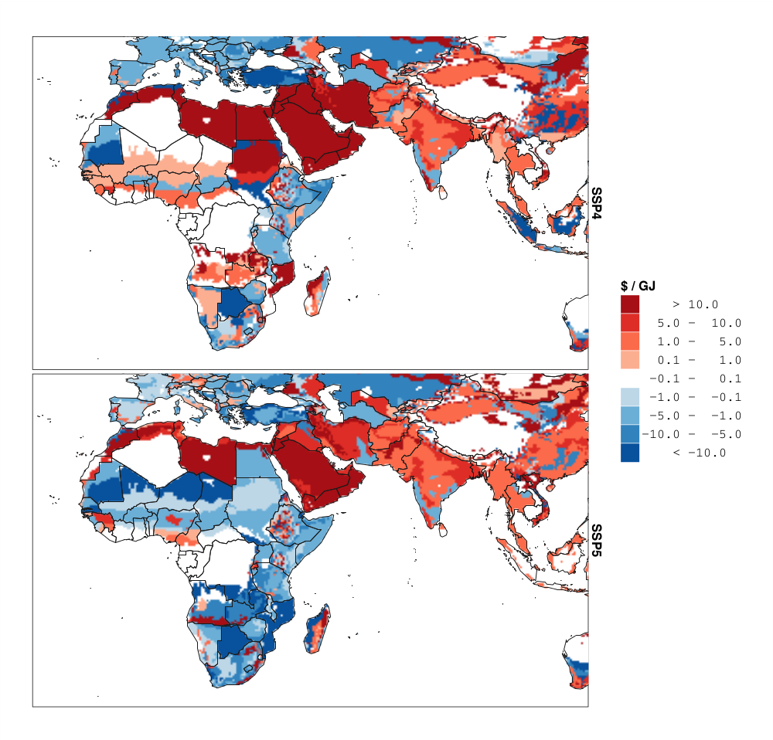
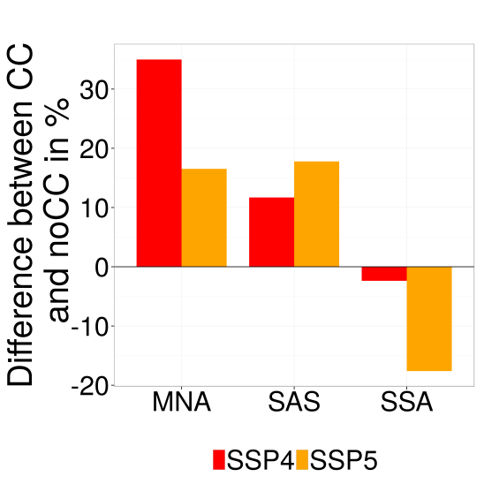
Costs of food
Difference in costs of food (CC-noCC),
2030.
SSP4
Costs of food
SSP5
Notes:
Explain costs of food: production costs:

Slide 26
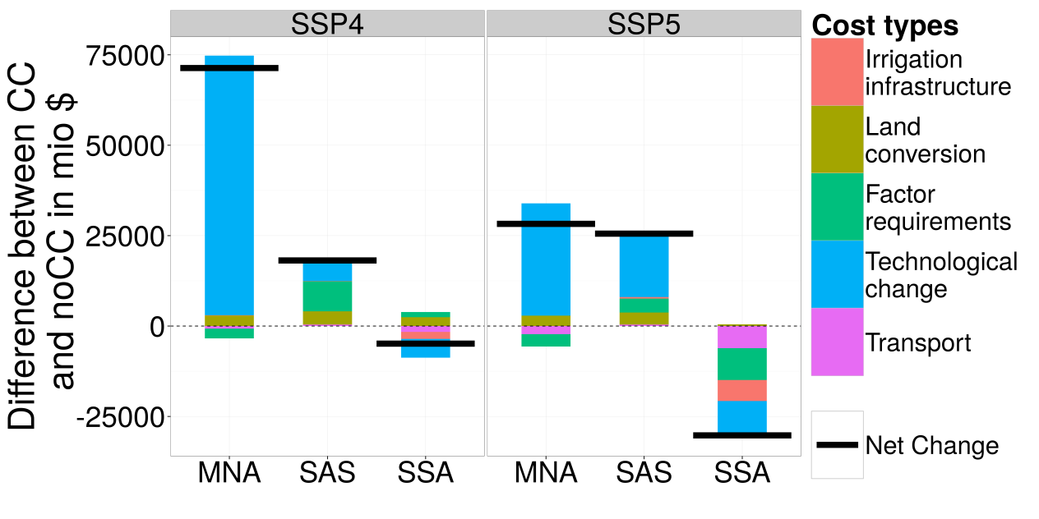
Processes which lead to a change in COF
Notes:
Cost increase in SAS are lower in SSP4 than in SSP5 because already in SSP4 wo CC there are many people which have to be fed and land had already expanded. SAS: the absolute higher costs in SSP5 come only from TC. The reason that TC is more expensive in this time-step is because in SSP5 SAS can start much later to invest in TC than SSP4 in order to compensate the lack or production and yields.

Slide 27
The agricultural vulnerability indicator

Slide 28
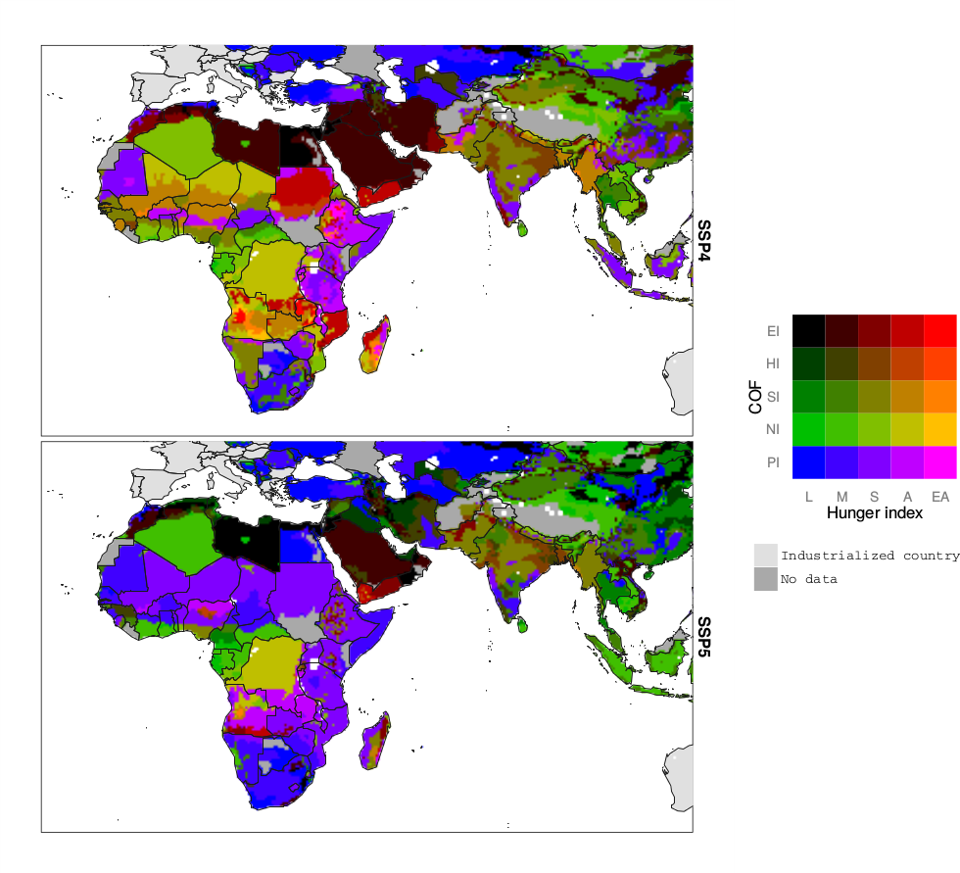
2030
SSP4
Cost of Food
Hunger Index
SSP5
Differences in the CC impacts on costs of food (COF) combined with the projected hunger index.

Slide 29
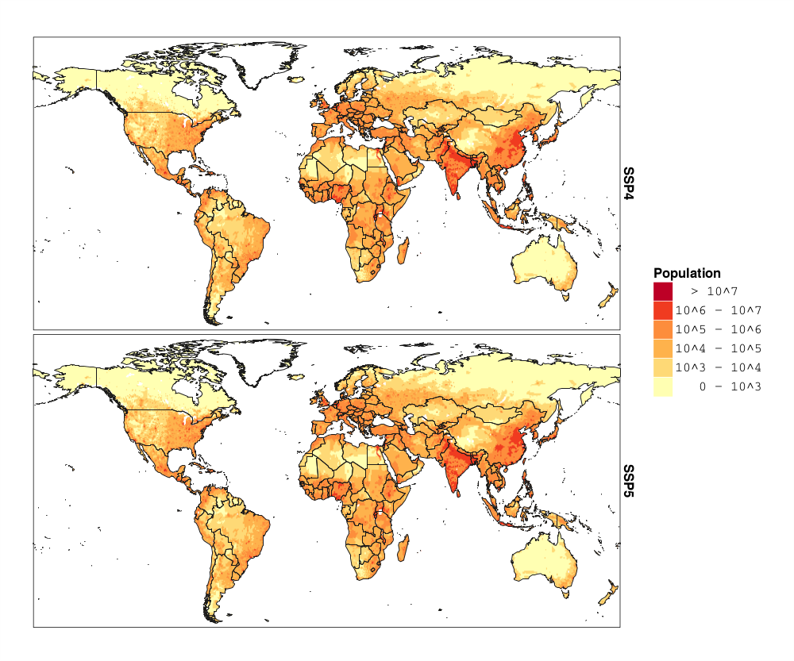

Spatially explicit population
SSP4
SSP5

Slide 30
Affected people in Mio. by changes of COF in the different
hunger index categories for Sub-Saharan Africa
 |  | SSP4 |  |  | SSP5
 |  | Hunger index
 |  | Serious | Alarming | Extremely Alarming | Serious | Alarming | Extremely Alarming
 | SSA
 | Serious | 205 | 224 | 28 | 164 | 8 | 3
 | High | 9 | 14 | 0 | 26 | 16 | 0
 | Extremely high | 13 | 81 | 16 | 33 | 2 | 0
Impact of CC on
costs of food

Slide 31

Thank you!
biewald@pik-potsdam.de

Slide 32
Quantified SSP specifications for MAgPIE
Model parameters (SSP indications) | Implementation SSP 4 |  |  | Implementation SSP 5
 | SSA | MNA | SAS | SSA | MNA | SAS
Population in Mio people in 2030 | 1396 | 511 | 2054 | 1240 | 508 | 2025
Kcal per capita in 2030 (GDP) | 2531 | 3245 | 2621 | 2707 | 3394 | 2763
Demand for food crops in Peta Joule in 2030 (population/ GDP) | 4462 | 2460 | 7013 | 4191 | 2100 | 7088
Share of livestock products in the diet in 2030 (GDP) | 0.09 | 0.145 | 0.14 | 0.10 | 0.145 | 0.14
Trade liberalization (Globalization) | Starting from 2010 trade barriers are relaxed by 10% percent per decade for developed regions, but are kept constant for developing regions considered here. |  |  | Starting from 2010 trade barriers are relaxed by 10% percent per decade globally.
Livestock intensification (Technology) | Slow |  |  | Fast
Nutrient efficiency (Technology) | High |  |  | Medium

Slide 33
Affected people by change in COF in the different hunger index categories
Affected people by change in COF and hunger index in Mio
 | SSP4 |  |  |  |  |  | SSP5
 | L | M | S | A | EA |  | L | M | S | A | EA
SSA
PI | 14 | 21 | 144 | 234 | 40 |  | 32 | 132 | 410 | 135 | 0
NI | 1 | 22 | 96 | 157 | 6 |  | 13 | 53 | 31 | 75 | 0
SI | 3 | 22 | 205 | 224 | 28 |  | 22 | 26 | 164 | 8 | 3
HI | 0 | 0 | 9 | 14 | 0 |  | 0 | 5 | 26 | 16 | 0
EI | 0 | 7 | 13 | 81 | 16 |  | 8 | 11 | 33 | 2 | 0
MNA
PI | 17 | 18 | 11 | 0 | 0 |  | 50 | 45 | 0 | 0 | 0
NI | 0 | 0 | 3 | 1 | 0 |  | 0 | 3 | 0 | 1 | 0
SI | 0 | 0 | 0 | 0 | 0 |  | 18 | 4 | 0 | 0 | 0
HI | 0 | 9 | 0 | 0 | 0 |  | 95 | 35 | 1 | 10 | 0
EI | 87 | 285 | 21 | 42 | 0 |  | 111 | 71 | 4 | 22 | 0
SAS
PI | 0 | 7 | 244 | 7 | 0 |  | 0 | 164 | 82 | 0 | 0
NI | 0 | 15 | 70 | 2 | 0 |  | 4 | 68 | 13 | 0 | 0
SI | 0 | 9 | 767 | 228 | 3 |  | 6 | 212 | 610 | 3 | 0
HI | 0 | 7 | 573 | 1 | 0 |  | 1 | 241 | 504 | 0 | 0
EI | 0 | 4 | 94 | 1 | 0 |  | 0 | 4 | 42 | 0 | 0

Slide 34


Slide 36
Modelling processes leading to a change of production patterns and resulting changes in costs of food
Regional food demand is exogenously given and constant
A decrease of yields and irrigation water can be compensated through:
  Imports
  Increase of production
  Production can be increased by:
  Expanding agricultural area
  Investing in irrigation infrastructure or
  Investing in R&D leading to higher yields

