Slide 1
Enabling the development of industrial capacity: Resource corridors, clusters and SEZs
World Bank Conference on Local Content Policies in the Oil, Gas, and Mining Sector
Ian Satchwell
1 October 2013

Slide 2
Overview
Context
Case studies from Australia
  Factors of success
  Overcoming obstacles
Clusters
Special economic zones
Resource corridors
Some questions for the panel

Slide 3
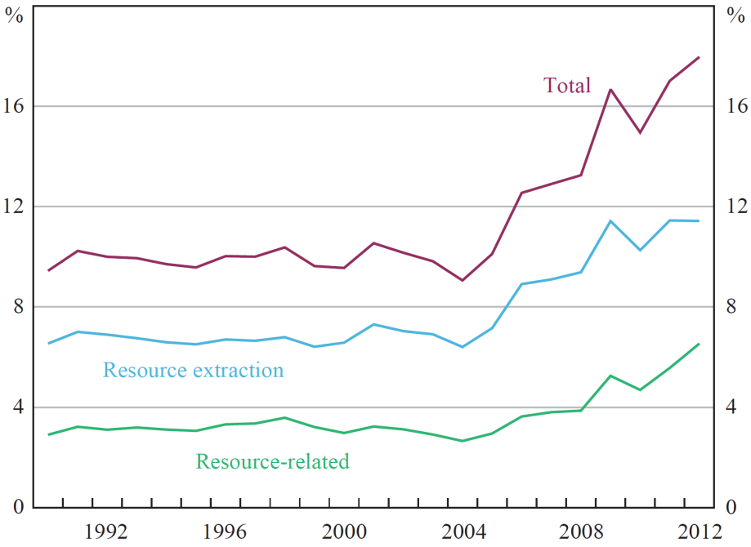
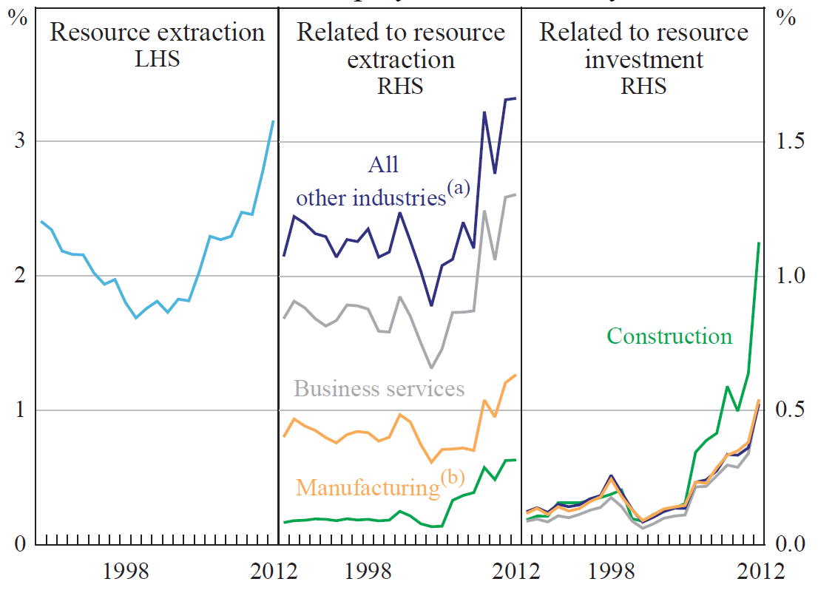
Resource economy in Australia: bigger than traditionally measured
Gross Value Added – resource economy 2011-12
Share of nominal GVA, financial year
(has more than doubled in past 10 years)
Resource employment by industry 2011-12
Share of total employment, financial year
18% of GVA
11.5% directly from extraction and processing
6.5% from other sectors providing inputs
10% of employment
3.25% directly from extraction and processing
6.75% from other sectors providing inputs
Source: Rayner and Bishop, Reserve Bank of Australia, February 2013
3

Slide 4
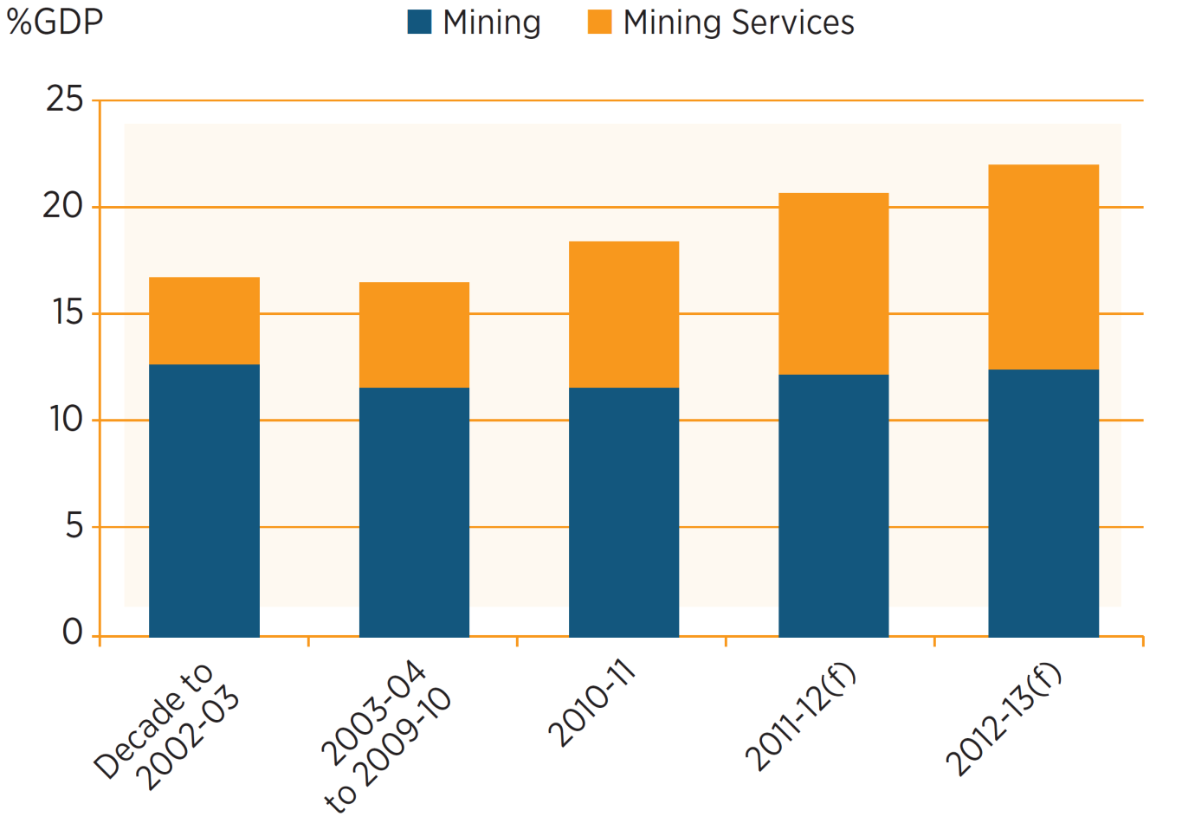
GDP contribution of Mining Equipment, Technology and Services (METS) sector has grown faster than mining’s
METS output is growing at 15 to 20% a year
4% of national output in 2002-03
8.4% in 2011-12
METS contribution to GDP
6.7% in 2010-11
Est. 9.4% in 2012-13
Many METS are knowledge- and technology-intensive
Source: Australian Treasury and Ed Shan / Minerals Council of Australia
4

Slide 5
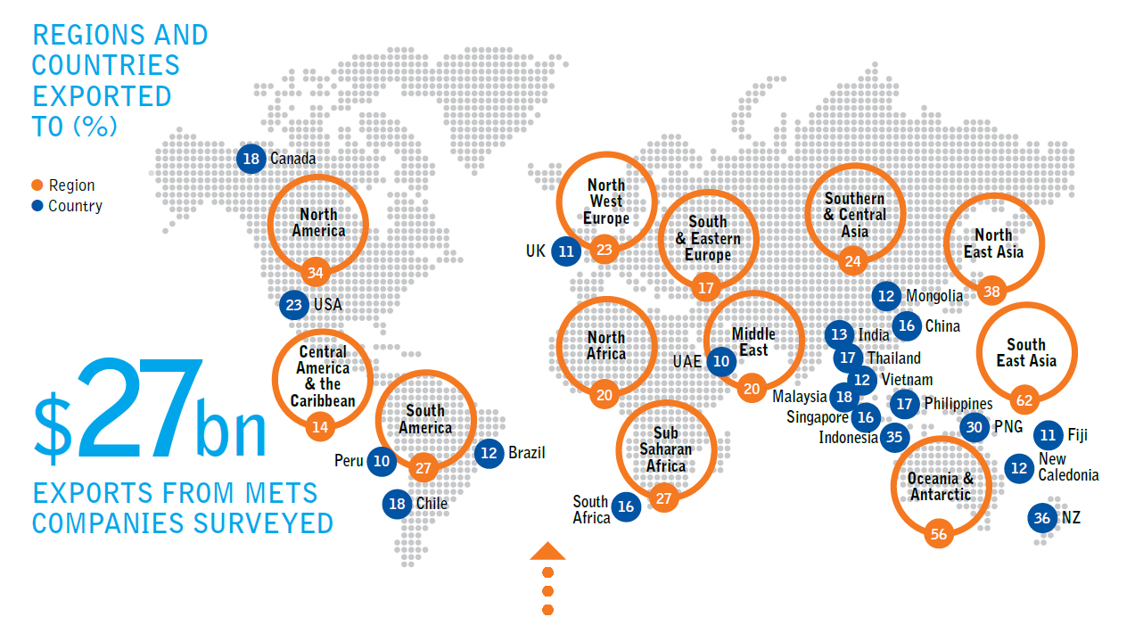
Australian METS firms are now major exporters of equipment, technology and knowledge

Slide 6

Case studies of METS clusters and a resource corridor
DARWIN
PILBARA REGION
Northern Territory
Queensland
Western Australia
KALGOORLIE
BRISBANE
South Australia
New South Wales
PERTH
SYDNEY
ADELAIDE
CANBERRA
Victoria
MELBOURNE
HOBART
6
Notes:
6

Slide 7
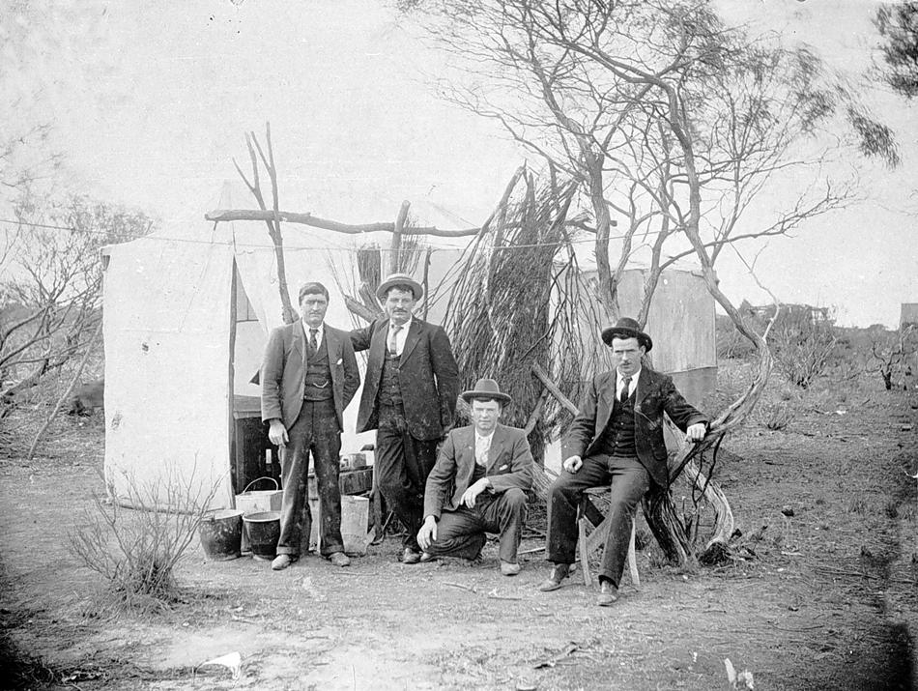
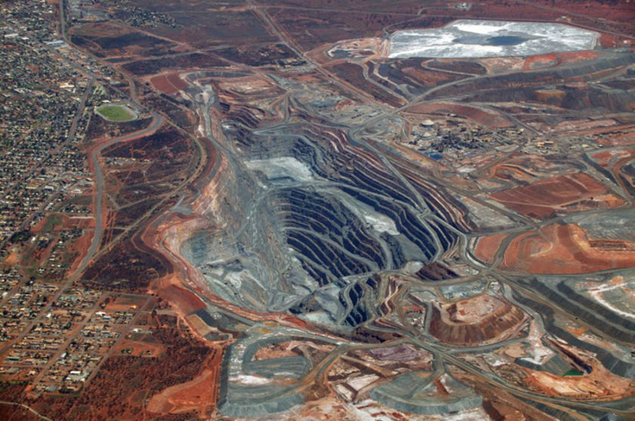
Case study 1: Kalgoorlie, Western Australia
Mining town since 1900s –
  Gold, nickel sulphide and nickel laterite – long life operations and evolving industry
600 km east of Perth
Region’s population 45,000
Mining services developed initially because of remoteness
Strong regional METS clusters (sectoral and geographic)
  ~200 manufacturing & services sites
Now a net ‘exporter’ of mining equipment and services to other locations
7

Slide 8
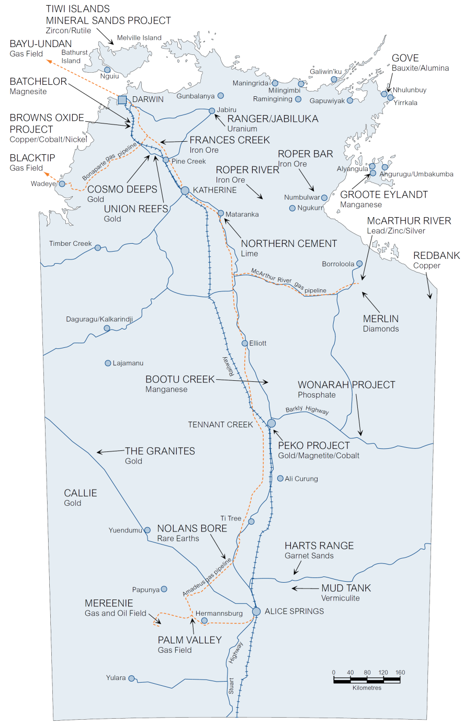
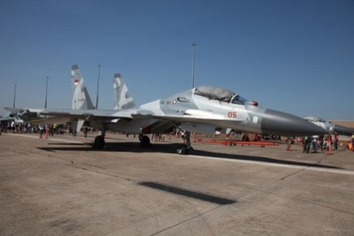

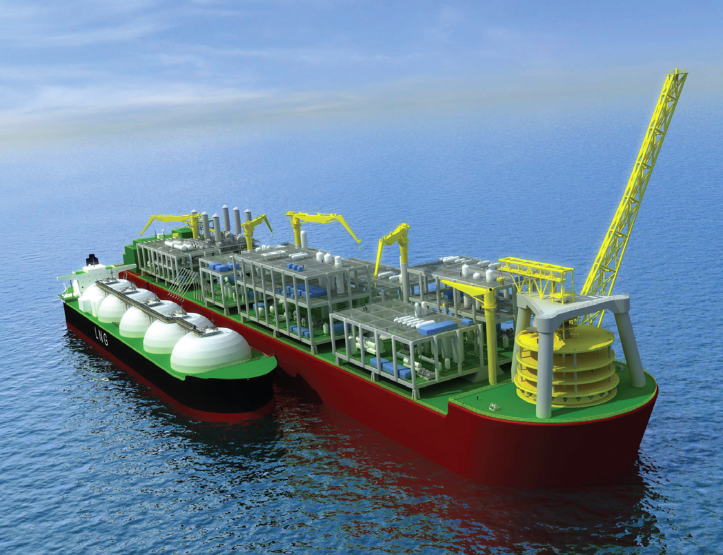
Case study 2: Darwin, Northern Territory
Australia’s most northern and isolated city
  Major service centre for mining, oil and gas, defence and marine sectors
Population 110,000
Mining services developed initially because of remoteness
Now has a competitive advantage in mining and petroleum services
Strong regional METS clusters (sectoral and geographic)
  ~300 manufacturing & services sites
  Collaborative business culture
Exporter of METS to other locations, including Indonesia
8

Slide 9
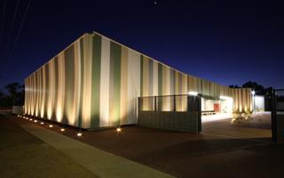
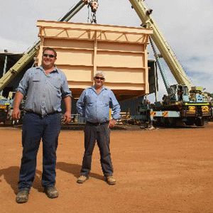

Kalgoorlie and Darwin: Factors of success
Long-life customer mining/petroleum operations ; diverse markets (Darwin)
Good business infrastructure: serviced industrial land, roads, energy, water, community
Skilled resident workforce; sustainable demographic profile; attractive town amenity
Education and training institutions: public and private secondary schools, and vocational training and education; universities / school of mines (Kalgoorlie)
Strong entrepreneurship culture, support networks, business services
Firms cooperating (incl. JVs) to win large and/or multidisciplinary contracts
Financial institutions that understand mining and services
Supportive, light-handed government interventions, eg: industry participation policies; partnerships with business to connect customers and suppliers; small business support
9

Slide 10
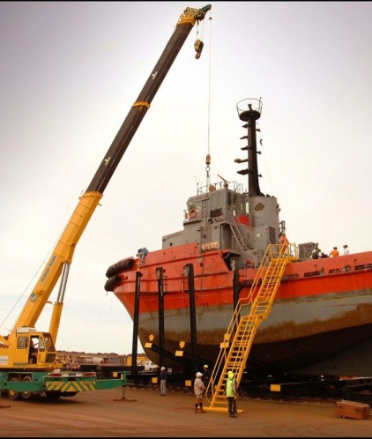
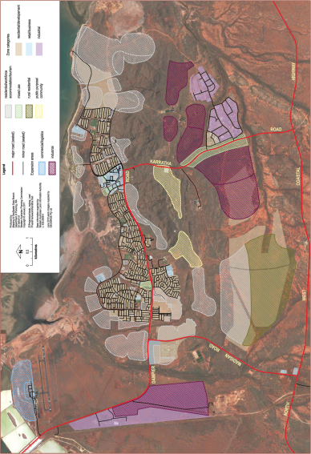
Kalgoorlie and Darwin: overcoming obstacles
Small scale and lack of capability and capacity of many firms
  collaborations – some multidisciplinary – enable winning of larger and more complex contracts
Lack of track record with customers / lack of QA capability
  mining operations form alliance relationships to help suppliers build and demonstrate capability, and become certified
  mining companies right-size contracts for smaller firms
  some operations have adopted ‘inside-out’ strategies to help employees become independent services suppliers
e-Procurement and payment processes difficult for small firms
  revised customer processes and payment schedules to suit small firms
  companies offer access to global supply chains for good performers
Market failure in supplier-customer linkages
  Australian Industry Participation National Framework overseen by government
  linkage mechanisms implemented by government-business partnerships – eg: Industry Capability Network; Project Connect
Infrastructure to support business
  State and local governments have invested in, and facilitated business infrastructure through PPPs (eg Darwin Marine Supply Base)
Industrial estates

Slide 11
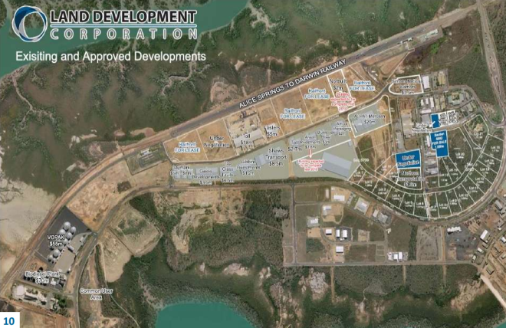
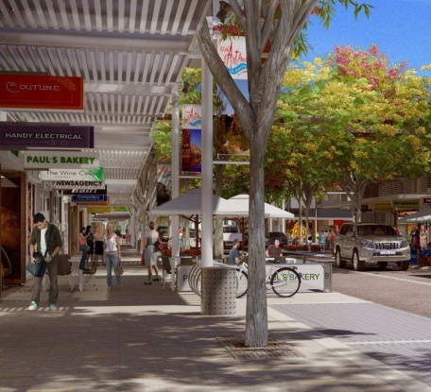
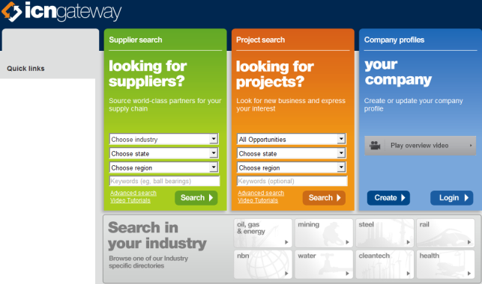
Some factors for successful cluster building
Diverse, deep and long life customer base
Existence of market leading/large firms – both customers
and leaders
Existence of an entrepreneurial ethos amongst leading firms
Networking and partnership cultures and relationships
Access to innovation and R&D capacity – through regional institutions or other companies
Existence of a skilled workforce (human capital base), plus education and training infrastructure
Business infrastructure, and community infrastructure for workforces
Access to adequate sources of finance
Commercial/market orientation by firms, with support from governments, industry chambers and large customers
11

Slide 12
Special economic zones
Dedicated, trade-oriented SEZs not successful in Australia
  History of under-performance and ultimate failure (at cost to public purse)
  Government investment now provides basic business infrastructure (on commercial terms) and support services in collaboration with business chambers
  Few taxation incentives; little tax relief other than business-wide provisions for R&D, export marketing, import duty relief
  Effect is ‘virtual’ SEZs in some resource regions and cities – clustering, value-chain corridors
SEZs can have benefits for developing countries with infrastructure deficits and low supplier capacity
  Flexible approach to create opportunity for private sector investment in SEZs, with government support, but insulating taxpayers from risks
  Focus benefits on export-oriented business (eg, duty relief) but other incentives and tax benefits risk gaming and revenue leakage
  All businesses benefit from organised public-private infrastructure concentration, including targeted soft infrastructure (eg: public-private training facilities)
  Aim is to create cluster dynamic between firms that is greater than sum of the parts

Slide 13
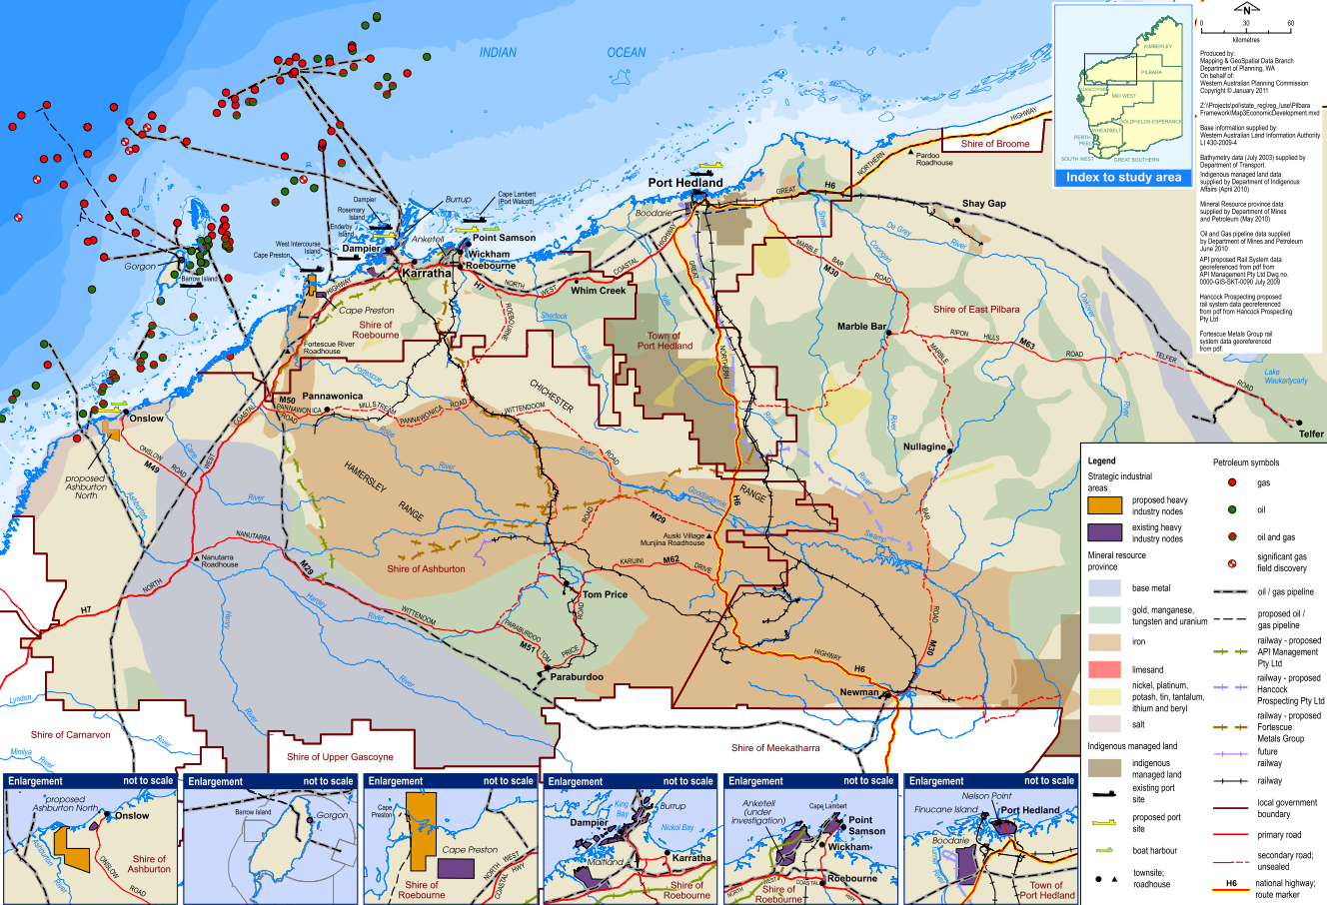
Resource corridors: Pilbara case study
13

Slide 14
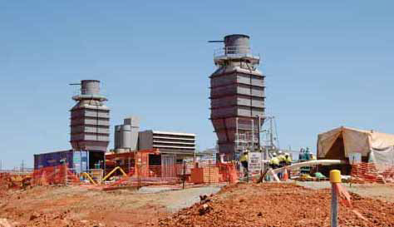
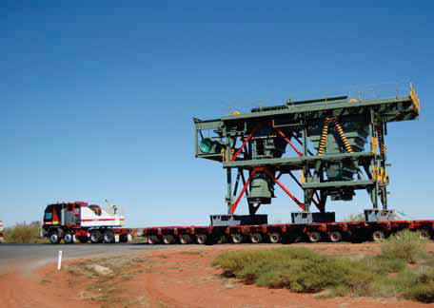
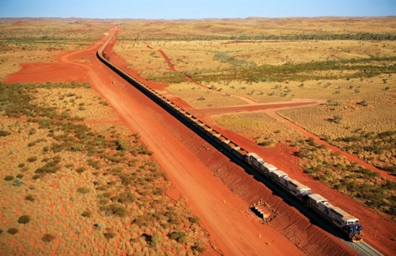
Resource corridors: Australian experience
Resource corridors provide holistic approach to infrastructure needs assessments and planning
Need integrated planning across all needs and classes of infrastructure
Essential to have early planning and coordination to
  ensure infrastructure is delivered when needed; maximise utility and efficiency
Partnerships between government – mining industry – infrastructure providers – financiers needed
  but government needs to be careful about over-exposure or interference in mining business
Predicting the future is very difficult
  uncertainty can be (part) managed though options-based approach
  managing risks and rewards essential for infrastructure investment
Efficient integrated production chains are vital for competitiveness of mining operations

Slide 15
Some questions for the panel
Facilitating clusters can involve picking winners. How do you pick winners? How do you also allow the market to operate?
Are geographic clusters more likely to work in developing markets than sectoral clusters?
The presence of market leaders/large firms as a condition for cluster efficiency. In most developing countries these are not domestic firms. What policies have been successfully used to foster localisation of these firms?
Are tax incentives the most important factor in driving the success of SEZs? What are other key factors?
What are the main obstacles to the creation of cross border resource corridors?

