Slide 1
Creation of a pilot cluster for the effective APG and the low-pressure gas usage in the Khanty-Mansiysk Autonomous Okrug - Yugra
Vienna, October 2013

Slide 2
Conditions of the resource base and APG usage level in the Russian Federation broken down by Federal Districts in 2012*:
Khanty-Mansiysk Autonomous Okrug – Yugra is a leader among federal subjects of the Russian Federation in APG resource volumes which constitute about 79% of the total volume of Russian APG.
In 2012 in the Urals Federal District the level of APG usage was 86.9% and in Yugra – 89.1%, meanwhile the average level in the Russian Federation was 71.8%.
Among the regions of the Urals Federal District Yugra is in the leading position from the point of view of the achieved APG usage level.
* (according to Central Dispatching Department of Fuel Energy Complex)
2

Slide 3
APG usage dynamics in Yugra in 2004-2012 and for the period up to 2014:
According to the Subsoil Management Department of Khanty-Mansiysk Autonomous Okrug - Yugra
3
Notes:
Since 2007 oil companies of the region has been successfully implementing the Program of Rational Usage of Associated Petroleum Gas broken down by each licensed subsoil lot on which oil and associated petroleum gas are produced.
Six years of fulfillment of activities of the Programs has favored certain positive results of rational APG usage in Yugra as a whole:
- APG usage volume has increased by 3.5 billion m³ (by 12.5%).
- in 2012 APG usage level increased by 10.6 % and reached 89.1%;
- in 2012 the annual volume of flared APG decreased by 3.9 billion m³ (by 49.8%), from 7.8 billion m³ to 3.9 billion m³.
According to the programs of oil companies achievement of the level of associated petroleum gas usage of 95% in the territory of Yugra is expected only in 2014. Not all oil companies will reach this level. In 2013 the expected level of APG usage will be 94.1 %, in 2014 – 95%.

Slide 4
Oil and gas industry: current situation
9 vertically integrated oil companies and 13 independent producers operate in the region.
Largest subsoil users are – JSC Rosneft, OJSC Surgutneftegas, OJSC LUKOIL Oil Company, OJSC NGK Slavneft, JSC Gazprom Neft.
Are already operating in the territory of the autonomous okrug:
6 oil-refining companies (in 2012 they processed 6 million tons of oil);
8 gas processing plants (in 2012 they processed 24.3 billion m³ of associated petroleum gas and 7.4 million tons of natural gas liquids).
4

Slide 5
Gas processing cluster: prerequisites for creation
Non-achievement of 95% efficient APG utilization in all licensed subsoil lots results from economic, technical and organizational reasons:
In most cases APG usage in distant, small and medium oilfields in economically inefficient without additional governmental support.
Existing technical standards and requirements to construction of gas processing facilities increase capital costs by 40% in comparison with similar facilities in other oil-producing countries (USA, Canada).
There are no complex approaches to solution of the task of rational APG usage in oil-producing territories. Each subsoil user solves the task of achieving 95% level of AGP usage independently.
5

Slide 6
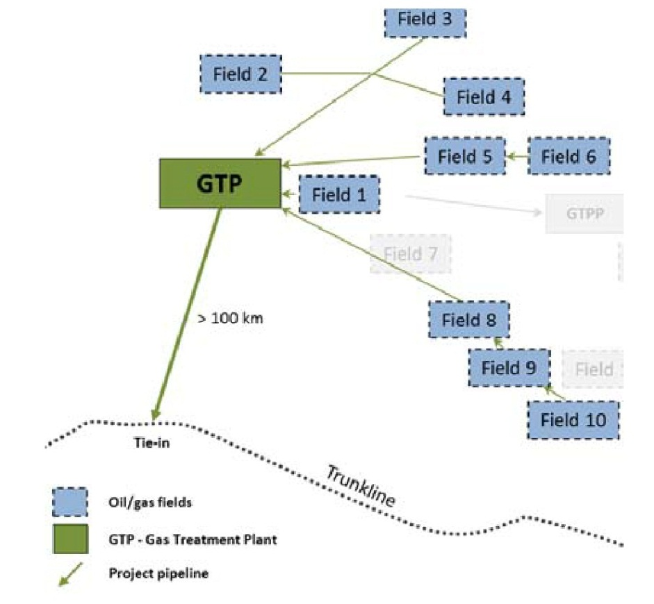
Grouping (clustering) of APG resources: Achieving economy through scale and utilization efficiency improvement
Collection of APG from numerous small and medium oilfields into the common infrastructure would help to decrease difficulties typical for small-scale APG utilization projects;
Cooperation can be the key to determination and search for optimum solutions;
Decrease of the cost of initial construction work in the total amount of capital investment into construction of production facilities;
Hedging of the risk of unevenness of facility load during the project life cycle (peak at the start of project implementation, then the gas volume is steadily decreases; that, with the significant share of permanent costs, results in considerable decrease of profitability of facilities);
Increase of economic efficiency of APG utilization projects.
6

Slide 7
Condition of APG rational usage in Yugra for the period of 2014-2030 in case of creation of the cluster:
In 2016-2030 addition volume of APG will be 5.3 billion m³
According to the Subsoil Management Department of Khanty-Mansiysk Autonomous Okrug - Yugra
7

Slide 8
Additional raw material sources: natural gas resource base in small fields in Berezovsky, Beloyarsky and Sovetsky districts of Yugra
In the territory of the okrug (as at January 01, 2012) there are 21 gas and condensate fields:
Consolidated resource of non-associated gas is 60.4 billion m³ of С₁ category and 8 billion m³ of С₂ category
In the distributed subsoil stock there are 6 fields with resource of non-associated gas of 22.6 billion m³ of С₁ category and 1.4 billion m³ of С₂ category
In the undistributed subsoil stock there are 15 fields in conservation with consolidated resource of non-associated gas of 37.8 billion m³ of С₁ category and 6.6 billion m³ of С₂ category
8

Slide 9
Prospective participants in the territorial and resource gas processing cluster:
Oil companies
APG
Gas processing companies
Electric power and heat producers
Higher educational institutions and secondary specialized colleges
R & D establishments
Engineering companies
Equipment manufacturers
Design institutes
Service companies
Construction and erection contractors
Small and medium innovation companies
Financial institutions
natural-gas-based motor fuel
electric power
dry stripped gas
petrols
gas utilization products
synthetic diesel fuel;
polyethylene; polypropylene
9
9

Slide 10
Why enterprises need the cluster:
Quick and cheap access to information, technological, consultation and analytical resources unavailable for the enterprise
Increase of own competencies
Easy absorption of innovations
Possibility to test innovative technologies and latest developments
Cost decrease on the basis of implementation of cooperation projects
Integration into the regional business environment and increase of entrepreneurial activity

Slide 11
Thanks for your attention!

